Slide 1
Hypothesis Testing (σ is known) p-value

Slide 2
P-value
Problem: A medical researcher wants to find out whether a new medication will have any undesirable side effects on patients’ pulse rates. The researcher is concerned with whether the pulse rate increases, decreases, or stays the same after taking the medication.
The researcher knows that the
mean pulse rate μ for the population under study is 82 beats per minute (bpm), and
population standard deviation σ is 5 bpm.
The researcher selects a random sample of 60 patients who take the medication and finds that their mean pulse rate is 80.7 bpm.
How would you test the claim that medication does affect the mean pulse rate, at significance level α = 0.01 ?

Slide 3
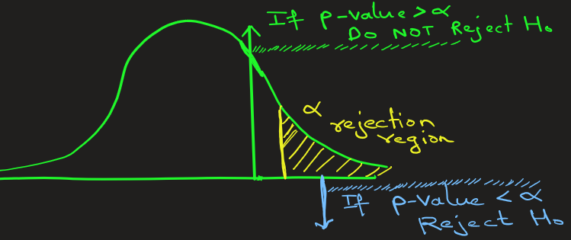
P-value
A P-value in hypothesis testing is the probability of obtaining results as extreme as, or more extreme than, the observed data, assuming the null hypothesis is true.
It measures the strength of evidence against the null hypothesis;
a small P-value (typically < 0.05) suggests the results are statistically significant.
Evidence is against null hypothesis → Null hypothesis can be rejected.
a large P-value (typically > 0.05) suggests the observed results are likely due to random chance.
Evidence is not against null hypothesis → Null hypothesis cannot be rejected.

Slide 4
P-value
A simple example to understand p-value:
Let Null hypothesis = "The medicine doesn’t work."
Then, p-value = "How surprising are my results if the medicine truly doesn’t work?"
Let’ say we choose a significance level, α = 0.05 (5%), which sets our threshold for surprising result.
If p = 0.001 = 0.1% < 5%, the results are very surprising → strong evidence the medicine might actually work. If p = 0.6 = 60% > 5% , the results are not surprising → no evidence that the medicine helps.

Slide 5
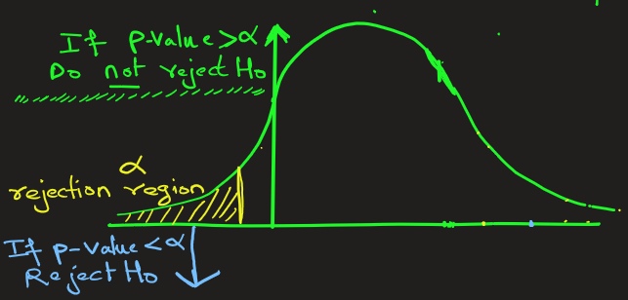
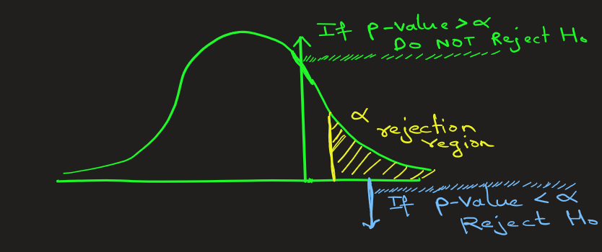
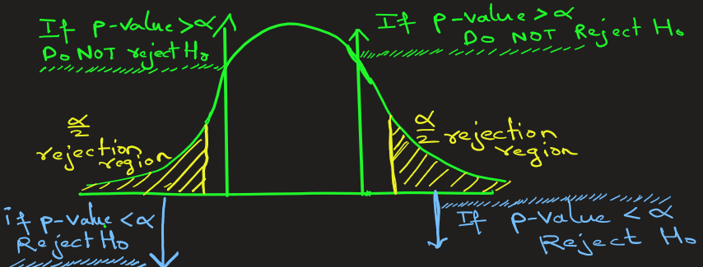
P-value
Hypothesis problems fall under 3 categories:
Left-tailed test
Right-tailed test
2-tailed test

Slide 6
P-value
Steps In Solving Hypothesis-testing Problems (P-Value method)
Step 1) State the hypothesis and identify the claim.
Step 2) Compute the z test value (or t test value)
Step 3) Find the P-value for the above test value.
Step 4) Compare P-value with significance level α and make the decision:
If P-value <= α, reject the null hypothesis.
If P-value > α, do not reject the null hypothesis.
Step 5) Summarize the results.

Slide 7
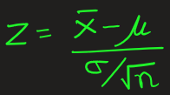

P-value: Applications
Problem : In a population of metal components, the average lifetime μ without a protective paint coating is 101 days. The lifetime is normally distributed, and the population standard deviation σ is 15 days. An engineer claims that applying the new protective paint coating increases the mean lifetime of the component beyond 101 days.
She tests this claim by selecting a random sample of 50 components with the coating and observes following lifetime:
[114 107 115 124 106 106 125 116 104 114 104 104 111 90 92 103 99 112 100 95 123 107 109 95 103 110 97 113 103 106 103 127 109 98 117 97 111 89 96 111 116 111 108 106 94 102 104 119 112 91]
The mean of above 50 samples is 107 days approx.
Test the engineer’s claim at significance level α = 0.05. Use the P-value method.
Step 3) Find the p-value
Look up the Z value in the Standard Normal table for Z=2.83
Now, P(Z>2.83)
= 1 − P(Z<2.83) (here look up in SN table)
= 1 – 0.9977 = 0.0023
So, the p-value is 0.0023
Ans:
Step 1) State the hypothesis and identify the claim.
H0: μ = 101 (The mean lifetime is 101 days; the coating has no effect)
H1: μ > 101 ( claim: The mean lifetime > 101 days; the coating increases
the lifetime) This is right-tailed test
Step 2) Here σ is known, so compute the z test value for μ = 101:
Step 4)
Since the P-value 0.0023 is less than α value of 0.05, we reject the null hypothesis at 5% significance level
Step 5) There is enough evidence at the 5% significance level to conclude that the new protective coating has no effect.

Slide 8
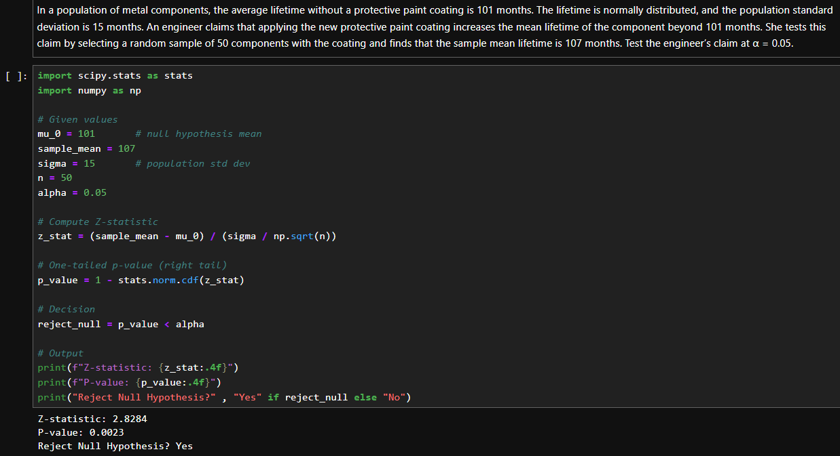
Computing p-value programmatically

Slide 9

P-value: Applications
Problem: A water treatment plant claims their new filtration system reduces contaminant levels to below 5 ppm which is the population mean μ. Environmental engineers want to verify the claim.
A random sample of 60 water samples is taken after treatment. The sample shows a mean contaminant level of 4.9 ppm, with a known population standard deviation σ of 0.8 ppm. Test the water treatment plant claim at significance level α = 0.10.
Step 3) Find the p-value
Look up the Z value in the Standard Normal table for Z = -0.97
Now P( Z < -0.97) = 0.1660
So, the p-value is 0.1660
Ans:
Step 1) State the hypothesis and identify the claim.
H0: μ = 5 ppm ( No improvement )
H1: μ < 5 ppm ( Claim: System reduces mean contaminant level )
This is left-tailed test
Step 2) Here σ is known, so compute the z test value .
Step 4)
Since the P-value 0.1660 is greater than α value of 0.10, we do not reject the null hypothesis at 10% significance level
Step 5)
Although the sample mean (4.9 ppm) is lower than 5 ppm, there is not enough evidence at the 10% level to conclude that the new filtration system reduces contaminant level.

Slide 10
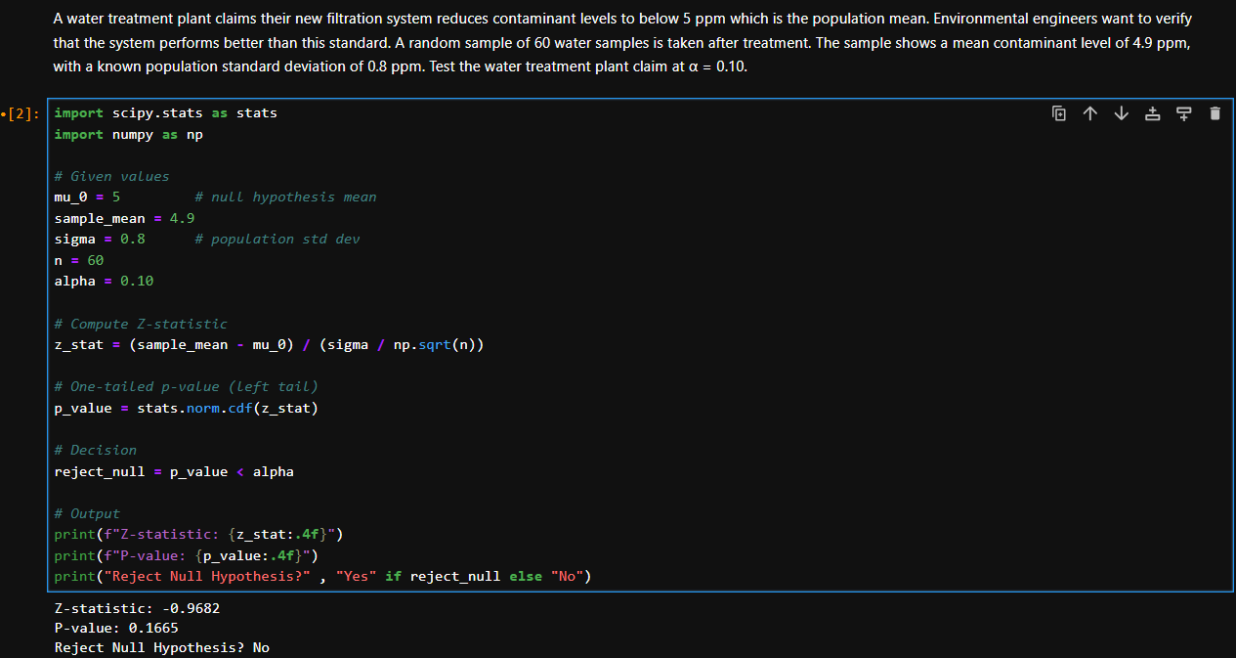
Computing p-value programmatically

Slide 11

P-value: Applications
Problem: A medical researcher is interested in finding out whether a new medication will have any undesirable side effects on patients’ pulse rates. The researcher is concerned with whether the pulse rate increases, decreases, or stays the same after taking the medication.
The researcher knows that the mean pulse rate μ for the population under study is 82 beats per minute (bpm), with a population standard deviation σ of 5 bpm. To investigate, the researcher selects a random sample of 60 patients who take the medication and finds that their mean pulse rate is 80.7 bpm. Test the claim that medication does affect the mean pulse rate at significance level α = 0.01
Step 3) Find the P-value
Look up the Z value in the standard normal table for Z = -2.014
Here, P(|Z| > 2.014) = 2*P(Z > 2.014) because of symmetrical nature of standard distribution curve.
Now, P(Z > 2.014)
= 1 − P(Z < 2.014) (here look up in SN table)
= 1 – 0.9778 = 0.0222
So, the p-value is P(|Z| > 2.013) = 2(0.0222)= 0.0444
Ans:
Step 1) State the hypothesis and identify the claim.
H0: μ = 82 BPM (The medication has no effect on mean pulse rate.)
H1: μ != 82 BPM (claim: The medication does affect the mean pulse rate (it could be higher or lower). This is 2-tailed test
Step 2) Here σ is known, so compute the z test value .
Step 4) Since the P-value 0.0444 is greater than α value of 0.01, we do not reject the null hypothesis at 1% significance level.
Step 5) Although the sample mean pulse rate after medication (80.7 bpm) is lower than the population mean 82.0 bpm, there is not enough evidence at the 1% level to conclude that the medication has any effect on mean pulse rate.

Slide 12
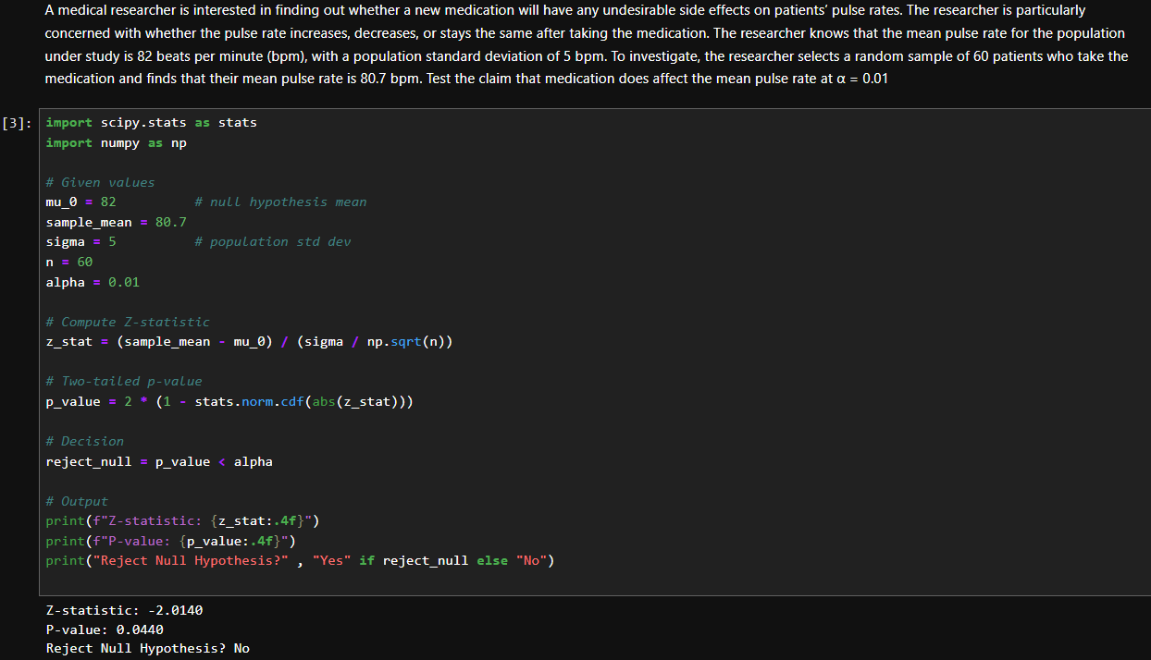
Computing p-value programmatically

Slide 13
EXTRA

Slide 15

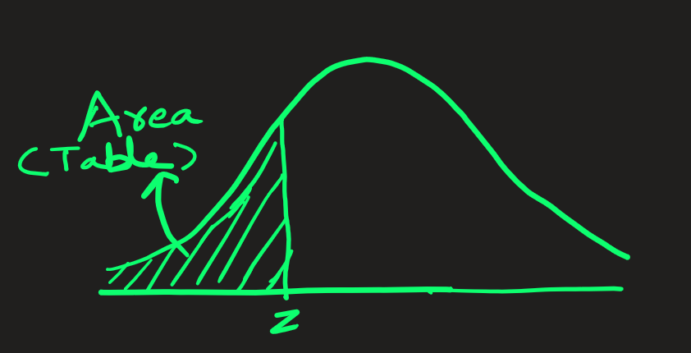
Standard Normal Distribution:
Table values represent AREA to the LEFT of the z-score
This table shows area for
z-values between -3.1 to -0.1

Slide 16

Standard Normal Distribution:
Table values represent AREA to the LEFT of the z-score
This table shows area for
z-values between 0.0 to +3.0

Slide 17
A statistical hypothesis is a conjecture about a population parameter (e.g. mean, variance, etc. ). This conjecture may or may not be true.
The null hypothesis (H0): is a statistical hypothesis that states that there is no difference between a population parameter and the observed parameter. That is, nothing is happening. Status quo
The alternative hypothesis (H1): is a statistical hypothesis that states that there is a difference between population parameter and the observed parameter. That is, something is happening.
Simple Example: Imagine you want to test if a new teaching method improves test scores.
Null hypothesis (H0): The new teaching method has no effect on test scores
( Students scores remained same as before. Nothing happened. No significant change)
Alternative hypothesis(H1): The new teaching method has positive effect test scores.
( Students scores increased. Something happened. There was significant change)
Side Note: The null hypothesis isn’t always only about comparing “population mean vs observed mean” — it can also be about proportions, variances, correlations, regression coefficients, etc.

Slide 18
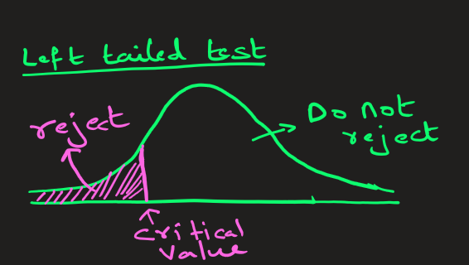
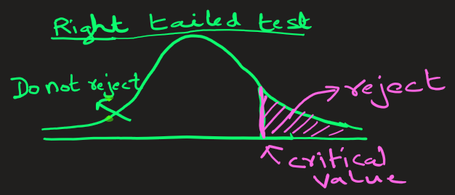
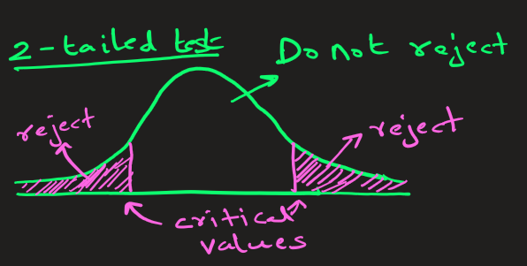
P-value
Hypothesis problems fall under following 3 categories:
Left-tailed test
Right-tailed test
2-tailed test

