Slide 1
Z – table: Application

Slide 2
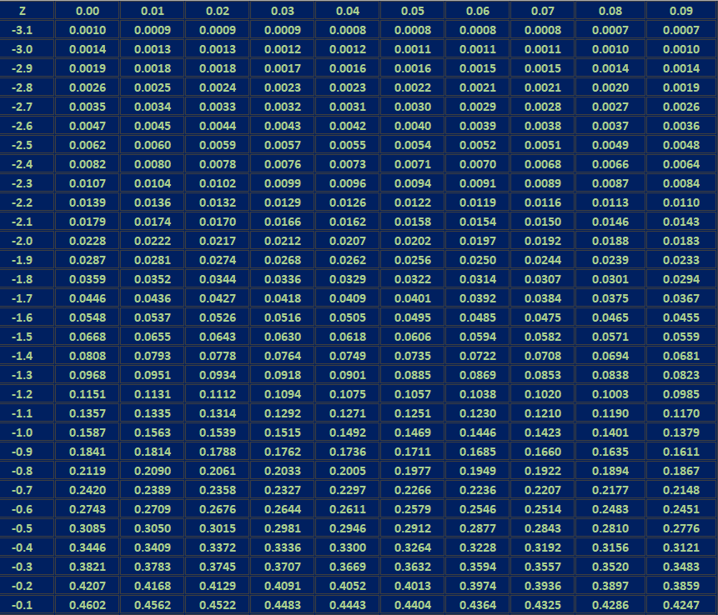
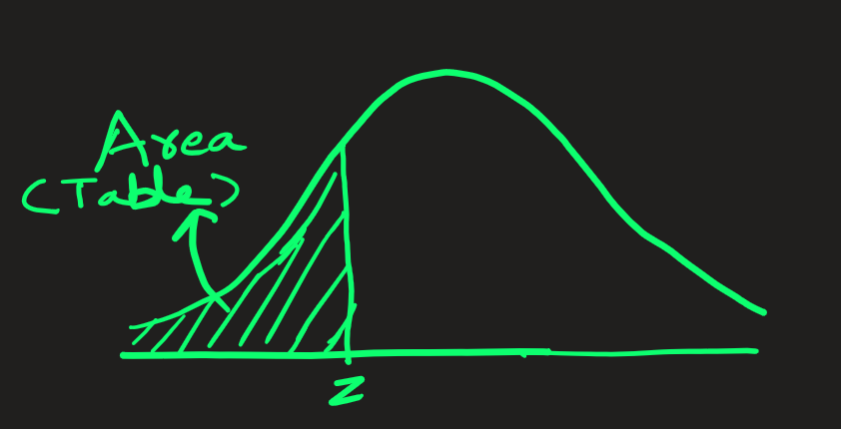
Standard Normal Distribution: Table values represent AREA to the LEFT of the z-score
This table shows z-values from -3.1 to -0.1

Slide 3
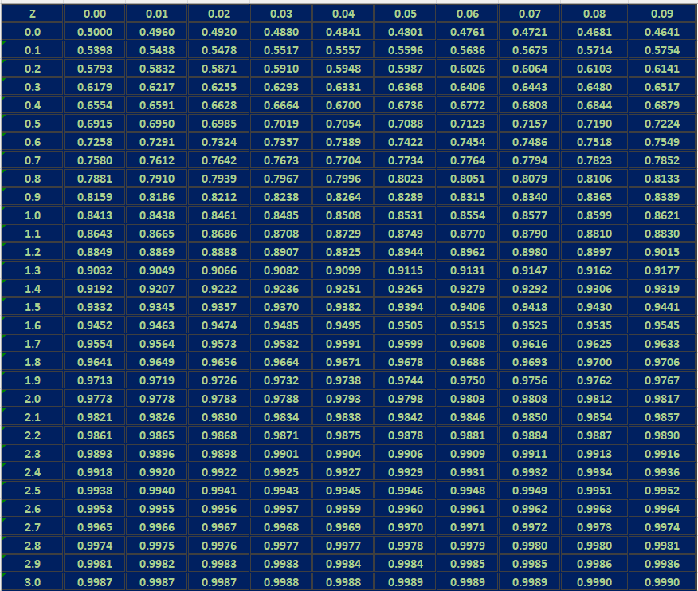
Standard Normal Distribution: Table values represent AREA to the LEFT of the z-score
This table shows z-values from 0.0 to +3.0

Slide 4

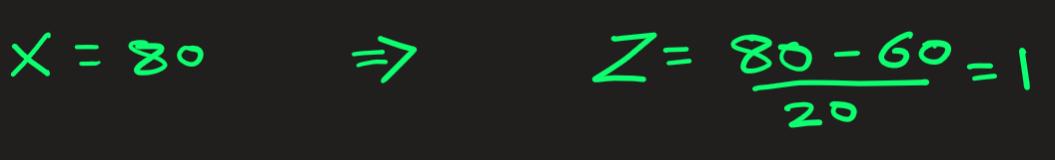
Q1) The annual rainfall at a particular geographical location is modeled as normal random variable with a mean of 60 cm and std dev of 20 cm. What is the probability that this year the average rainfall will be at most 80 cm?
Solution: Let X represent the mean rainfall.
You have to find
P(mean rainfall is at most 80 cm)
= P(X < 80)
First, we convert normal RV to standard RV
X = 80 => Z = 1.00
P(X < 80)
= P (Z < 1)
= 0.8413

Slide 5
Q2) The annual rainfall at a particular geographical location is modeled as normal random variable with a mean of 60 cm and std dev of 20 cm. What is the probability that this year the average rainfall will be at least 80 cm?
Solution: Let X represent the mean rainfall.
You have to find
P(mean rainfall is at least 80 cm)
= P(X > 80)
First, we convert normal RV to standard RV
X = 80 => Z = 1.00
P(X > 80)
= P (Z > 1)
= 1 – P(Z < 1)
= 1 - 0.8413
= 0.1587

Slide 6
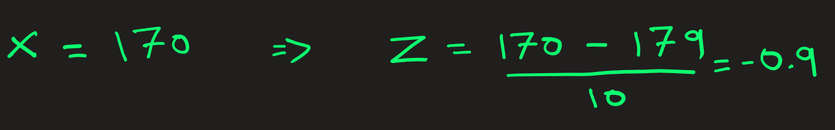
Q3) The average height of a person is modeled as normal random variable with a mean of 179 cm and std dev of 10 cm. What is the probability that a random person selected height is at most 170 cm?
Solution: Let X represent the height.
You have to find
P(mean height is at most 170 cm)
= P(X < 170)
First, we convert normal RV to standard RV
X = 170 => Z = -0.90
P(X < 170)
= P (Z < -0.9)
= 0.1841

Slide 7
Q4) The average height of a person is modeled as normal random variable with a mean of 179 cm and std dev of 10 cm. What is the probability that a random person selected height is at least 170 cm?
Solution: Let X represent the height.
You have to find
P(height is at least 170 cm)
= P(X > 170)
First, we convert normal RV to standard RV
X = 170 => Z = -0.90
P(X > 170)
= P (Z > -0.9)
= 1 - P (Z < -0.9)
= 1 - 0.1841
= 0. 8159

Slide 8
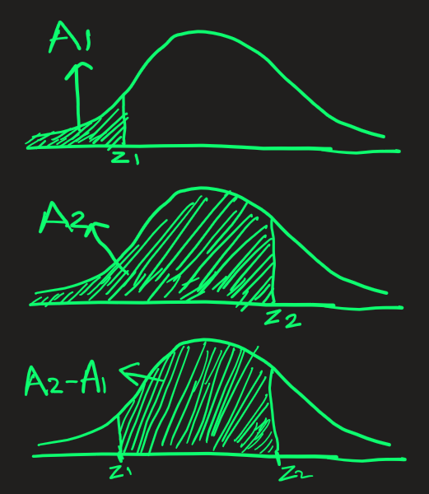
Q5) The average height of a person is modeled as normal random variable with a mean of 179 cm and std dev of 10 cm. What is the probability that a random person selected height is between 160 cm and 170 cm?
Solution: Let X represent the height.
You have to find
P(mean height between 160 cm and 170 cm)
= P( 160 < X < 170)
First, we convert normal RV to standard RV
x1 = 160 => z1 = -1.90
x2 = 170 => z2 = -0.90
We see from z-table:
P( Z < −1.9) = 0.0287
P( Z < -0.9 ) = 0.1841
So ,
P(160 < X < 170)
= P(-1.9 < z < -0.9 )
= 0.1841−0.0287
= 0.1554
= 15.54% that a randomly chosen person height is between 160 cm and 170 cm

Slide 9
Q6) Suppose normal human body temperature follows a normal distribution with mean 98.6 deg Fahrenheit and standard deviation of 0.7 deg Fahrenheit
What is the probability that a randomly chosen patient’s temperature is between 98°F and 99°F?
Solution: Let X represent the temperature.
You have to find
P(temperature is between 98°F and 99°F )
= P(98 < X < 99)
First, we convert normal RV to standard RV
x1 = 98 => z1 = −0.86
x2 = 99 => z2 = + 0.57
We see from z-table:
P( Z < −0.86) = 0.1949
P( Z < 0.57 ) = 0.7157
So ,
P(98 < X < 99)
= P(-0.86 < z < +0.57 )
= 0.7157−0.1949
= 0.5208
= 52.08% that a randomly chosen patient’s temperature is between 98°F and 99°F

