Slide 1
How to read the Z-table AKA Standard Normal Distribution Table

Slide 2
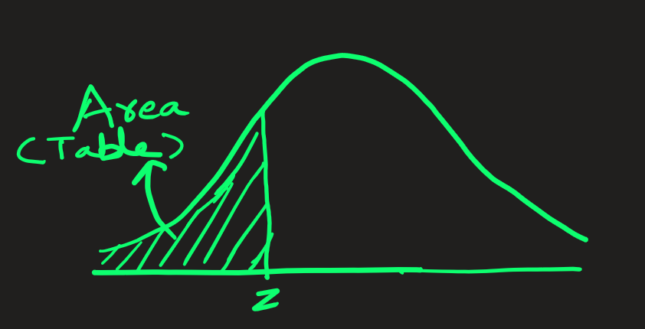
Once we know z-value, then using Standard Normal Distribution table, we can find the area under the curve.
The area represents the probability of finding a values less than z-value. i.e. P(value < z)

Slide 3
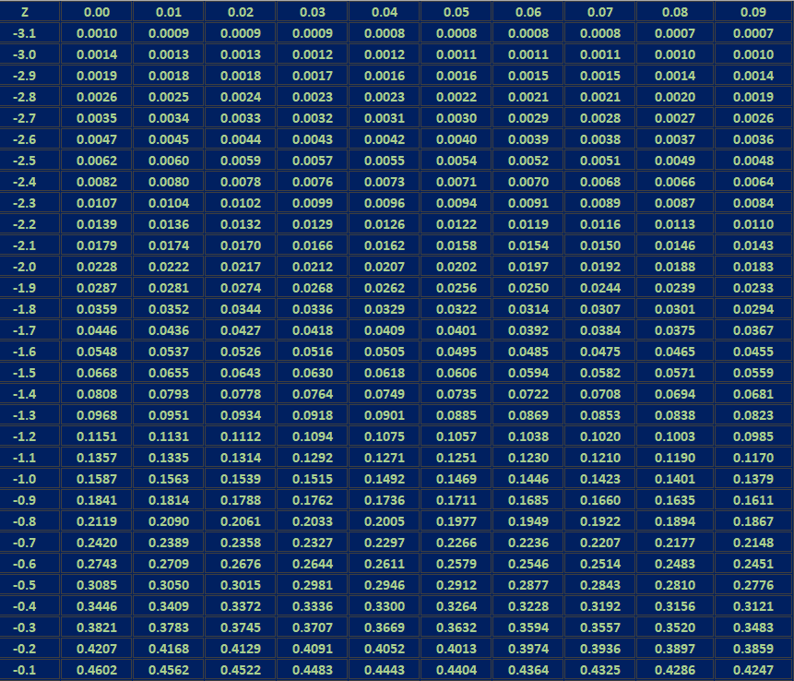
Standard Normal Distribution:
Table values represent AREA to the LEFT of the z-score
This table shows area for
z-values between -3.1 to -0.1

Slide 4
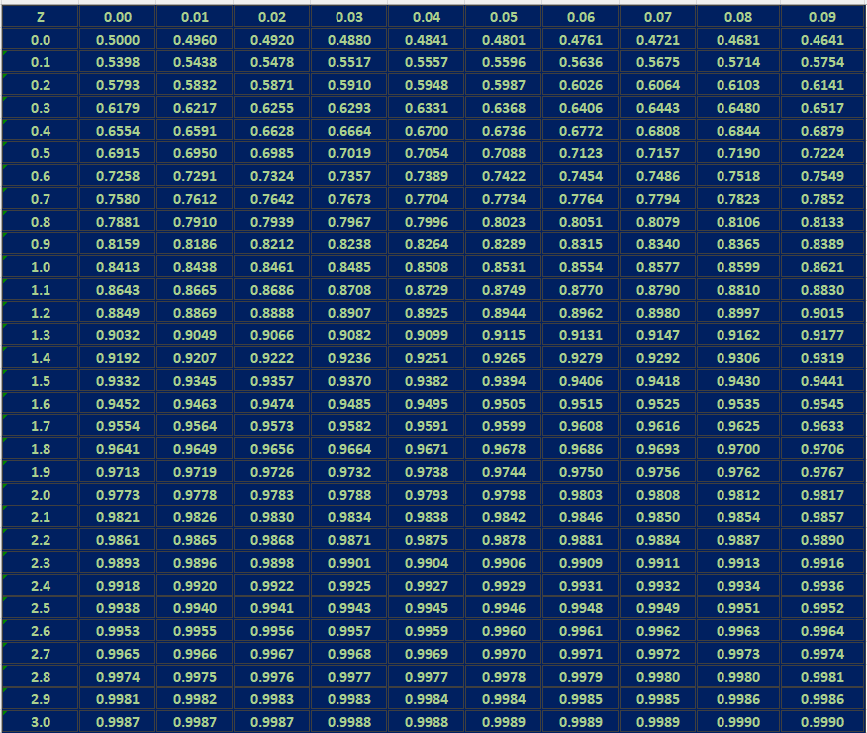
Standard Normal Distribution:
Table values represent AREA to the LEFT of the z-score
This table shows area for
z-values between 0.0 to +3.0

Slide 5
Q. Find the area under the standard normal distribution curve to the left of z = - 2.76
Ans:
Look up in the Standard Normal Distribution table for the area.
From the table we see that area = 0.0029
This represents probability of finding z < -2.76,
i.e., P(z < -2.76) = 0.0029 = 0.029%

Slide 6

Q. Find the area under the standard normal distribution curve to the left of z = - 1.89
Ans:
Look up in the Standard Normal Distribution table for the area.
From the table we see that area = 0.0294
This represents probability of finding z < -1.89
i.e., P(z < -1.89) = 0.0294 = 2.94%

Slide 7
Q. Find the area under the standard normal distribution curve to the left of z = 2.09
Ans:
Look up in the Standard Normal Distribution table for the area.
From the table we see that area = 0.9817
This represents probability of finding z < 2.09
i.e., P(z < 2.09) = 0.9817 = 98.17%

Slide 8

Q. Find the area under the standard normal distribution curve to the left of z = 1.56
Ans:
Look up in the Standard Normal Distribution table for the area.
From the table we see that area = 0.9406
i.e., P(z < 1.56) = 0.9406

Slide 9

Q. Find the area under the standard normal distribution curve to the right of z = 1.56
Ans:
Look up in the Standard Normal Distribution table for the area.
From the table we see that area to the left = 0.9406
i.e., P(z < 1.56) = 0.9406
The area to the right = 1 – 0.9406 = 0.0594
i.e., P(z > 1.56) = 0.0594

Slide 10
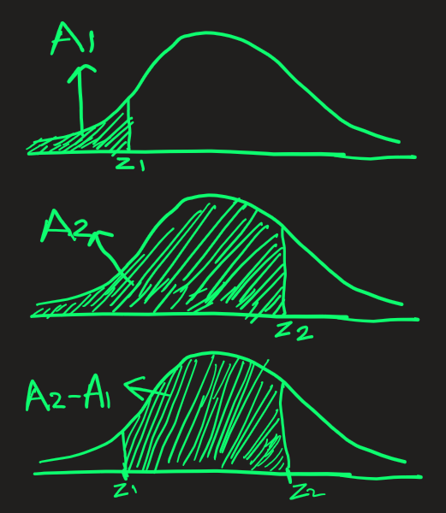
Q. Find the area under the standard normal distribution curve between z1 = -1.45 and z2 = 1.56
Ans:
Look up in the Standard Normal Distribution table for the area.
From the table we see that area to the left of z1 = -1.45 is 0.0735
From the table we see that area to the left of z2 = 1.56 is 0.9406
So, using plain visual geometry we can find the area between z1 = -1.45 and z2 = 1.56 to be 0.9406 - 0.0735 = 0.8671
i.e., P( -1.45 < z < 1.56 ) = 0.8671

