Slide 1






Sampling Methods
Problem: You’re the quality manager at a company that just received a truckload of 10,000 mangoes from farmers living in East, West, North, South of country.
Your boss says:
“Check if the shipment is good enough to send to the export market.”
You can’t cut open all 10,000 mangoes to test sweetness and ripeness. You only have time to test 50 mangoes.
How will you pick those 50 mangoes so that your decision represents the whole truckload ?
Simple Random Sampling
Systematic Sampling
Stratified Sampling
Cluster Sampling
Judgment Sampling
Convenience Sampling

Slide 2
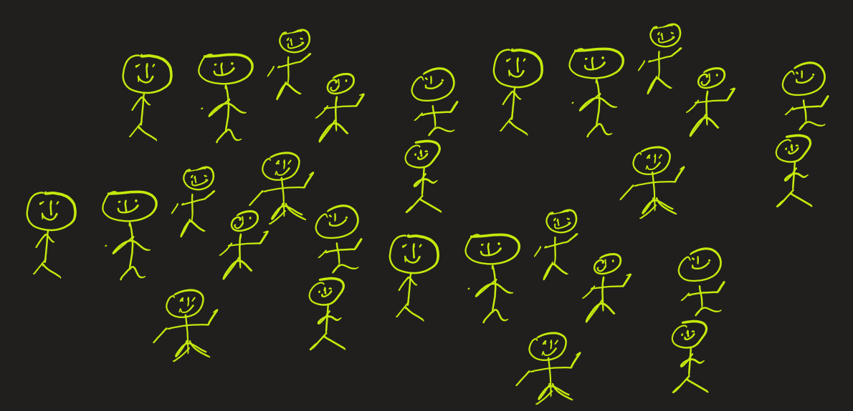




What is Sampling and Why Do We Need It?
Sampling is the process of selecting a small subset (sample) from a larger group (population) to draw conclusions about the entire population. You could be drawing conclusion about mean, variance, etc.
Population → The entire group you want to study e.g., all college students in Country
Sample → A smaller group chosen from the population e.g., 500 students selected from different colleges

Slide 3


What is Sampling and Why Do We Need It?
Why sampling ?
Because collecting data from the entire population is usually impractical or expensive, we rely on samples.
For example, suppose a drug manufacturer would like to research the adverse side effects of a drug on the country’s population. In that case, it is almost impossible to conduct a research study that involves everyone. In this case, the manufacturer decides on a sample of people from each demographic and then researches side effects of drugs.

Slide 4
Fun Fact About Sampling Methods
In 1936, The Literary Digest magazine mailed out 10 million surveys to predict who would win the Presidential election — and they were wrong.
They predicted Alf Landon would win by a landslide.
But the actual winner was Franklin D. Roosevelt, who won by huge margin!
Why was the magazine wrong?
Because the magazine sent surveys only to people who had cars, telephones, or magazine subscriptions — mostly wealthier Citizens — and ignored poorer voters.
So even with millions of responses, the sample was biased.

Slide 5









What are Types Sampling Methods?
Sampling Methods
Probability Sampling:
Every individual in the population has a known, non-zero chance of being selected - It helps avoid bias and supports statistical inference.
Non-Probability Sampling:
Not everyone has a known or equal chance of being selected — can lead to bias but often used when probability sampling isn’t possible.
Simple Random Sampling
Systematic Sampling
Stratified Sampling
Cluster Sampling
Convenience
Sampling
Judgment Sampling
Quota Sampling
Snowball Sampling

Slide 6

Sampling Method1 : Probability Sampling Types
Simple Random Sampling:
Every member has an equal chance of being chosen
Example: Randomly pick 10 names from a list

Slide 7

Sampling Method1 : Probability Sampling Types
Systematic Sampling:
Select every kth item
Example:
Pick every 3rd student from a list

Slide 8
Sampling Method1 : Probability Sampling Types
Stratified Sampling:
Divide population into subgroups (strata) and take random samples from each
Example: You want a sample of 40 students from a population of 400 that represents all years proportionally.
Here the strategy is to
divide students by year (1st, 2nd, 3rd, 4th) and
then sample proportionally.
1st yr
2nd yr
3rd yr
4th yr
STEP1:
Divide by Year
STEP2:
Here 40 is 10% of total, so we take 10% of students from each year.
Year | Number of Students
1st Year | 120
2nd Year | 100
3rd Year | 80
4th Year | 100
Total | 400
Year | Total Students | Sample Size
1st Year | 120 | 0.10 × 120 = 12
2nd Year | 100 | 0.10 × 100 = 10
3rd Year | 80 | 0.10 × 80 = 8
4th Year | 100 | 0.10 × 100 = 10
Total | 400 | 40

Slide 9
Sampling Method1 : Probability Sampling Types
Cluster Sampling:
Divide population into clusters, then randomly select whole clusters. Each clusters should have similar characteristics within themselves.
Example: Suppose we want to conduct survey from students. Here divide student’s population into 20 clusters based on colleges. Randomly select 5 colleges (say C, F, K, N, S) and survey all students in those colleges.
College K | 480
College L | 335
College M | 255
College N | 305
College O | 225
College P | 410
College Q | 380
College R | 300
College S | 420
College T | 455
College | Students
College A | 450
College B | 320
College C | 610
College D | 275
College E | 390
College F | 520
College G | 205
College H | 410
College I | 360
College J | 290

Slide 10




Problem:
You’re the quality manager at a company that just received a truckload of 10,000 mangoes from farmers living in East, West, North, South of country.
Your boss says: “Check if the shipment is good enough to send to the export market.”
You can’t cut open all 10,000 mangoes to test sweetness and ripeness. You only have time to test 50 mangoes.
How will you pick those 50 mangoes so that your decision represents the whole truckload ?

Slide 11
Answer: Since the mangoes came from different regions (E, W, N, S), their quality may differ by source. So, you should divide the 10,000 mangoes into 4 strata (E, W, N, S).
Example:
East: 4,000 mangoes
West: 3,000 mangoes
North: 3,000 mangoes
South: 0 mangoes
Here 50 is 50/10,000 x 100 = 0.5%. So, Sample proportionally from each stratum, that is, 0.5% from each strata:
East → 4,000 × 0.5 = 20 mangoes
West → 3,000 × 0.5 = 15 mangoes
North → 3,000 × 0.5 = 15 mangoes
South → 0 × 0.5 = 0 mangoes
Then randomly select those mangoes within each group. So, we use Stratified Random Sampling.

Slide 12
Sampling Method 2: Non-Probability Sampling Types
Method | Description | Example
Convenience Sampling | Choose who is easiest to access | Survey people in your School because they are easiest to access
Judgment Sampling | Researcher selects based on expertise | A doctor chooses patients she thinks represent her clinic. (Maybe patients are > 40 years of age. Choose samples of patients whose age > 40.)
Quota Sampling | Ensure specific groups are represented | Interview 50 males and 50 females, regardless of randomization
Snowball Sampling | Participants recruit others | Used for hard-to-reach groups like rare disease patients

Slide 13
STOP

