Slide 1
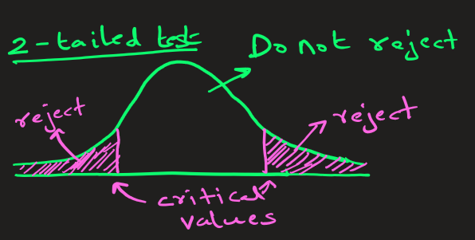
T-Table
Problem:
Find the t-critical value for a 95% confidence interval with n = 11 samples.

Slide 2
t-table: When Do We Choose t-distribution Over z-distribution ?
1. The population standard deviation (σ) is unknown
If you don’t know σ, and instead estimate it using the sample standard deviation (s), you must use the t-distribution instead of the normal (z) distribution.
2. The sample size is small (n < 30)
The t-distribution is specifically designed for small sample sizes, where estimates of variability are less reliable and have more uncertainty.

Slide 3
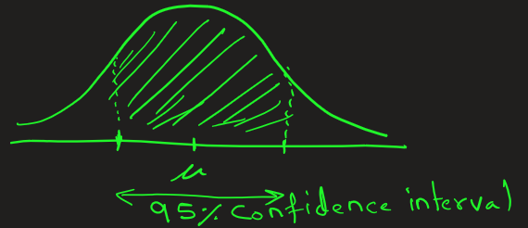
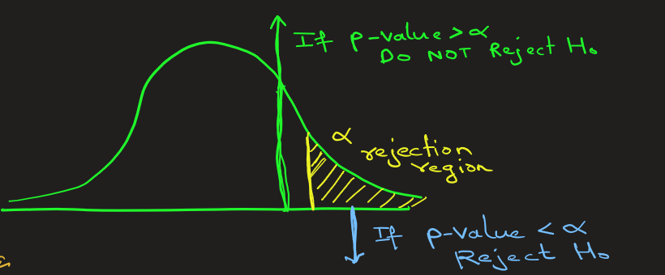
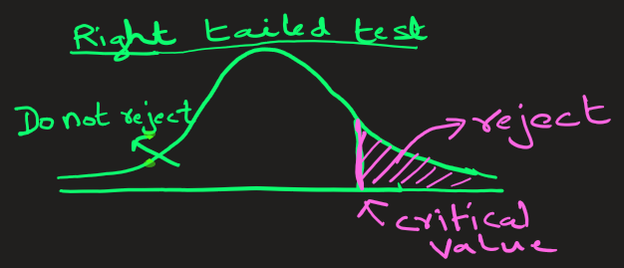
We need a critical t-value (tₐ or tₐ/₂) when we solving problems of following kind:
Finding confidence intervals
Performing hypothesis testing
Determining rejection regions
For this we look up the t-table critical t-value.

Slide 4
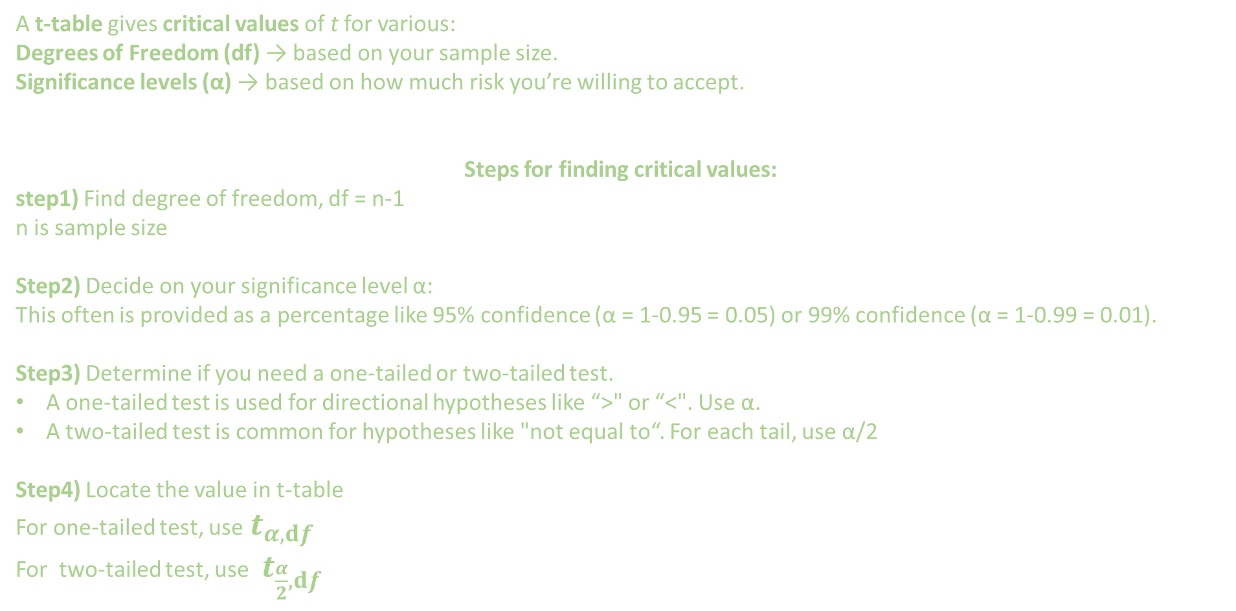
A t-table gives critical values of t for various:
Degrees of Freedom (df) → based on your sample size.
Significance levels (α) → based on how much risk you’re willing to accept.
Steps for finding critical values:
step1) Find degree of freedom, df = n-1 n is sample size
Step2) Decide on your significance level α:
This often is provided as a percentage like 95% confidence (α = 1-0.95 = 0.05) or 99% confidence (α = 1-0.99 = 0.01).
Step3) Determine if you need a one-tailed or two-tailed test.
A one-tailed test is used for directional hypotheses like “>" or “<". Use α.
A two-tailed test is common for hypotheses like "not equal to“. For each tail, use α/2
Step4) Locate the value in t-table
For one-tailed test, use $t_{α,ⅆf}$
For two-tailed test, use $t_{\frac{α}{2},ⅆf}$

Slide 5
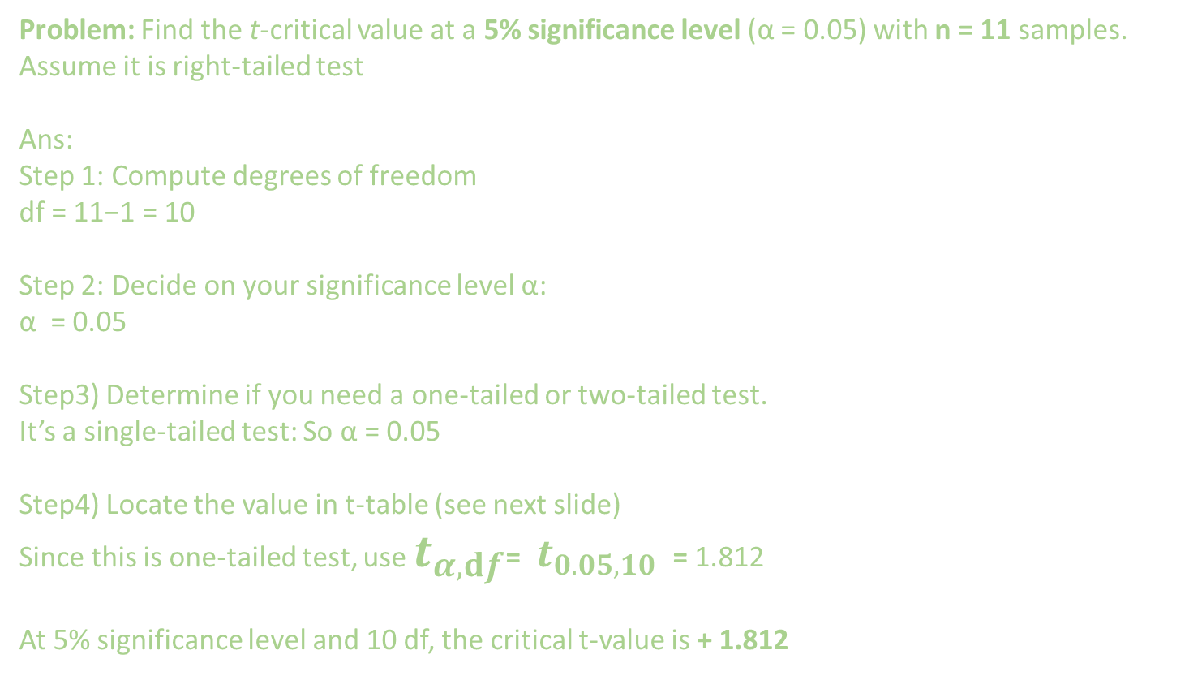
Problem: Find the t-critical value at a 5% significance level (α = 0.05) with n = 11 samples.
Assume it is right-tailed test
Ans:
Step 1: Compute degrees of freedom
df = 11−1 = 10
Step 2: Decide on your significance level α:
α = 0.05
Step3) Determine if you need a one-tailed or two-tailed test.
It’s a single-tailed test: So α = 0.05
Step4) Locate the value in t-table (see next slide)
Since this is one-tailed test, use $t_{α,ⅆf}$= $t_{0.05, 10}$ = 1.812
At 5% significance level and 10 df, the critical t-value is + 1.812

Slide 6

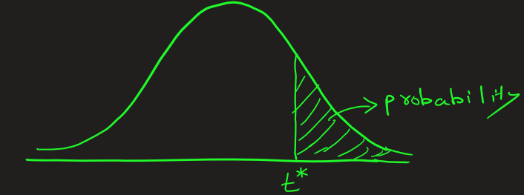
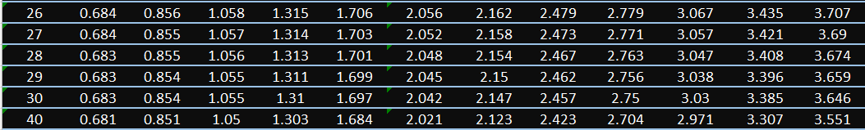



$t_{α,ⅆf}$ = $t_{0.05, 10}$ = 1.812
The value in the t-table represents the area of the t-distribution curve towards the right of t-test value for a given d.f. and α

Slide 7
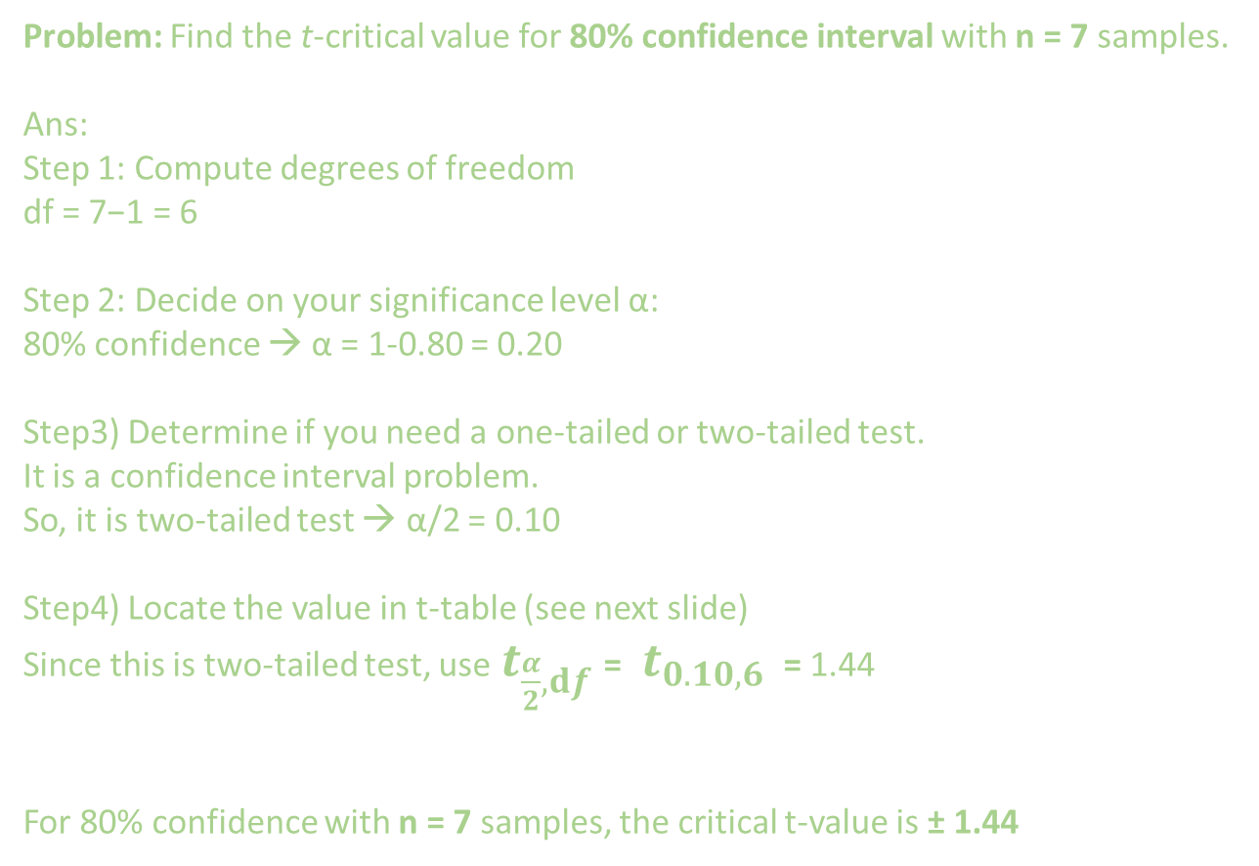
Problem: Find the t-critical value for 80% confidence interval with n = 7 samples.
Ans:
Step 1: Compute degrees of freedom
df = 7−1 = 6
Step 2: Decide on your significance level α:
80% confidence → α = 1-0.80 = 0.20
Step3) Determine if you need a one-tailed or two-tailed test.
It is a confidence interval problem.
So, it is two-tailed test → α/2 = 0.10
Step4) Locate the value in t-table (see next slide)
Since this is two-tailed test, use $t_{\frac{α}{2}, ⅆf}$= $t_{0.10, 6}$ = 1.44
For 80% confidence with n = 7 samples, the critical t-value is ± 1.44

Slide 8
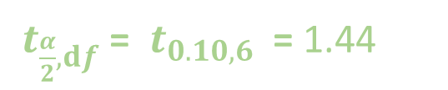


$t_{\frac{α}{2}, ⅆf}$= $t_{0.10, 6}$ = 1.44
The value in the t-table represents the area of the t-distribution curve towards the right of t-test value for a given d.f. and α

Slide 9
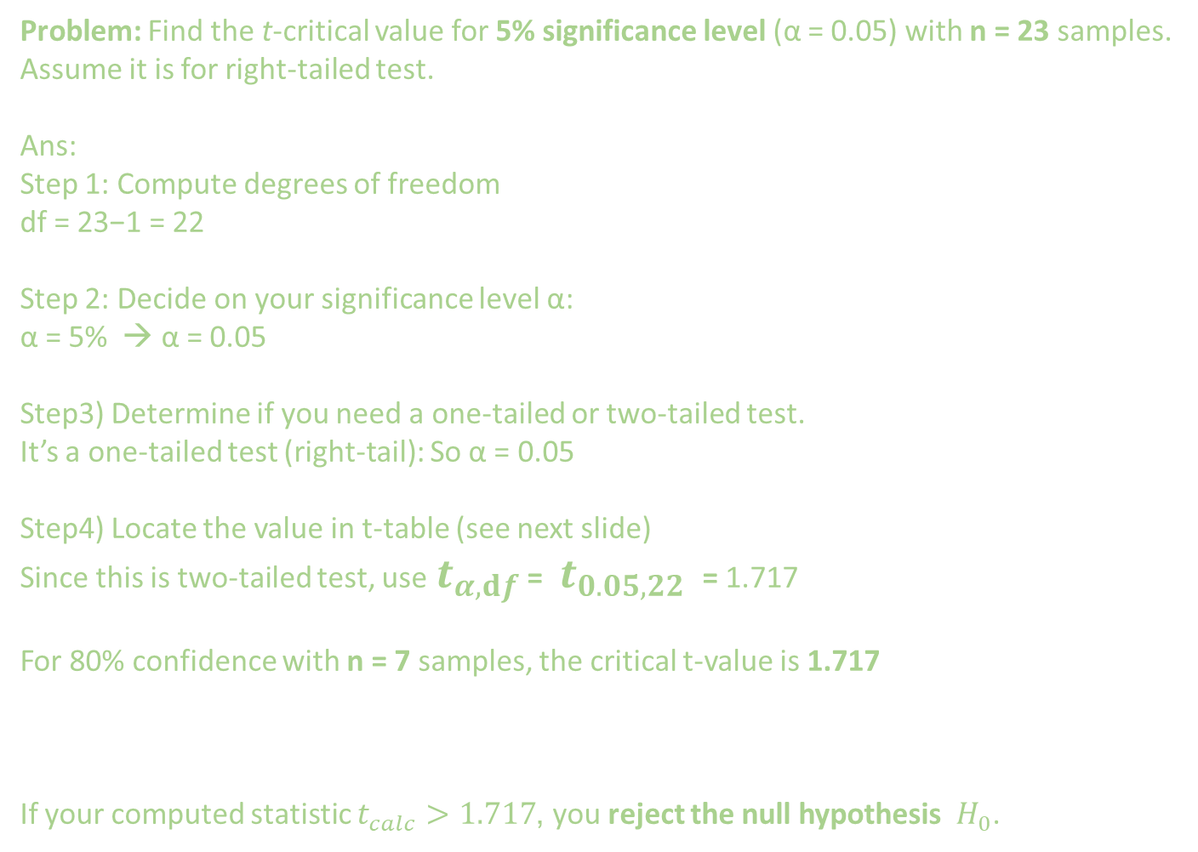
Problem: Find the t-critical value for 5% significance level (α = 0.05) with n = 23 samples. Assume it is for right-tailed test.
Ans:
Step 1: Compute degrees of freedom
df = 23−1 = 22
Step 2: Decide on your significance level α:
α = 5% → α = 0.05
Step3) Determine if you need a one-tailed or two-tailed test.
It’s a one-tailed test (right-tail): So α = 0.05
Step4) Locate the value in t-table (see next slide)
Since this is two-tailed test, use $t_{α,ⅆf}$ = $t_{0.05, 22}$ = 1.717
For 80% confidence with n = 7 samples, the critical t-value is 1.717
If your computed statistic $t_{calc}>1.717$, you reject the null hypothesis $H_{0}$.

Slide 10
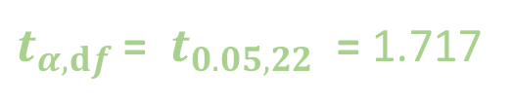

$t_{α,ⅆf}$ = $t_{0.05, 22}$ = 1.717
The value in the t-table represents the area of the t-distribution curve towards the right of t-test value for a given d.f. and α

Slide 11
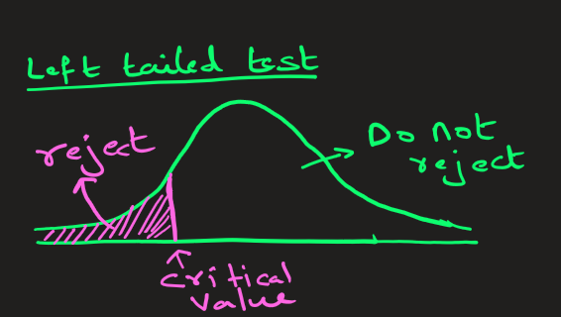
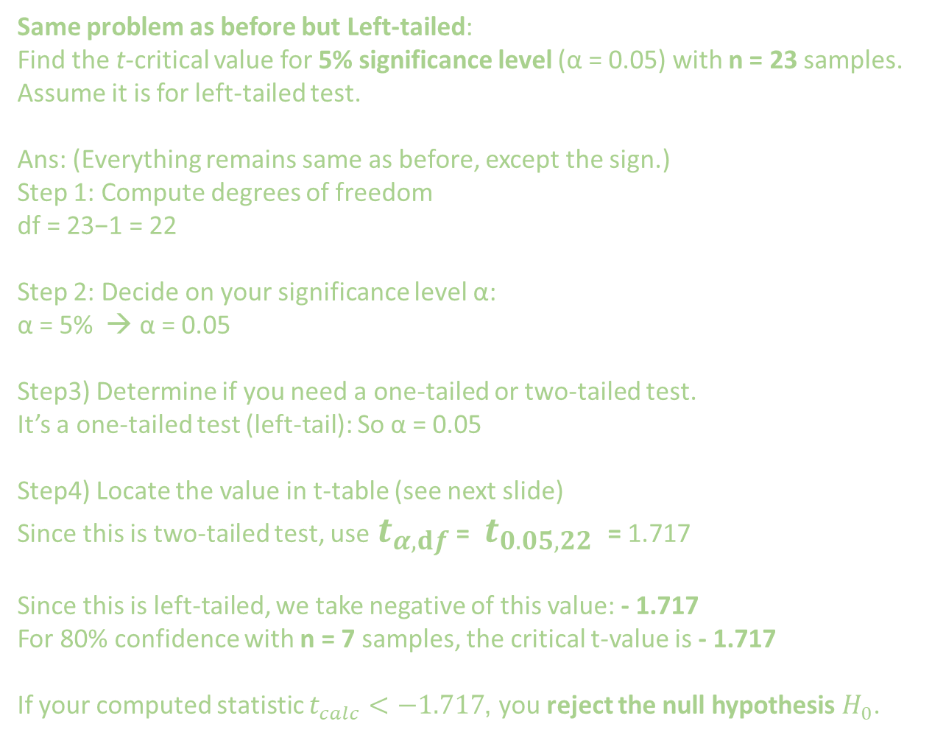
Same problem as before but Left-tailed:
Find the t-critical value for 5% significance level (α = 0.05) with n = 23 samples. Assume it is for left-tailed test.
Ans: (Everything remains same as before, except the sign.)
Step 1: Compute degrees of freedom
df = 23−1 = 22
Step 2: Decide on your significance level α:
α = 5% → α = 0.05
Step3) Determine if you need a one-tailed or two-tailed test.
It’s a one-tailed test (left-tail): So α = 0.05
Step4) Locate the value in t-table (see next slide)
Since this is two-tailed test, use $t_{α,ⅆf}$ = $t_{0.05, 22}$ = 1.717
Since this is left-tailed, we take negative of this value: - 1.717
For 80% confidence with n = 7 samples, the critical t-value is - 1.717
If your computed statistic $t_{calc}<−1.717$, you reject the null hypothesis $H_{0}$.

Slide 12
$t_{α,ⅆf}$ = $t_{0.05, 22}$ = 1.717
The value in the t-table represents the area of the t-distribution curve towards the right of t-test value for a given d.f. and α

Slide 13



t-values for common confidence level:
Confidence Level | Two-Tailed α | One-Tailed α | Common Critical t (large df)
90% | 0.10 | 0.05 | 1.645
95% | 0.05 | 0.025 | 1.960
99% | 0.01 | 0.005 | 2.576

Slide 14
Extra

Slide 15
α significance level | Test Type | Critical z-value(s) (Found from z-table)
0.10 | Two-tailed | +- 1.645
0.10 | One-tailed | ±1.28 (+ for Right Tailed and – for Left Tailed)
0.05 | Two-tailed | ±1.96
0.05 | One-tailed | ±1.645 (+ for Right Tailed and – for Left Tailed)
0.01 | Two-tailed | ±2.576
0.01 | One-tailed | ±2.33 (+ for Right Tailed and – for Left Tailed)

