Slide 1
Learning Goals
By the end of the class, students should:
Understand sequential data
Grasp why traditional ML fails for sequences
Build intuition for RNN
Implement a simple RNN in TensorFlow/Keras

Slide 2
Use cases of RNN
Autocompletion by google in search/email:
Places near me to -> eat
What is Recurrent Neural -> Network
Thanks, and -> regards.

Slide 3
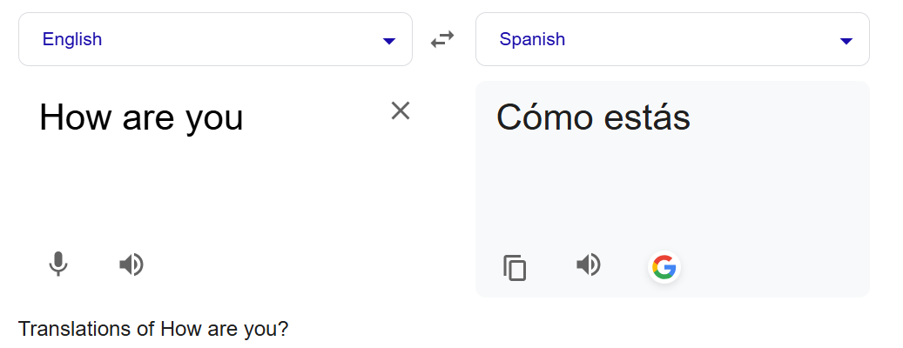
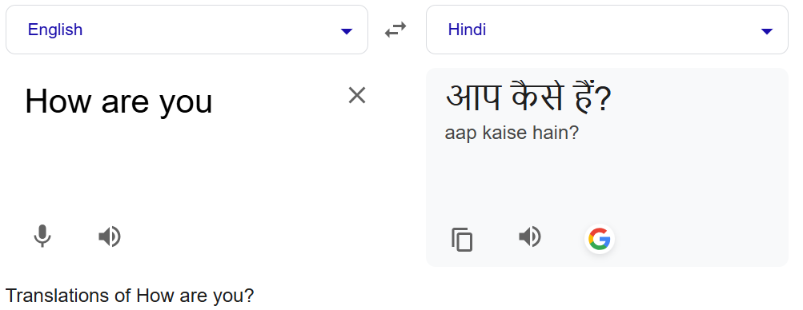
Use cases of RNN
Language translation:

Slide 4
Use cases of RNN
Named Entity Recognition
X:
John Doe works at Loxford Academy in Bangalore. He met Lomax Kumar at Google headquarters in California. The meeting happened on 12 January 2024.
John → B-PER
Doe → I-PER
works → O
at → O
Loxford → B-ORG
Academy → I-ORG
in → O
Bangalore → B-LOC
. → O
He → O
met → O
Lomax → B-PER
Kumar → I-PER
at → O
Google → B-ORG
headquarters → O
in → O
California → B-LOC
. → O
The → O
meeting → O
happened → O
on → O
12 → B-DATE
January → I-DATE
2024 → I-DATE
. → O
Tag meanings:
B- → Beginning of entity
I- → Inside entity
O → Outside (not an entity)
Entity Types:
PER → Person
ORG → Organization
LOC → Location
DATE → Date

Slide 5
Use cases of RNN
Sentiment Analysis
I love pizza and watching movies -> 5 star
This movie was OK. I would not watch it again -> 3 star
In all of the above problems, sequence is important.
To deal with this type of data, where sequence is important, we have RNN.
RNN is a type of NN that specializes in dealing with sequential type data.

Slide 6
1️⃣ What is Sequential Data?
Examples:
Text → “I love AI”
Time series → stock prices
Speech → audio waveform
👉 Key idea:
Order matters!
Example in text:
“dog bites man” ≠ “man bites dog”

Slide 7
2️⃣ Problem with Traditional Models
👉 If I use Logistic Regression:
It treats inputs as independent
No memory of previous words
Example:
"I am feeling ___"
Traditional Model doesn’t know previous words → poor prediction

Slide 8
3️⃣ RNN Intuition (Core Concept)
🔁 Key Idea:
RNN has "memory"
Diagram Explanation
h1 = f(x1)
h2 = f(x2, h1)
h3 = f(x3, h2)
h1 = f(x1)
h2 = f(x2, h1)
h3 = f(h2, x3)
h1
h2
h3
X1
X2
X3

Slide 9

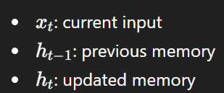
👉 Hidden state carries information forward
Input: I → love → AI
State: h1 → h2 → h3
h1 = f(x1)
h2 = f(x2, h1)
h3 = f(h2, x3)
h1
h2
h3
X1
X2
X3

Slide 10
4️⃣ Real NLP Example
Task: Next Word Prediction
Input: "I love"
Output: "AI"
Flow:
Convert words → numbers (tokenization)
Feed sequence into RNN
Predict next word
h1 = f(x1)
h2 = f(x2, h1)
h3 = f(h2, x3)
h1
h2
h3
X1
X2
X3

Slide 11
EXTRA
Xxxxxxxxxxx
xxxxxxxxxxxx

