Slide 1
Regular Expression for Natural Language Processing

Slide 2
Data Structures
Data Structure
Unstructured Data
Quasi-structure Data
Semi-structured Data
Structured Data
Data that has no predefined structure or format.
It cannot be easily organized or stored in a database or spreadsheet.
emails, social media posts, documents like Word files or PDFs, Wikipedia etc
80-90% available data is unstructured.
Text data with inconsistent formats.
It's not structured but can be partially organized with tools.
It’s readable but needs cleaning and parsing for analysis.
Typically found in: Logs, clickstream data
5-10% available data is unstructured.
Data that doesn't reside in a relational database but still has some organizational properties (tags or markers).
Example: JSON, XML files
5-10% available data is unstructured.
<student>
<id>101</id>
<name>Anant</name>
<age>14</age>
</student>
Data with a clearly defined format, organized into rows and columns
Relational databases (like MySQL, Oracle).
Easily searchable and analyzable.
<10% available data is unstructured.

Slide 3
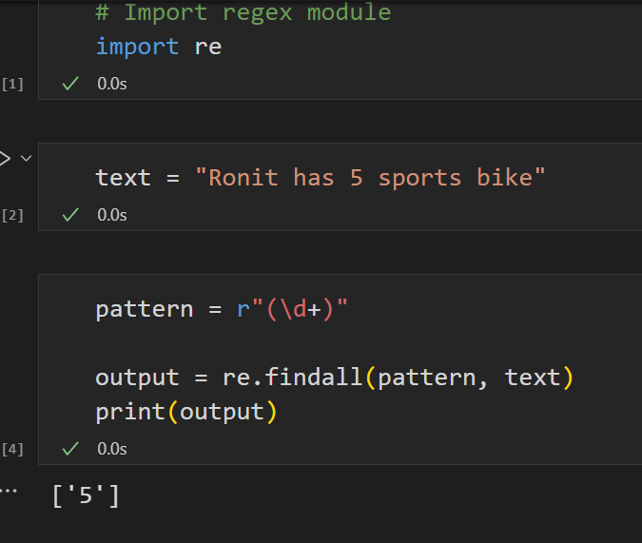

Regular Expressions - 1
Regular expressions are a powerful language for matching text patterns
A regular expression (regex or RE) is a sequence of characters that defines a search pattern. It's used to match specific characters or patterns within a string of text, allowing you to find, replace, or validate text based on certain criteria.
The re library in Python is a built-in library that provides support for regular expressions
To use the re library, you first need to import it at the beginning of your Python script by using the following line:
import re
findall() is probably the single most powerful function in the re module. It findall() finds *all* the matches and returns them as a list of strings, with each string representing one match.

Slide 4
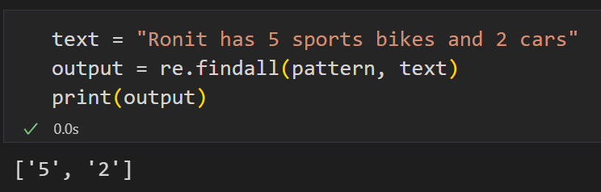
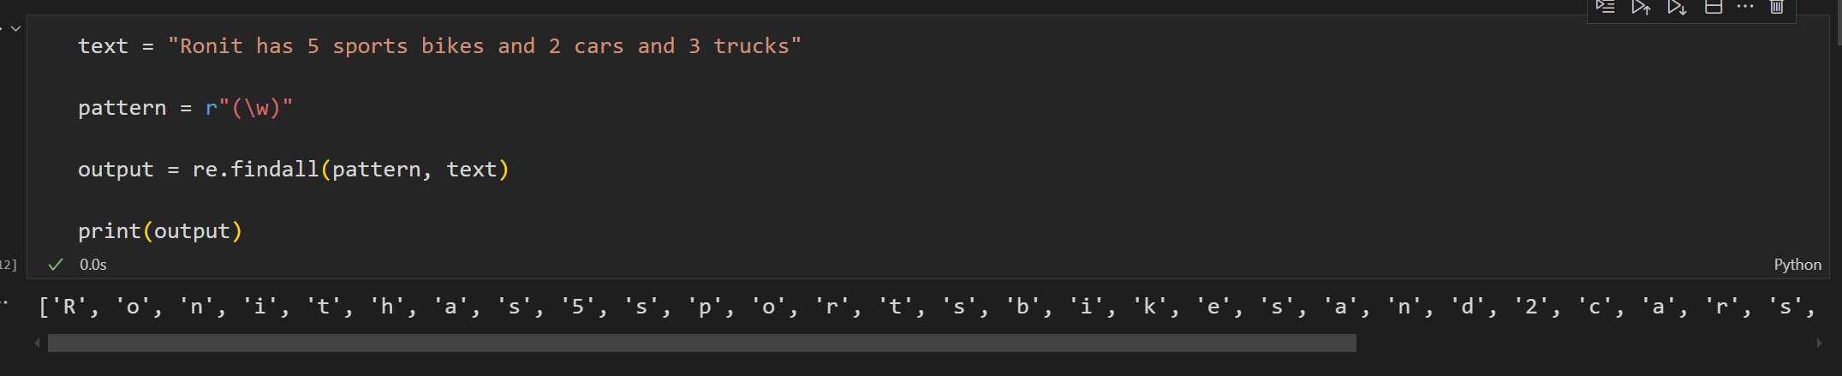
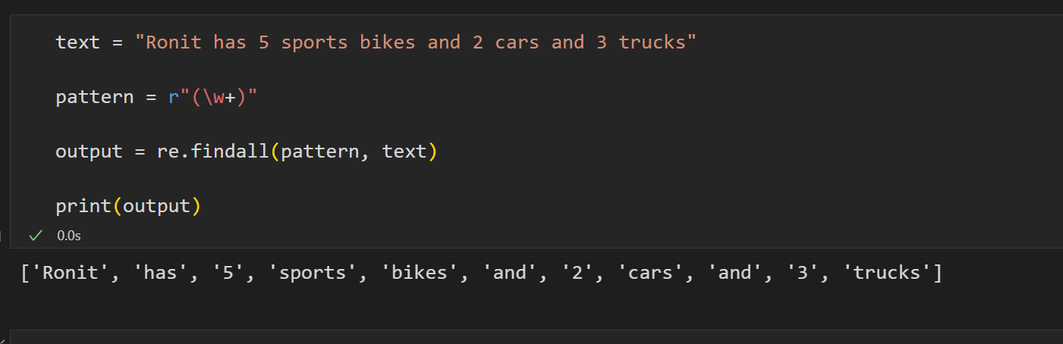
Regular Expression - 2
\w+ matches one or more word characters. A word character is any letter, digit, or underscore

Slide 5
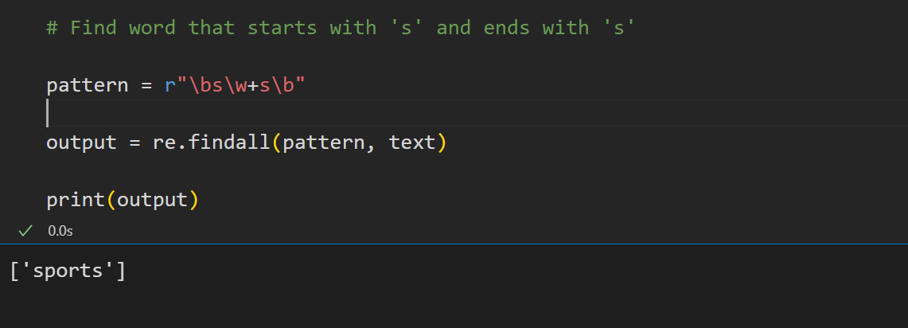
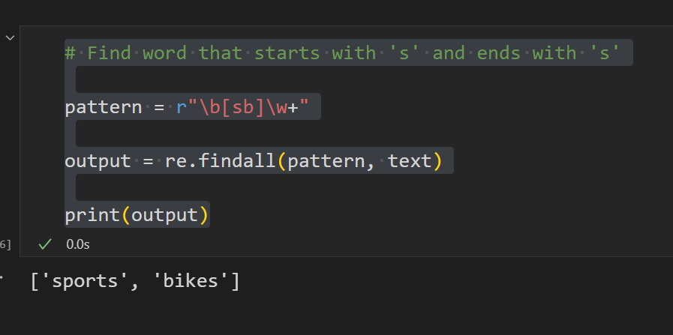
Regular Expression - 3
In regular expressions, \b is a special character that represents a word boundary. It indicates the position where a "word character" (letters, digits, underscores) meets a "non-word character" (anything else, including spaces and punctuation). Think of it as a marker for the beginning or end of a word.

Slide 6
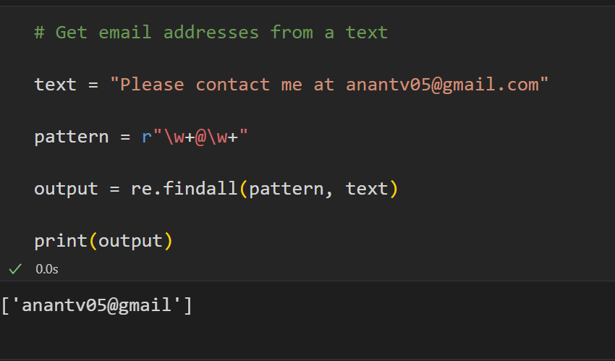
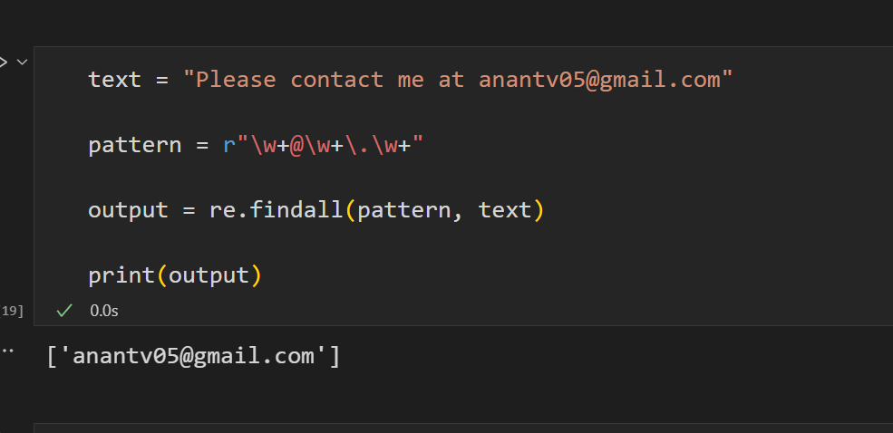
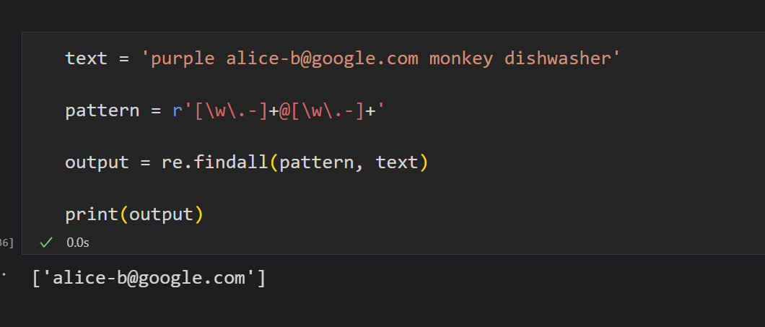
Regular Expression – 3 (Class-work)

Slide 7
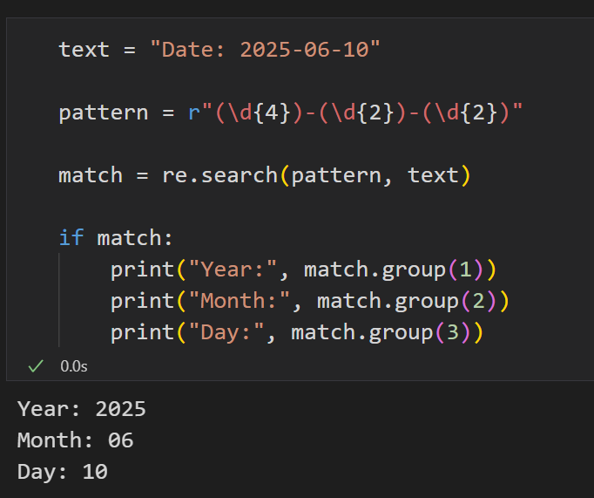
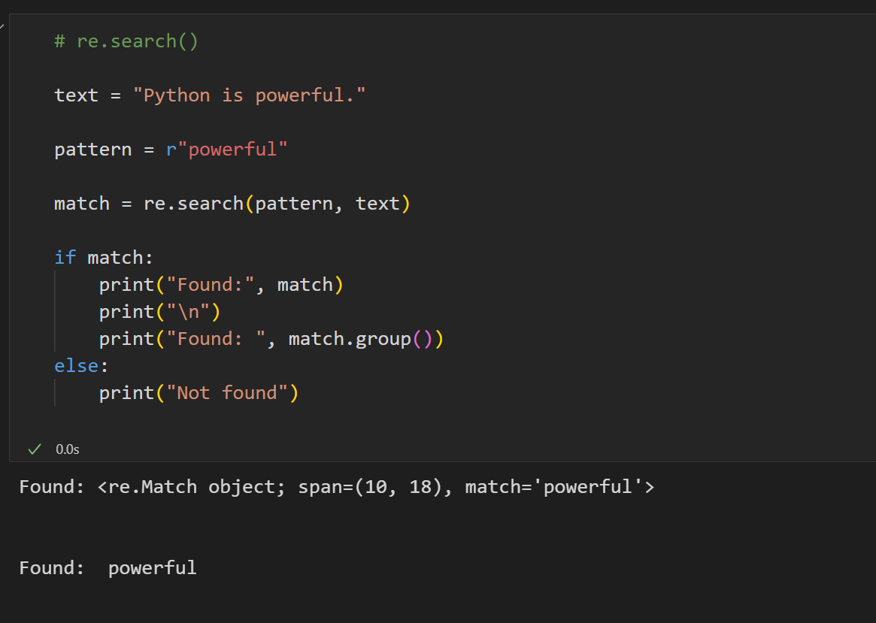
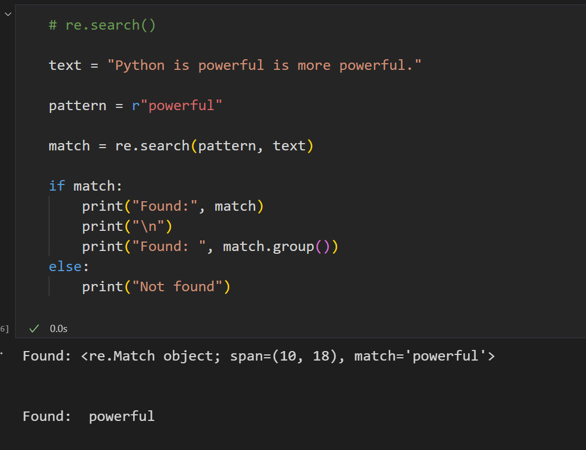
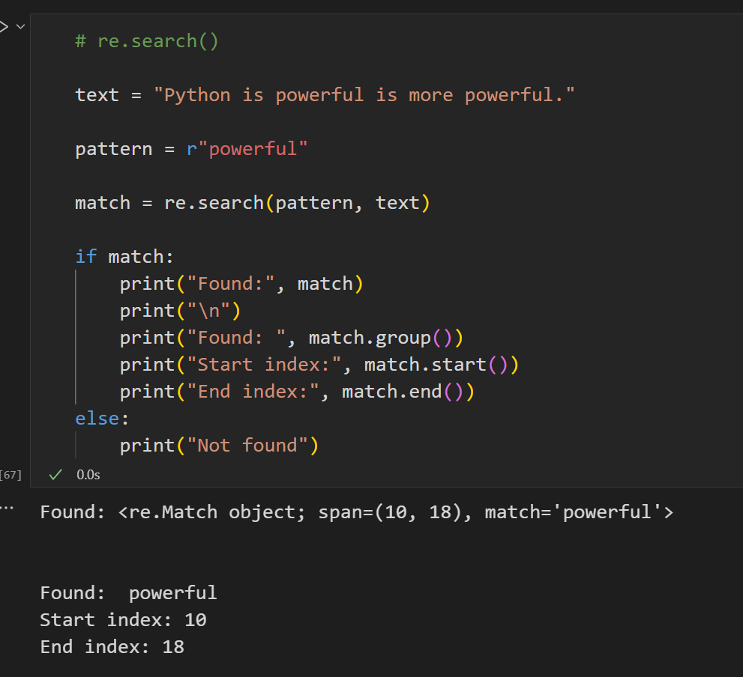
Regular Expression – re.search()
re.search(pattern, string)
scans through the entire string and returns the first match of the pattern.
If a match is found → returns a match object
If no match → returns None

Slide 8
Regular Expression – re.search()
re.search(pattern, string)
scans through the entire string and returns the first match of the pattern.
If a match is found → returns a match object
If no match → returns None
re.search() vs re.findall()
Feature | re.search() | re.findall()
Purpose | Finds the first match only | Finds all matches in the string
Returns | A match object or None | A list of strings (all matches)
When to use | When you only need the first match or to extract groups | When you want to find all occurrences of a pattern

Slide 9
Regular Expression – re.sub()
re.sub(pattern, replacement, string, count=0, flags=0)
Parameter | Description
pattern | The regex pattern to search
replacement | The string to replace the matched pattern
string | The input text
count | Optional. Number of replacements (default = all)
flags | Optional. Modify matching behavior (e.g., ignore case)
Use Case | Example Use
Cleaning Text | Removing extra spaces, punctuation
Data Masking | Hiding phone numbers or emails
HTML/XML cleanup | Removing tags
Pattern-based Replacements | Replacing words, abbreviations, etc.
Use Case Summary

Slide 10
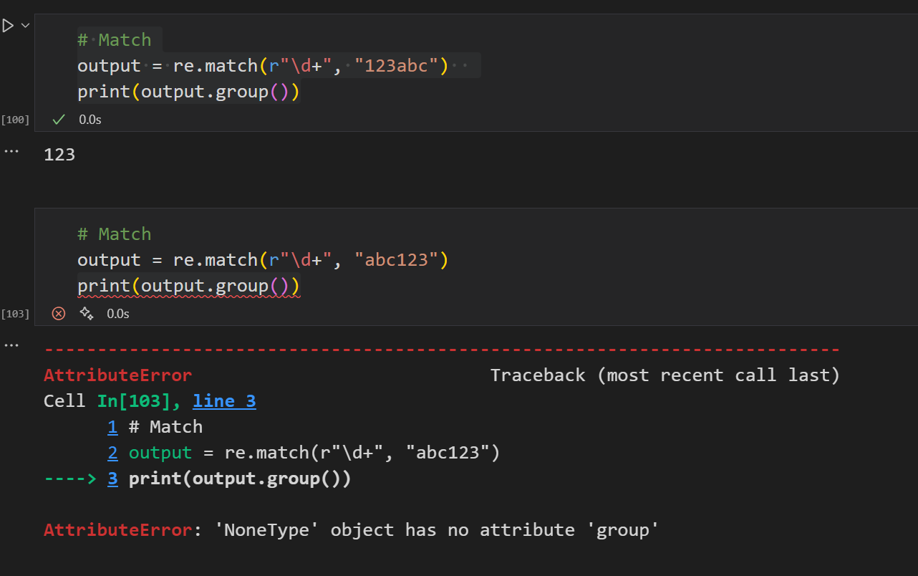
Regular Expression – re.match()
Match - Match a regular expression pattern to the beginning of a string.

Slide 11
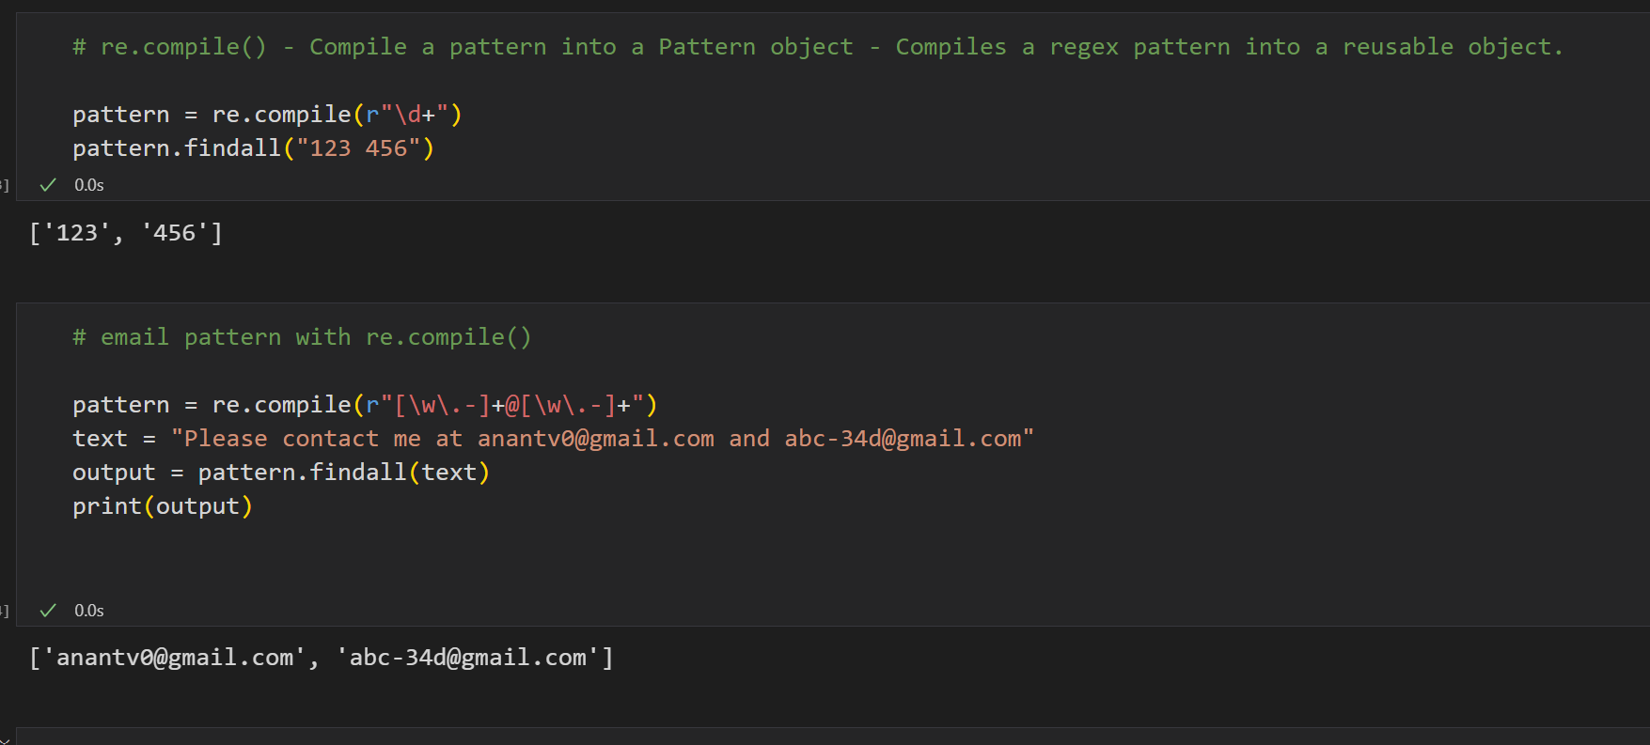
Regular Expression – re.compile()
Match - Match a regular expression pattern to the beginning of a string.

Slide 12

https://developers.google.com/edu/python/regular-expressions#:~:text=Regular%20expressions%20are%20a%20powerful,module%20provides%20regular%20expression%20support.&text=The%20code%20match%20=%20re.search,r'%20just%20as%20a%20habit.

Slide 13


