Slide 1
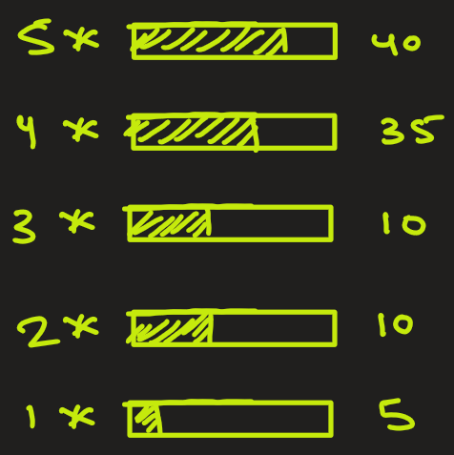
Probability
Problem: Suppose a product has been rated by customers with ratings given below:
5-star → 40 times
4-star → 35 times
3-star → 10 times
2-star → 10 times
1-star → 5 times
If a rating is randomly chosen, what is the probability that it is 4-star or 5-star?

Slide 2
What is probability in plain English ?
Think of probability as a measure of uncertainty
Whenever you’re unsure what will happen — rolling a die, predicting rain, or getting a job offer — you’re thinking in terms of probability.

Slide 3
Few key terms
Sample space
Events
Experiments / Trials
Outcome
Probability

Slide 4
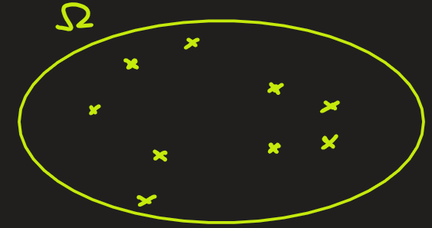
Sample space (Ω): All possible outcomes. Let’s see few examples.
Toss 1 coin -> Ω = { H, T } . Size of Ω is 2
Toss 2 coins -> Ω = { HH, HT, TH, TT }. Size of Ω is 4
Toss 3 coins ->
Ω = { HHH, HHT, HTT, HTH, THH, TTH, THT, TTT } . Size of Ω is 8
H
T
H
H
H
T
T
H
T
T
H
H
H
H
H
T

Slide 5
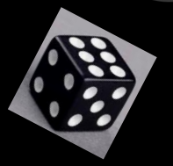
Roll a dice -> Sample space is Ω = { 1, 2, 3, 4, 5, 6 }. Size of Ω is 6
In drawing a card -> Ω = 52 outcomes or elements

Slide 6
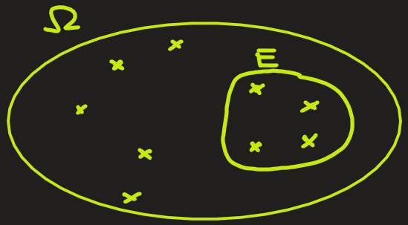
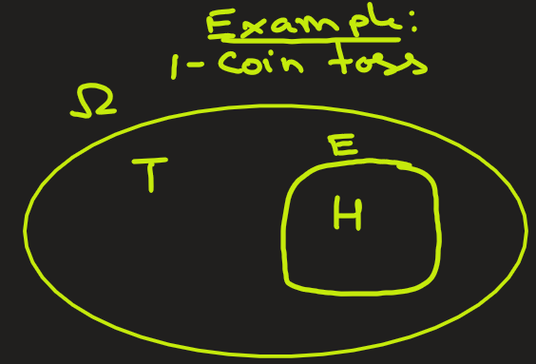
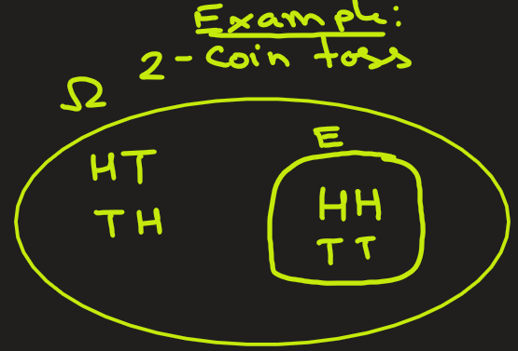
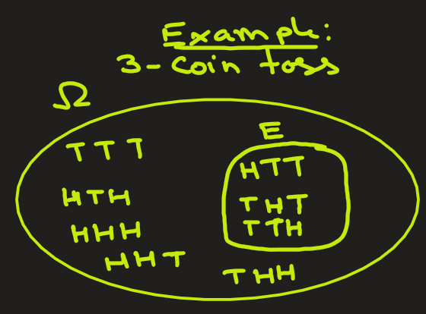
Events (E): It is a subset of the sample space Ω
e.g.1 In a 1-coin toss trial, event could be getting H :
{H}.
Size of E = 1
e.g.2 In a 2-coin toss trial, event could be getting same outcome in both toss:
{HH, TT}.
Size of E = 2
e.g.3 In a 3-coin toss trial, event is getting exactly 1 head :
{HTT, THT, TTH}.
Size of E = 3

Slide 7
e.g.4 In dice roll, event could be getting an even number on dice
{ 2, 4, 6}.
Size of E = 3
e.g.5 In drawing a card, event could be that the card is ace:
{Ace of heart, Ace of diamond, Ace of clubs, Ace of Spades}.
Size of E = 4
1, 3, 5
2, 4, 6

Slide 8
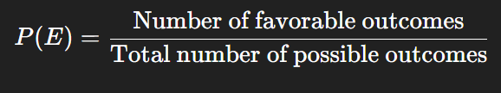

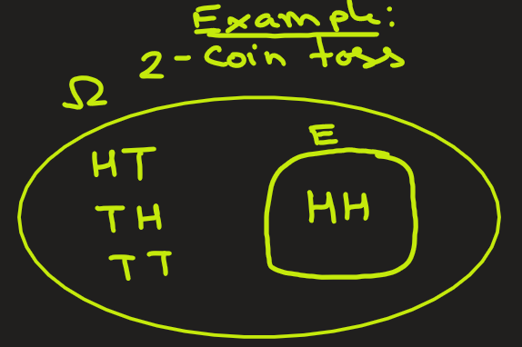
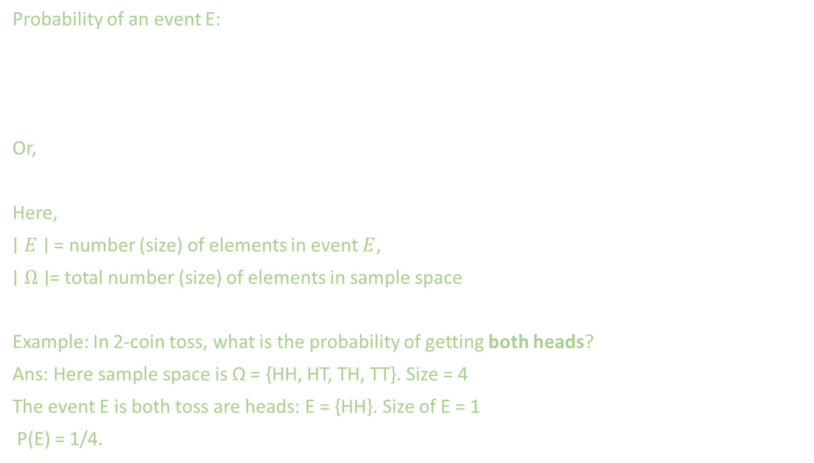
Probability: Definition
Probability of an event E:
Or,
Here,
$∣E∣$ = number (size) of elements in event $E$,
$∣Ω∣$= total number (size) of elements in sample space
Example: In 2-coin toss, what is the probability of getting both heads?
Ans: Here sample space is Ω = {HH, HT, TH, TT}. Size = 4
The event E is both toss are heads: E = {HH}. Size of E = 1
P(E) = 1/4.
H
H
H
T
T
H
T
T

Slide 9
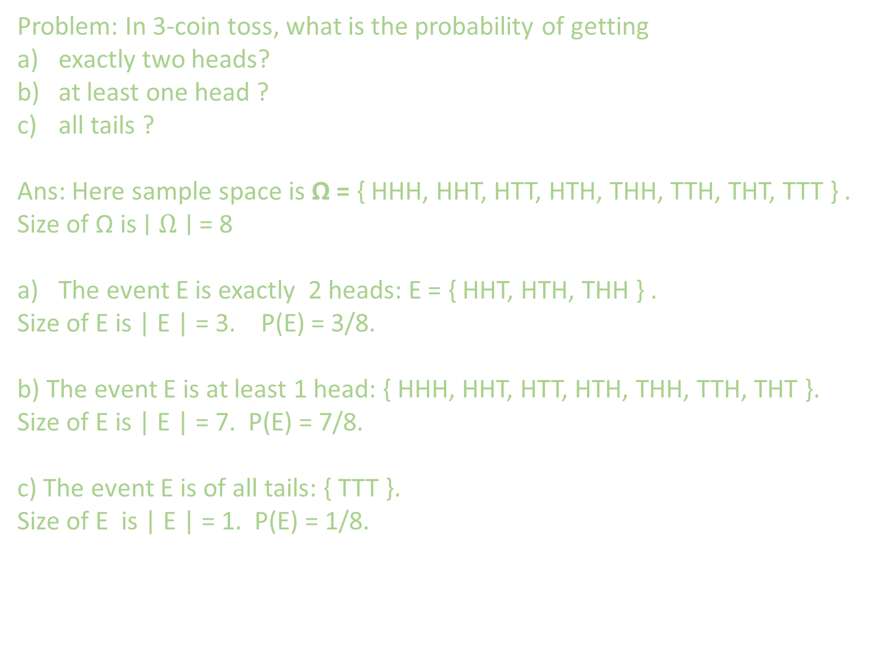
Probability: Application
Problem: In 3-coin toss, what is the probability of getting
exactly two heads?
at least one head ?
all tails ?
Ans: Here sample space is Ω = { HHH, HHT, HTT, HTH, THH, TTH, THT, TTT } .
Size of Ω is $∣Ω∣$ = 8
The event E is exactly 2 heads: E = { HHT, HTH, THH } .
Size of E is | E | = 3. P(E) = 3/8.
b) The event E is at least 1 head: { HHH, HHT, HTT, HTH, THH, TTH, THT }.
Size of E is | E | = 7. P(E) = 7/8.
c) The event E is of all tails: { TTT }.
Size of E is | E | = 1. P(E) = 1/8.
H
H
H
H
H
T
H
T
H
H
T
T
T
H
H
T
H
T
T
T
H
T
T
T

Slide 10
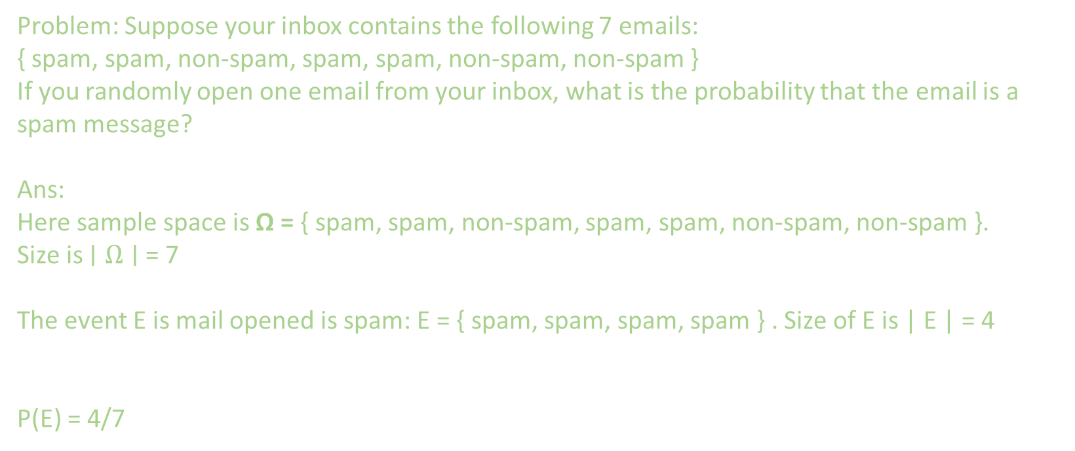
Probability: Application
Problem: Suppose your inbox contains the following 7 emails: { spam, spam, non-spam, spam, spam, non-spam, non-spam }
If you randomly open one email from your inbox, what is the probability that the email is a spam message?
Ans:
Here sample space is Ω = { spam, spam, non-spam, spam, spam, non-spam, non-spam }.
Size is $∣Ω∣$ = 7
The event E is mail opened is spam: E = { spam, spam, spam, spam } . Size of E is | E | = 4
P(E) = 4/7

Slide 11
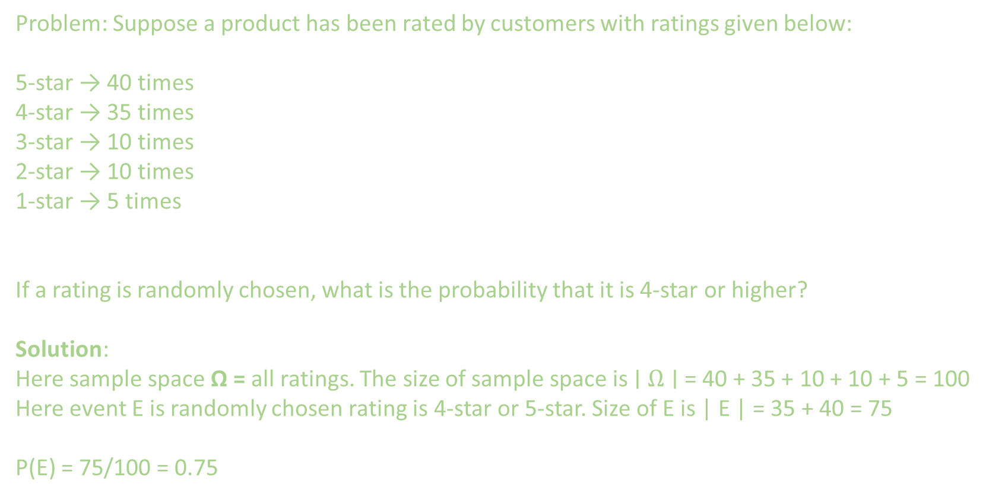
Probability: Application
Problem: Suppose a product has been rated by customers with ratings given below:
5-star → 40 times
4-star → 35 times
3-star → 10 times
2-star → 10 times
1-star → 5 times
If a rating is randomly chosen, what is the probability that it is 4-star or higher?
Solution:
Here sample space Ω = all ratings. The size of sample space is $∣Ω∣$ = 40 + 35 + 10 + 10 + 5 = 100
Here event E is randomly chosen rating is 4-star or 5-star. Size of E is | E | = 35 + 40 = 75
P(E) = 75/100 = 0.75

