Slide 1

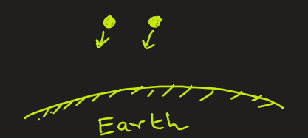
Poisson Distribution
Problem1:
A bank receives an average of 5 customers per hour. What is the probability that exactly 3 customers will arrive in the next hour?
Problem2:
Scientists have observed that, on average, 2 meteorites strike Earth per year.
Find the probability that 3 or more meteorites strike the Earth in a year.

Slide 2

Poisson Distribution
It deals with types of situations where you have to determine (k)
Number of customers arriving at a bank in the next 45 minutes.
Number of phone calls received at call center in 2 hours
Number of patients arriving at a hospital in next 2 minutes
Number of typing errors per page
Number of car accidents in a city per day
Number of data packet arrivals at a server per second

Slide 3
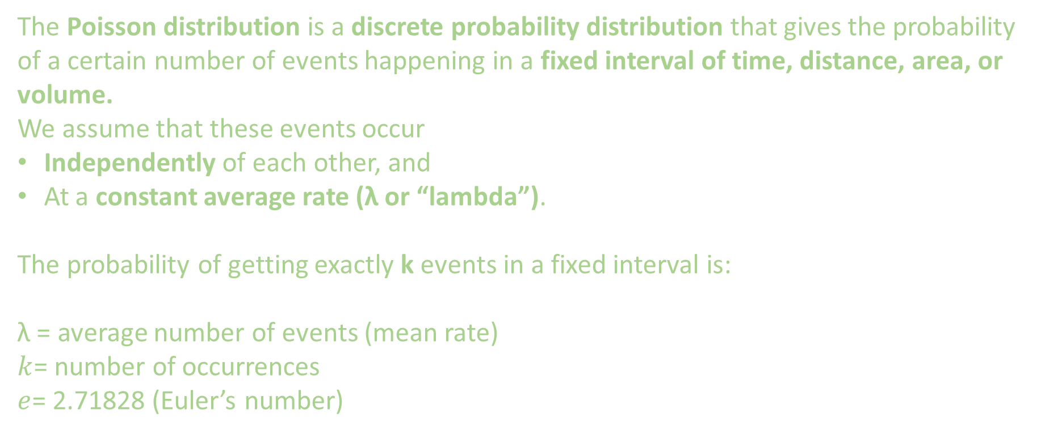
Poisson Distribution
The Poisson distribution is a discrete probability distribution that gives the probability of a certain number of events happening in a fixed interval of time, distance, area, or volume.
We assume that these events occur
Independently of each other, and
At a constant average rate (λ or “lambda”).
The probability of getting exactly k events in a fixed interval is:
λ = average number of events (mean rate)
$k$= number of occurrences
$e$= 2.71828 (Euler’s number)

Slide 4
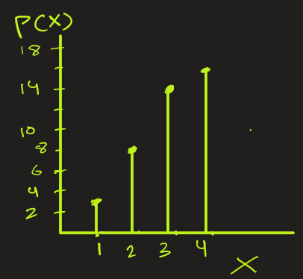



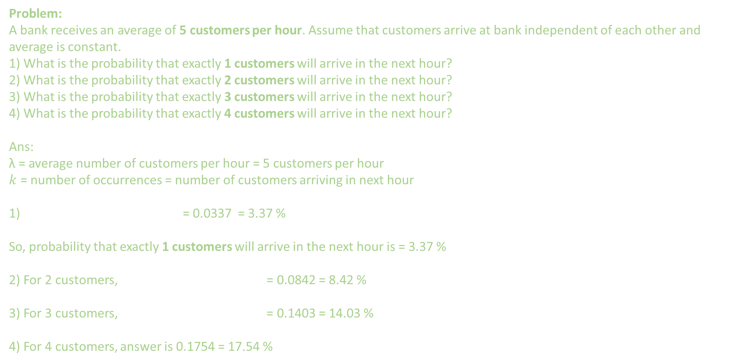
Poisson Distribution
Problem:
A bank receives an average of 5 customers per hour. Assume that customers arrive at bank independent of each other and average is constant. 1) What is the probability that exactly 1 customers will arrive in the next hour?
2) What is the probability that exactly 2 customers will arrive in the next hour?
3) What is the probability that exactly 3 customers will arrive in the next hour?
4) What is the probability that exactly 4 customers will arrive in the next hour?
Ans:
λ = average number of customers per hour = 5 customers per hour
$k$ = number of occurrences = number of customers arriving in next hour
1) = 0.0337 = 3.37 %
So, probability that exactly 1 customers will arrive in the next hour is = 3.37 %
2) For 2 customers, = 0.0842 = 8.42 %
3) For 3 customers, = 0.1403 = 14.03 %
4) For 4 customers, answer is 0.1754 = 17.54 %
Cont…

Slide 5
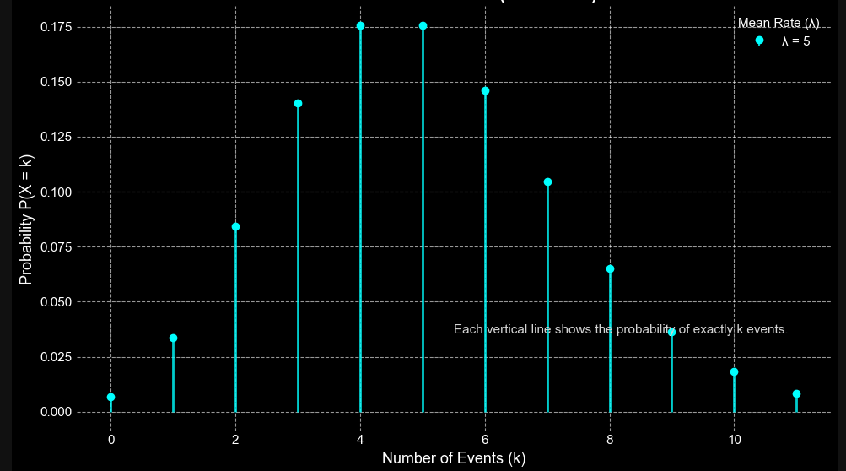
Cont…
Poisson Distribution
As we increase the value of k , the Poisson distribution curve will look as shown below.

Slide 6
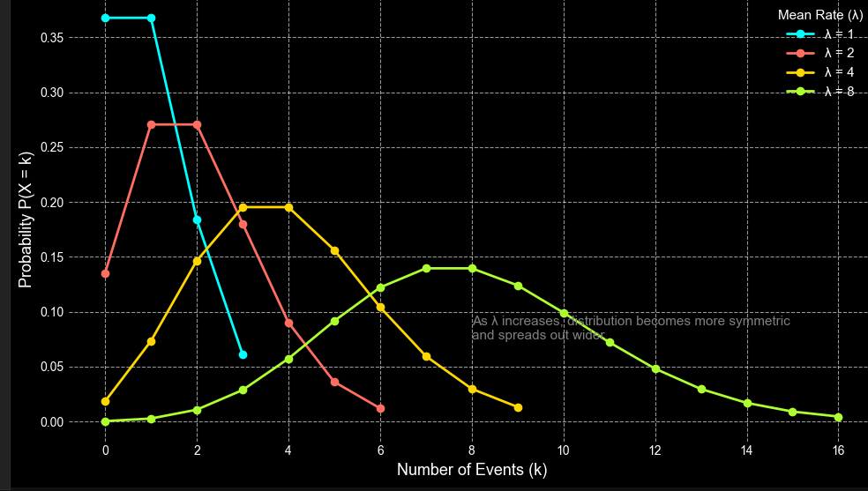
Cont…
Poisson Distribution
As a matter of fact, as we increase lambda the shape of the Poisson distribution curve becomes bell-shaped.

Slide 7
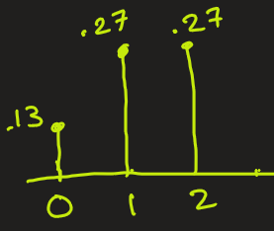
Poisson Distribution
Problem:
Scientists have observed that, on average, 2 meteorites large enough to be detected by ground-based sensors strike Earth per year. Assume meteorite strikes:
Occur randomly and independently,
Happen at a constant average rate (λ = 2 per year).
1) Find the probability that 2 or less meteorites strike the Earth in a year.
2) Find the probability that 3 or more meteorites strike the Earth in a year.
Ans:
1) Probability that 2 or less meteorites strike the Earth in a year is
P(X≤2)
= P(X=0) + P(X=1) + P(X=2) (Apply the formula)
= + 0.1353 + 0.2707 + 0.2707
= 0.6767 = 67.67 %

Slide 8
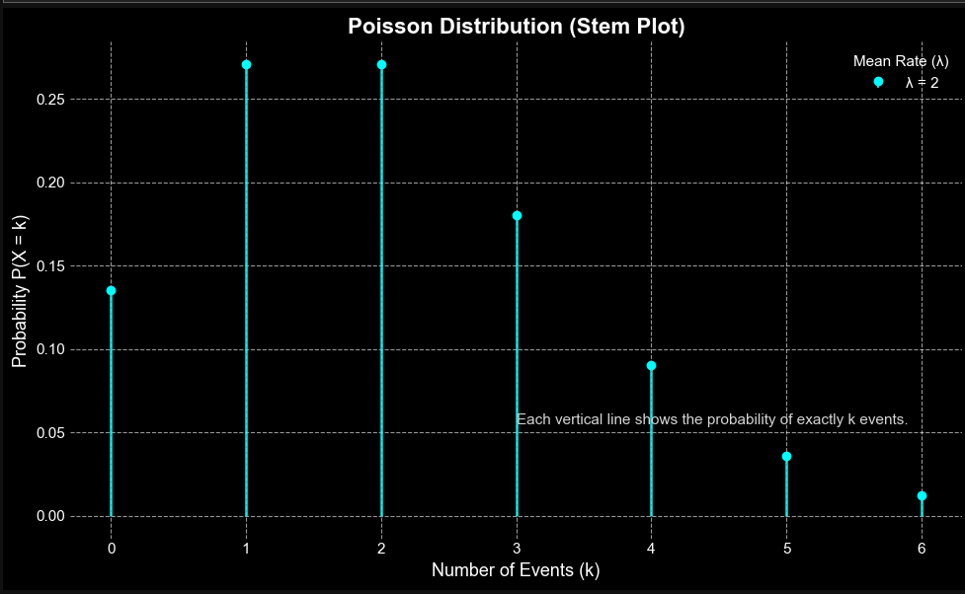
Poisson Distribution
2) Probability that 3 or more meteorites strike the Earth in a year is
P(X≥3)
= 1 − P(X≤2)
= 1 – 0.6767 ( from previous result)
= 0.3233 = 32.33%
Side Note: Poisson is often used in astronomy and
space science for modeling meteorite impacts,
Supernova occurrences, Gamma-ray bursts,
Cosmic ray detections because these are rare, random,
independent events over space or time

Slide 9
STOP

Slide 10
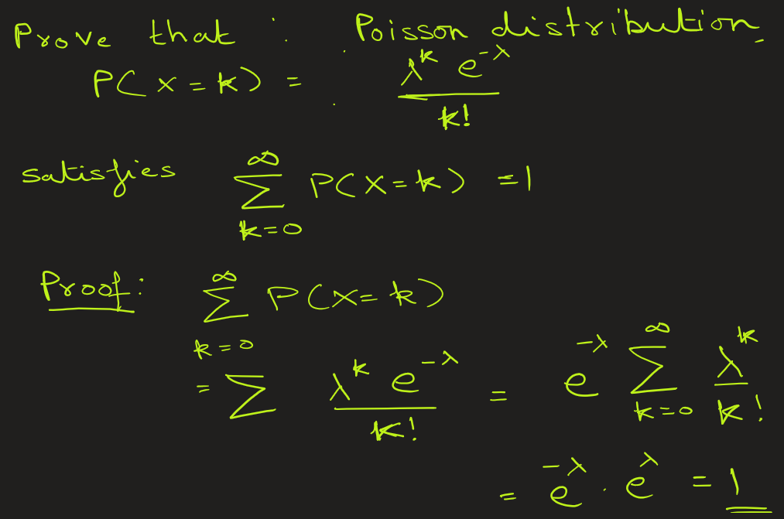
Poisson Distribution

Slide 11
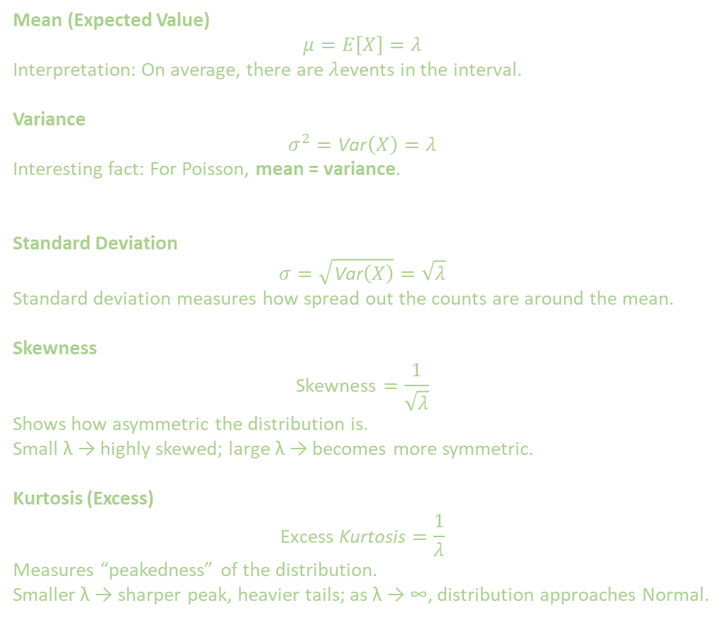
Mean (Expected Value)
$$μ=E\left[X\right]=λ$$
Interpretation: On average, there are $λ$events in the interval.
Variance
$$σ^{2}=\text{Var}\left(X\right)=λ$$
Interesting fact: For Poisson, mean = variance.
Standard Deviation
$$σ=\sqrt{\text{Var}\left(X\right)}=\sqrt{λ}$$
Standard deviation measures how spread out the counts are around the mean.
Skewness
$$\text{Skewness}=\frac{1}{\sqrt{λ}}$$
Shows how asymmetric the distribution is. Small λ → highly skewed; large λ → becomes more symmetric.
Kurtosis (Excess)
$$\text{Excess} \text{Kurtosis}=\frac{1}{λ}$$
Measures “peakedness” of the distribution. Smaller λ → sharper peak, heavier tails; as λ → ∞, distribution approaches Normal.

