Slide 1

Normal Distribution:
A normal distribution is a continuous probability distribution in which data is symmetrically distributed around the mean, forming a bell-shaped curve.
Most values occur near the average (mean), and fewer values appear as you move away from the center.

Slide 2
Suppose you have following data (age):
51, 55, 55, 55, 56, 56, 57, 57, 57, 57, 58, 58, 59, 59, 59, 59, 59, 60, 60, 60, 61, 61, 61, 61, 61, 61, 62, 62, 62, 62, 62, 62, 62, 62, 62, 62, 63, 63, 63, 63, 63, 63, 63, 63, 63, 63, 63, 63, 64, 64, 64, 64, 64, 64, 65, 65, 65, 65, 65, 65, 65, 65, 66, 66, 66, 66, 66, 66, 66, 66, 66, 66, 66, 66, 66, 67, 67, 67, 68, 68, 68, 68, 69, 69, 69, 69, 69, 69, 69, 70, 70, 70, 71, 72, 72, 72, 72, 72, 72, 74

Slide 3
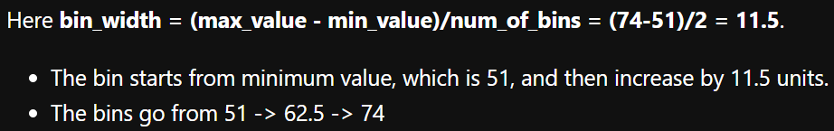
Suppose we create 2 bins of equal size. We would get following:
We would get following counts for the 2 bins:
Bin range | Frequency
51 - 62.5 | 36
62.5 - 74 | 64
51, 55, 55, 55, 56, 56, 57, 57, 57, 57, 58, 58, 59, 59, 59, 59, 59, 60, 60, 60, 61, 61, 61, 61, 61, 61, 62, 62, 62, 62, 62, 62, 62, 62, 62, 62, 63, 63, 63, 63, 63, 63, 63, 63, 63, 63, 63, 63, 64, 64, 64, 64, 64, 64, 65, 65, 65, 65, 65, 65, 65, 65, 66, 66, 66, 66, 66, 66, 66, 66, 66, 66, 66, 66, 66, 67, 67, 67, 68, 68, 68, 68, 69, 69, 69, 69, 69, 69, 69, 70, 70, 70, 71, 72, 72, 72, 72, 72, 72, 74

Slide 4
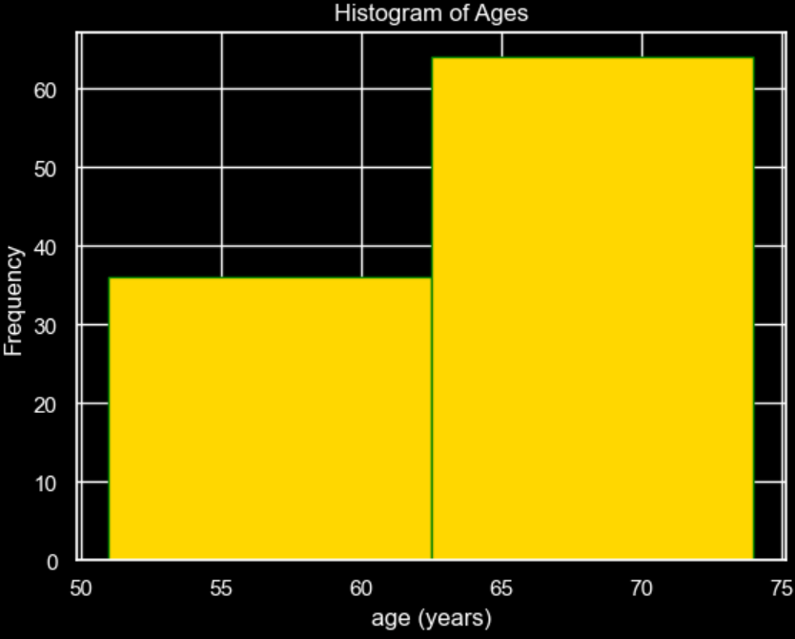
If we create histogram of these 2 bins
we would get ->
Bin range | Frequency
51 - 62.5 | 36
62.5 - 74 | 64
51, 55, 55, 55, 56, 56, 57, 57, 57, 57, 58, 58, 59, 59, 59, 59, 59, 60, 60, 60, 61, 61, 61, 61, 61, 61, 62, 62, 62, 62, 62, 62, 62, 62, 62, 62, 63, 63, 63, 63, 63, 63, 63, 63, 63, 63, 63, 63, 64, 64, 64, 64, 64, 64, 65, 65, 65, 65, 65, 65, 65, 65, 66, 66, 66, 66, 66, 66, 66, 66, 66, 66, 66, 66, 66, 67, 67, 67, 68, 68, 68, 68, 69, 69, 69, 69, 69, 69, 69, 70, 70, 70, 71, 72, 72, 72, 72, 72, 72, 74

Slide 5
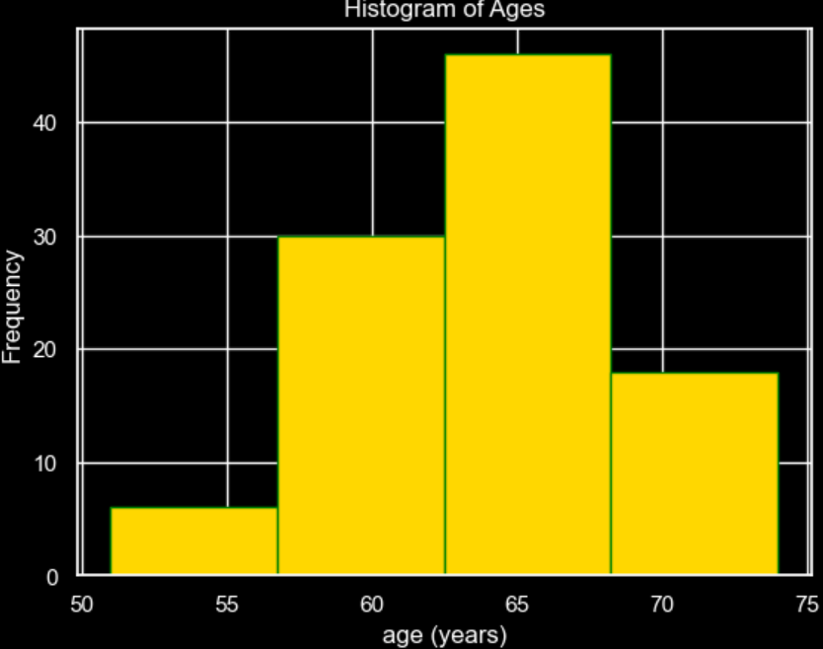
Let’s increase the bin count to 4.
So, the bin width = (74-51)/4 = 5.75
We would get following counts for the 4 bins
Bin range | Frequency
51 – 56.75 | 6
56.75 – 62.5 | 30
62.5 – 68.25 | 46
68.25 – 74 | 18
51, 55, 55, 55, 56, 56, 57, 57, 57, 57, 58, 58, 59, 59, 59, 59, 59, 60, 60, 60, 61, 61, 61, 61, 61, 61, 62, 62, 62, 62, 62, 62, 62, 62, 62, 62, 63, 63, 63, 63, 63, 63, 63, 63, 63, 63, 63, 63, 64, 64, 64, 64, 64, 64, 65, 65, 65, 65, 65, 65, 65, 65, 66, 66, 66, 66, 66, 66, 66, 66, 66, 66, 66, 66, 66, 67, 67, 67, 68, 68, 68, 68, 69, 69, 69, 69, 69, 69, 69, 70, 70, 70, 71, 72, 72, 72, 72, 72, 72, 74

Slide 6
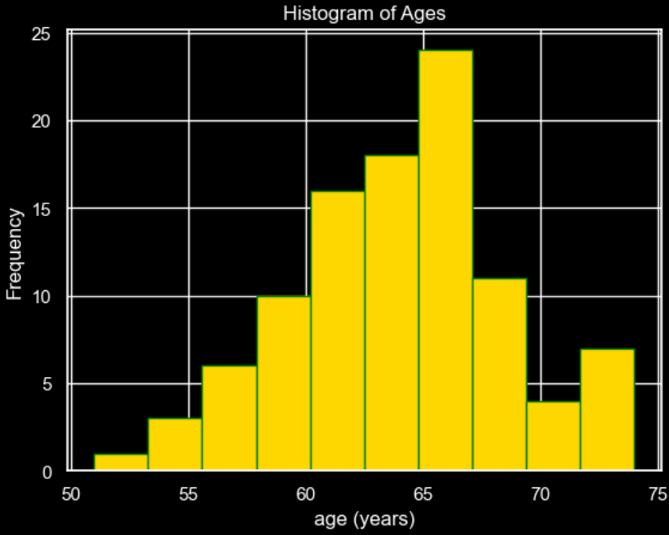
Let’s increase the bin count to 10:
So, the bin width = (74-51)/10 = 2.3
We would get following counts for the 10 bins: 1, 3, 6, 10, 16, 18, 24, 11, 4, 7
Bin range | Frequency
51 – 53.3 | 1
53.3 – 55.6 | 3
…… | …..
71.7 – 74 | 7
51, 55, 55, 55, 56, 56, 57, 57, 57, 57, 58, 58, 59, 59, 59, 59, 59, 60, 60, 60, 61, 61, 61, 61, 61, 61, 62, 62, 62, 62, 62, 62, 62, 62, 62, 62, 63, 63, 63, 63, 63, 63, 63, 63, 63, 63, 63, 63, 64, 64, 64, 64, 64, 64, 65, 65, 65, 65, 65, 65, 65, 65, 66, 66, 66, 66, 66, 66, 66, 66, 66, 66, 66, 66, 66, 67, 67, 67, 68, 68, 68, 68, 69, 69, 69, 69, 69, 69, 69, 70, 70, 70, 71, 72, 72, 72, 72, 72, 72, 74

Slide 7
As bins increases, the histogram becomes bell shaped, that is takes a shape of normal distribution.
51, 55, 55, 55, 56, 56, 57, 57, 57, 57, 58, 58, 59, 59, 59, 59, 59, 60, 60, 60, 61, 61, 61, 61, 61, 61, 62, 62, 62, 62, 62, 62, 62, 62, 62, 62, 63, 63, 63, 63, 63, 63, 63, 63, 63, 63, 63, 63, 64, 64, 64, 64, 64, 64, 65, 65, 65, 65, 65, 65, 65, 65, 66, 66, 66, 66, 66, 66, 66, 66, 66, 66, 66, 66, 66, 67, 67, 67, 68, 68, 68, 68, 69, 69, 69, 69, 69, 69, 69, 70, 70, 70, 71, 72, 72, 72, 72, 72, 72, 74

Slide 8
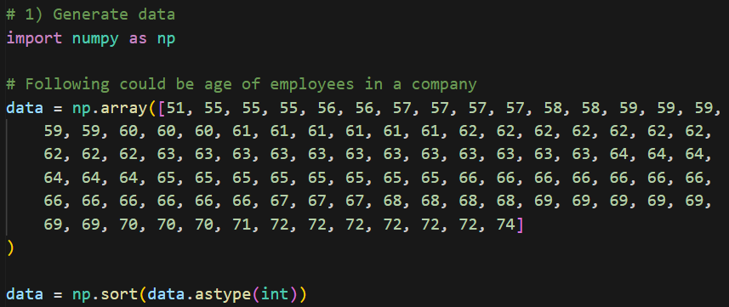
Code

Slide 9
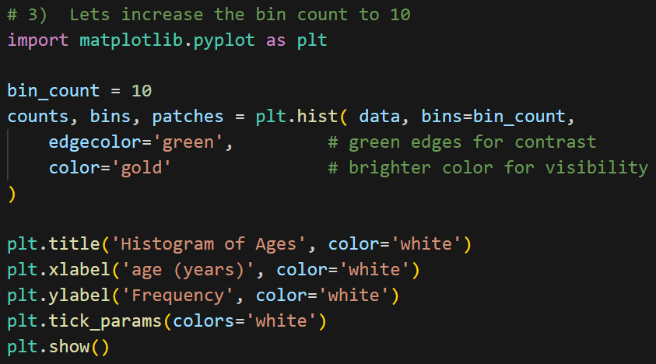

Slide 10
Normal Distribution Functions

