Slide 1
Azure - Document Intelligence

Slide 2
Azure Document Intelligence (formerly known as Azure Form Recognizer) is an enterprise-grade, cloud-based AI service by Microsoft that automates data extraction from forms, documents, and images
Azure Document Intelligence uses
Advanced machine learning and
Optical Character Recognition (OCR)
understand document structures, context, and semantic meaning.
Notes:
It automates data extraction from pdf forms, documents and even images

Slide 3
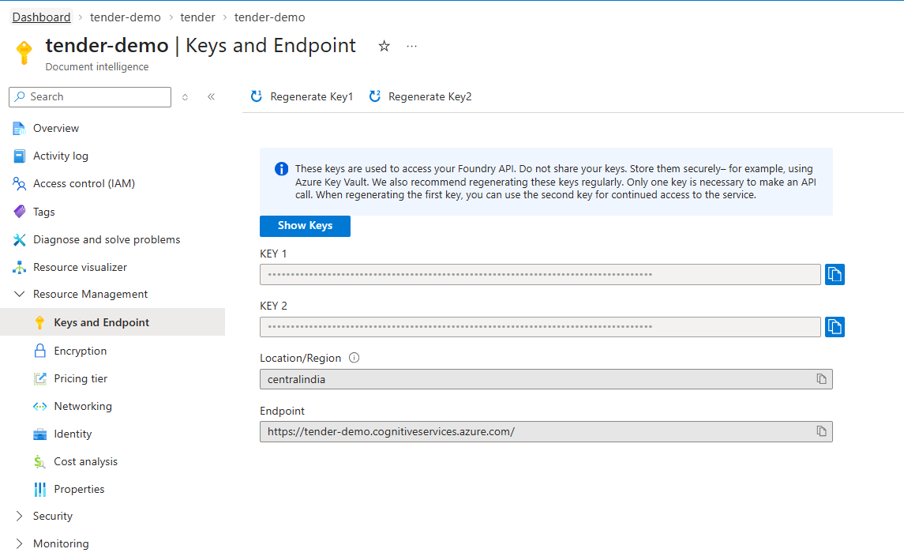


To get key

Slide 4
