Slide 1
Graph RAG
By
Microsoft Research

Slide 2
Prerequisite:
Needs OpenAI API Key
Had to install rust on windows from https://rustup.rs
Then close and reopen VSCODE

Slide 3
Step 1: Ingestion

Slide 4
Step1: Ingestion
The objective to transform a folder of unstructured text documents into a searchable knowledge graph.
Here I am using one file: my_text_files/01_company.txt
Text Documents
│
▼
Graph RAG Indexing Pipeline
│
▼
Knowledge Graph + Embeddings + Community Reports

Slide 5
Step 2: Retrieval

Slide 6
Step 2: Retrieval
1) Here we visualize 2 files that was generated during ingestion phase
graph_export.gexf → This can be viewed through online tool https://lite.gephi.org/v1.0.2/
graph_visualization.html

Slide 7
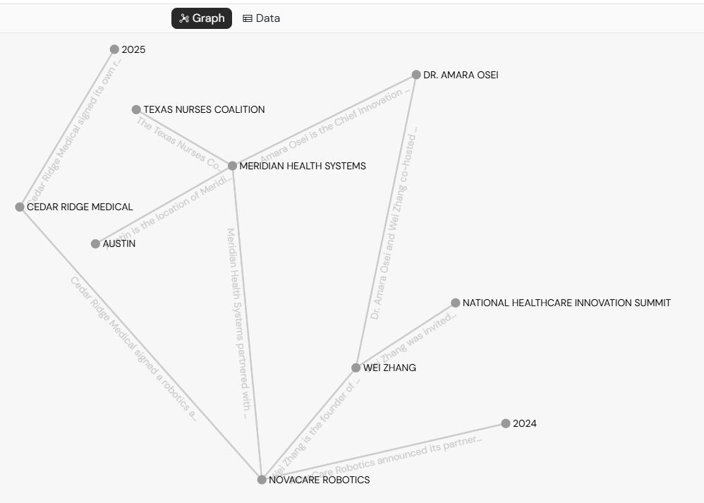

graph_export.gexf

Slide 8
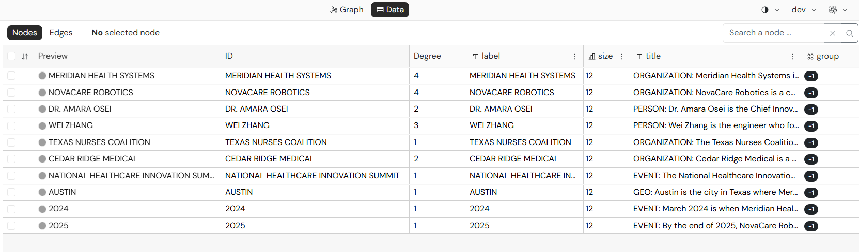

graph_export.gexf

Slide 9
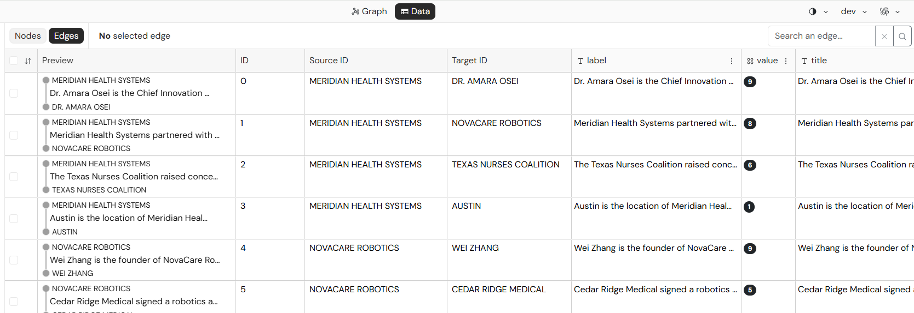
graph_export.gexf

Slide 10
Here there are 4 types of retrieval:
1) Global Search
This is the first retrieval method.
api.global_search(...)
What it does
Global Search is designed for high-level questions about the entire document collection.
It searches community reports.
Example questions
What are the major themes?
Summarize the research.
What are the important trends?
User Question
│
▼
Retrieve Relevant Communities
│
▼
Read Community Reports
│
▼
LLM Combines Reports
│
▼
Final Summary

Slide 11
Here there are 4 types of retrieval:
2) Local Search
api.local_search(...)
This is the most commonly used GraphRAG search.
What it does
Local Search answers questions about specific entities. Local Search explores the knowledge graph around one entity.
Example
Who manages Bob?
Where does Alice work?
What products does Microsoft own?
Question
↓
Find Important Entity
↓
Find Neighboring Nodes
↓
Retrieve Related Text Units
↓
Use Community Report
↓
Generate Answer

Slide 12
Here there are 4 types of retrieval:
3) Basic Search
api.basic_search(...)
This is simply a vector search.
There is no graph traversal.
Workflow
Question
↓
Embedding
↓
Vector Similarity Search
↓
Relevant Text Chunks
↓
LLM Answer

Slide 13
Here there are 4 types of retrieval:
4) DRIFT Search
api.drift_search(...)
This is the most advanced retrieval strategy.
It combines
graph traversal
vector search
community reports
Instead of stopping after one search, it keeps expanding into nearby knowledge.
This is useful for complex reasoning questions, but
trade-off is that it is slower and uses more LLM calls.
Bob
↓
Manager
↓
Department
↓
Organization
↓
Related Projects

Slide 14
Here there are 4 types of retrieval:
Compare Search Types
Search Type | Uses Graph | Uses Embeddings | Best For
Basic Search | ❌ | ✅ | Simple fact lookup
Local Search | ✅ | ✅ | Questions about a specific entity
Global Search | ✅ | ✅ | Whole-dataset summaries
DRIFT Search | ✅ | ✅ | Deep reasoning across connected information

Slide 15
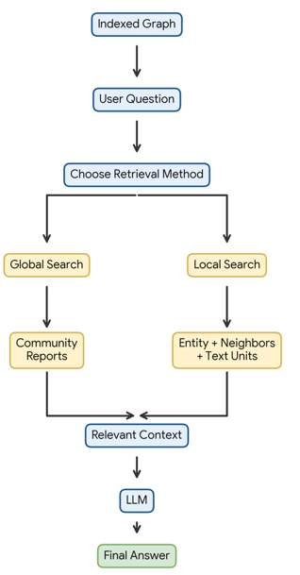
Complete retrieval workflow

