Slide 1
Lang Chain
Installation
Set Up
Code Explanation

Slide 2
Agent
LLM
Tools
Weather
Calculator
Memory

Slide 3
# STEPS
## Work with python3.11.
### 1) Create virtual environment (Took 2 minutes):
> C:\Users\hi\AppData\Local\Programs\Python\Python311\python.exe -m venv .venv
### 2) Activate virtual environment
> .venv\Scripts\Activate.ps1

Slide 4
# STEPS
### 3) Install jupyter (Took 3 minutes):
> python -m pip install jupyter
### 4) Run jupyter:
> python -m jupyter notebook

Slide 5
# STEPS
### 5) Install following packages located in requirements.txt

Slide 6
Code: step1 - Run jupyter notebook
step_1_agent_with_2Tools_weather_calculator.ipynb

Slide 7
Code: step2 – Run streamlit app

Slide 8
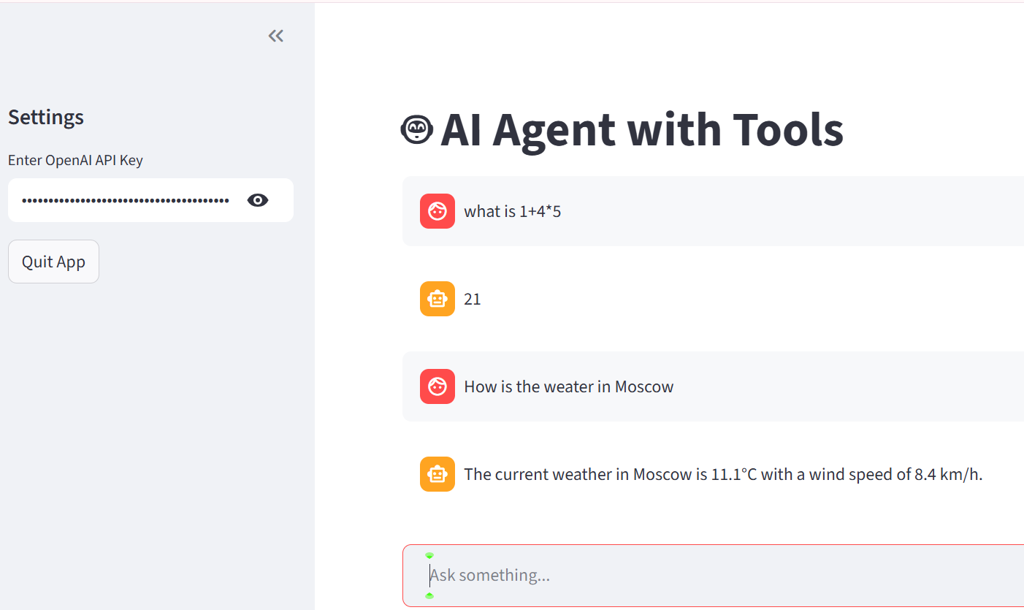
Now we put this in streamlit
Install streamlit: python -m pip install streamlit
2) Create file
step2_agent_logic.py
and put the code in there
3) Create app.py
4) Goto same dir that contains
app.py and Run
> python -m streamlit run app.py
(See the screenshot of the output)

