Slide 1
What is a Vector Database?
“Computers don’t understand text directly… they understand numbers.”
So, we convert text → numbers (called vectors/embeddings)
We store these vectors into vector DB.

Slide 2
What is a Vector (AKA Embeddings)?
Example:
"Machine learning is powerful“ → [0.21, -0.45, 0.78, 0.11, ..., -0.45]
“The quick brown fox jumps” -> [0.023, -0.045, 0.128, -0.011, ..., 0.087, -0.032, 0.114]
This list of numbers = vector ( AKA embedding)

Slide 3
Why do we need Vector DB ?
Problem with normal search is that it performs keyword search:
If you perform normal search on "car“,
results would be articles containing:
car insurance ✅
car repair ✅
car tires ✅
But a normal SQL search would miss out
automobile ❌ (missed!)
4-wheeler ❌ (missed!)
ride ❌ (missed!)
Toyota ❌ (missed!)
Category | Contact | Cost
Car insurance | Bob | 12,000 | ✅
Car tires | Raju | 2,000 | ✅
Car insurance | Thomas | 13,000 | ✅
Car tires | Harry | 2,500 | ✅
Automobile tires | John | 34,000 | ❌
4-wheeler | Harry | 32,999 | ❌
House | Nancy | 28,000 | ❌
SELECT Cost
FROM table_expenses
WHERE LOWER(Category) LIKE '%car%';

Slide 4
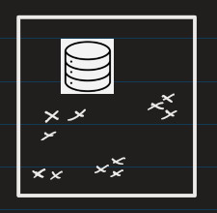
This is where Vector DB comes in.
Here search is based on meaning ( = semantic search ), not exact words
Search: "car"
Results based on semantic search would be :
Car ✅
Automobile ✅
Vehicle ✅
Ride ✅
Transport ✅

Slide 5
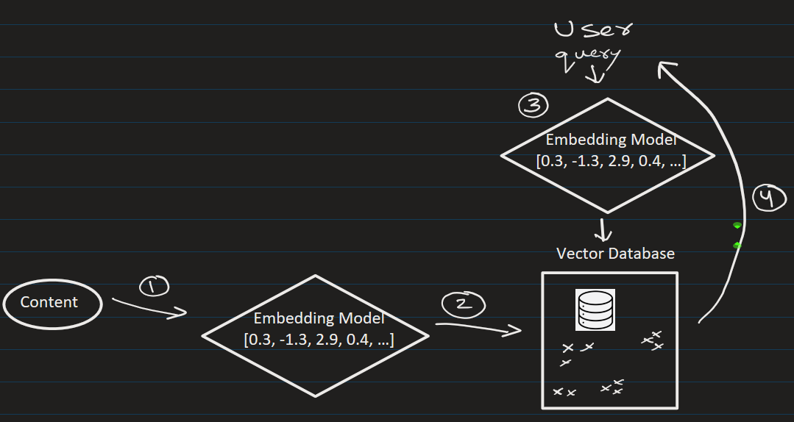








How Semantic Search works (Step-by-step)
1. We convert the content(pdf) into embedded vectors
2. We store the vectors in Vector DB
3. User enters query. Convert query → embeddings/vector
4. Search in Vector DB and find most similar vectors and return the result.
Example
Suppose the user query:
"best laptop for coding"
Semantic search can retrieve:
"top programming laptops"
“good computers for developers”
Even though words are different ✅

Slide 6
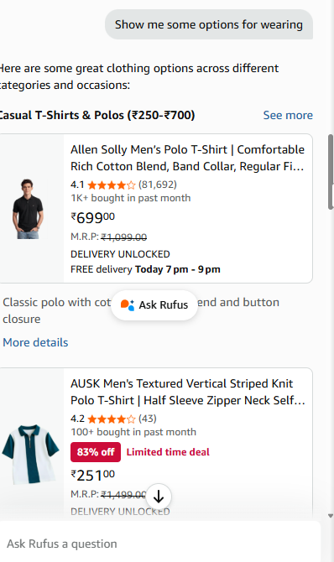
Some Use Cases of Vector DB:
Chatbots (like e-commerce website)

Slide 7
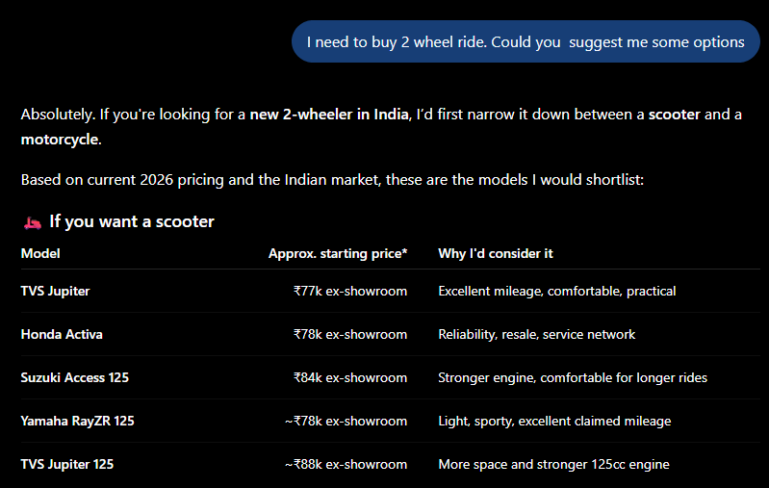
Some Use Cases of Vector DB:
Chatbots (like ChatGPT)

Slide 8
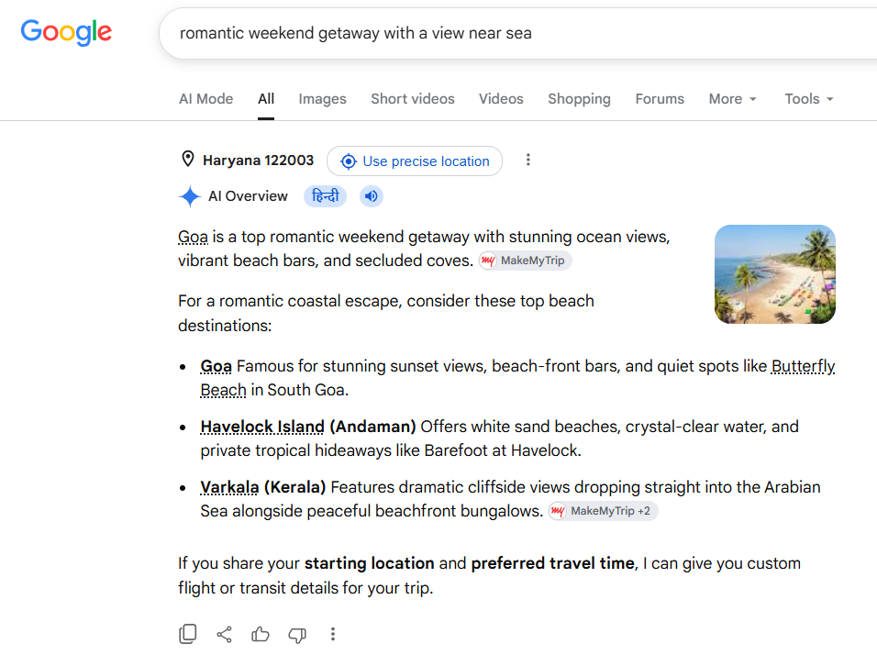

Some Use Cases of Vector DB:
Google

Slide 9
Some Use Cases of Vector DB:
Document search
Recommendation systems – (“Recommend me good scary flicks ”)
RAG pipelines

Slide 10



What kind of data does vector DB store?
Data | Stored As
Text | Vector (numbers)
Image | Vector
Audio | Vector

Slide 11
Common Vector DB as of today:
Pine Vector DB:
  User need to login (free)
  Get API Key and use it (Look at docs on how to use API keys with python code)
  You can have up to 5 index for free. (See the jupyter notebook)

Slide 12
Common Vector DB as of today:
FAISS (Facebook AI Similarity Search)
  Can be done locally. (See the jupyter notebook)

Slide 13
FAISS vs Pinecone:
Feature | FAISS | Pinecone
Setup | Local | Cloud
Scaling | Manual | Automatic
Use Case | Learning / small apps | Production systems

Slide 15
EXTRA
Ffnbksdfd
Fdslj;f
Fl;ds

