Slide 1
RAG
Retrieval-Augmented Generation

Slide 2



Can ChatGPT or any LLM answer questions about YOUR personal files?
Ans: No!
User
LLM
(ChatGPT, etc)
Private Data
PDF, DB, etc.

Slide 3
How do business leverage LLM to their own domain ?
Let’s understand the problem first.
❌ Problem with Normal LLMs
Large Language Models (LLMs):
Are trained on fixed data (training data)
Do not know recent updates
Can sometimes hallucinate (make up answers)
Example:
Ask: "What is my company, Loxford Academy, policy?"
A normal LLM will either:
Guess ❌
Give generic answer ❌
User
LLM
(ChatGPT, etc)
Private Data
PDF, DB, etc.
Normal Flow: Without RAG

Slide 4












What is RAG?
RAG (Retrieval-Augmented Generation) is a technique in Generative AI where a language model (like GPT)
first retrieves relevant information from an external source, and
then uses that information to generate a better, more accurate response.
User
LLM
(ChatGPT, etc.)
Private Data
PDF, DB, etc.

Slide 5
How RAG helps you use LLM for your domain ?
RAG connects the model to your own data source:
PDFs
Databases, Websites, Company documents
User
LLM
(ChatGPT, etc.)
Private Data
PDF, DB, etc.

Slide 6
Beyond PDF/text/SQL, common enterprise RAG data sources include:
Documents & files
Office formats: Word, Excel, PowerPoint (often converted to Markdown/text )
Wikis/knowledge bases: Confluence, Notion, SharePoint, internal wikis
Cloud drives: Google Drive, OneDrive, Dropbox
Structured data
Relational DBs: SQLite, Postgres, MySQL, SQL Server, Oracle
Data warehouses: Snowflake, BigQuery, Redshift — for analytics-heavy queries at larger scale
NoSQL: MongoDB, Elasticsearch — common for logs, product catalogs, semi-structured records

Slide 7
Beyond PDF/text/SQL, common enterprise RAG data sources include:
SaaS/collaboration tools (usually pulled via API, not file scan)
Slack/Teams message history
Salesforce, Zendesk, Jira, ServiceNow — support tickets, CRM records
Email (Outlook/Exchange, Gmail) — often the messiest source, needs heavy de-dup/PII filtering
Other
Web content: intranet sites, public site crawls
Code repos: for engineering-focused assistants (source + commit history)
Audio/video transcripts: call recordings, meeting notes (via a transcription step before chunking)
Scanned/image documents: examples - pymupdf4llm for no-text-layer PDFs, etc.

Slide 8
Now flow becomes:
User asks question
RAG system would search relevant documents
Retrieve useful information related with the query and send it to the LLM
LLM would generate answer based on your data source
✔ Result:
Accurate answers
Up-to-date information
User
LLM
(ChatGPT, etc.)
Private Data
PDF, DB, etc.

Slide 9
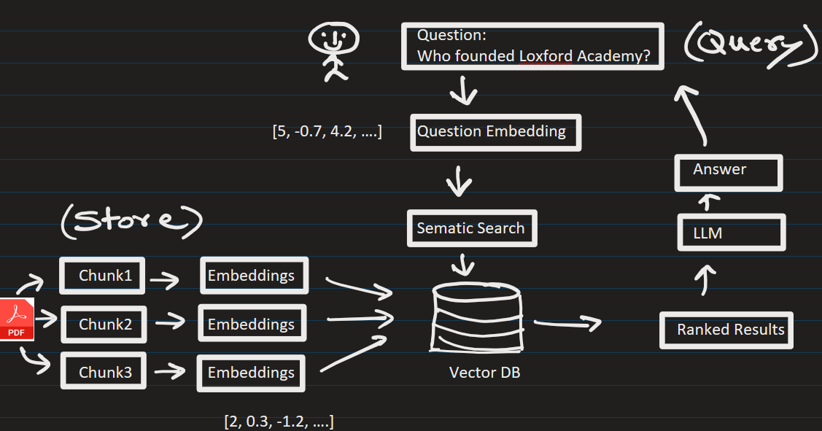




RAG Architecture/Process
Phase A – Ingestion (Populate The Vector DB)
1. Data Collection
Collect documents
(PDFs, text, etc.)
2. Chunking
Break data into small pieces
(chunks)
3. Embeddings
Convert text into vectors using models
4. Storage
Store vectors in a database called Vector DB
(e.g., Pinecone, FAISS, etc.)

Slide 10



Phase B - Retrieval (User Query )
Example of Query:
Who founded Loxford Academy ?
Ranked Results From VectorDB (Similar data):
1) Founder of Loxford Academy are living in Moscow
2) Ms. Lomax and Mr. Thomas founded Loxford Academy in 2018
3) One of the founders of Loxford Academy went to MIT.
1. Retrieval
When user asks a question (query):
Convert query into vector
Find similar data from Vector DB (AKA context)

Slide 11





Phase B ( User Query )
PROMPT:
Answer ONLY from the context.
Context:
{context_from_VectorDB}
Question:
{user_query}
2. Generation
Pass (retrieved data + question = prompt) to LLM
LLM generates final answer and sends it to user

Slide 12





Phase B ( User Query )
Prompt passed to LLM:
PROMPT:
Answer ONLY from the context.
Context:
1) Founders of Loxford Academy are living in Moscow. It is cold there.
2) Ms. Lomax and Mr. Thomas created this academy in 2018.
3) One of the founders of Loxford Academy went to MIT.
Question:
Who founded Loxford Academy ?
LLM responds: Ms. Lomax and Mr. Thomas founded Loxford Academy.

Slide 13
🔹 Key Benefits
✔ Reduces hallucination
✔ Keeps answers updated
✔ Works with private data

Slide 14
Where is RAG Used?
Chatbots for companies
Customer support systems
Legal document search
Medical record assistants
Internal knowledge assistants

Slide 15
EXTRA
xxxxxxxxxxxxxx

