Slide 1
Graph DB Challenges

Slide 2
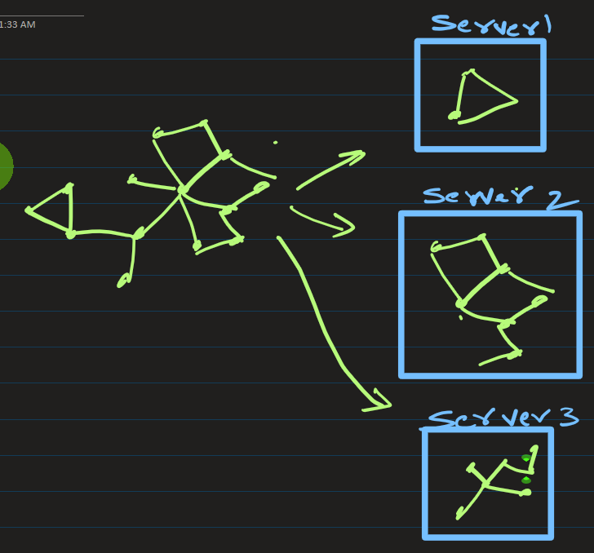
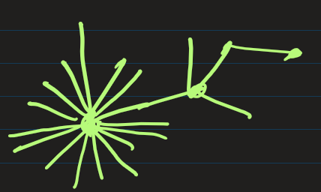
Architectural and Scaling Challenges
Difficult Distributed Scaling (Sharding): Splitting a graph database across multiple physical servers (sharding) is difficult: If you cut a graph across servers, a single query might constantly have to jump across the network to follow edges, destroying performance.
The "Super-node" Problem: Nodes with millions of connections (e.g., a celebrity account on social media or a major hub airport) cause massive performance bottlenecks. Querying or updating a super node requires traversing millions of edges, which can slow down or crash the database engine.
High Memory Consumption: Graph databases rely heavily on RAM to keep the network of nodes and relationships readily available for fast traversal (index-free adjacency). This makes hosting them expensive than standard databases.

Slide 3
2. Development and Data Modeling Challenges
Steep Learning Curve: Developers must learn completely new, specialized query languages like Cypher (Neo4j) or Gremlin (Apache TinkerPop). Writing efficient graph queries requires thinking in traversals rather than table joins.
Modeling Flexibility Trap: Because graph databases are often schema-less or schema-flexible, it is easy for a development team to design a messy data model ("spaghetti graph").
Slow Bulk Writes and Inserts: Graph databases excel at reading connected data, but writing data in bulk is relatively slow. Every time you insert a new node, the database engine must also create, index, and link multiple pointer relationships (edges) in memory.

Slide 4
3. Operational and Ecosystem Challenges
Immature Tooling Ecosystem: Compared to the decades of mature tooling available for SQL databases, the graph ecosystem has fewer third-party tools for backup, reporting, data visualization, and Object-Relational Mapping (ORM).
Lack of Standardization: There is no single universal standard query language for graphs like SQL is for relational databases. If you write your entire application using Neo4j's Cypher language, migrating to a different graph engine later can require a total rewrite of your codebase.

Slide 5
4. Graph Challenges in GenAI (GraphRAG)
If you are using a graph database specifically to store data for a Generative AI or Retrieval-Augmented Generation (RAG) pipeline, you will face unique extraction hurdles:
High LLM Cost for Construction: Building a graph from raw text requires using an LLM to read documents and extract "entities" and "relationships." This takes thousands of LLM API calls, making graph creation slow and expensive.
Entity Resolution: If one document mentions "AWS" and another mentions "Amazon Web Services", the system might accidentally create two separate nodes instead of linking them to the same concept, breaking the logic of your graph.

