Slide 1
Graph DB Challenges

Slide 2
Phase 1 ingestion for a Graph RAG system:
Read raw documents
Break them into chunks
Get LLM-extracted entities/relationships
Get them validated
Get them entity-resolved
Make them canonicalized
Finally loaded into Neo4j.

Slide 3
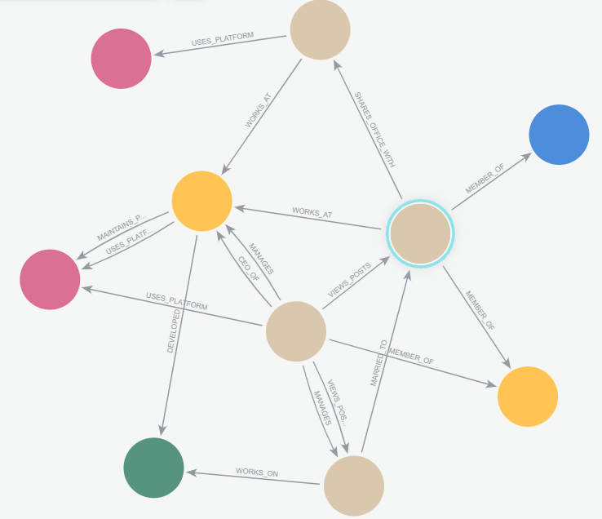
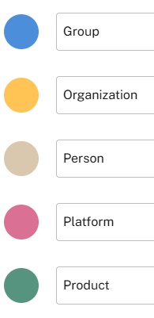

Slide 4
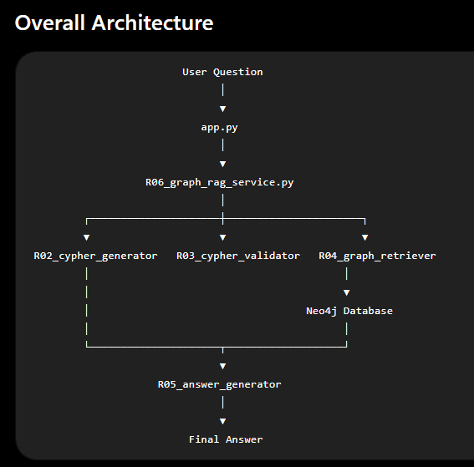
Phase 2: Retrieval

Slide 5
Here R06_graph_rag_service.py is the orchestrator. It does not perform any AI itself.
Instead, it coordinates every component.
Workflow:
Question
│
▼
Generate Cypher
│
Validate Cypher
│
Execute Query
│
Generate Answer
│
Return everything

Slide 6
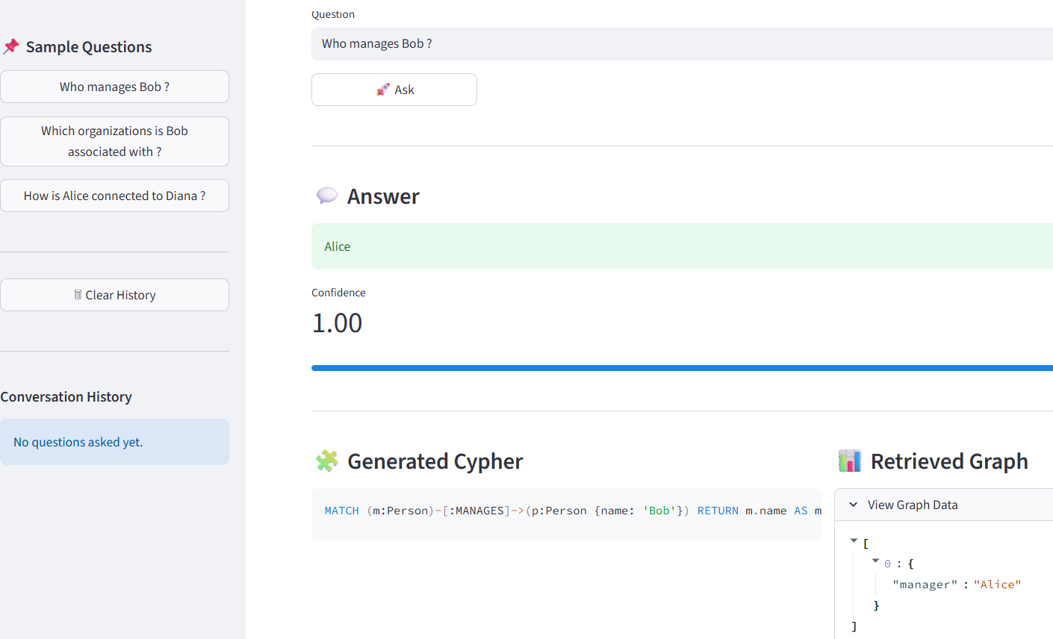
You can retrieve using CLI or streamlit:
For CLI: python app_CLI.py
For streamlit: python –m streamlit run app_streamlit.py

Slide 7
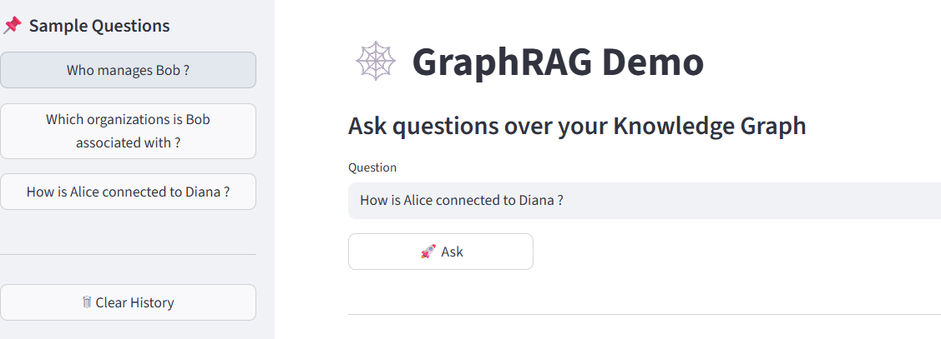
Query: How is Alice connected to Diana
Continued…

Slide 8
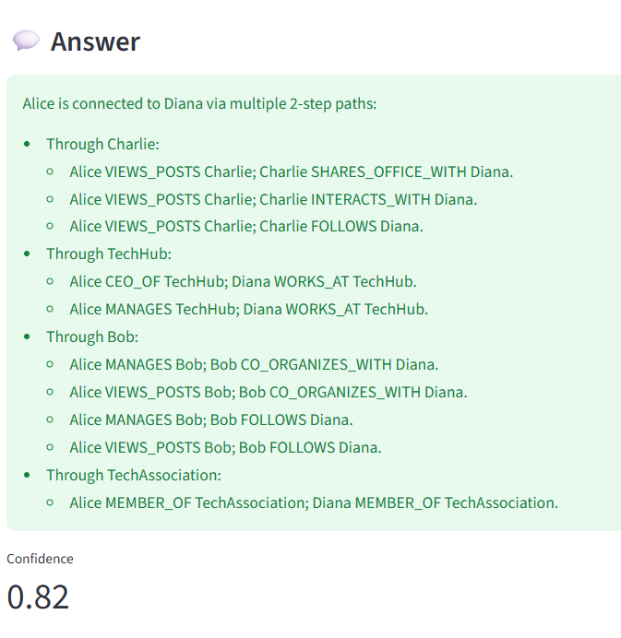
Query: How is Alice connected to Diana
Continued…

Slide 9
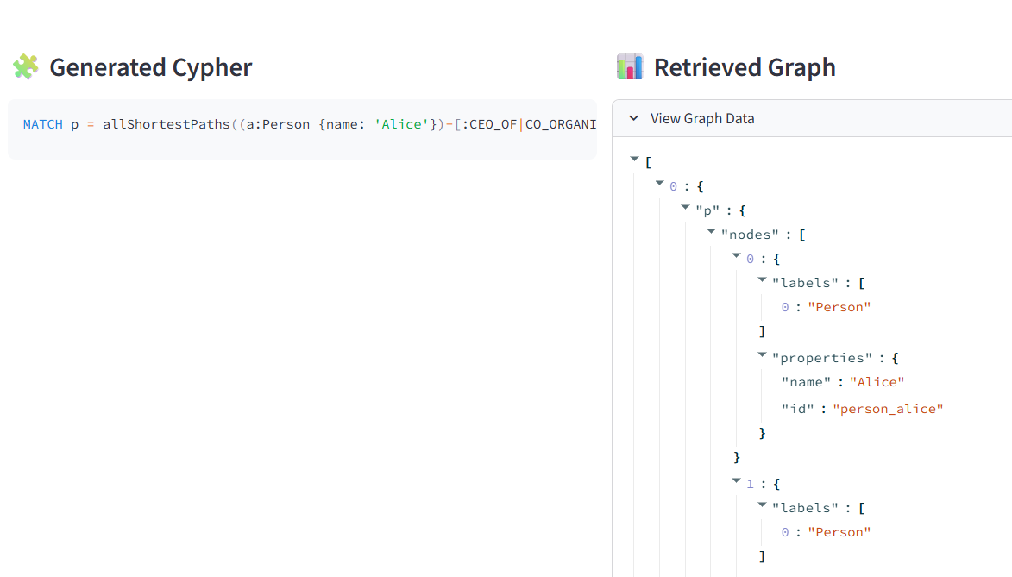
Query: How is Alice connected to Diana
Continued…

