Slide 1
Automated Student Assignment & Extension Portal
(Non-Agentic)

Slide 2
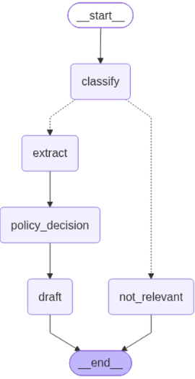
Workflow built with LangGraph:
It reads a professor's Gmail inbox,
classifies student emails -
  Extension
  Late submission
  Grade clarification
  Other
extracts structured info,
applies a written university policy, and
leaves a **draft reply** (never sends) for the professor to review and creates a log

Slide 3
The Role of LLM
Classify (nodes/classify.py):
Reads the subject + a snippet of the body and decides which bucket the email falls into: extension_request, late_submission, grade_clarification, or other.
2. Extract (nodes/extract.py)
Reads the full email body and pulls out structured facts:
student name,
roll number,
course code,
the reason given, and
a normalized reason_category (medical / personal_emergency / technical / workload).

Slide 4
The Role of LLM
3. Apply policy (nodes/policy_decision.py)
This is the most "reasoning-heavy" step. It's given the full text of policy.md plus the extracted facts, and has to match the situation to the right rule — e.g.
"reason_category is medical → grant 3 days, no proof required up front."
It also has to know when to punt: if the situation isn't clearly covered by the policy, it should return escalate_to_professor rather than making something up.
This is really a small grounded-reasoning task, not just lookup — the LLM has to read the student's stated reason, map it onto the closest policy clause, and produce a decision + rationale.

Slide 5
The Role of LLM
4. Draft the reply (nodes/draft.py)
Takes the policy decision and generates the actual reply text —
subject and body,
polite tone,
right length,
no impersonating a specific professor, and
(importantly) not stating an approval/denial if the decision was escalate_to_professor.
This is generation, not extraction.

Slide 6
The Role of LLM
So, across the four nodes the LLM does four different kinds of work (i.e. LLM handles judgment ):
classification → extraction → policy-grounded reasoning → generation.
Everything else in the project —
reading Gmail,
writing the draft to Gmail,
routing between graph nodes,
reading policy.md off disk
writing logs
— is plain deterministic code with no LLM involved.

Slide 7
NOTE:
The policy is defined in a separate file: policy.md
The log of draft replies are stored in logger.db. The processed emails are stored in processed_email.db
The main_demo.py would not create draft in the GMail because the fake incoming mails are not regular genuine emails and so do not have Thread ID.
The main.py would create draft in the GMail because the incoming mails are genuine emails and so do have Thread ID.

Slide 8
NOTE:
To run this, send an email :
Sender: <sender_email>
Subject: Extension request for Assignment 3
Body:
Dear Professor,
I am Priya Sharma, roll number CS21B045, from course CS301. I was hospitalized for the last two days with a fever and could not finish Assignment 3. Could I please get a short extension?
Thank you,
Priya

Slide 9
NOTE:
To automate this,
use cron job, or
run main_schedule.py . This checks email every 5 minutes

Slide 10
It's not agentic in the fuller sense, because:
The control flow is fixed. The LLM doesn't decide what to do next or which tool to call — the graph (classify → extract → decide → draft → save) is hardcoded by you. The only "decision" affecting flow is a binary branch (relevant vs. not) baked into a conditional edge.
No looping, no re-planning. A more agentic system might re-read the policy if its first decision looked uncertain, or ask a clarifying sub-question. This one runs each node exactly once, straight through.
This is often called a "workflow" or "compound LLM pipeline"

