Slide 1
Example:
“A manager wants business insights but does not know SQL.”
Here:
Manual SQL querying is difficult
Dashboards are static
AI agents can automate analytics

Slide 2
openai==2.33.0
pandas==3.0.2
streamlit==1.57.0
python-dotenv==1.2.2

Slide 3
Frontend (Streamlit)
↓
AI Agent
↓
Guardrails
↓
Database
↓
Results

Slide 4
To run the app:
> python –m streamlit run app_step2.py

Slide 5
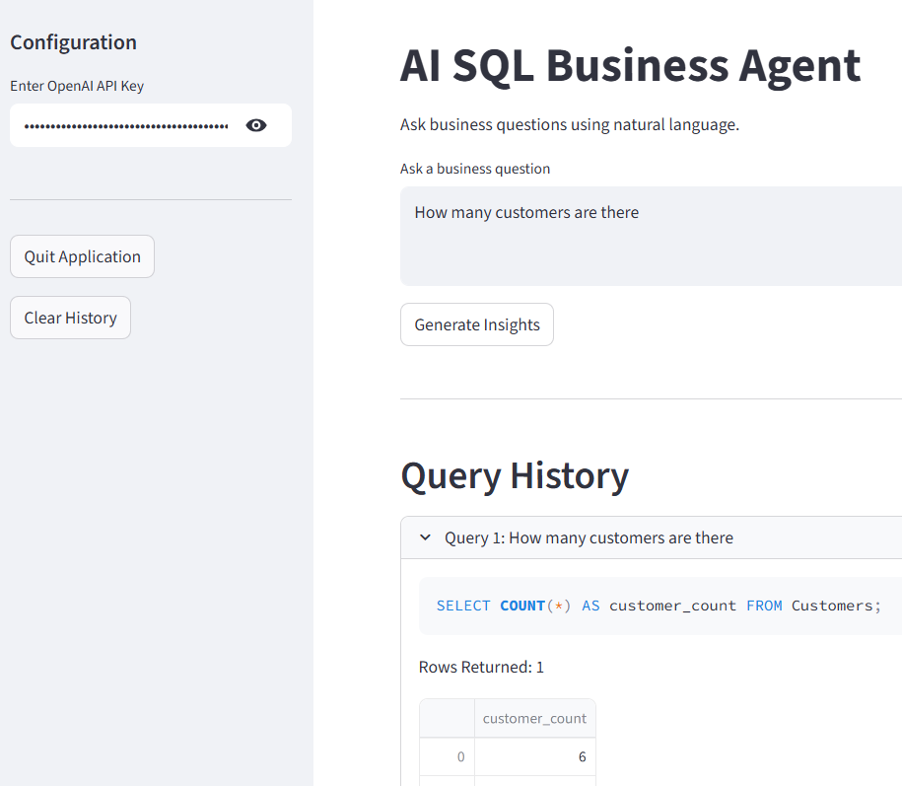

Slide 6
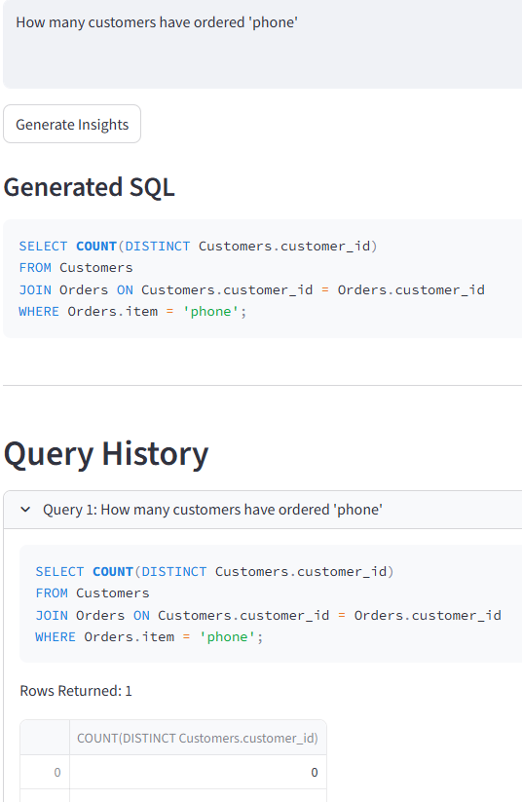
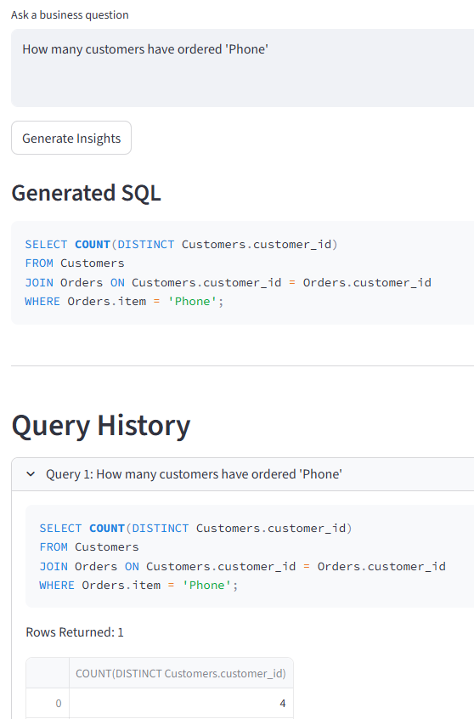
Uppercase and lowercase matters:
Phone and phone are different

