Slide 1
NLP Process

Slide 2
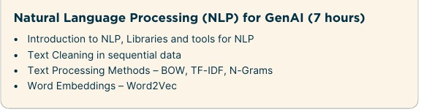
Good Source: https://www.deeplearning.ai/resources/natural-language-processing/

Slide 3
Key terms:
Corpus: A corpus is a structured collection of text data, often used as a dataset for training NLP models. It can include various types of text, such as books, articles, and social media posts.
Document: In NLP, a document can refer to a single text unit, such as a sentence, paragraph, or entire article. The definition of a document can be flexible depending on the specific NLP task.
Sentence: A grammatically complete idea within that document.
Vocabulary / dictionary: The vocabulary is a list of all the unique words that appear in the corpus. It's essentially a set of distinct tokens within the text data.
Words: Words (or tokens) are the individual units of text within the corpus, including repeated instances of the same word.
Review 1: "The delivery was fast. The product arrived intact. "
Review 2: “Awesome service, but the product was old."
Review 3: “Timely response. Excellent customer support."
Review 4: “I liked the book. It was brand new as described."
Corpus = {Review 1, Review 2, Review 3, Review 4 }
Documents = 4 customer reviews -> there are 4 documents
Sentence: Document1 has 2 sentence in it.
Vocabulary = Unique set of words across all corpus
Words (Tokens) = all lowercase words extracted from corpus
You determine corpus size based on any 1 of following:
How many documents it has,
How many total words (tokens), <- common
How many unique words (vocabulary size).

Slide 4
Key steps in NLP
1. Text Acquisition
Collect or load raw text data.
Sources: files, databases, APIs (e.g., Twitter API), web scraping, etc.
2. Text Cleaning (Preprocessing)
Lowercasing
Remove unwanted parts:
like punctuation, special characters, numbers, HTML tags, URLs, @
Remove emojis
3. Tokenization
Split text into individual words or subwords.
Example: "Virgin America is great" → ["Virgin", "America", "is", "great"]
Libraries: nltk, spaCy, transformers.
4. POS tagging & Normalization
4.0) POS tagging improves normalization
4.1) Norm. makes words more uniform:
Stemming (cut to root form): "running" → "run"
Lemmatization (dictionary form): "better" → "good"
4.2) Norm. removes stopwords (common words like "is", "the").

Slide 5
Key steps in NLP
5. Text Representation
Convert text into numerical format (models can't read raw text).
Methods:
a) N-gram
b) Bag of Words (BoW)
c) TF-IDF (Term Frequency - Inverse Document Frequency)
d) Word Embeddings (Word2Vec, GloVe, FastText)
d) Transformer Embeddings (BERT, RoBERTa, etc.)
6. Model Building
Choose and train models:
Classical ML: Logistic Regression, SVM, Random Forest
Deep Learning: RNN, LSTM, GRU, Transformer
Pretrained Models: BERT, GPT, etc.
7. Evaluation
Evaluate model performance using metrics:
Accuracy
Precision, Recall, F1-Score
Confusion Matrix
Especially important if imbalanced data (e.g., more negative tweets than positive).
8. Postprocessing
Interpret model outputs.
Decode token IDs back to words if needed (in generation tasks).
Aggregate results or produce final labels (for classification tasks).

Slide 6
1. Text acquisitions
Websites for NLP datasets:
https://ics.uci.edu/~smyth/courses/cs175/text_data_sets.html
https://github.com/niderhoff/nlp-datasets
a) File-Based Extraction:
PDF and HTML: Text can be extracted from these file formats using specialized libraries and tools.
Text Files: Text files can be directly imported and processed for analysis.
DataFrames: Text files can be imported into DataFrames, a common format for data manipulation and analysis in Python.

Slide 7
1. Text acquisitions
b) Web Scraping:
Web Scraping Tools:
Libraries like Beautiful Soup and Scrapy can be used to extract text from websites.
c) API Integration:
They provide structured data
APIs can provide access to structured text data, such as news articles, social media posts, or product reviews.

Slide 8
1. Text acquisitions
d) Data Augmentation(see jupyter n/b):
Let’s say you have data (X, Y), where X is a sentence(e.g. product review) and Y(e.g. sentiment) is its corresponding label.
In data augmentation, we transform this X and create X’ out of it, while still preserving the label Y.
(X, Y) ——T——> (X’, Y)
X | Y
The movie was amazing. | positive
I will highly recommend this movie | positive
Waste of my time | negative
X | Y
The picture was very good | positive
I will strongly suggest the picture | positive
Time wasted | negative

Slide 9
1. Text acquisitions
d.1) Synonym Replacement:
Replace words with synonyms to create variations in the dataset.
" cheap smartphones.“ -> "affordable mobile phones"
Note: We can also do antonym replacement, but it would make sense in sentiment analysis:
(I liked the spoons, +) -> (I hated the spoons, -)

Slide 10
1. Text acquisitions
d.2) Back Translation:
Translate text to another language and then back to the original, introducing diverse phrasing.
e.g. 1: English → French → English
e.g. 2: English → German → French → English
Original Sentence (English):
"The weather is nice today, and I feel like going for a walk.“
To French:
"Il fait beau aujourd'hui et j'ai envie de me promener.“
To English:
"It is beautiful today and I want to go for a walk."

Slide 11
1. Text acquisitions
d.3) Paraphrasing:
Rephrasing sentences while maintaining the original intent can also be used for data augmentation.
Original Sentence: "She completed the project before the deadline."
Paraphrased Versions:
"The project was finished by her ahead of the deadline."
"She wrapped up the project on time."
"Before the deadline, she managed to complete the project."
"Her project was done prior to the due date.“
USE tools like QuillBot

Slide 12
1. Text acquisitions
4.4) Adding Noise:
Introduce random noise or perturbations to augment data.
Original Sentence: "The manager approved the new policy yesterday."
Noisy Paraphrased Versions:
Character Swap (common typo): "The mnaager approved the new policy yesterday."
(“manager” → “mnaager”)
Character Deletion: "The manger approved the new policy yesterday."
(“manager” → “manger” — which also creates a valid but incorrect word)
Missing Word: "Manager approved new policy yesterday."
(Dropped “The” and “the” — still understandable, often found in informal text)

Slide 13
1. Text acquisitions
4.4) Adding Noise:
Homophone Confusion: "The manager approved the knew policy yesterday."
(“new” → “knew” — valid word, wrong context)
Keyboard Proximity Error: "The manager approvdd the new policy yesterday."
(Double 'd' for 'ed' — a common fast-typing error)

Slide 14
2. Text cleaning(preprocessing): Why we need it in NLP sequential data?
Raw text is messy: Tweets, customer reviews, comments, etc. often have typos, emojis, hashtags, URLs, user mentions, extra spaces, casing differences, etc.
Consistency: Different variations like happy, Happy, and HAPPY should mean the same thing, but without cleaning, the model sees them as completely different words.
Efficiency: Smaller, cleaner vocabularies lead to faster training and better generalization.
Noise removal: Removes unnecessary data that could confuse the model (like HTML tags, random symbols).
Sequential models learn based on token order: If your text is full of garbage (like @username or random links), the model will waste time learning meaningless patterns.

Slide 15
2. Text cleaning(preprocessing): Why we need it in NLP sequential data?
In Sequential Models (like RNN), cleaning is even more important because:
Sequence matters (order of tokens is critical).
Input size needs to be limited (you often fix input length; you want it full of meaningful words).
Garbage in → garbage out (noisy inputs = bad outputs).
Bottom line:
Clean text helps the model focus on real patterns (like grammar, sentiment, or meaning) rather than noise.

Slide 16
2. Text cleaning(preprocessing): Why we need it in NLP sequential data?
Cleaning Step | Purpose | Example
Lowercasing | Make text uniform | "Happy" → "happy"
Removing user mentions | Remove noise | "@user123" → ""
Removing URLs | Remove web links | "Visit http://..." → ""
Removing HTML tags | Tags do not hold important info..(but heading may) | <p>This is good movie</p> ->This is good movie
Removing punctuation | Reduce unnecessary tokens | "Wow!!!" → "Wow"
Removing numbers | Optional, depends on task | "I am 20 years old" → "I am years old"
Removing extra whitespace | Make text neat | "Hello world" → "Hello world"
Removing stop words | (Optional) Remove very common words | "the", "is", "in"
Spelling correction | (Optional, heavy) Correct typos, library-> pyspellchecker | "recieve" → "receive"
Removing or replacing emojis/special chars | (Optional) Clean text for simple models or replace emojis with actual words | "I ❤️ AI" → "I AI“ or “I love AI”

Slide 17
3. Tokenization:
Example 1: Simple Word Tokenization
Input Sentence: "Virgin America is my favorite airline!"
['Virgin', 'America', 'is', 'my', 'favorite', 'airline', '!']
Example 2: Sentence Tokenization: Here, the text is split into separate sentences.
Suppose you have a paragraph:
"Virgin America is great. I had a wonderful experience! Highly recommended."
Sentence tokens:
['Virgin America is great.',
'I had a wonderful experience!',
'Highly recommended.']

Slide 18
3. Tokenization:
Example 3: Subword Tokenization (using BERT tokenizer)
Input Sentence: "Unbelievable service!"
Subword Tokens: ['un', '##believable', 'service', '!']
Notice: un and believable are split because BERT uses WordPiece tokenization, handling rare words more efficiently.

Slide 19
3. Tokenization:
Example 4: Character-level Tokenization
Input Sentence: "Airline"
Character Tokens: ['A', 'i', 'r', 'l', 'i', 'n', 'e']
Example 5: Tokenization preserving hashtags, mentions, etc. (Twitter data)
Input Sentence: "Thanks @VirginAmerica for the amazing service! #happycustomer“
['Thanks', '@VirginAmerica', 'for', 'the', 'amazing', 'service', '!', '#happycustomer']

Slide 20
3. Tokenization: Why do we need it ?
Without tokenization, it would be hard to understand:
Which words occur most frequently?
What is the sentence sentiment?
Which words are meaningful (e.g., named entities)?
Tokenization is essential because computers cannot directly understand or process unstructured human language. By breaking text into tokens, we convert it into a structured format that can be analyzed, modeled, or used as input to NLP algorithms.
Advantages of tokenization:
Makes text data manageable: Tokenization breaks down large text into smaller, more easily processed chunks, making it easier for NLP models to work with.
Facilitates analysis and understanding: By isolating individual units (tokens), NLP models can analyze the meaning and relationships between them, leading to a deeper understanding of the text.
Lays the foundation for other NLP tasks: Tokenization is a fundamental step that enables various other NLP tasks, such as text classification, sentiment analysis, machine translation, and language modeling.
Enables text-to-numerical conversion: Tokenization is crucial for converting raw text into a numerical format that machine learning models can process, as they typically work with numbers rather than raw text.

Slide 21
3. Tokenization: Libraries used
Library | Use-case | Speed | Deep Learning Ready?
NLTK | Classical NLP, education | Medium | No
spaCy | Industrial, fast processing | Very fast | No (but embeddings possible)
transformers | Deep learning models | Fast | Yes
TextBlob | Easy NLP tasks | Medium | No
SentencePiece | Pretraining tokenizers | Fast | Yes

Slide 22
4.1) POS Tagging(p1)
Why POS tagging?
POS tags can help in better normalization (e.g., you might lemmatize differently based on the word's part of speech: "running" → "run" if it's a verb).
POS tags can become extra features fed into a model (especially in more advanced NLP tasks).
Some downstream models (like Named Entity Recognition, Question Answering, etc.) perform better with POS information.
Simple Example:
Suppose after tokenization, you get: ["dogs", "are", "running"]
POS tagging assigns: [("dogs", "NOUN"), ("are", "VERB"), ("running", "VERB")]
Later during normalization, you lemmatize "running" to "run" because you know it's a verb (instead of wrongly guessing).

Slide 23
4.1) POS Tagging: Realistic Examples + How It's Used(p2)
1. Chatbots / Virtual Assistants
Example Input: "Book a flight to Paris."
POS Tags:
Book (Verb)
a (Determiner)
flight (Noun)
to (Preposition)
Paris (Proper Noun)
Usage:
The chatbot needs to know that "Book" is a verb (an action), and "flight" is the object. This helps the chatbot understand the user's intent: booking something rather than asking about books.
3. Text Summarization Tools
Example Input: "The stock market rose sharply due to the new policy announcements."
POS Tags:
stock (Noun)
market (Noun)
rose (Verb)
sharply (Adverb)
due (Preposition)
new (Adjective)
policy (Noun)
announcements (Noun)
Usage:
Nouns and verbs are prioritized to extract key points.
Adjectives/adverbs like "sharply" might be selectively used for richer summaries.
2. Voice Assistants Understanding Commands (Alexa, Siri)
Example Input: "Play relaxing music."
POS Tags:
Play (Verb)
relaxing (Adjective)
music (Noun)
Usage:
Helps distinguish between commands (verbs like "play", "call", "set") and objects (nouns like "music", "alarm").
4. Grammar Checkers ( Grammarly, MS Word)
Example Input: "He run fast.“ <- TODO: Try this in grammarly
POS Tags:
He (Pronoun)
run (Verb)
fast (Adverb)
Usage:
System realizes "He" is singular, but "run" is plural — catches subject-verb disagreement error.

Slide 24
4.1) POS Tagging: Realistic Examples + How It's Used(p3)
5. Named Entity Recognition (NER)
Example Input: "Apple is looking at buying a startup in the UK."
POS Tags:
Apple (Proper Noun)
is (Verb)
looking (Verb)
buying (Verb)
startup (Noun)
UK (Proper Noun)
Usage:
Helps distinguish "Apple" as a company (not a fruit!) based on context.
6. Search Engines Understanding Queries
Example Input: "best places to visit near me"
POS Tags:
best (Adjective)
places (Noun)
to (Preposition)
visit (Verb)
near (Preposition)
me (Pronoun)
Usage:
Recognizes "places" as the core noun and "visit" as the action — tailors better location-based search results.

Slide 25
4.1) POS Tagging: Libraries used(p4)
Library | Strength | Speed | Accuracy | Best For
NLTK | Education, quick prototyping | ✅ | ⚪ | Learning NLP basics
spaCy | Production NLP pipelines | ⚡ | ✅ | Real-world applications
TextBlob | Simplicity, quick tasks | ✅ | ⚪ | Beginners
Stanza | Deep learning, multi-lingual | ⚡ | ✅✅ | Academic or robust NLP
Flair | Contextual embeddings | ⚡⚡ | ✅✅ | Advanced NLP tasks

Slide 26
4.2) Normalization: Lemmatization(p1)
Lemmatization
Convert words to their base dictionary form.
"The passengers are flying to New York" -> "The passenger be fly to New York“
Keep in mind that the actual lemmatization result may depend on part of speech (POS) tagging — so these are grouped accordingly
Original Word | Part of Speech | Lemmatized Form
Running, ran, runs | verb | run
Better, best | adjective | good
was, were, being, been, | verb (past) | be
cars | noun (plural) | car
geese | noun (plural) | goose
Studies, reads | verb/noun | study
Go, going, gone, goes | verb | go
ate | verb (past) | eat

Slide 27
4.2) Normalization: Stemming(p2)
Stemming
Chop off word endings to their root form. This Reduce dimensionality of the vocabulary.
E.g. (connect, connects, connected, connecting, connection, connections, connectivity, connective) -> connect
Unlike lemmatization, stemming is rule-based and typically faster but less accurate.
The stemmed output isn't always a valid English word (happili, studi, relat).
"Passengers loved the amazing services" -> "passeng love the amaz servic"
Original Word | Stemmed Form(Using the Porter Stemmer - one of the most common stemmers)
running | run
happily | happili
studies | studi
studying | studi
bigger | big
fishing | fish
agreement | agree
relational | relat

Slide 28
4.2) Normalization: Expanding Contractions(p3)
Expanding Contractions
Expand things like "don't" into "do not".
"I can't believe it!" -> "I can not believe it!"
Models understand "can" and "not" separately, improving meaning capture.

Slide 29
5. Text Representation: N-gram
N-grams are used to capture word sequences and contextual patterns in text data.
What is an N-gram?
An N-gram is a contiguous sequence of N items (usually words or characters) from a given text. It helps preserve context and word order to a limited extent.
Unigram (1-gram): "I", "love", "pizza"
Bigram (2-gram): "I love", "love pizza"
Trigram (3-gram): "I love pizza"
Why is it used?
While single words (unigrams) ignore order and context, N-grams let you:
Capture phrases or collocations like "New York" or "machine learning"
Improve models in sentiment analysis, text classification, and autocorrect
Enhance predictive performance by using common word pairings or triplets

Slide 30
5. Text Representation: How does BoW work? (Step-by-Step Example)
Suppose you have two sentences:
"I love, love flying with Delta Airlines."
"Delta Airlines has great service."
Step 1: Build a Vocabulary (list of unique words)
All the words from both sentences:["I", "love", "flying", "with", "Delta", "Airlines", "has", "great", "service"]
Step 2: Represent each sentence as a Vector
Each sentence becomes a vector showing whether a word appears (and sometimes how many times).
Word | I | love | flying | with | Delta | Airlines | has | great | service
Sent 1 | 1 | 2 | 1 | 1 | 1 | 1 | 0 | 0 | 0
Sent 2 | 0 | 0 | 0 | 0 | 1 | 1 | 1 | 1 | 1
Now machine learning models can understand the sentences numerically!

Slide 31
5. Text Representation: BOW
Principles of Bag of Words (BoW):
We convert text into numbers (vectors) for modeling.
We ignore grammar and word order.
We only care about whether a word occurs (and sometimes how often).
It's simple, fast, and a great starting point for text-based models
It’s called "Bag" because we only care about the words and their counts — like putting words into a "bag" and shaking them — order doesn't matter.

Slide 32
5. Text Representation: Where is BoW used in NLP tasks?
Spam Detection
→ "free", "winner", "offer" appear? => Spam!
Sentiment Analysis
→ "love", "hate", "awesome", "bad" words are critical.
Topic Classification
→ "flight", "hotel", "restaurant" words hint about travel vs food.

Slide 33




5. Text Representation: TF-IDF(see jupyter n/b for implementaion)
TF-IDF stands for TF – Term Frequency, IDF – Inverse Document Frequency
It’s a technique used to evaluate how important a word is in a specific document relative to a collection of documents (corpus).
When analyzing text, some words like "the", "is", "and" appear everywhere, but they’re not very informative. TF-IDF helps filter out common words and highlights keywords that are more meaningful to a specific document.
It’s a smarter alternative to Bag of Words — where word frequency alone might mislead the model.
NOTE: log is to the base e.
$$TF\left(t,d\right)= \left(\frac{Number of times term t appears in document d}{Total number of terms in d}\right)$$
Measures how often a term appears in a documents
or
$$TF\left(t,d\right)= \log\left(\frac{Number of times term t appears in document d}{Total number of terms in d}\right)$$
$$IDF\left(t\right)= \log\left(\frac{Total number of documents}{Number of documents containing t+1}\right)+1$$
Measures how uniques/rare the word is across all documents

Slide 34
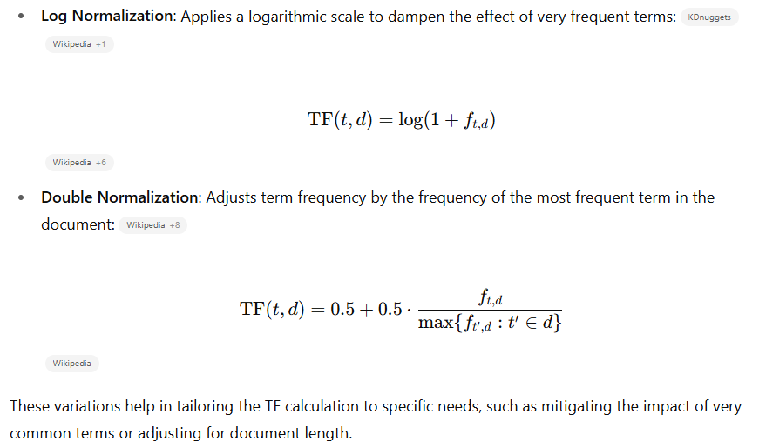
5. Text Representation: TF-IDF
Variants of Term frequency:

Slide 35
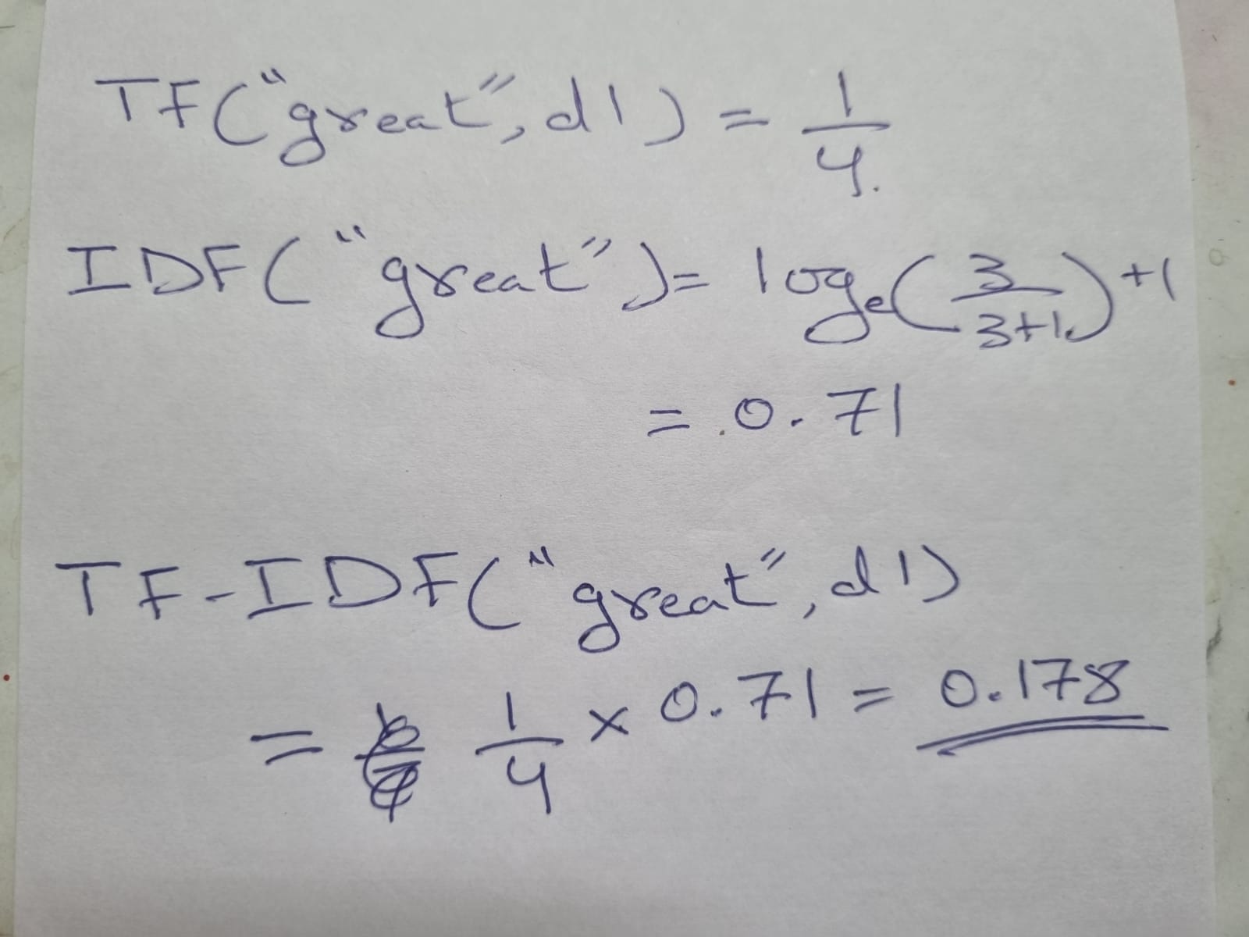
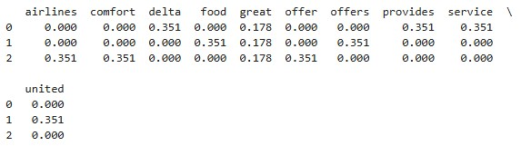
5. Text Representation: TF-IDF (Example)
Example
Let’s say you have 3 documents:
d1: "Delta provides great service“
d2: "United offers great food“
d3: "Great airlines offer comfort"
The word "great" appears in 3 documents — so its IDF will be low(0.71) (not unique).
But the word "comfort" appears only once — so it has a high IDF(1.4).
TF-IDF will highlight "comfort" over "great", since "great" is common and not very informative.
TF-IDF values:

Slide 36
5. Text Representation: What is document in TF-IDF?
In practice:
If you’re analyzing tweets, each tweet is a “document.”
For news classification, each article is a “document.”
For summarization, each paragraph or longer text is treated as a “document.”

Slide 37
5. Text Representation: TF-IDF, how does it help?
Filters out common, less informative words
Keeps meaningful, rare keywords
Improves performance in:
Text classification
Search engines (e.g., Google ranking)
Document similarity
Keyword extraction

Slide 38
5. Text Representation: Word embeddings
Word2Vec is a powerful method developed by Google to create these embeddings using a neural network. It converts each word into a fixed-size vector (e.g., 100-300 dimensions), and captures context by training on large corpora.
It represents words in a continuous vector space where semantically similar words are mapped to nearby points

Slide 39
5. Text Representation: Word embeddings, Word2Vec Architecture
How Word2Vec Works (High Level)
It has two main architectures:
1. CBOW (Continuous Bag of Words):
Predicts the target word from its context words.
Example: "The cat sat on the ___" → Predict: "mat"
2. Skip-Gram:
Predicts context words from a target word.
Example: Given "sat" → Predict words like "cat", "on", "the"

Slide 40
5. Text Representation: Word embeddings (Word2Vec)
Why is Word2Vec powerful?
Because it learns relationships like:
vec("King") - vec("Man") + vec("Woman") ≈ vec("Queen")
Words like ["apple", "banana", "mango"] end up near each other in vector space.
Captures synonyms, analogies, and even grammatical similarities.
Library used: gensim

Slide 41
EXTRA
Xxxxxxxxxxx
xxxxxxxxxxxx

