Slide 1
Connect to google calendar

Slide 2
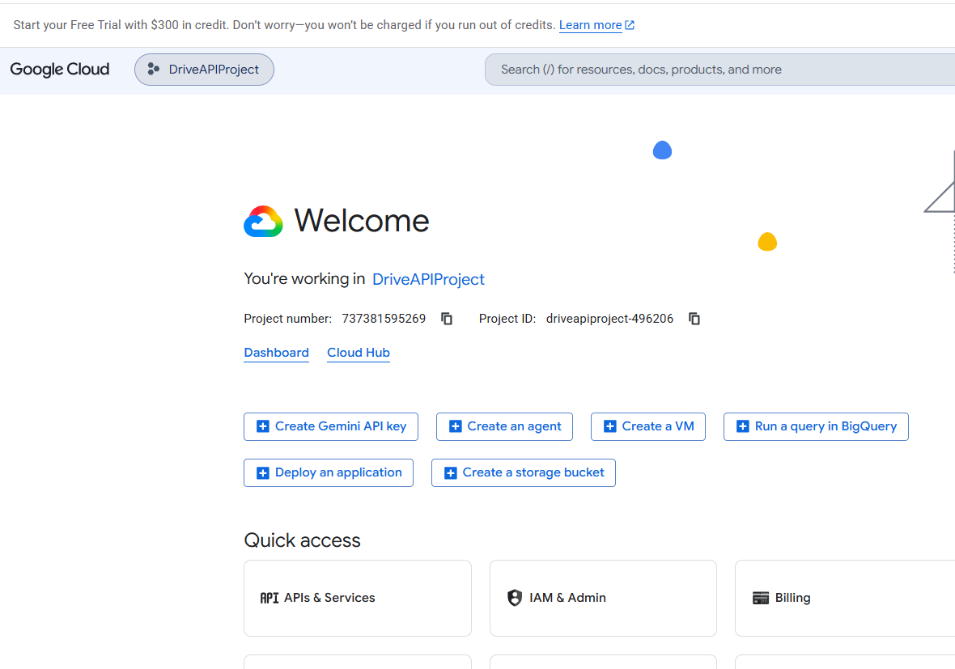

1. Set Up Your Project
Open the Google Cloud Console.
https://console.cloud.google.com/
Click the project dropdown list at the top of the page.
Select an existing project or click New Project to create one.

Slide 4
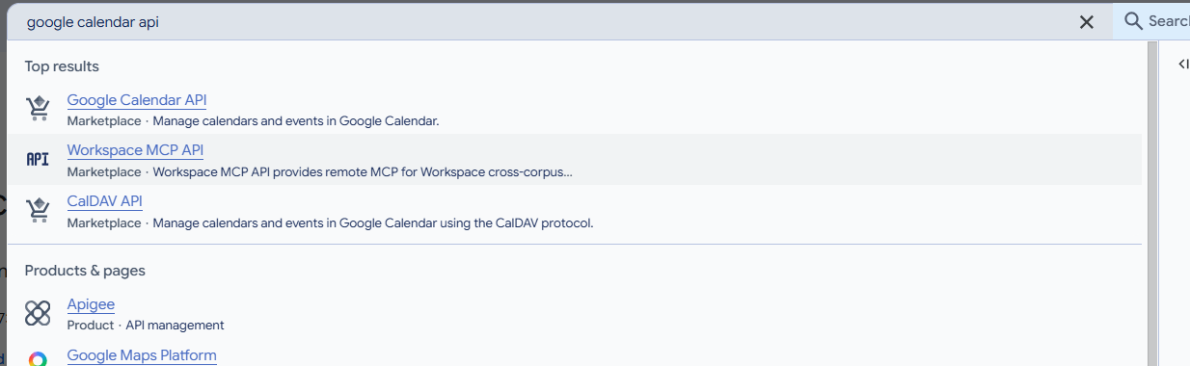



2. Enable the Google Calendar API
Use the top search bar to search for "Google Calendar API".
Click on the API from the search results.
Click the Enable button.

Slide 6
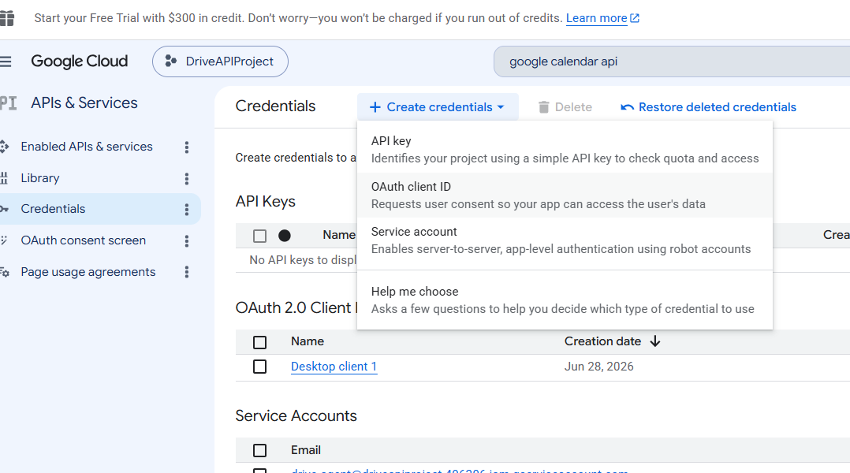


3. Generate Your API Key
Open the left navigation menu and head to APIs & Services > Credentials.
Click the + Create Credentials button at the top.
Select API key from the dropdown menu.
Copy the generated key string from the pop-up box

Slide 7
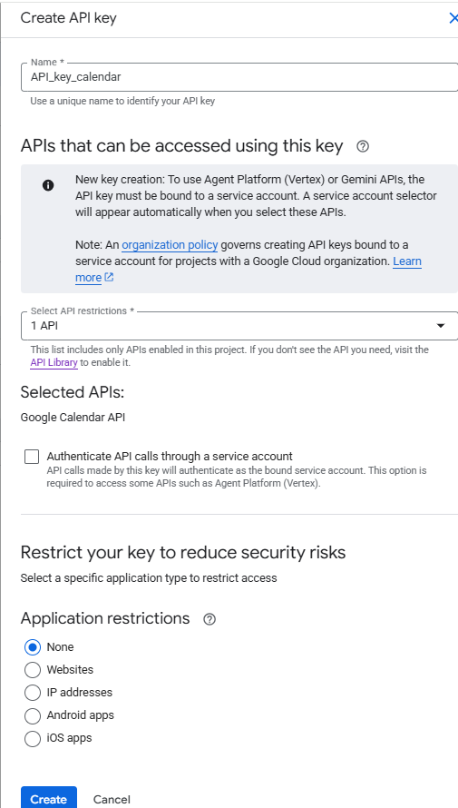



3. Generate Your API Key
Open the left navigation menu and head to APIs & Services > Credentials.
Click the + Create Credentials button at the top.
Select API key from the dropdown menu.
Copy the generated key string from the pop-up box

Slide 8
🔒 Crucial Security Step: Restrict Your Key
Because standard API keys are insecure and easily scraped if exposed, you should restrict them immediately:
In the Credentials tab, click the edit icon next to your newly created API key.
Under API restrictions, select Restrict key.
Choose Google Calendar API from the dropdown menu and save. This ensures your key cannot be misused to access other Google Cloud services

