Slide 1
Connect to google drive

Slide 2
Configure your project in the Google Cloud Console by
Creating a new project
Enabling the Google Drive API
Configuring the OAuth consent screen, and
Downloading the credentials.json file for a "Desktop app".
Create Test user
Finally, we run python script

Slide 3
Creating a new project

Slide 4
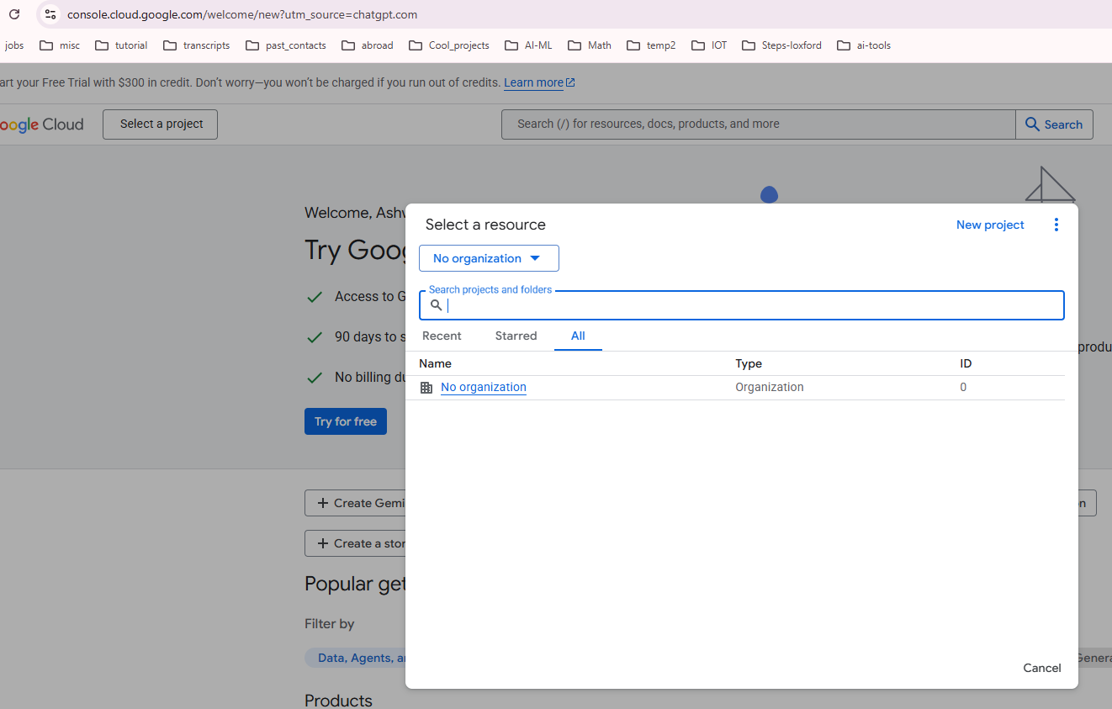
Creating a new project
Open Google Cloud Console: https://console.cloud.google.com/welcome/new
Create a new project (for example, DriveAPIProject).

Slide 5
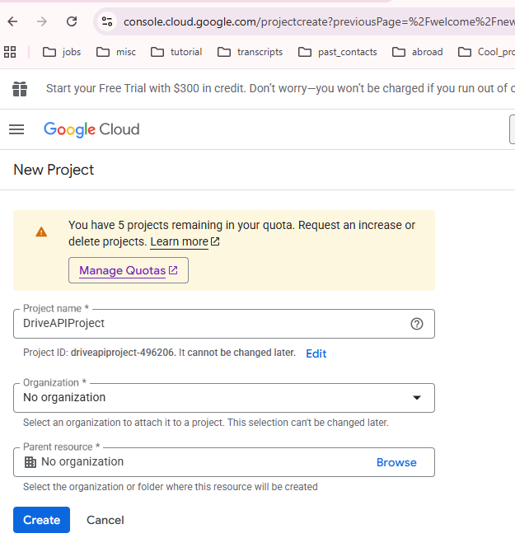
Creating a new project
Open Google Cloud Console: https://console.cloud.google.com/welcome/new
Create a new project (for example, DriveAPIProject).

Slide 6
Enabling the Google Drive API

Slide 7
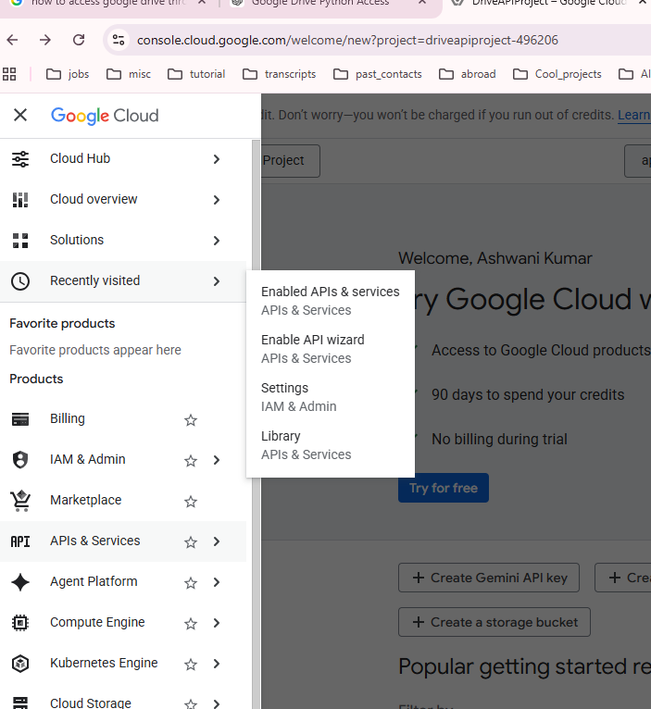
Enabling the Google Drive API
In the left menu, go to APIs & Services → Library.
Search for Google Drive API and enable it.

Slide 8
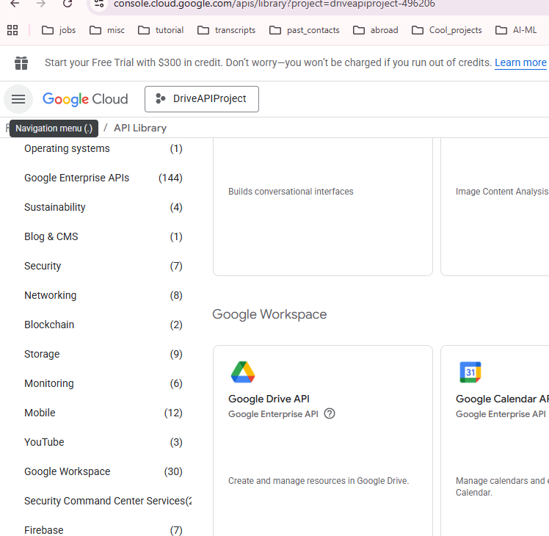
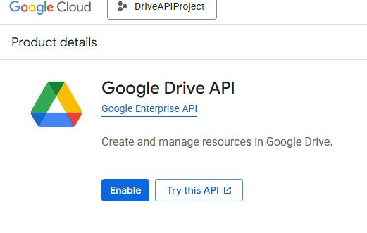

Enabling the Google Drive API
In the left menu, go to APIs & Services → Library.
Search for Google Drive API and enable it.

Slide 9
Configuring the OAuth consent screen

Slide 10
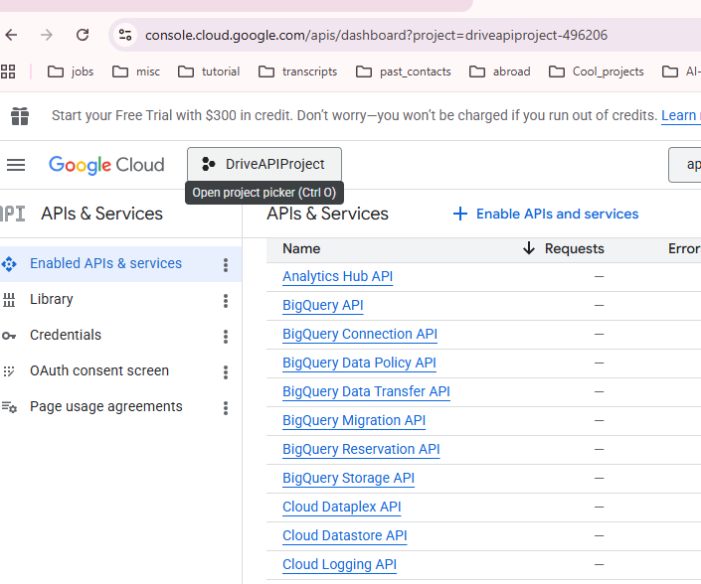
Configuring the OAuth consent screen
Go to APIs & Services → OAuth consent screen. -> Get Started
Choose External and fill in the required app details.
Go to APIs & Services → Credentials.
Click Create Credentials → OAuth client ID.
Select Desktop app.
Give it a name and click Create.

Slide 11
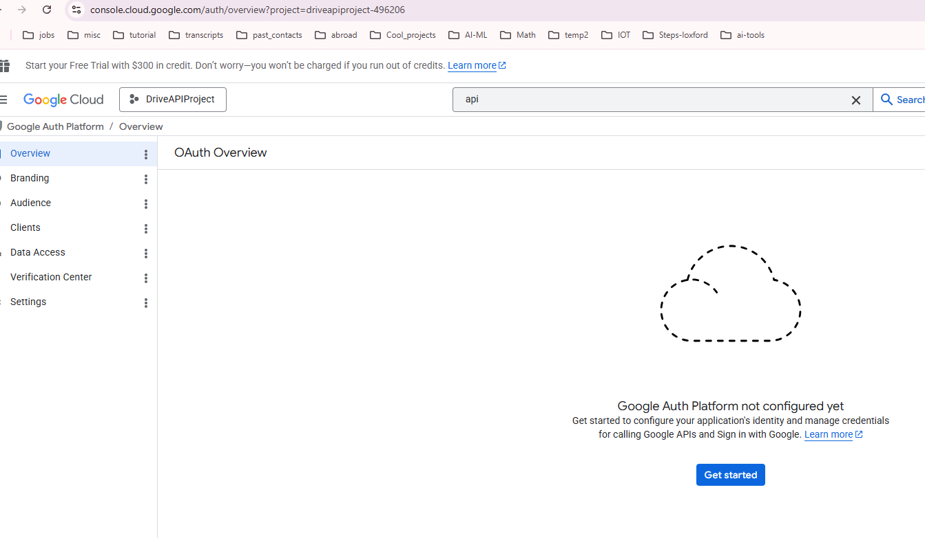
Configuring the OAuth consent screen
Go to APIs & Services → OAuth consent screen. -> Get Started
Choose External and fill in the required app details.
Go to APIs & Services → Credentials.
Click Create Credentials → OAuth client ID.
Select Desktop app.
Give it a name and click Create.

Slide 12
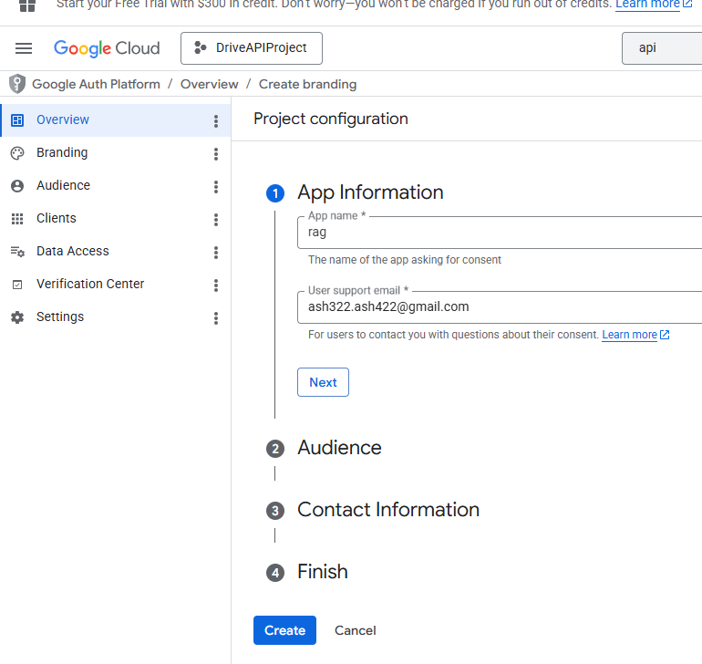

Configuring the OAuth consent screen
Go to APIs & Services → OAuth consent screen. -> Get Started
Choose External and fill in the required app details.
Go to APIs & Services → Credentials.
Click Create Credentials → OAuth client ID.
Select Desktop app.
Give it a name and click Create.

Slide 13
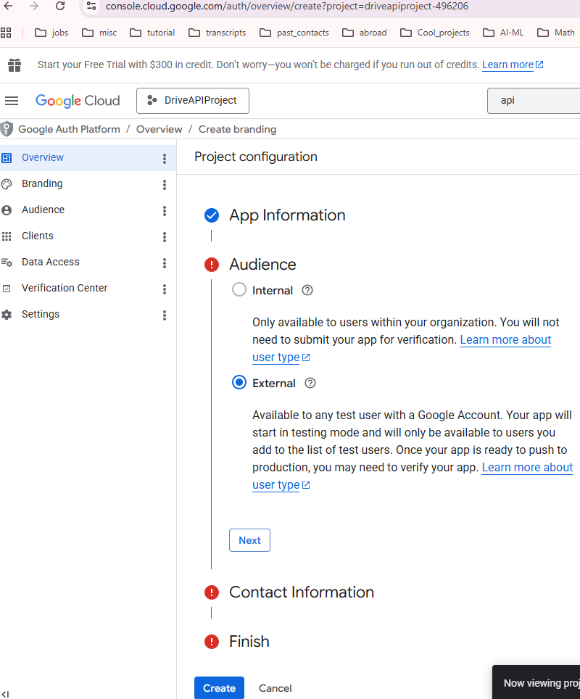

Configuring the OAuth consent screen
Go to APIs & Services → OAuth consent screen. -> Get Started
Choose External and fill in the required app details.
Go to APIs & Services → Credentials.
Click Create Credentials → OAuth client ID.
Select Desktop app.
Give it a name and click Create.

Slide 14
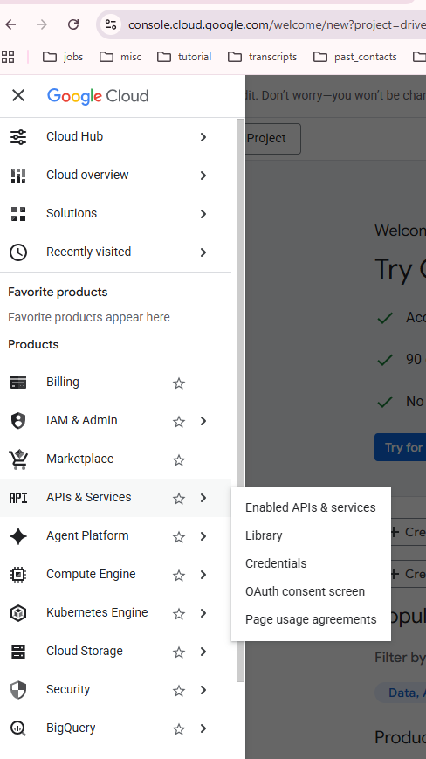

Configuring the OAuth consent screen
Go to APIs & Services → OAuth consent screen. -> Get Started
Choose External and fill in the required app details.
Go to APIs & Services → Credentials.
Click Create Credentials → OAuth client ID.
Select Desktop app.
Give it a name and click Create.

Slide 15
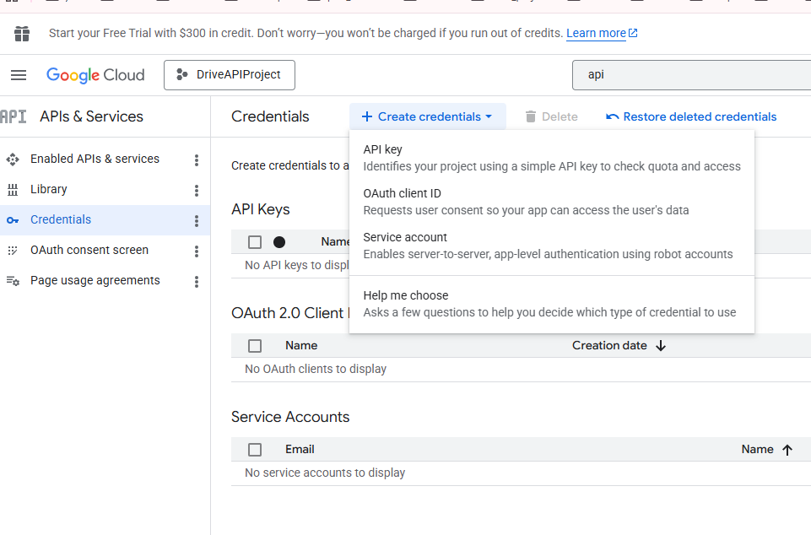


Configuring the OAuth consent screen
Go to APIs & Services → OAuth consent screen. -> Get Started
Choose External and fill in the required app details.
Go to APIs & Services → Credentials.
Click Create Credentials → OAuth client ID.
Select Desktop app.
Give it a name and click Create.

Slide 16
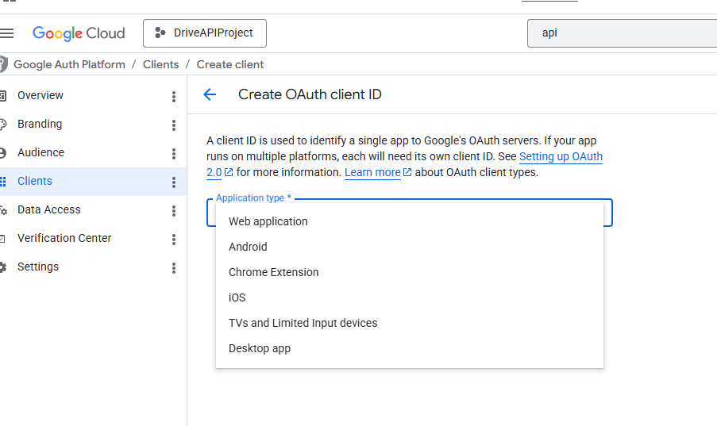

Configuring the OAuth consent screen
Go to APIs & Services → OAuth consent screen. -> Get Started
Choose External and fill in the required app details.
Go to APIs & Services → Credentials.
Click Create Credentials → OAuth client ID.
Select Desktop app.
Give it a name and click Create.

Slide 17
Downloading the credentials.json file for a "Desktop app".

Slide 18
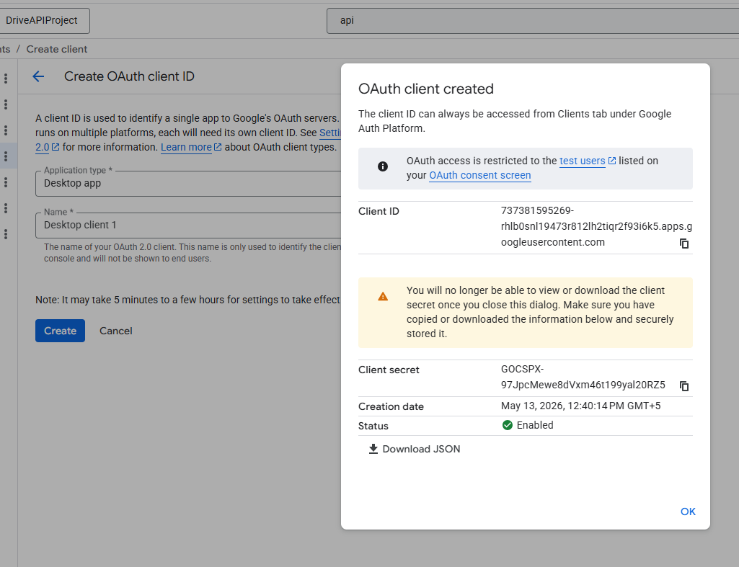
Downloading the credentials.json file for a "Desktop app".
Click Download JSON.
Rename the downloaded file to credentials.json.

Slide 19
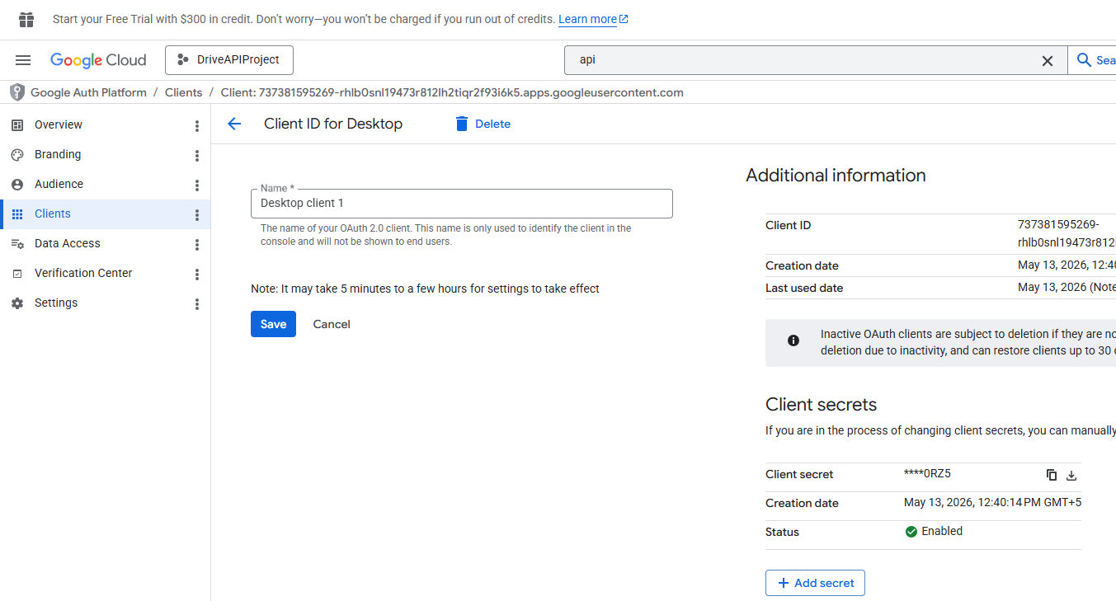
NOTE:
Later you can also download this file using below console:

Slide 20
Create Test user

Slide 21
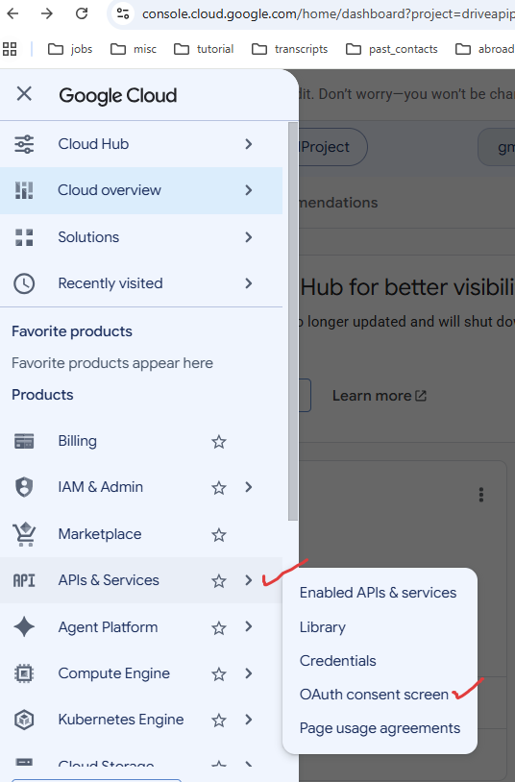
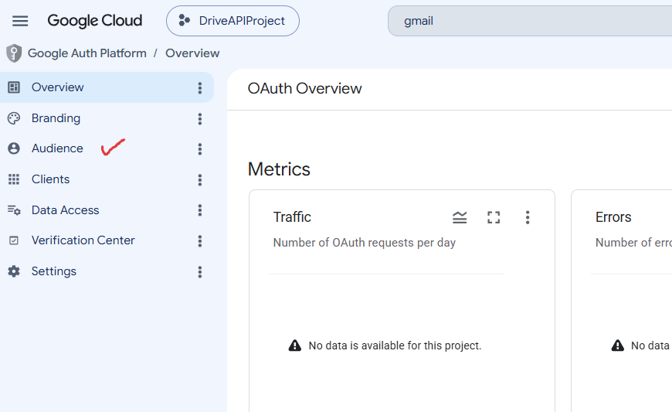

Slide 22
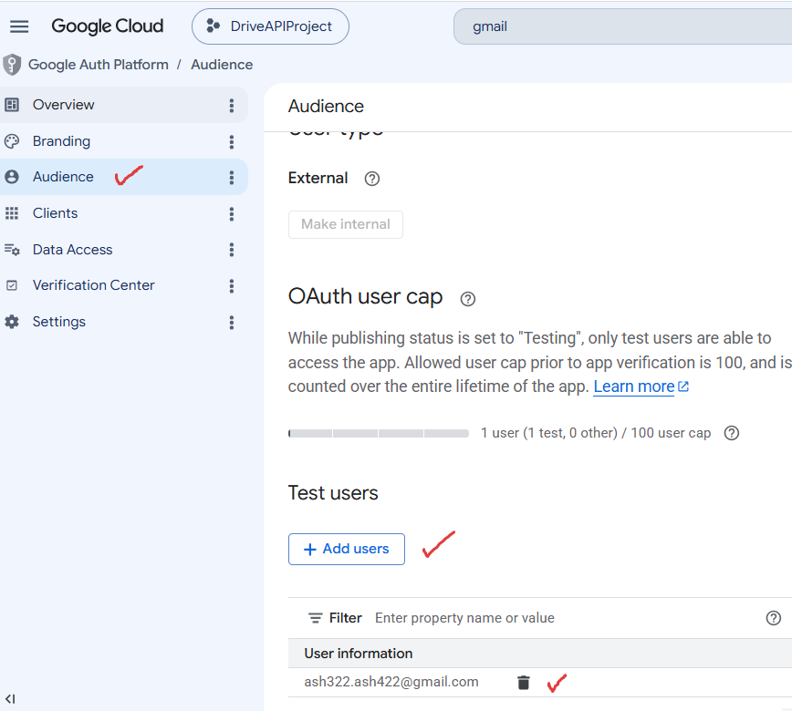

Slide 23
The python code

