Slide 1
RAG (Retrieval-Augmented Generation)
Using AI Agent

Slide 2
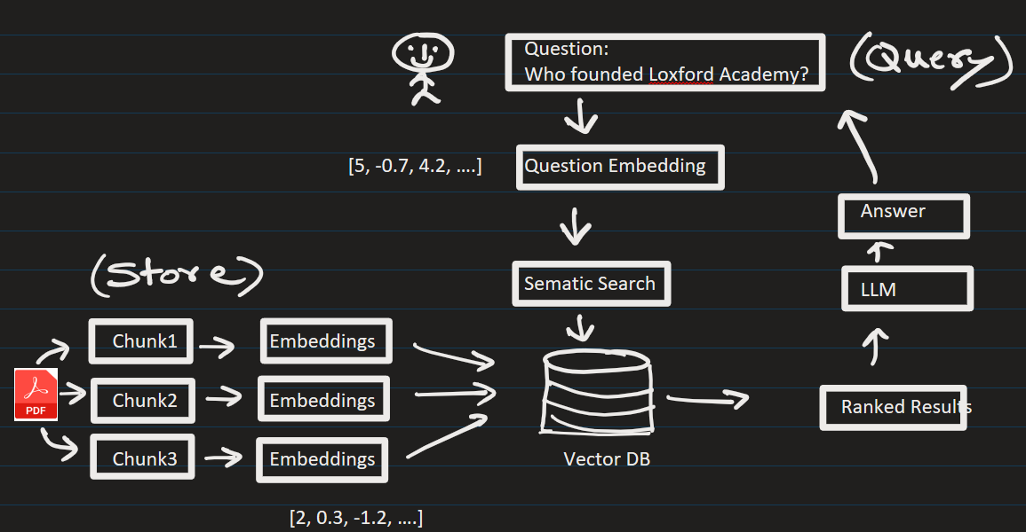
RAG (Retrieval-Augmented Generation)

Slide 3
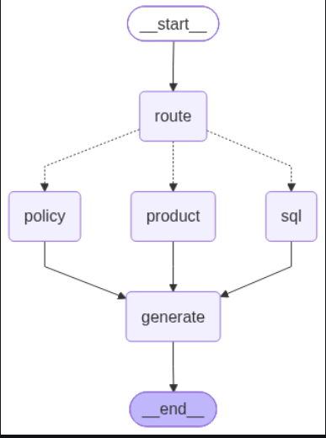

Slide 5
EXTRA
Ffnbksdfd
Fdslj;f
Fl;ds

