Slide 1
1. What is NLP Pipeline?
An NLP pipeline is a sequence of steps to convert raw text into a format a model can understand.
Pipeline Flow:
Raw Text → Tokenization → Integer Encoding → Padding → Embeddings → Model (RNN)
The model could be sentence-completion, sentiment analysis, etc.

Slide 2
2. Tokenization
Concept
Tokenization = Breaking text into smaller units (words/subwords)
Example:
"I love Cherry" → ["I", "love", “Cherry"]

Slide 3
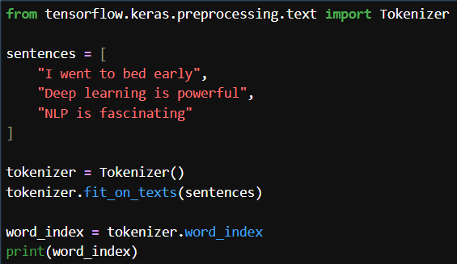

Slide 4
3. Text → Sequences (Integer Encoding)
Convert words into numbers:
Example:
"I love Cherry" → [3, 4, 7]

Slide 5
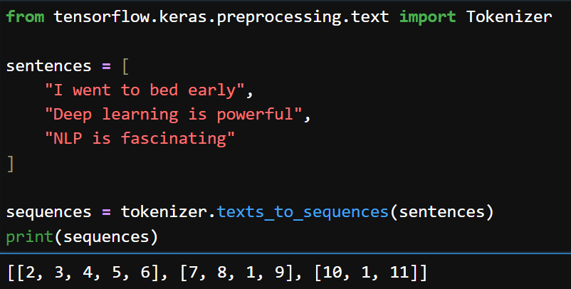

Slide 6
4. Padding (Very Important)
Problem:
Different sentences have different lengths → Neural networks need fixed size
Solution:
Add zeros (padding)

Slide 7
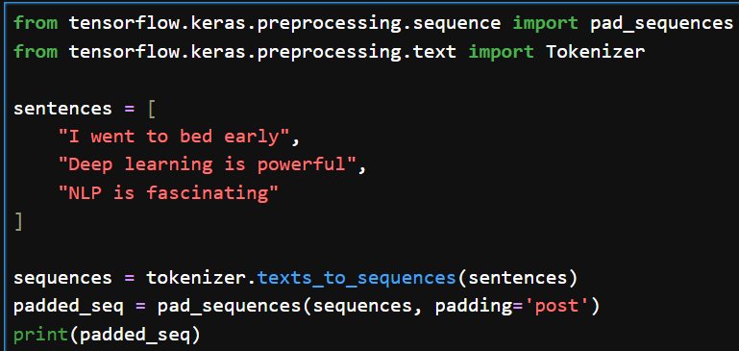
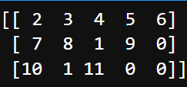
padding='pre' → add zeros at start
padding='post' → add zeros at end (recommended)

Slide 8
5. Embeddings (Core Concept)
Problem:
Numbers like [3,4,7] have no meaning
Solution:
Convert into dense vectors
Example:
3 → [0.2, -0.1, 0.9, -0.2, 0.003]

Slide 9
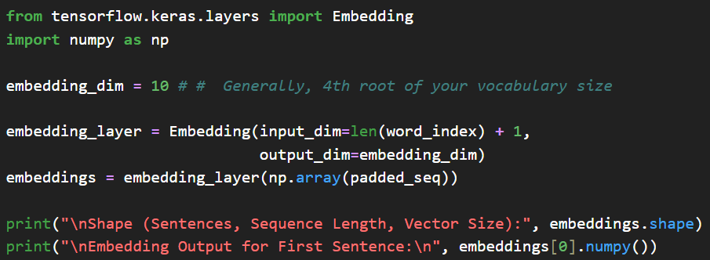
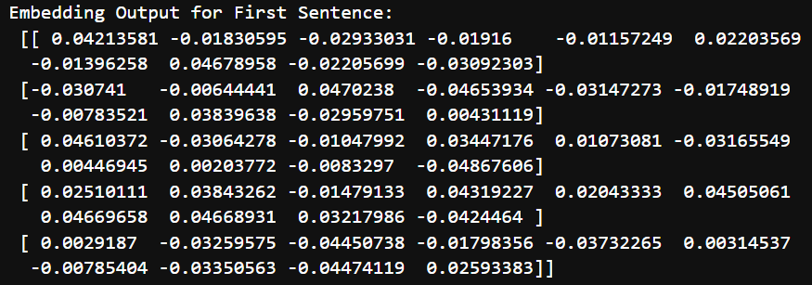

Slide 10
Why embedding ?
1. Captures semantic meaning: Embeddings place similar words closer in vector space.
king ≈ queen
apple ≠ king
2. Fix sparsity problem (better than one-hot encoding)
Without embeddings:
Vocabulary size = 10,000
One-hot vector = 10,000 dimensions (mostly zeros ❌)
With embeddings:
Dense vector (e.g., 100 dimensions) ✅ 👉 More efficient + meaningful

