Slide 1
Regular Expression

Slide 2
Data Structure
Unstructured Data
Quasi-structure Data
Semi-structured Data
Structured Data

Slide 3
Un-structure Data
Data that has no predefined structure or format
It cannot be easily organized or stored in a database or spreadsheet.
Examples: emails, social media posts, documents like Word files or PDFs, Wikipedia, etc.
80-90% available data is unstructured.

Slide 4
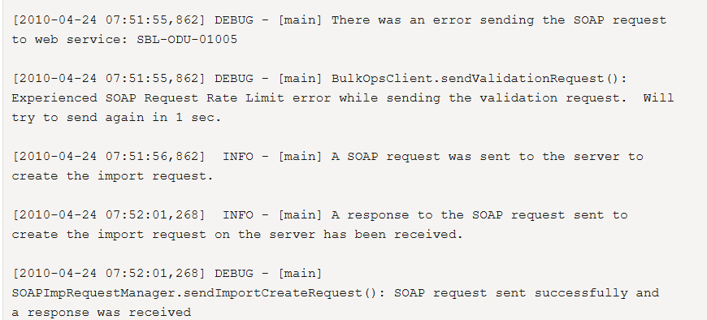
Quasi-structure Data
It's not structured but can be partially organized with tools.
It’s readable but needs cleaning and parsing for analysis.
Typically found in: Logs, clickstream data
5-10% available data is unstructured.

Slide 5
Semi-structured Data
Data that doesn't reside in a relational database but still has some organizational properties (tags or markers).
5-10% available data is unstructured.
Example: JSON, XML files
<student>
<id>101</id>
<name>Loxford</name>
<age>19</age>
<id>102</id>
<name>Khan</name>
<age>22</age>
</student>

Slide 6
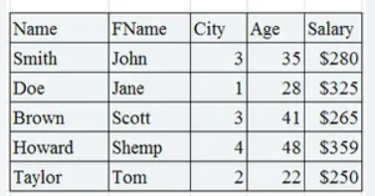
Structured Data
Data with a clearly defined format, organized into rows and columns
Relational databases (like MySQL, Oracle).
Easily searchable and analysable.
< 10% available data is unstructured.

Slide 7
EXTRA
Xxxxxxxxxxx
xxxxxxxxxxxx

Slide 8
EXTRA
Xxxxxxxxxxx
xxxxxxxxxxxx

