Slide 1
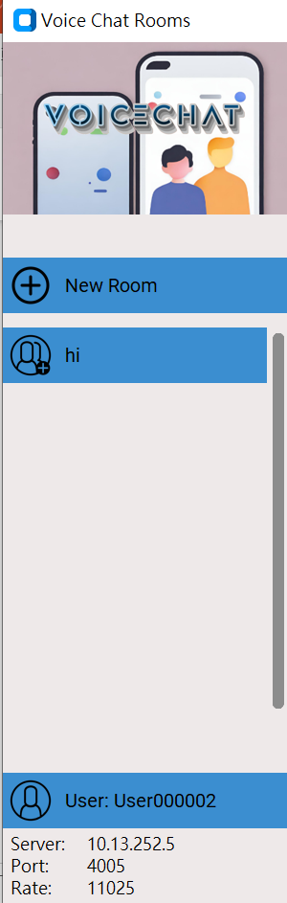
CSCI3280 Project Demo
Group 15
Elvis MAN Tze Wa, Sam TAM Ka Ho, Jerry LAM Hei Yui

Slide 2

Features
Seamless integration of voice recording
Real-time communication
Enhanced features…

Slide 3
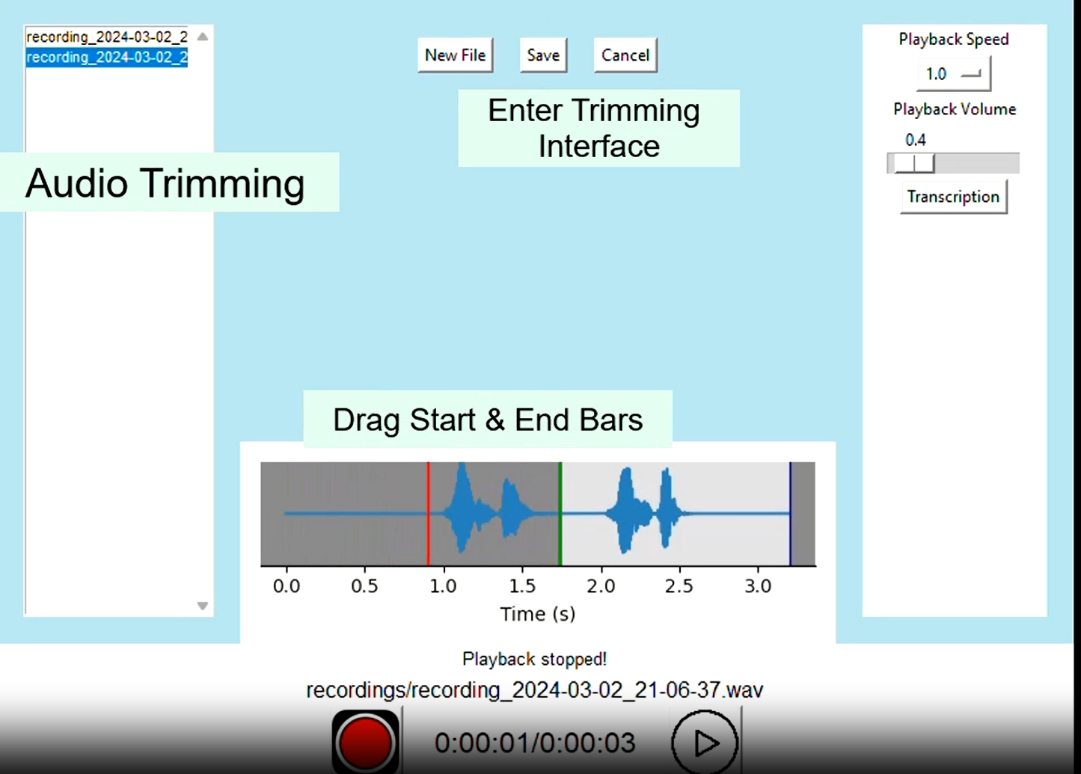
Overview – Phase 1
Sound recorder
Recording and playing functions

Slide 4
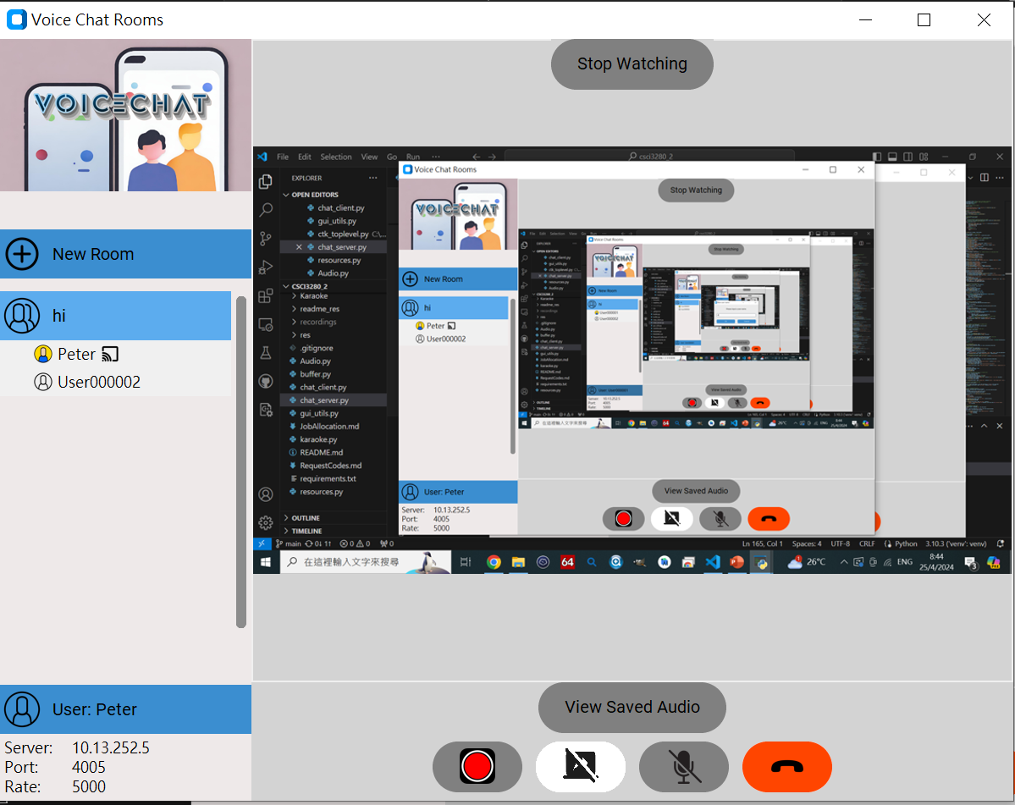
Overview – Phase 2
Create, join and interact within chat rooms

Slide 5
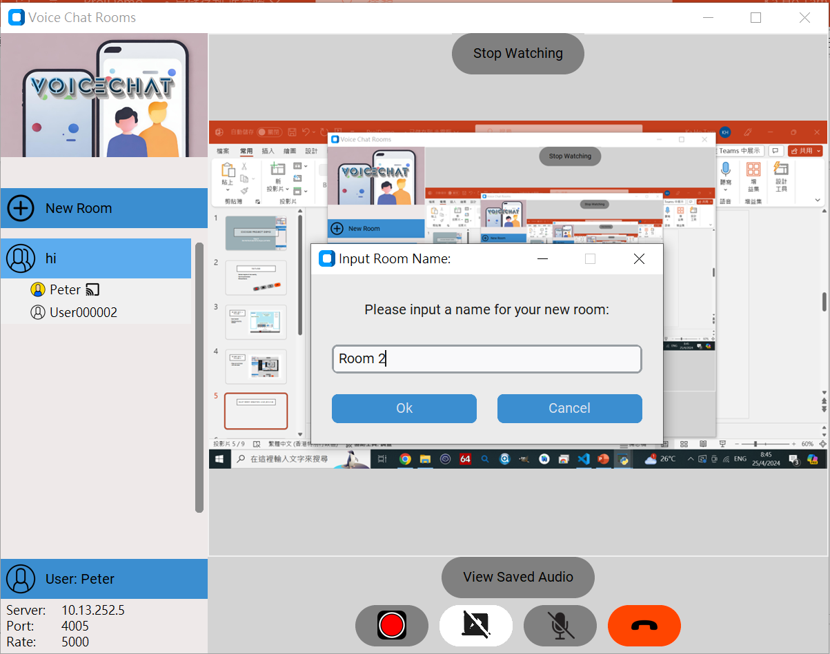
Chat Room Creation and joining

Slide 6
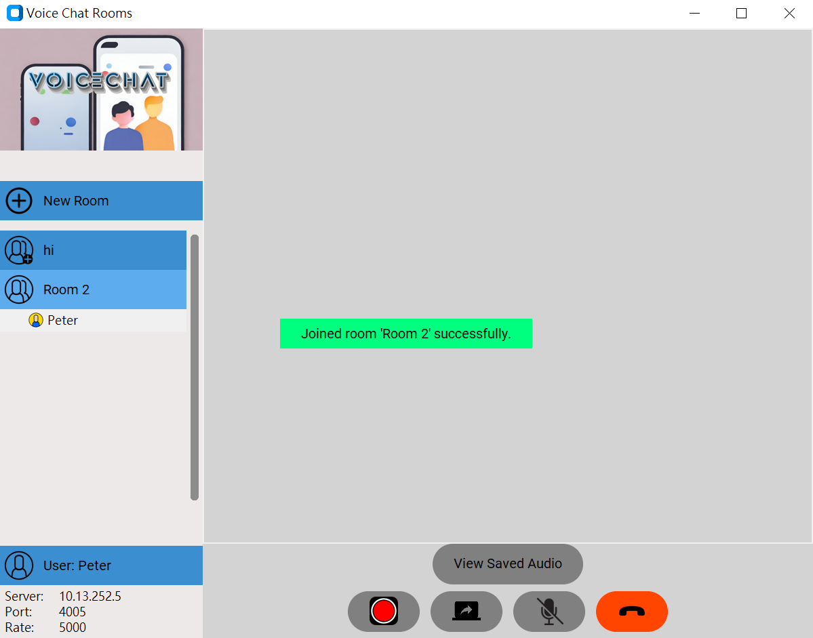
Chat Room Creation and joining
Disconnect all streaming services automatically when changing room
Real-time updates user lists for the room quitted

Slide 7
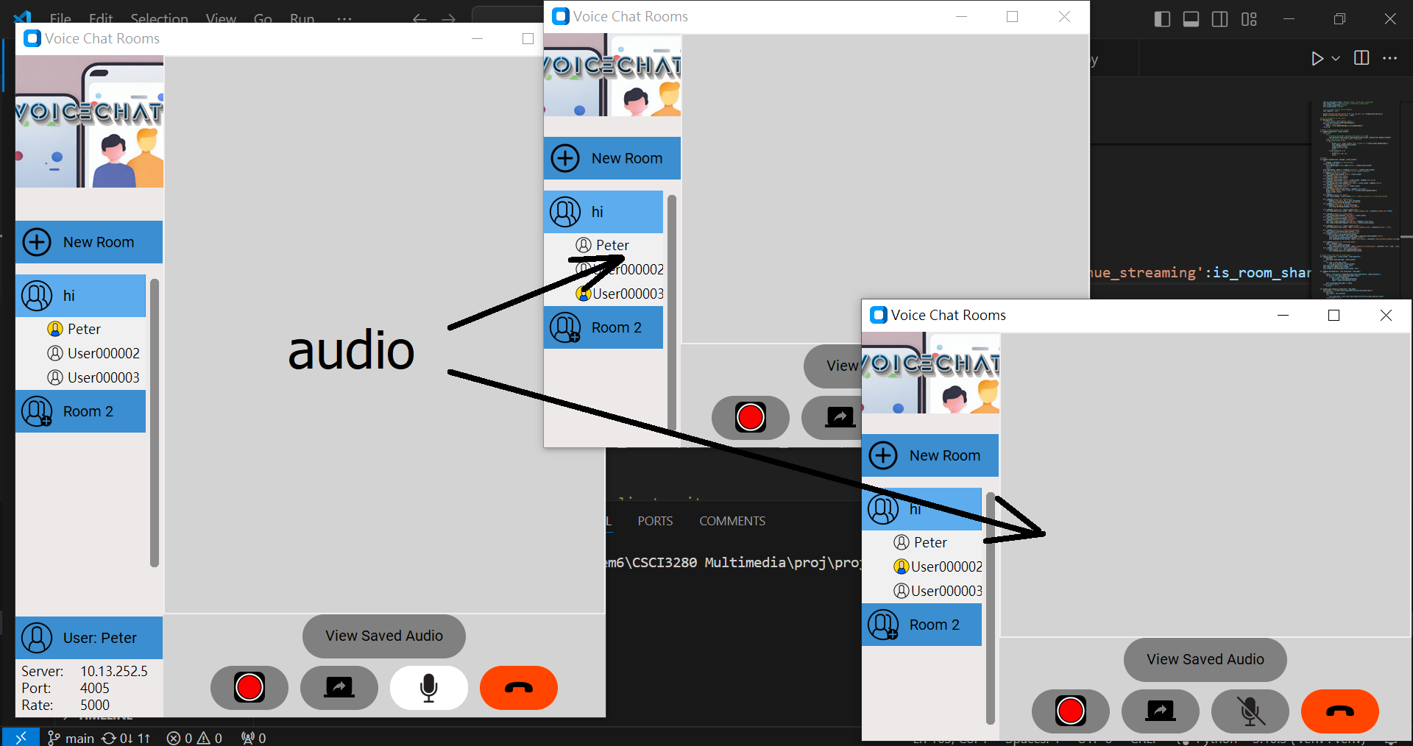
Multi-user voice chat
Supports more than 3 people speaking at the same time
Synchronized block-wise so that no clear lag in voice can be heard

Slide 8
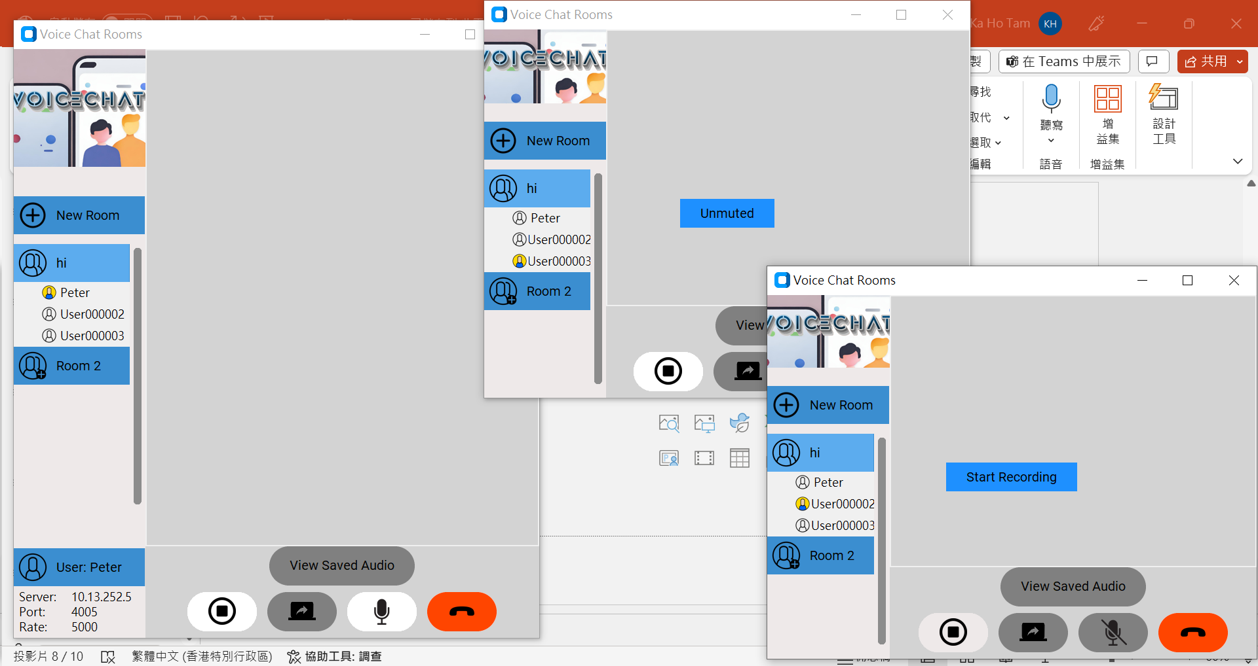
Recording features
All users can see that the room is being recorded
Recorded audio stored in the server
A list of audios can be seen in ‘view saved audio’

Slide 9
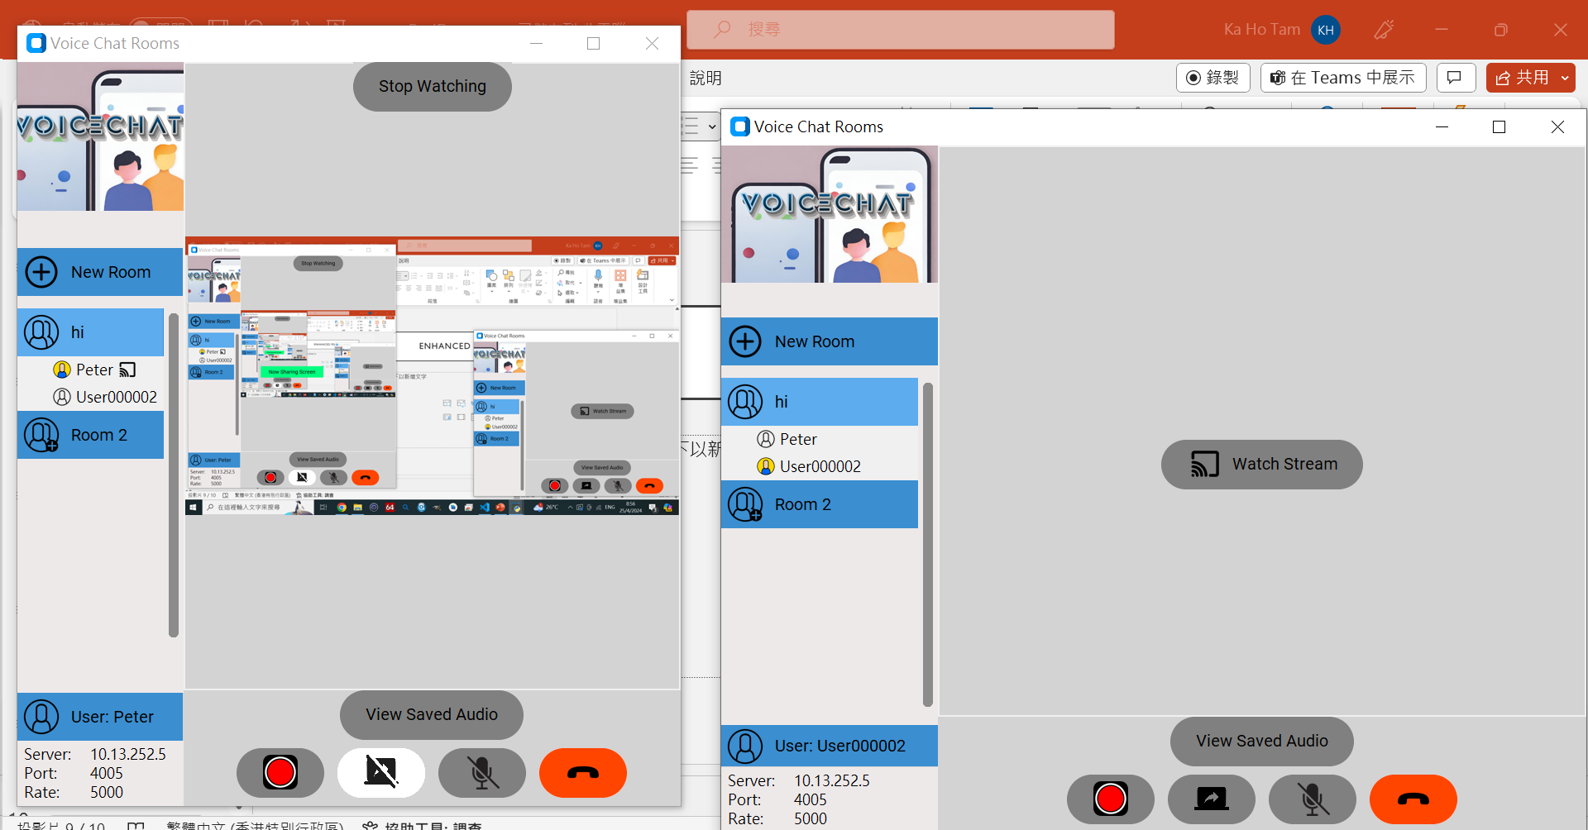
Enhanced features
Client can share screen
Other clients can choose to watch the current screen or stop watching at any time they want

Slide 10
Capability of computers
Users can lower the sample rate of the audio when setting up the server

Slide 11
Capability of computers
We ensure that crashes in client end will not affect other clients and the server’s normal use

Slide 12
thankyou

