Slide 1
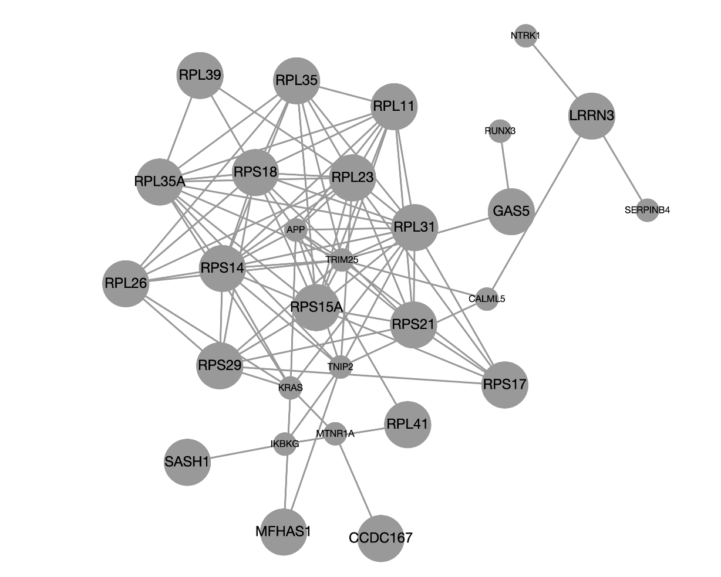
SES down

Slide 2
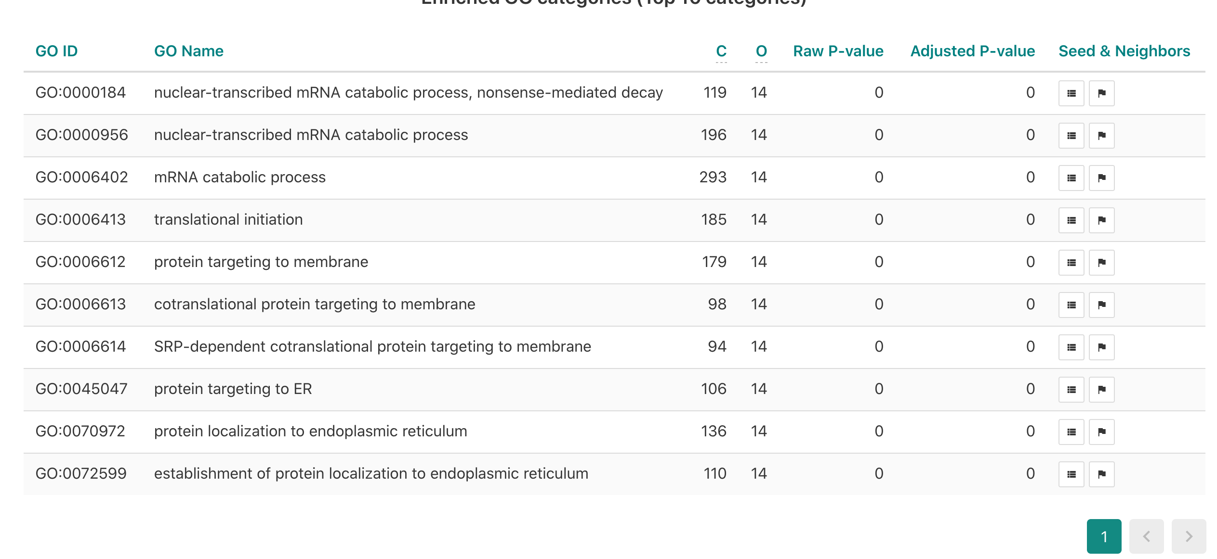

Slide 3
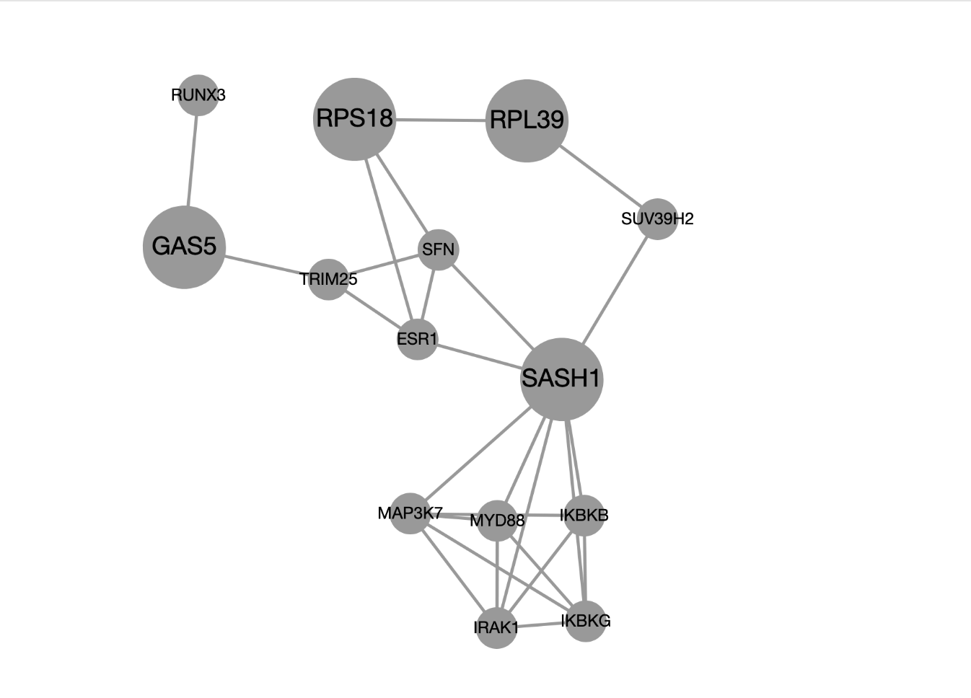
SES4 income intersection down

Slide 4
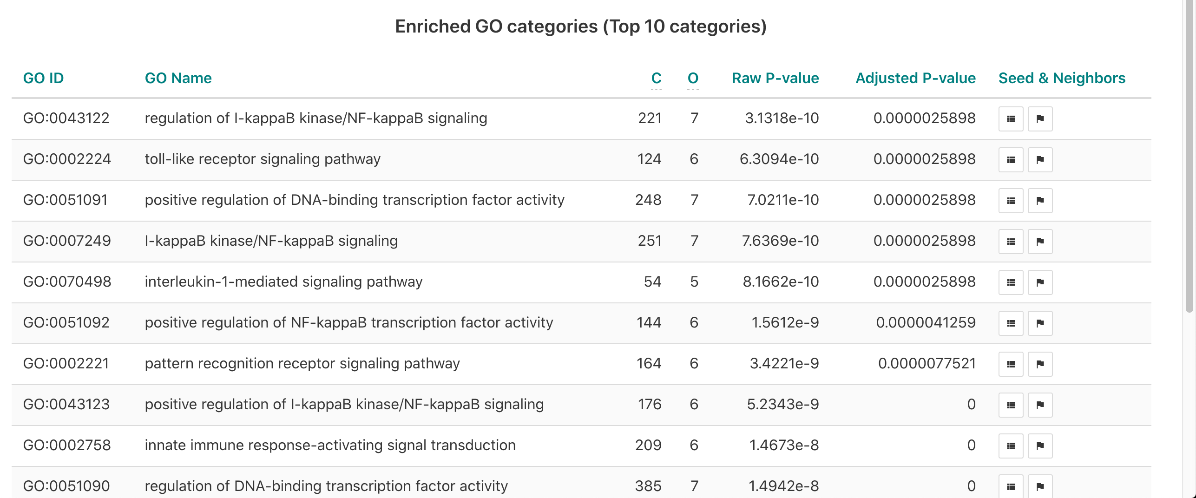

Slide 5
Fig 2
SES4 down
mRNA catabolic processes, Translational
initiation and Endoplasmic reticulum
SES4 income intersection down
KappaB signaling, Toll-like receptor
Pathways Interleukin pathways
b) Differential expression by SES predictors in the rest of the genome. This Venn diagram indicates which SES indicators drive DE among the

