Slide 1
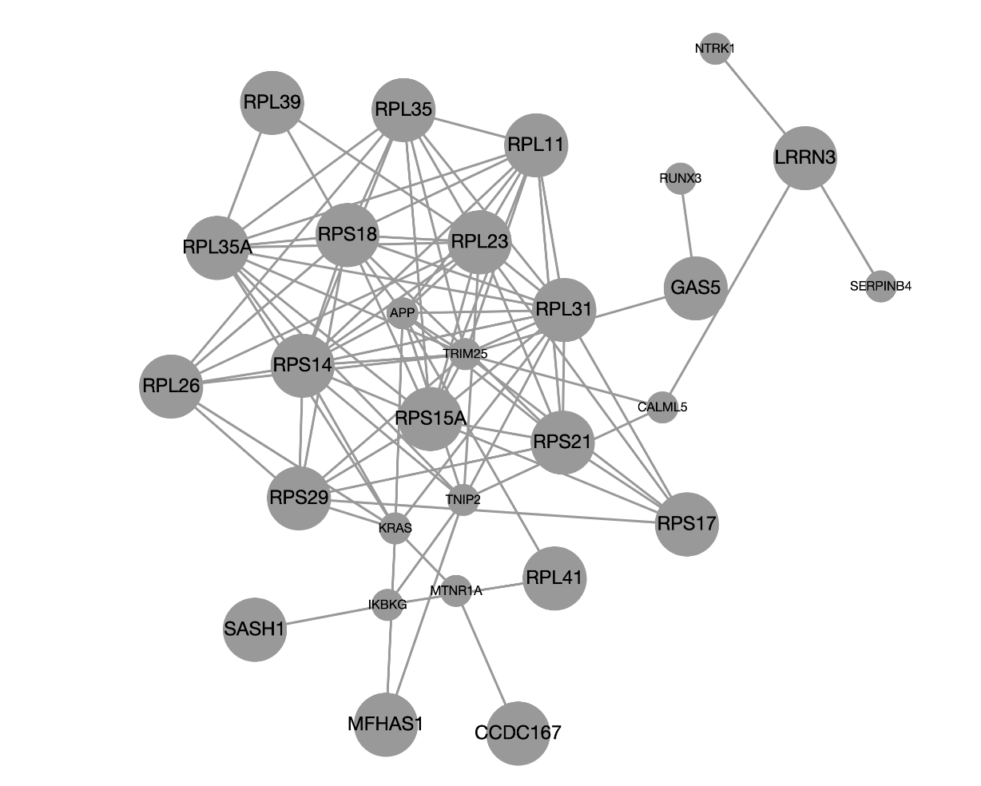
SES down

Slide 2
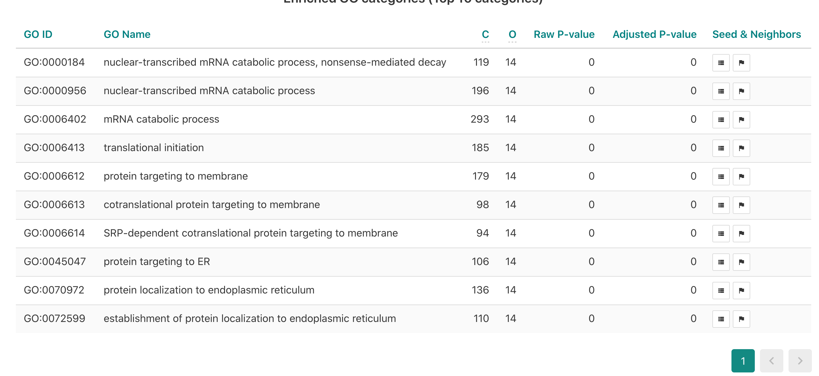

Slide 3
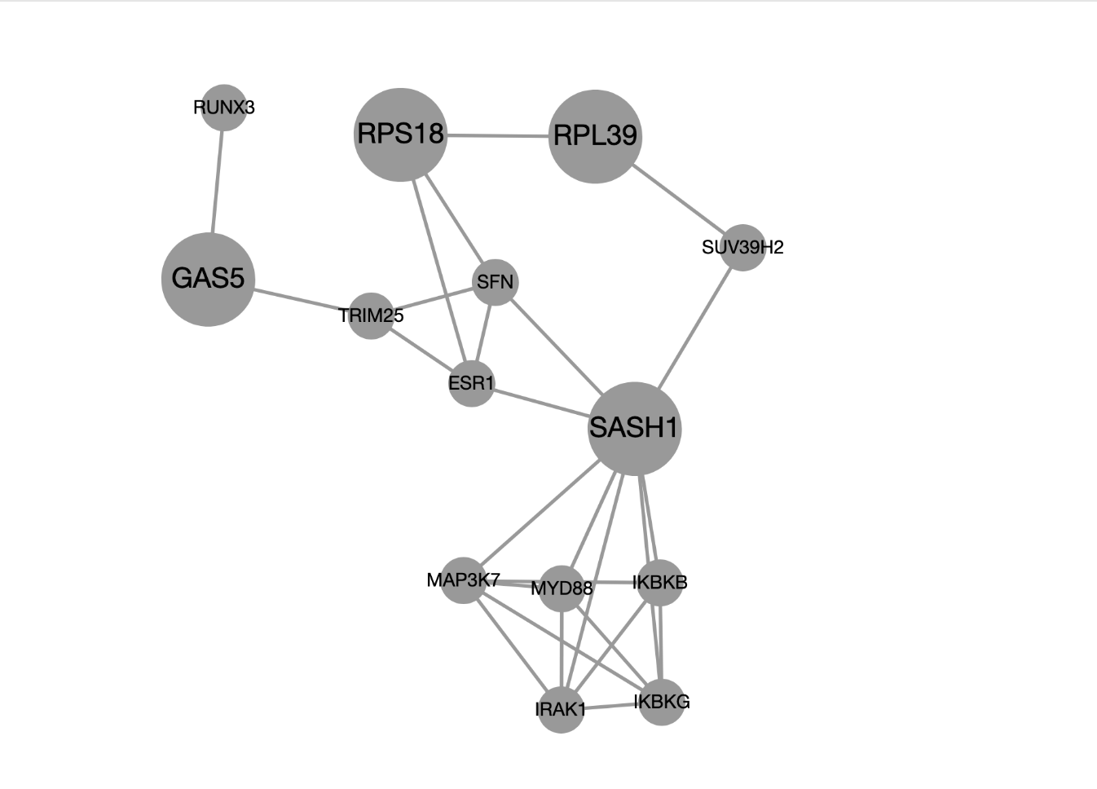
SES4 income intersection down

Slide 4
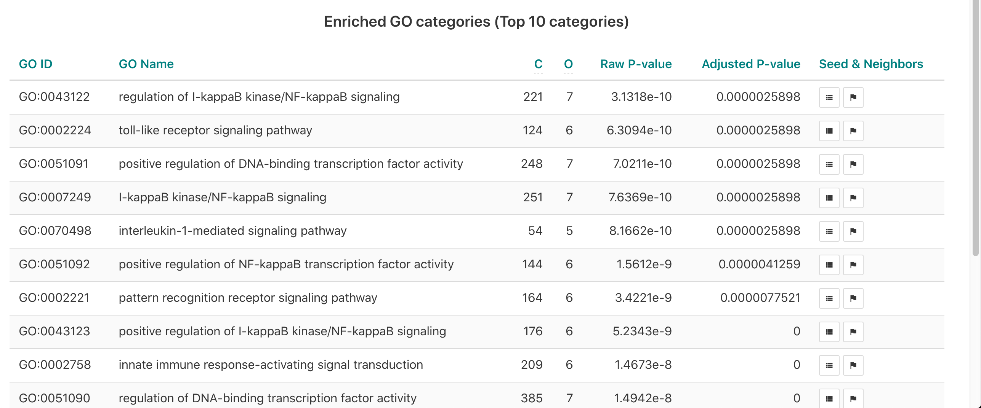

Slide 5
Fig 2
SES4 down
mRNA catabolic processes, Translational
initiation and Endoplasmic reticulum
SES4 income intersection down
KappaB signaling, Toll-like receptor
Pathways Interleukin pathways
b) Pathway analysis on clusters of co-expressed genes. We ran pathway analyses on the 29 downregulated genes with SES4 (negative effect direction) and the 8 genes simultaneously downregulated for SES4 and income. Significance was determined via GO-terms in WEBGESTALT. In particular, we constructed networks by means of the (default) network expansion method based on the top ranking 10 neighbors. We addressed multiple testing corrections using Benjamini & Hochberg FDR. A significance threshold of 0.05 after correction for multiple testing was applied. (a) One cluster of downregulated genes with SES4 and (b) one cluster of genes downregulated with SES4 and income were enriched for GO terms; representative pathways are mentioned next to the cluster names (See appendix for full details).

