Slide 1
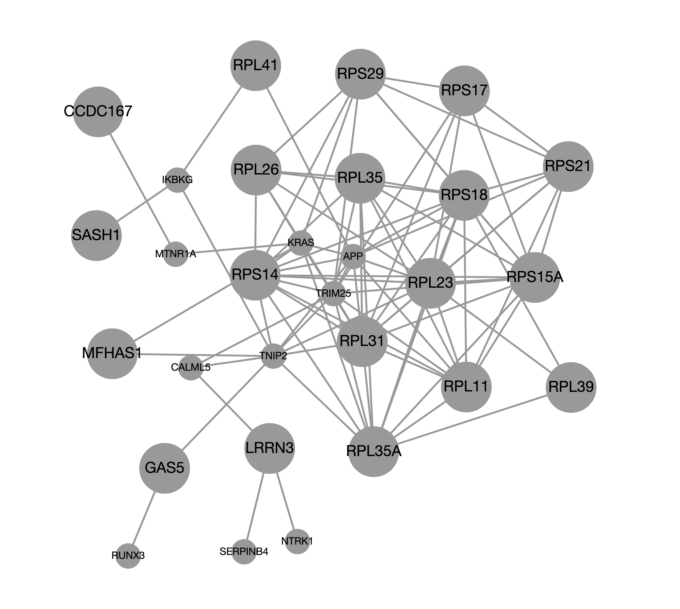
Network-topology analyses revealed significant findings for ses4_down (which was significant by both network expansion and prioritization methods). We have highlighted the top genes based on the network diffusion analysis, i.e. genes which are probably the hub genes, boasting more connectivity than other network members. See the appendix for an enrichment gene ontology over-representation analysis for the network which details which give the major functions associated with the network.

