Slide 1
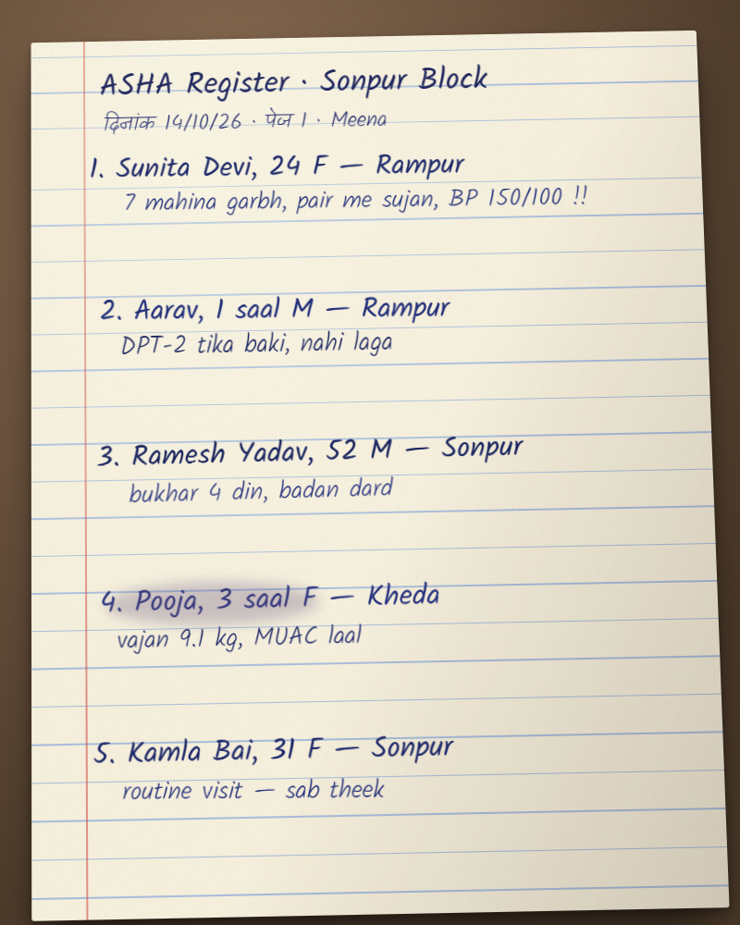
Bridge the Gap · Devlympics Shunya 2026
Kaagaz
Paper that talks back
One photo of the register a village health worker already keeps becomes live, triaged health data, and the doctor’s advice comes back to her in Hindi, by voice.
[Team name] · [Member names]
Notes:
Kaagaz means paper. We built a bridge between India’s village health workers and their doctors, made of the paper they already use. (Fill in team name and members before presenting.)

Slide 2
The gap
Village health lives on paper
1M+
11
2 days
ASHA workers record rural India’s health
paper registers one ASHA may keep
for one ASHA to enter 200 TB patients into an app
National Health Mission
KhushiHealth · MIT Solve
New Lines Magazine
Digitisation so far has added work: paper is never phased out, so workers do everything twice.
Notes:
A million ASHA workers write village health on paper. They may keep up to eleven registers. Every app added so far has meant more typing, not less; one worker told New Lines that entering 200 TB patients took almost two days. And the doctor sees the data weeks later; nothing goes back to the village.

Slide 3
Two sides
They should talk every day. Today, they can’t
ASHA worker
District doctor
village · paper · Hindi · low signal
town · dashboards · English
Writes everything on paper
Sees danger signs first
No doctor to ask
Often no data connection
Gets data weeks late
Can’t see who needs help today
Spots outbreaks too late
No way to reply to the village
~3 weeks
one way
Notes:
One side holds the information, the other holds the expertise. Between them: paper, a monthly reporting cycle, and roughly three weeks of delay. Nothing crosses back.

Slide 4
What exists today
Every tool so far adds an app
Who | What they do | Where it breaks
ANMOL · RCH portal (MoHFW) | Tablet app for ANMs | 75.6% of surveyed staff rated it very difficult to use
SAMASTA (Karnataka) | Digital ASHA diary, 485 → 134 fields (reported) | Still typing; earlier rollout failed on signal and training
Khushi Baby · CommCare | Offline forms, NFC records | Worker becomes a form filler; data flows one way
Wadhwani AI | Single-task AI assistants | A separate app per task; registers untouched
Doxper · Ninx | Digital pen; Gemini reads documents | Special hardware, or one-way with no worker loop
WhatsApp groups | What workers actually use | Duplicate reporting, privacy risk
Kaagaz | Reads the paper she already keeps | 0 new typing · two-way · FHIR into ABDM
Notes:
We studied every tool in this space. Government apps, NGO platforms and AI tools all share one move: they add an app. Sources are in our README: the ANMOL usability study, SAMASTA coverage, Khushi Baby and CommCare documentation, Wadhwani AI, Doxper, and Ninx from the Gemini competition.

Slide 5
The loopholes they share
Five gaps, five answers
1
More typing, not less
The paper is the input: zero new typing
2
Data flows one way
Advice comes back as a Hindi voice note
3
Every app is a silo
Standard FHIR R4 records for ABDM
4
Needs signal and skill
SMS replies, offline queue, speak instead of write
5
Black-box AI
The evidence glows on the handwriting
Notes:
Five loopholes, and Kaagaz answers each one. No new typing; help comes back; standard records instead of a silo; it works on SMS and offline; and the AI shows its evidence.

Slide 6
The bridge
Keep the paper. Lose the delay
1
2
3
4
Snap
AI reads
Doctor acts
Voice back
The ASHA photographs today’s register page. No typing, no forms.
Gemini reads Hindi and English handwriting and flags danger signs.
Urgent patients first. Advice or referral in one tap.
A Hindi voice note on her phone. She replies by speaking.
Up as a photo, back down as a voice: the bridge works both ways.
Notes:
One photo goes up. Help comes back down, in Hindi, by voice.

Slide 7
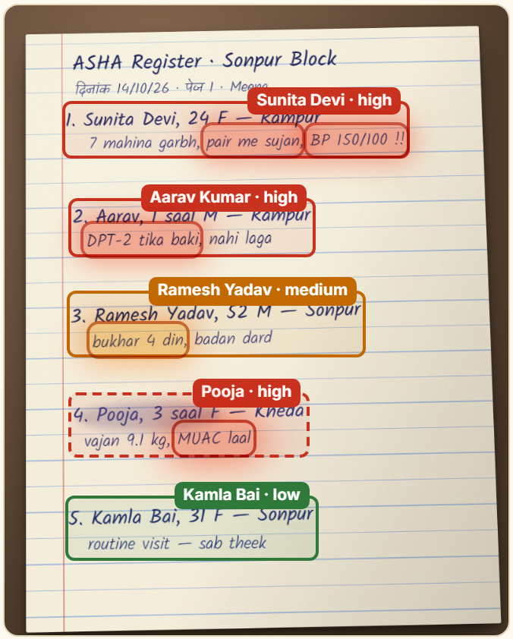
Step 1 · Paper to AI
The AI shows why a patient is urgent
Reads every row
Hindi, English and Hinglish handwriting, with a confidence score per row.
Highlights the evidence
“BP 150/100” and “pair me sujan” (swollen feet) glow red: possible pre-eclampsia.
Flags what it isn’t sure of
Low-confidence rows go to a human, shown beside the original handwriting.
Notes:
Gemini reads the handwriting and shows why someone is urgent: BP 150 over 100 and swollen feet, glowing right on the page. No black box.

Slide 8
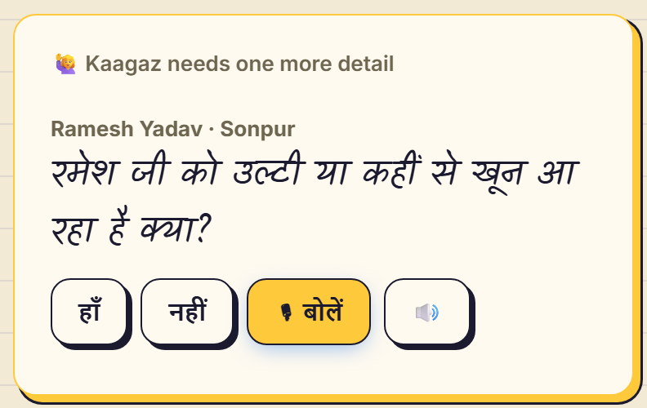
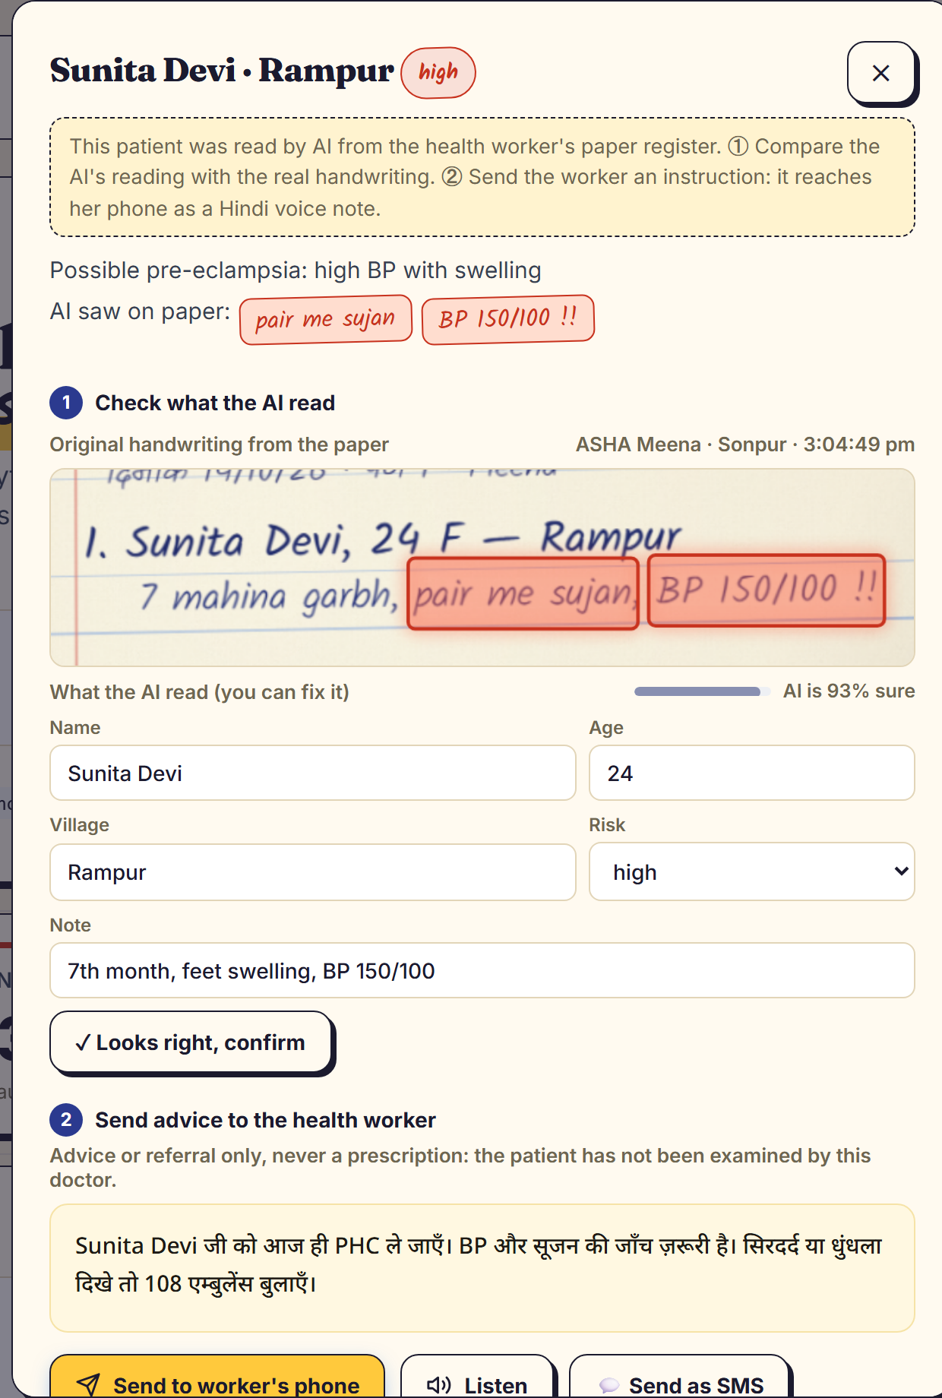
Steps 2 and 3
AI asks, a human checks
The doctor sees the AI’s reading next to the real handwriting, corrects it, then sends advice.
AI suggests. The doctor decides.
Something missing? The phone asks the ASHA out loud in Hindi. She says “हाँ” and Ramesh becomes urgent on the doctor’s screen.
Notes:
If a detail would change the decision, the phone asks the worker out loud. Then a doctor always checks the AI against the original handwriting before acting.

Slide 9
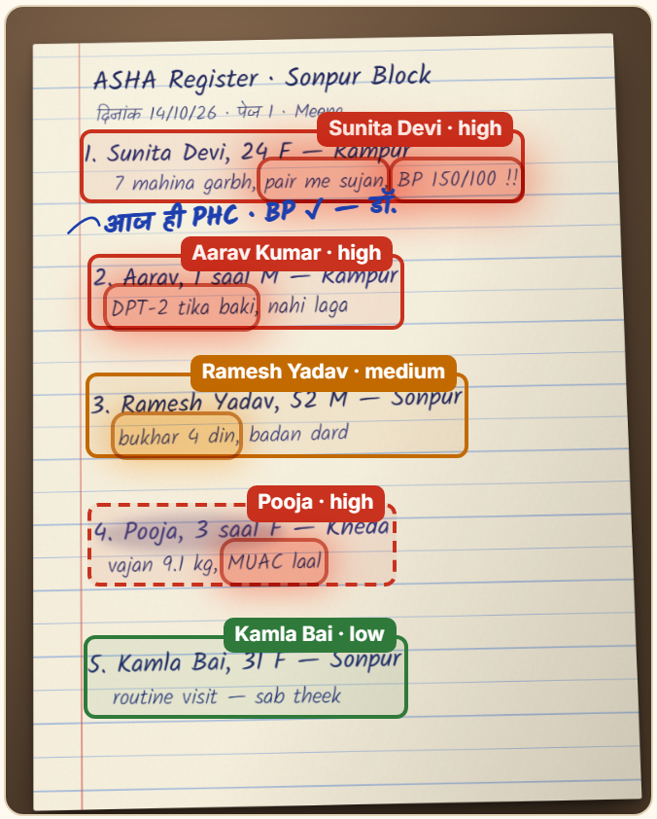
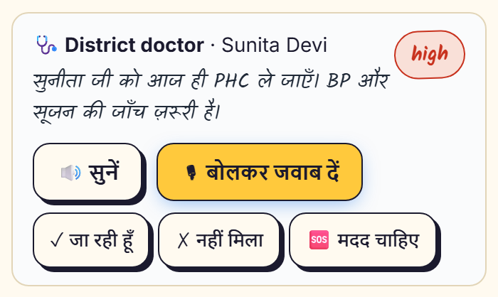
Step 4 · Back to the village
The paper talks back
She replies by voice
“हाँ, अभी जा रही हूँ”
The doctor sees: Sent → Heard → Replied. The loop is closed.
“सुनीता जी को आज ही PHC ले जाएँ।”
Arrives as a Hindi voice note, and the doctor’s reply is written in ink into the margin of her own page.
Notes:
Her phone speaks the instruction, and the doctor’s reply appears in ink on her own page. She answers by voice, and the doctor sees it.

Slide 10
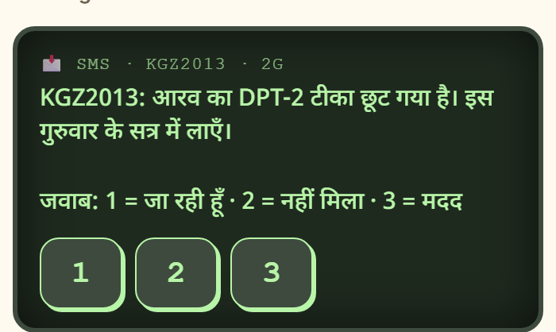
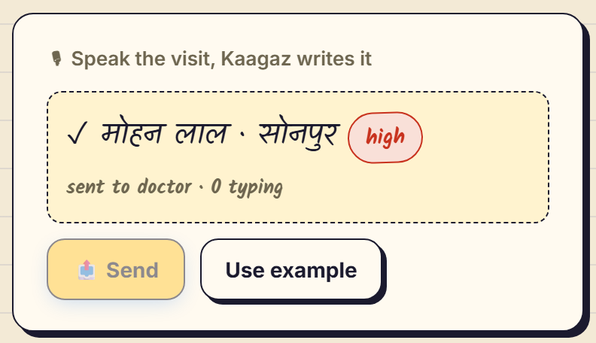
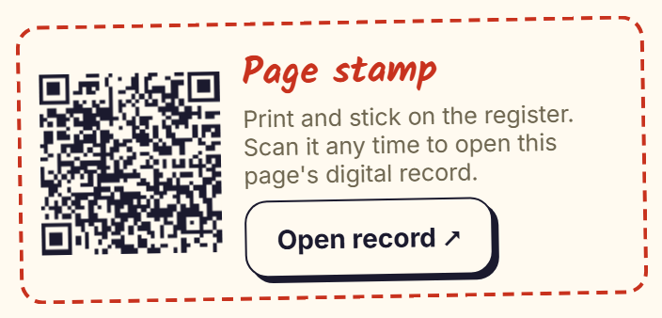
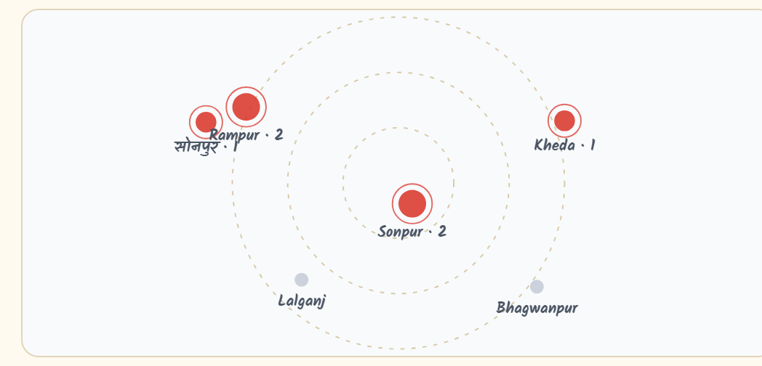
Built for real villages
Works where the network doesn’t
SMS-only phones
Speak, don’t write
QR page stamp
Outbreak alarm
Advice arrives as an SMS; reply with one key: 1, 2 or 3.
Say the visit in Hindi; it becomes a triaged record.
A sticker on the paper opens its digital record.
3 fever cases in one village raise an alarm early.
Notes:
No data? It works by SMS. Can’t write? She speaks. Offline? Pages queue on the phone and sync later. The app installs on the phone and opens with zero signal.

Slide 11
Standards and safety
Feeds the national system, not another silo
AI suggests, the doctor decides
HL7 FHIR R4, shaped to ABDM
Triage stays preliminary until a doctor confirms it.
One document per patient, built on NRCeS profiles:
Patient
Encounter
Advice, never a prescription
A remote doctor who hasn’t examined the patient gives advice or referral only.
Observation (LOINC)
RiskAssessment
Provenance
DocumentReference
Every value traces to paper
Provenance: ASHA wrote it, AI read it, doctor verified it.
Communication
Validated against the official HL7 FHIR R4 schema. Not yet certified in the ABDM sandbox.
Privacy on the projector
One tap hides every patient name.
Notes:
Every page exports as standard FHIR R4 records shaped to India’s ABDM profiles, validated against the official HL7 schema. The doctor’s message is advice or referral, never a prescription, and every value traces back to the original paper.

Slide 12
The one number
Paper → doctor → voice → reply
0:21
~3 weeks
today · one way
with Kaagaz · both ways · measured in our live demo
From weeks to seconds, and for the first time, the village hears back.
Notes:
Three weeks, one way. Twenty-one seconds, both ways: that is the full loop from paper to doctor to voice to reply, timed live in our demo.

Slide 13
What’s next
From one PHC to any paper register
Pilot
Integrate
Extend
[1 PHC · __ ASHAs · __ months]
ABDM sandbox certification
Any paper register
Measure: read accuracy on real pages, time to doctor, replies closed.
Push FHIR records into state HMIS / ABHA-linked records.
Anganwadi, school attendance, ration shops: same bridge, new form.
No new hardware, no new habits. Runs on the phones ASHAs already carry. Cost per page: [₹__ on Gemini Flash].
Notes:
Next: a pilot at one PHC, then ABDM sandbox certification, then any paper register: anganwadi, school, ration. Fill in the pilot size and the per-page cost before presenting.

Slide 14
Kaagaz · कागज़
Same paper. Same worker.
Now the paper talks back
Gemini 2.5 Flash Vision
HL7 FHIR R4 · ABDM
Web Speech · Hindi
Offline PWA
Open source
github.com/ash41106/Devlympics · [Team name]
Notes:
Same paper. Same worker. Now the paper talks back. Then switch to the live demo on the Live Bridge.

