Slide 1


Football Hackathon
Data-Driven Players Performance Assessment
Team Members
Team Name
Heritage is Real
Alyal Samal
Ashis Kumar Parida

Slide 2
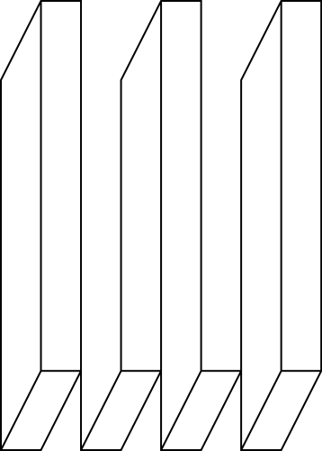
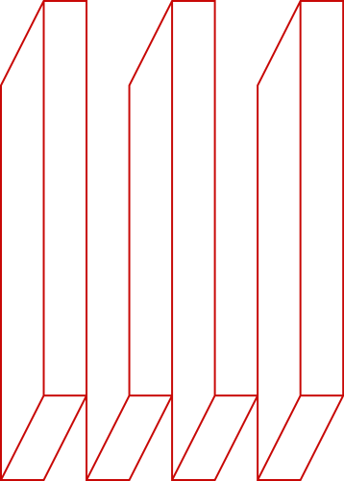
Brief description of the problem at hand:
Given access to one of the largest proprietary scouting datasets in the world - physical, contextual, kinematical, technical, and tactical oriented data related to the players, the team as a whole, and their opponents, we had to leverage this data as a strategic asset, to create an algorithm, that will be able to decompose the performance of the players into its main objective elements.

Slide 3

Data Wrangling:
1. There are more than 50 columns which have more than 80% Null Values and some of
them even had 100% Null Values.
2. There are columns which seem to have continuous values, but in reality, they have
multimodal distribution. (Especially Raw vars).
3. There are plenty of columns with skewed Distribution. (Especially Derived and Ratio Vars).

Slide 4

Approach:
1. For Columns with 100% Null Values, we decide to drop them. And for the rest of the
Columns, we adopted the mean Imputation Technique.
2. We decided to apply Label Encoding to specific Raw Vars which had Multimodal Distribution.
3. We applied Quantile Transformation to specific ‘Derived’ and ‘Ratio’ Columns with skewed distribution.
4. Then we modelled the data using mainly 3 kinds of Regressors, i.e, XGBoost, CatBoost and LGBMRegressor. We also tried Blending Various Model Outputs. But We finalised a stacked model of CatBoost and LGBMRegressor.
5. A more Significant Model was CatBoost, where we specifically provided input for the specific columns to be considered categorical columns.

Slide 5







Solution Pipeline:
BOX
Plots
KDE
Plots
Analysis
Selecting Categorical Features to be passes in as Cat Features
Dropped Columns with 100% NaN values
Label Encoding the inherently 'Object' Type Columns
Simple mean value imputation
for rest of columns
having NaN values
CatBoost
80-20 Split
with
stratification
of Target
Dropping Row Id and Rating Num before combining train and test data to do preprocessing at one go
Converted columns with multimodal distribution
to object type
and Label Encoding them
LGBM
DATA
Stacked
Model
Applying Quantile Transformer on certain 'Derived' and 'Ratio' Columns
MODELLING
FINAL OUTPUT
*The main challenge was to deal with so many variables (~800) under given constraints.

Slide 6
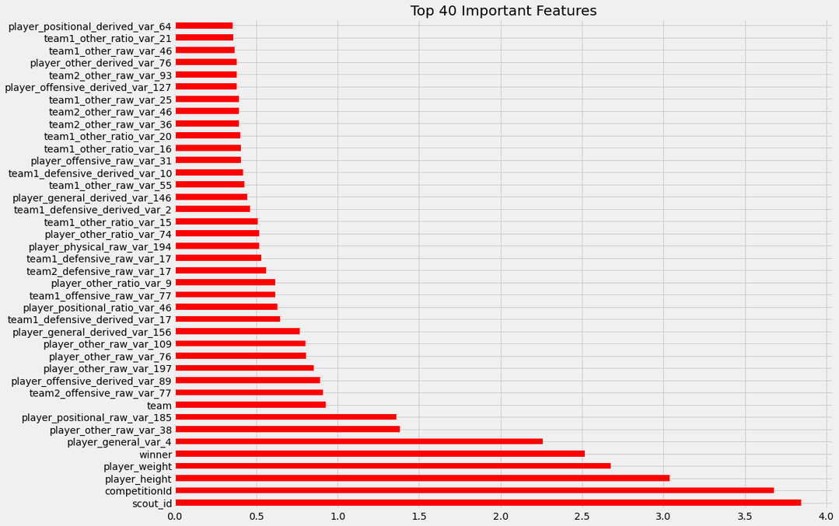
Top 40 Features :

Slide 7
Comparing Results of Various Models
XGBoost Model Results
CatBoost Model Results
Validation R2 Score : 0.30095
Validation R2 Score : 0.36722
LGBM Model Results
Stacking Results
( Best Results )
Validation R2 Score : 0.32278
Validation R2 Score : 0.37708

Slide 8
Future Areas of Improvement:
- Fine Tuning the Models
- More Meaningful Feature Selection
- More Meaningful Feature Engineering
- Clustering the Data and assigning them a label

Slide 9
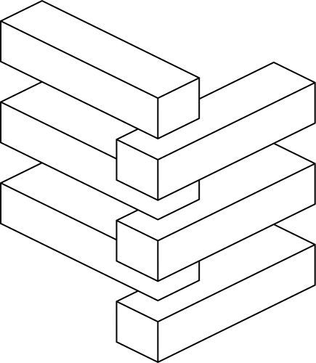

Technology/Tool Stack Used:
- Pandas, Numpy, Matplot-Lib
- tqdm
- sklearn
- XGBoost, CatBoost, LGBM
*All of the code has been written in Python

Slide 10

THANK YOU

