Slide 1
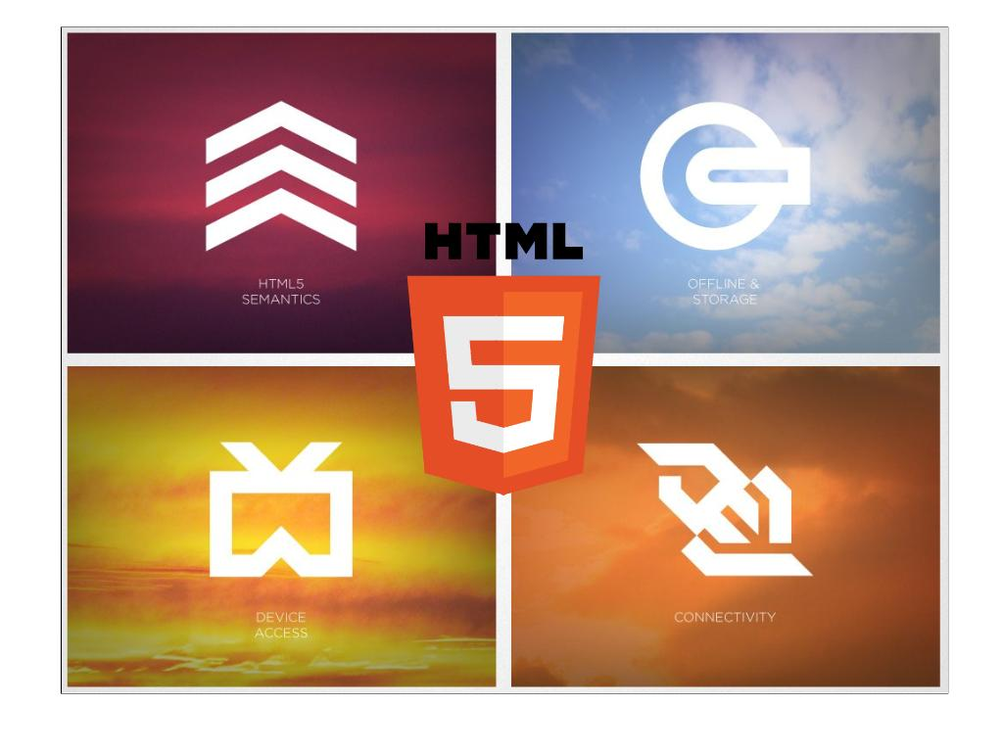
Game Development Workshop
Vortex
Vortex via Delta, Nit-Trichy
Intro to world of Web Gaming Platforms
1

Slide 2






Content
Javascript and HTML5
About Canvas
Game Programming
Assets & Tools
Demo
Resources & References

Slide 3

A Web Game
- Let’s Get Start
3

Slide 4
An Overview of HTML5
Web Socket
Drag & Drop
Web Storage
History
HTML5
Web Worker
Offline App
Web Database / Indexed DB
Geolocation
Canvas
Video / Audio

Slide 5

Why Javascript?
Easy to develop
Fast deployment
Easy to debug
Open source
Free tools
Wide support:
Web browers
Mobile devices
Social networking application

Slide 6
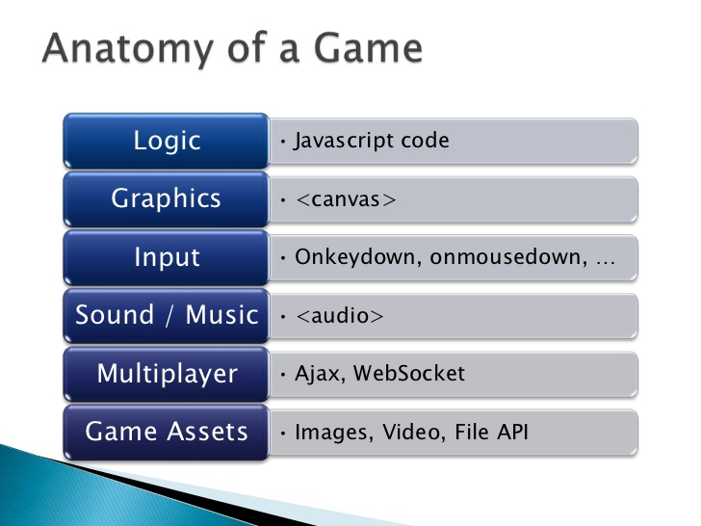

Slide 7

Canvas ???
- Lets get into this beautiful term
7

Slide 8
An overview of Canvas
2D drawing platform within the browser
Uses nothing more than JavaScript and HTML – no plugins
Extensible through a JavaScript API
Created by Apple for dashboard widgets
Now openly developed as a W3C spec

Slide 9
What is it for?
Data visualisation
Animated graphics
Web applications
Games

Slide 10
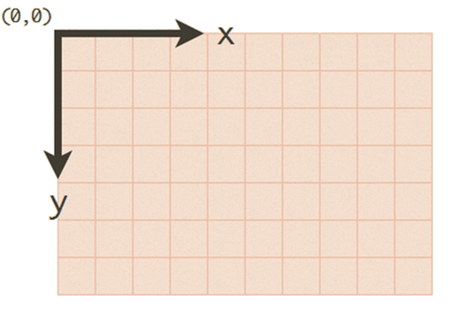
How to use?
<canvas height='600' width='800'></canvas>
Uses the standard screen-based coordinate system

Slide 11
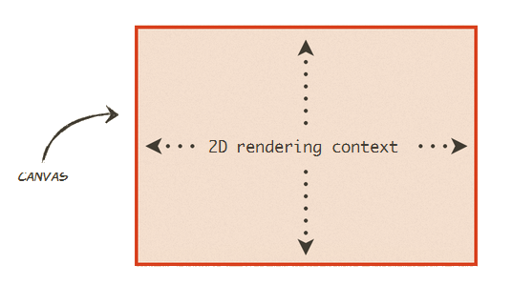
How to use?
Everything is drawn onto the 2D rendering context (ctx)

Slide 12
Using context
var canvas = document.getElementById("canvas");
var ctx = canvas.getContext("2d");
ctx.fillStyle = 'rgb(255, 0, 0)';
ctx.strokeStyle = 'rgba(0, 255, 0, 0.5)';
Method | Action
ﬁllRect(x, y, w, h) | Draws a rectangle using the current ﬁll style
strokeRect(x, y, w, h) | Draws the outline of a rectangle using the current stroke style
clearRect(x, y, w, h) | Clears all pixels within the given rectangle

Slide 13
Using context
Text
Shadows & blurring
Lines, shapes, image
Gradients
Saving state of drawing context
Transformations
Composites
Pixel Manipulation
http://www.html5canvastutorials.com/

Slide 14
The future of canvas
OOP programming allows much to be achieved through canvas
It’ s ﬂexible and powerful
Animation engines
Pseudo 3D graphics
Reading pixel values opens a lot of doors
Integration with other HTML5 elements is a killer feature

Slide 15

Canvas vs. Flash
HTML5 Canvas
More open than Flash
Smaller result.
Javascript is built into browsers
Works on most of platforms
No need to compile.
Adobe Flash
Great authoring tool, easy to go from idea to working product
Better sound support - many JavaScript libraries use SoundManager2, which falls back on Flash and tends to lag
Do not work good in all platforms, for example Linux.

Slide 16
Game Programming
- Get to the Core of the Problem
16

Slide 17
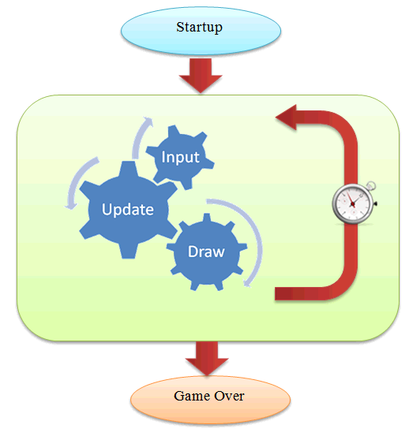
Typical Game Loop
var FPS = 60;
setInterval(gameTick,1000/FPS)
function gameTick()
{
processInput();
updateGame();
draw();
}
don’t always need a game loop

Slide 18
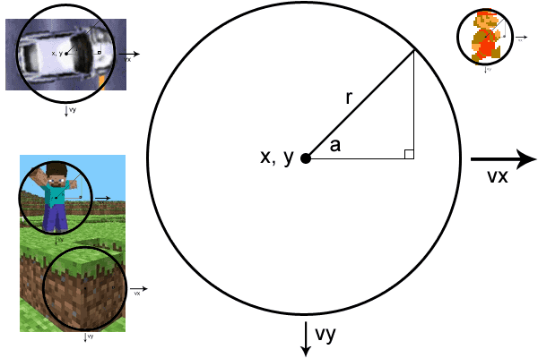
Physics
Euclid
Rotation (known angle)
Rotation (unknown angle)
Rotation (triangle overlay)
Rotation + particles
Newton
Position
Velocity
Acceleration
Collisions

Slide 19
Optimization Techniques
Optimizing game loop, skipping draw.
Use requestAnimationFrame instead of setInterval / setTimeout.
Frame buffering, multiple canvases.
Avoid unnecessary canvas state change.
Dirty rectangle: redraw only those areas that have changed.
Use DOM Elements whenever possible.

Slide 20
Assets & Tools
– Make everything simple
20

Slide 21
*There are inbuilt Libraries
*Which makes Game
*Development in Javascript
*much more easier.

Slide 22
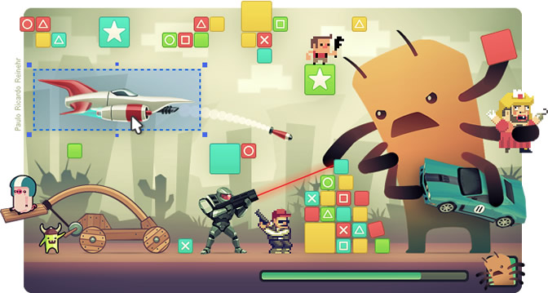
Html5 Game Engines
1. HTML5 Game Engine
High Performance
Fully Documented
2d Physics
Intuitive Interface
Offline Support
http://www.scirra.com/html5-game-engine

Slide 23
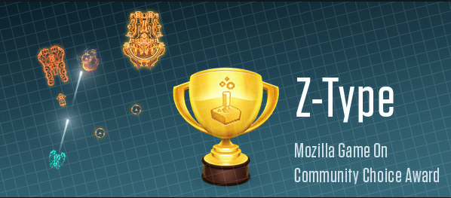
Html5 Game Engines
2. Impact Js
Play Everywhere
Flexible Level Editor for Anything 2D
Publish game into the AppStore with almost native performance
Powerful Debug Tools
http://impactjs.com/

Slide 24
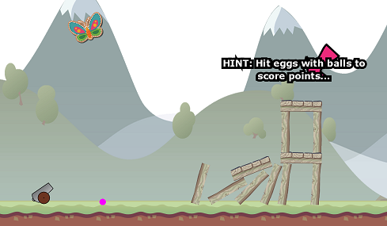
Html5 Game Engines
3. Isogenic Engine
Advanced Realtime Networking
Facebook Integration
High Performance Canvas
Physics system built-in utilising Box2d
http://www.isogenicengine.com/

Slide 25
Demo
- Now we will write a small Game from Scratch
25

Slide 26
I name this Game as “Vortex Kills”
--Doesn't Matter--
All the usual gameplay, avoid collision from evils and keep moving your hero.
No need to download any plugins to play.
Online version and source code are available on
http://www.vortex.nitt.edu/Vkills

Slide 27
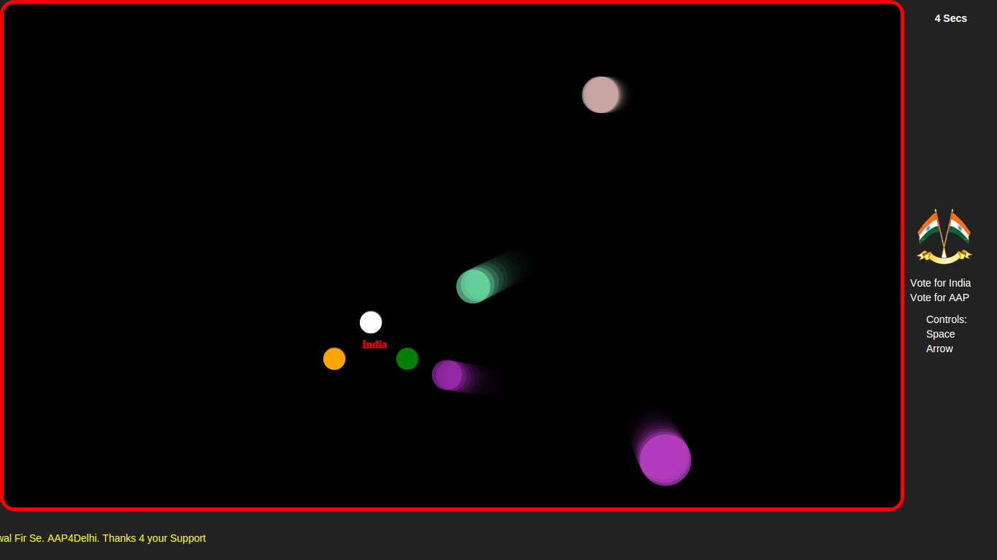

Slide 28
Step 1: Drawing a Canvas
<canvas id="canvas"></canvas>

Slide 29
That is not Enough, browser must know parents of canvas element to draw it. Lets write standard html format.
<!DOCTYPE html> //
<head>
<style>
</style>
</head>
<body>
<canvas id=”canvas”></canvas>
</body>
</html>

Slide 30
Add style to our canvas, to make it look like a game field
<style>
*{ padding:0px;
margin:0px;
}
body{
background-color:”white”;
}
canvas{
background-color:black;
position:absolute;
border:5px red solid;
border-radius:10px;
}
</style>

Slide 31
Lets Start a small Game.
<script>
//defining our all global variables..
//rendering canvas element on our window screen.
var canvas=document.getElementById('canvas'),
context=canvas.getContext('2d');
canvas.style.left=0.1*window.innerWidth;
canvas.style.top=0.1*window.innerHeight;
canvas.width=0.9*window.innerWidth;
canvas.height=0.9*window.innerHeight;
</script>

Slide 32
Game Script continued....
Var x=300,
y=300,
veloX=0,
veloY=0,
speed=5,
friction=0.98,
keys=[],
W=0.9*window.innerWidth,
H=0.9*window.innerHeight,
evils=[],
time=0,
score=0;

Slide 33
Creating Objects- Evils
function evils(){
this.xPos=Math.floor(Math.random()*W/5);
this.yPos=Math.floor(Math.random()*H/5);
this.xVelo=Math.floor(Math.random()*8-3);
this.yVelo=Math.floor(Math.random()*8-3);
this.r=Math.random()*255>>0;
this.g=Math.random()*255>>0;
this.b=Math.random()*255>>0;
this.radiusEvil = Math.random()*20+20;
}

Slide 34
Lets create 5 evils for Our Game
for(var i = 0; i < 5; i++)
{
evils.push(new evil());
}

Slide 35
Create Object-Hero [Our Hero moves with Keys...]
document.addEventListener("keydown", function (e) {
keys[e.keyCode || e.which] = true;
});
document.addEventListener("keyup", function (e) {
keys[e.keyCode || e.which] = false;
});

Slide 36
Game loop
function update() {
if (keys[38]) {
if (velY > -speed) {
velY--;
}
}
if (keys[40]) {
if (velY < speed) {
velY++;
}
}

Slide 37
Game loop continued.....
if (keys[39]) {
if (velX < speed) {
velX++;
}
}
if (keys[37]) {
if (velX > -speed) {
velX--;
}
}

Slide 38
Game loop continued...
velY *= friction;
y += velY;
velX *= friction;
x += velX;
if (x >= (canvas.width-5)) {
x = 5;
} else if (x <= 5) {
x = (canvas.width-5);
}
if (y >= (canvas.height-5)) {
y = 5;
} else if (y <= 5) {
y = (canvas.height-5);
}

Slide 39
Game loop continued.... Drawing canvas & Hero
ctx.fillStyle="rgba(0,0,0,0.3)";
ctx.fillRect(0, 0, canvas.width, canvas.height);
ctx.beginPath();
ctx.arc(x, y, 15, 0, Math.PI * 2);
ctx.fillStyle="white";
ctx.fill();

Slide 40
Game loop continued... Drawing Evils
for(var t = 0; t < evils.length; t++)
{ var p = evils[t];
ctx.beginPath();
ctx.fillStyle="rgba("+p.r+","+p.g+","+p.b+",0.6)";
ctx.arc(p.xt, p.yt, p.radiust, Math.PI*2, false);
ctx.fill();
p.xt+= 2*p.vx;
p.yt += p.vy;
if(p.xt < -50) p.xt = W+50;
if(p.yt < -50) p.yt = H+50;
if(p.xt > W+50) p.xt = -50;
if(p.yt > H+50) p.yt = -50;

Slide 41
Game loop continued.... Check collision of Hero with Evils.
//check collision of evils with hero...
if(Math.abs(p.xt-x)<p.radiust+15 && Math.abs(p.yt- y)<p.radiust+15 {
alert('game over');
clearInterval(gameloop);
}
} //end of Function ...
var gameloop=setInterval(update,10);

Slide 42
Resources & References
- For further research
42

Slide 43
Resources
Learning HTML5
List of HTML5 Presentation Resources – Earlier post with many links for this session
HTML5: Edition for Web Authors – Focused subset of the specification for web devs
HTML5 on the Internet Explorer Learning Site – Videos, tutorials, articles
HTML5 Demos from Giorgio Sardo – HTML5, CSS, JS, etc.
HTML5 Doctor – HTML5 articles, Element Index, and resources
Implementing HTML5
CanIUse.com – Details support by browser for HTML5, CSS3, and other technologies
Modernizr – HTML5 & CSS3 feature detection made easy
HTML5 Cross Browser Polyfills – Helpful for implementing features while supporting a range of browsers

Slide 44
Docs & References
HTML5 Specification
http://developers.whatwg.org/
Dive into HTML5
http://diveintohtml5.info/
Physics for Lazy Game Developers
http://labs.skookum.com/demos/barcampclt_physics/
Developing Your First HTML5 Game
http://www.script-tutorials.com/html5-game-development-lesson-1
HTML5 Canvas Tutorial
http://www.html5canvastutorials.com/
HTML5 Game Development Resources
http://blogs.msdn.com/b/cbowen/archive/2011/12/15/html5-game-development-resources-from-the-game-camps.aspx

Slide 45
Thank you!
Vortex- NIT-TRICHY
45

