Slide 1
MANAGE A GYM
Yuguang Yao, Xingyu Sha, Zheyu Wang
Modeling environment: Edraw max

Slide 2
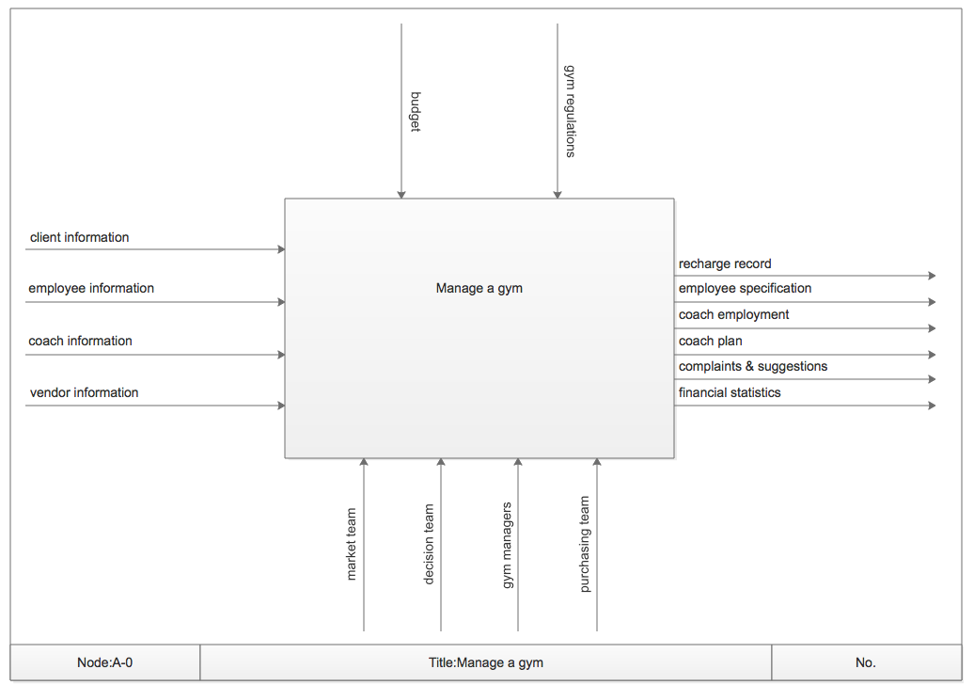
A-0

Slide 3
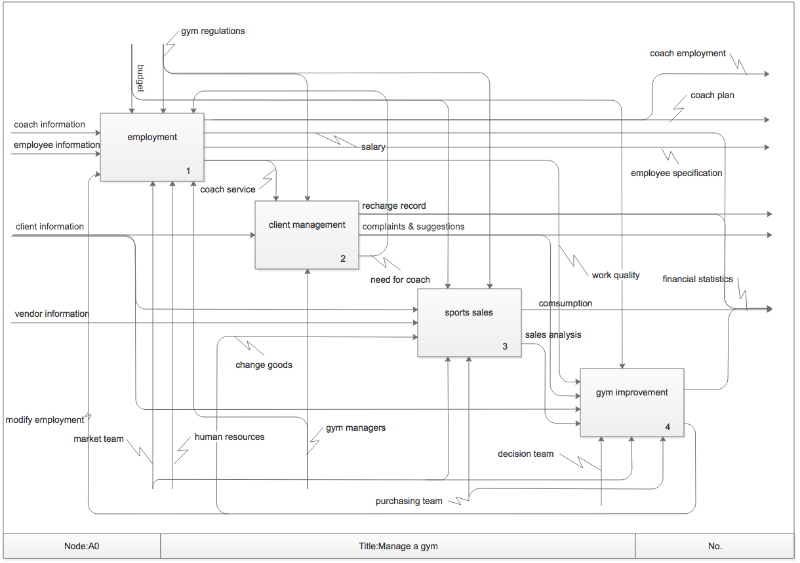
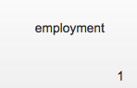



A0

Slide 4
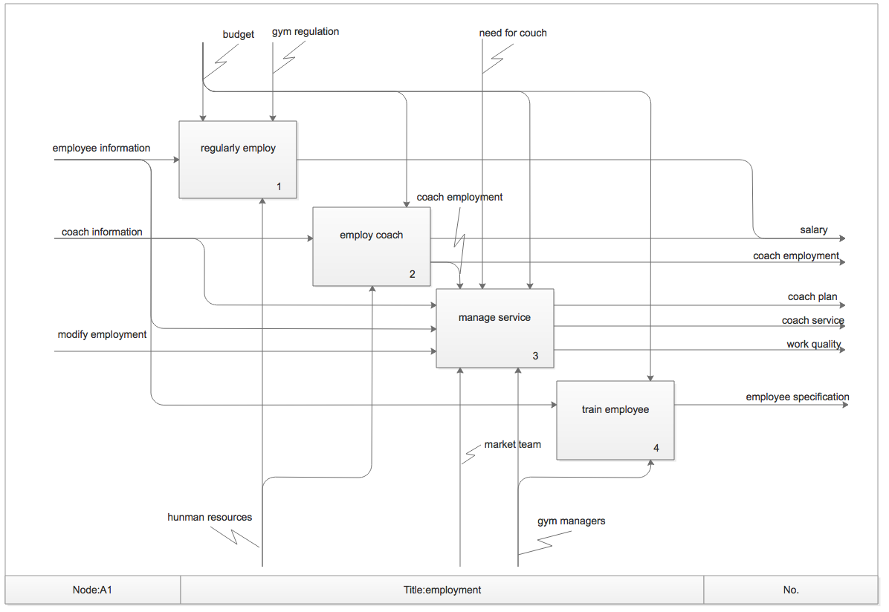
A1

Slide 5
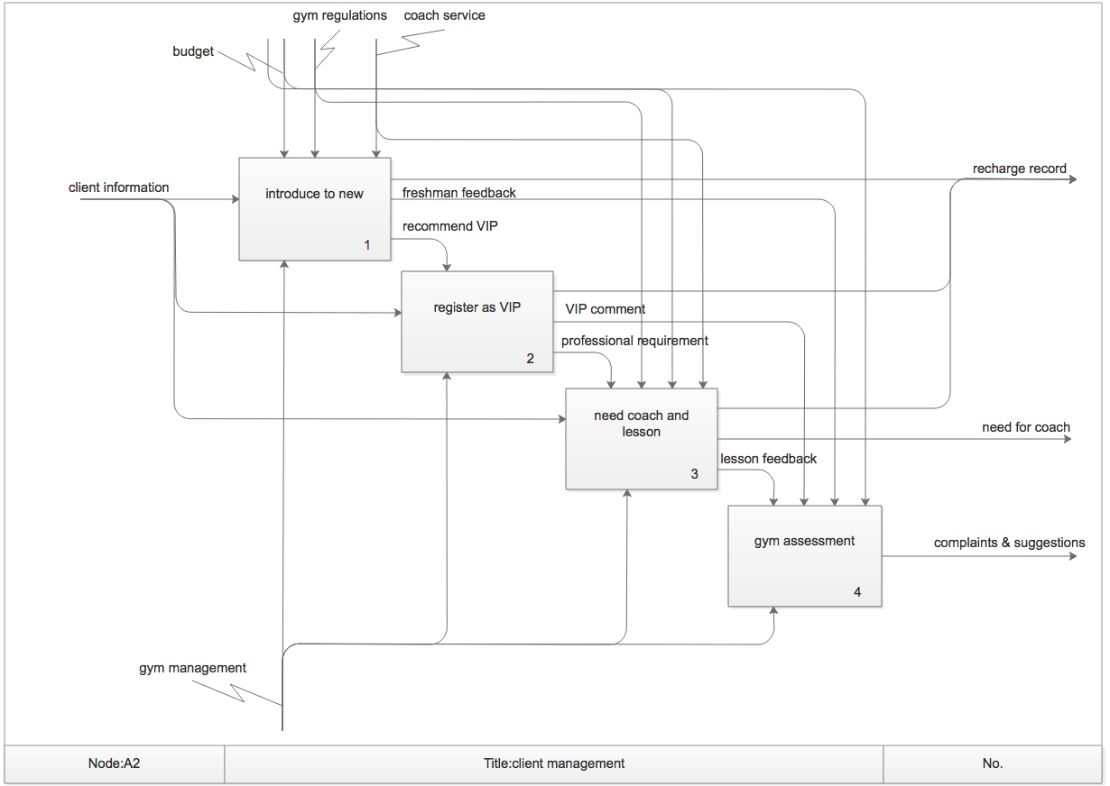
A2

Slide 6
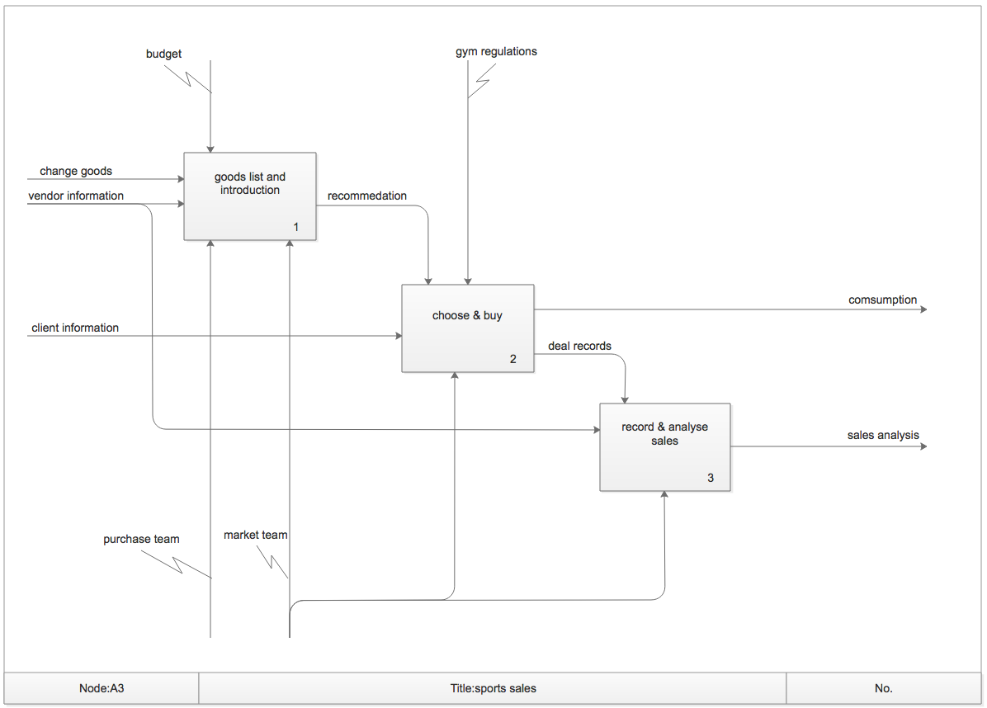
a3

Slide 7
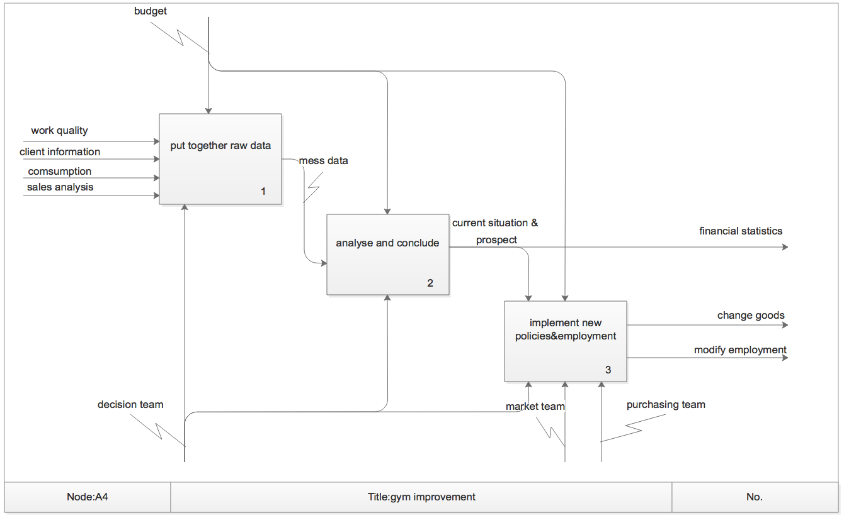
A4

