Slide 1
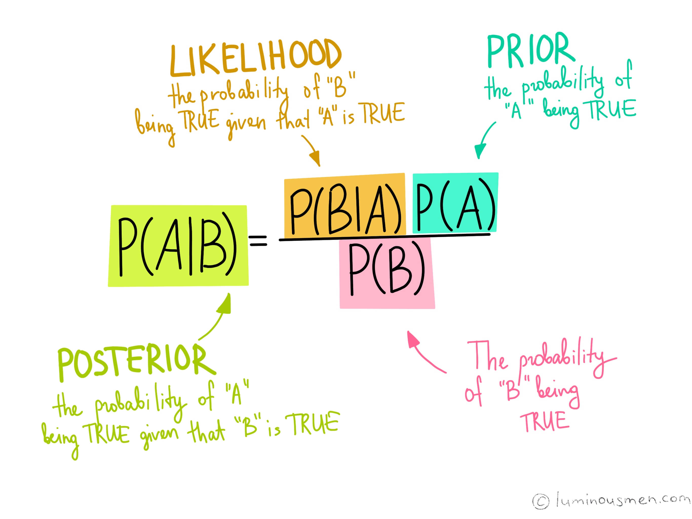

Slide 2
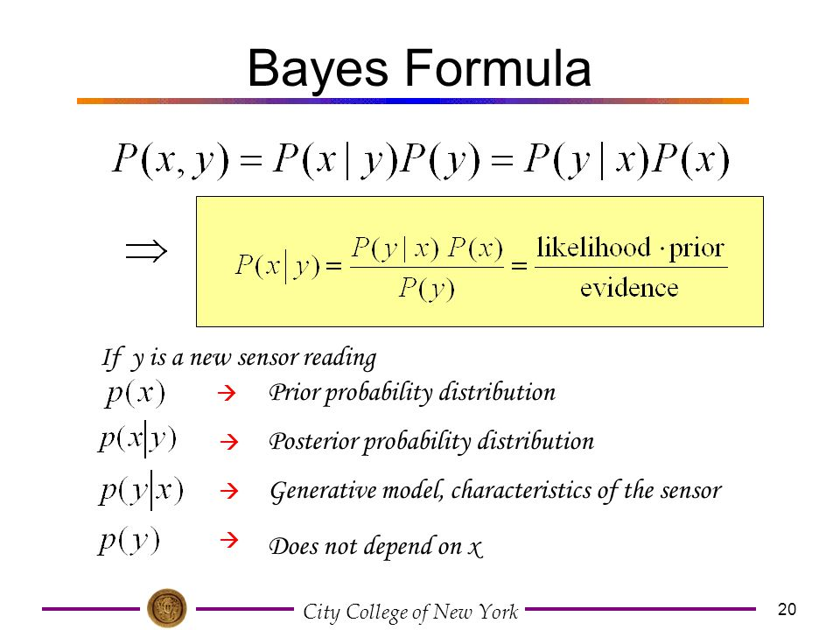

Slide 3
BADMINTON PLAY DATA
DAY | OUTLOOK | TEMP | HUMIDITY | WIND | PLAY
1 | SUNNY | HOT | HIGH | WEAK | NO
2 | SUNNY | HOT | HIGH | STRONG | NO
3 | OVERCAST | HOT | HIGH | WEAK | YES
4 | RAIN | MILD | HIGH | WEAK | YES
5 | RAIN | COOL | NORMAL | WEAK | YES
6 | RAIN | COOL | NORMAL | STRONG | NO
7 | OVERCAST | COOL | NORMAL | STRONG | YES
8 | SUNNY | MILD | HIGH | WEAK | NO
9 | SUNNY | COOL | NORMAL | WEAK | YES
10 | RAIN | MILD | NORMAL | WEAK | YES
11 | SUNNY | MILD | NORMAL | STRONG | YES
12 | OVERCAST | MILD | HIGH | STRONG | YES
13 | OVERCAST | HOT | NORMAL | WEAK | YES
14 | RAIN | MILD | HIGH | STRONG | NO

Slide 4
THE MODEL TRAINING PHASE
DAY | OUTLOOK | TEMP | HUMIDITY | WIND | PLAY
1 | SUNNY | HOT | HIGH | WEAK | NO
2 | SUNNY | HOT | HIGH | STRONG | NO
3 | OVERCAST | HOT | HIGH | WEAK | YES
4 | RAIN | MILD | HIGH | WEAK | YES
5 | RAIN | COOL | NORMAL | WEAK | YES
6 | RAIN | COOL | NORMAL | STRONG | NO
7 | OVERCAST | COOL | NORMAL | STRONG | YES
8 | SUNNY | MILD | HIGH | WEAK | NO
9 | SUNNY | COOL | NORMAL | WEAK | YES
10 | RAIN | MILD | NORMAL | WEAK | YES
11 | SUNNY | MILD | NORMAL | STRONG | YES
12 | OVERCAST | MILD | HIGH | STRONG | YES
13 | OVERCAST | HOT | NORMAL | WEAK | YES
14 | RAIN | MILD | HIGH | STRONG | NO
P(PLAY=NO)=5/14
P(PLAY=YES)=9/14

Slide 5
Learning Phase
OUTLOOK | PLAY = YES | PLAY = NO
SUNNY | 2/9 | 3/5
OVERCAST | 4/9 | 0/5
RAIN | 3/9 | 2/5
TEMP | YES | NO
HOT | 2/9 | 2/5
MILD | 4/9 | 2/5
COOL | 3/9 | 1/5
HUMIDITY | YES | NO
HIGH | 3/9 | 4/5
NORMAL | 6/9 | 1/5

Slide 6
WIND | YES | NO
STRONG | 3/9 | 3/5
WEAK | 6/9 | 2/5
TEST PHASE
TEST PHASE
----GIVEN A NEW INSTANCE PREDICT ITS LABEL
X’=(OUTLOOK=SUNNY, TEMP=COOL, HUMIDITY= HIGH, WIND= STRONG
LOOK UP TABLES ACHIEVED IN THE LEARNING PHASE

Slide 7
YES PLAY
P(OUTLOOK=SUNNY|PLAY=YES)=2/9 | P(OUTLOOK=SUNNY|PLAY=NO)=3/5
P(TEMP=COOL|PLAY=YES)=3/9 | P(TEMP=COOL|PLAY=NO)=1/5
P(HUMIDITY=HIGH|PLAY=YES)=3/9 | P(HUMIDITY=HIGH|PLAY=NO)=4/5
P(WIND=STRONG|PLAY=YES)=3/9 | P(WIND=STRONG|PLAY=NO)=3/5
P(PLAY=YES)=9/14 | P(PLAY=NO)=5/14
TEST PHASE
GIVEN INSTANCE PREDICT THE CONDITION
DECISION MAKING WITH THE MAP RULE

Slide 8
P(YES|X’)=[P(SUNNY|YES)P(COOL|YES)P(HIGH|YES)P(STRONG|YES)] P(PLAY=YES)
P(YES|X’)= (2/9)*(3/9)*(3/9)*(3/9)*(9/14)
P(YES|X’) =0.0053
P(NO|X’)=[P(SUNNY|NO)P(COOL|NO)P(HIGH|NO)P(STRONG|NO)] P(PLAY=NO)
P(NO|X’)= (3/5)*(1/5)*(4/5)*(3/5)*(5/14)
P(NO|X’) =0.0206
P(|X’)=[P(SUNNY)P(COOL)P(HIGH)P(STRONG)])=(5/14*4/14*7/14*6/14)=0.021865
P(yes)=0.0053/0.021865= 0.2424=24%
N(no)=0.0206/0.021865=0.9421=94%
We say our final outcome is NO

