Slide 1
Final Project Presentation
Aishwarya Bose
NJIT ID- 31381556
ab822

Slide 2
Problem Statements
Prediction of Presidential Election outcome based on Election poll.
Finding the accuracy of the prediction models created.
Performing 5-fold cross validation on the models.

Slide 3
Challenge
A good sampling strategy needs to consider many factors for presidential election. So polls prediction can be biased.
Possible factors affecting predictions are sampling time, state, sample size, the way the sampling is done, any other external effects.
Polls are conducted on basis of “likely voter” basis which is challenging part.

Slide 4
Pre-Processing
Attributes for consideration are sample size , polling weight, number of days from start date till today. Weighted average of this data is created using
tmp_weight = polling_weight
tmp_weight *= df.samplesize[count]
tmp_weight /= days_from_poll[count]
Margin of adjustment between raw poll data and adjusted data are taken into consideration.
States are considered to be a factor because of political preference.
Binomial data is created trump_win=0 and clinton_win=1.

Slide 5
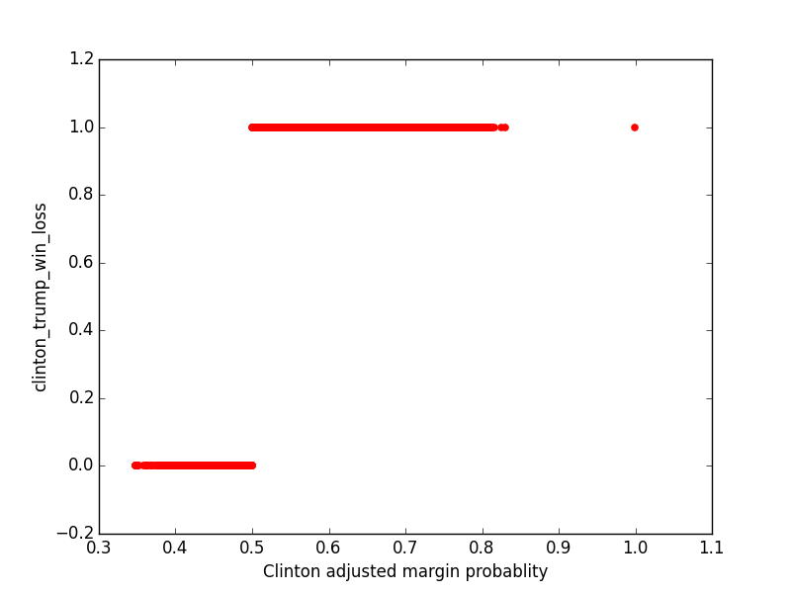
Modeling
The modeling will return 0 and 1 as response.
To predict the relationship between dependent binary variable and independent variables Logistic Regression is used.

Slide 6
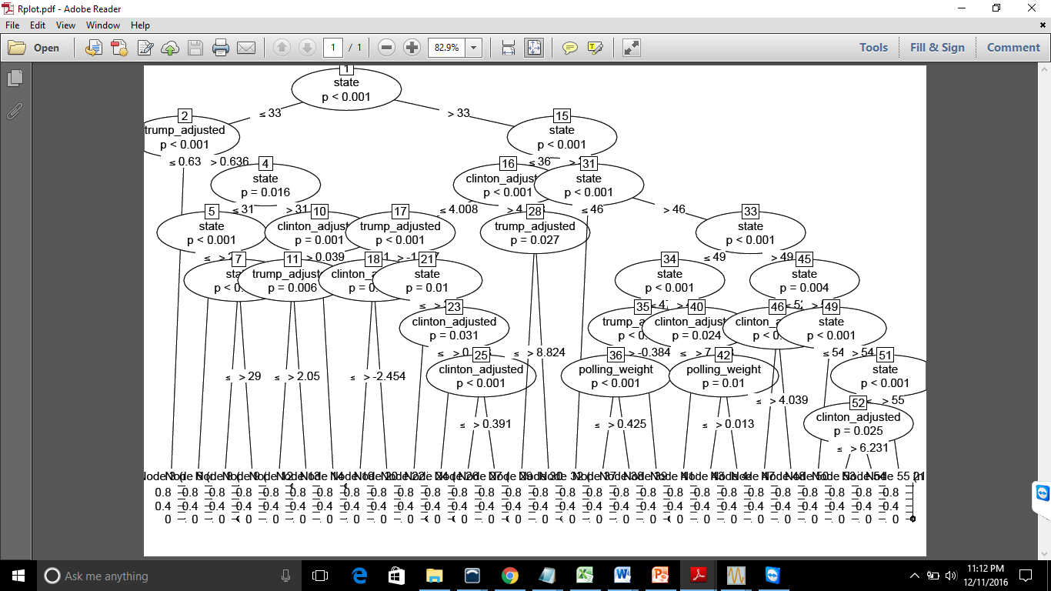
Modeling
Decision tree modeling is also used.

Slide 7
Conclusion
Accuracy Score for Logistic Regression is 0.634
Accuracy Score for Decision Tree is 0.9117
As per above score, Decision Tree outcome is better than Logistic Regression.
What else could be done to improve the solution
Other parameters like grade of the polls can be considered.

