Slide 1
DevOps Automation Solution
- Asha Keta

Slide 2
User stories
Developer
As a developer, I should be able to move my code from my local development environment into a production hosting environment with as little human intervention as possible.
Business stakeholder
As a business stakeholder, I should be confident that the work we are deploying is not going to have a negative impact on the service I depend on.
Site reliability engineer
As a SRE, I want to eliminate as much toil as possible from the deployment process. Please don't involve me at all in a routine deployment.

Slide 3
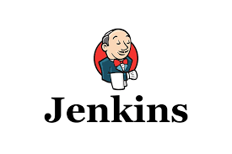

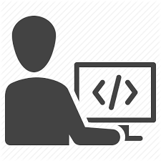


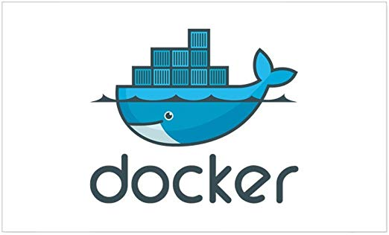




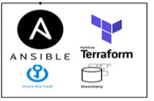
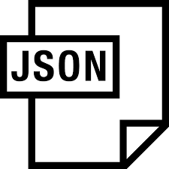

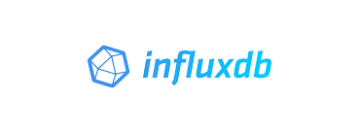


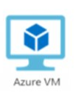

Automated Infrastructure Deployment
Developer develops/updates the IaC code and commits to Bitbucket
Continuous Integration
Jenkins Job checks out the code from GitHib
Code Quality and Security Scan
on the IaC code
1
2
3
Version Control
After Sonar scanner analysis the IaC code will be moved to Ansible docker container
4
Ansible JSON output is stored in InfluxDB for further reporting
Provision Landing Zone
Provision Azure Vm
6
Provision Azure MySql PaaS
Reporting – Transactional data fetch from InfluxDB
Join Azure AD and provide access
7
5
Notes:
Jenkins polls for the GitHub IaC code changes and pull the latest code to Jenkins and send to SonarQube analysis.(Continues Integration)
On successful quality gates checks, Jenkins will push the IaC code to Ansible container
Jenkins pipeline triggers automation scripts
IaC scripts automates the provisioning of the landing zone (VNet,Subnet,Firewall , NSG, Network Interface , Public IP )
IaC scripts automates the provisioning of Azure VM
IaC scripts automates the provisioning of Azure PAAS (i.e Azure Database for MySql servers)
IaC scripts automates the joining of newly provisioned Azure VM to Azure AD
IaC scripts automates the access of Azure AD User to newly provisioned Azure VM

Slide 4
Automated Application Deployment
Developer develops/updates the Application code and commits to Bitbucket
Continuous Integration
Jenkins Job checks out the code from GitHib
Code Quality and Security Scan
on the Application code
1
2
3
Version Control
After Sonar scanner analysis the Application code will be moved to Ansible docker container
4
Ansible JSON output is stored in InfluxDB for further reporting
5
Install PHP and Dependencies for Laravel
6
Install Composer
7
Reporting – Transactional data fetch from InfluxDB
Configure MySql and Webserver
Pull the latest code base to web server ,update .env file and run composer install
Notes:
Jenkins pipeline triggers automation scripts
IaC scripts automates the Install PHP and Dependencies for Laravel and Install Composer on Azure VM(Webserver)
IaC scripts automates the Configure MySql and Webserver
IaC scripts automates the pull the latest code base to web server which is placed in ansible container after the SonarQube analysis ,update .env file and run composer install
IaC scripts automates the verification process of web application is up and running
To deploy new changes (Continuous Delivery):
If the Client is ok with downtime, they we can follow below steps to deploy the application
Stop the application
Deploy the latest code in the existing application folder
Run Composer Install
DB migration can be done if required
Start the application
2. For Zero-Downtime Deployment
a. Create a new folder and pull the application code into that folder
b. Update .env file and run Composer install
c. Update the Symbolic link to point it to new folder
In the above approach there is very less/no manual intervention is needed.

Slide 5
Thank You

