Slide 1

HOW CAN A WELLNESS TECHNOLOGY COMPANY PLAY IT SMART?
bellabeat
MAY 2021
Asha Anil

Slide 2
Objective
Identify the factors which can lead to sales improvement

Slide 3
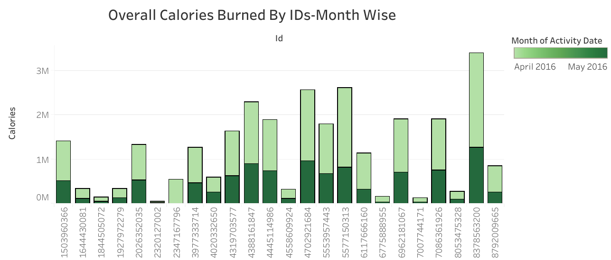
Overall Calories burned by the given data have decreased over the two month period
Data Overview
Data is showing for the two month period from April to May 2016
Search queries are limited to randomly chosen 30 IDs

Slide 4
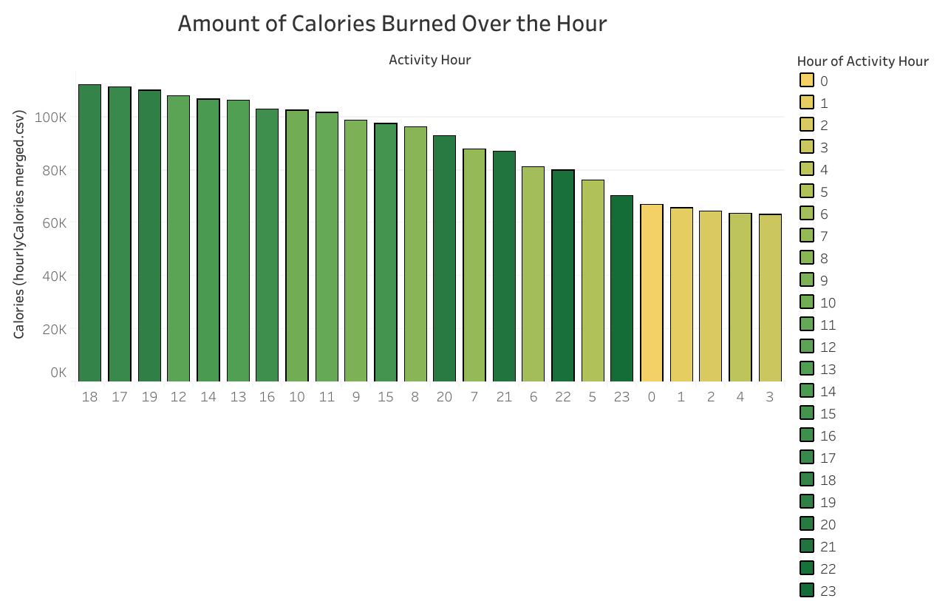
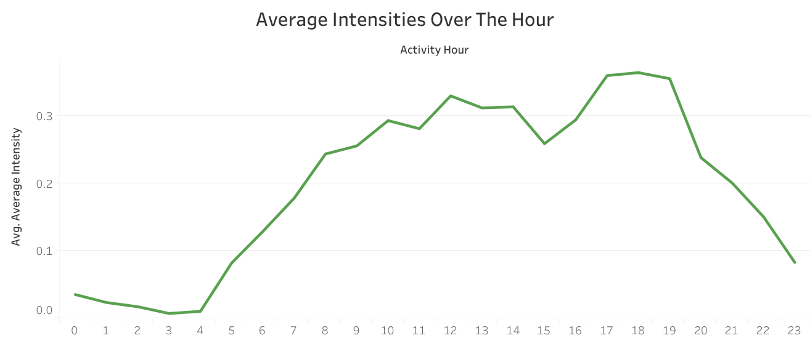
Calories Burned Peak Hours
Observations
Peak hour of calory burn is during afternoon (11am – 4pm) and evening (6pm-8pm)
Average Intensity observed during evening (5pm-8pm)

Slide 5
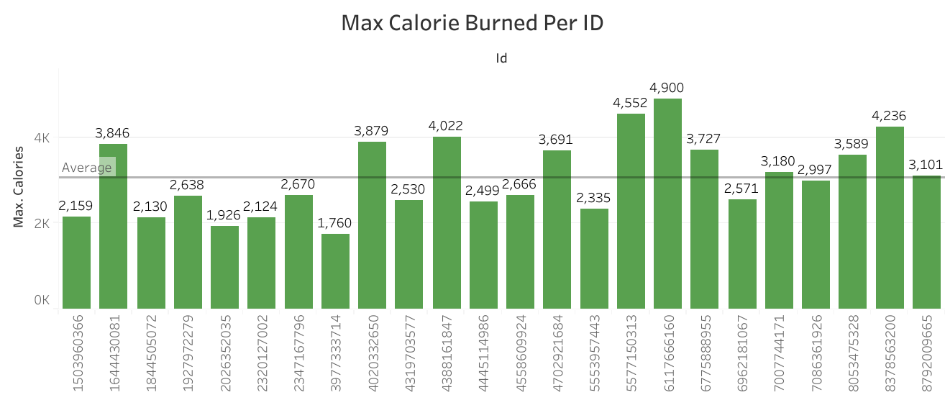
Maximum Calorie Burned Per ID
Observations
Average Calorie burned is over 3k
40% of the data burns over the overall average calorie

Slide 6
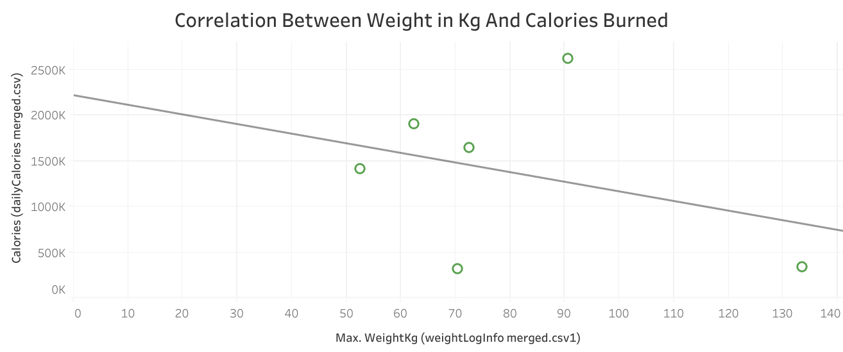
Correlation Between Calories Burned and Weight(kg)
Observations
Negative Correlation observed between calories burned and Weight in Kg

Slide 7
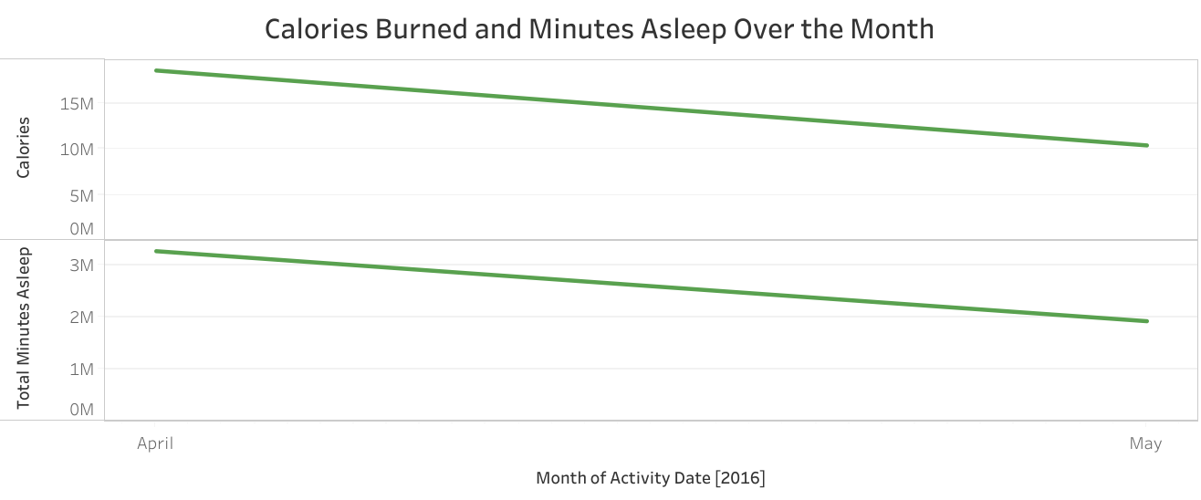
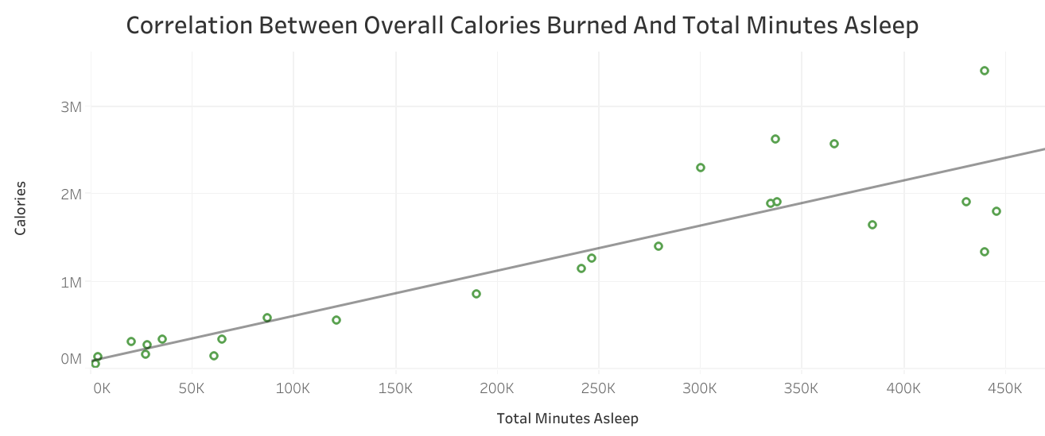
Correlation Between Calories Burned and Minutes Asleep
Observations
Both overall calories burned and minutes asleep have decreased over the two months
Positive Correlation observed between calories burned and minutes asleep

Slide 8
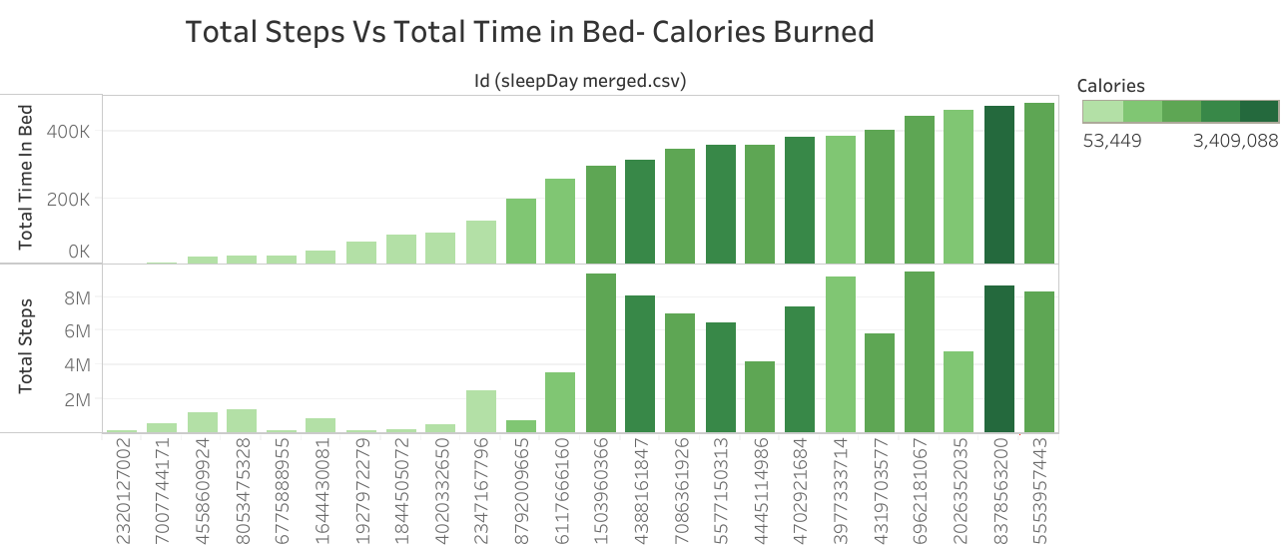
Total Steps Vs Total Time in Bed
(Calories Burned)
Key takeaways
People who worked out more have a good amount of sleep minutes and burned more calorie
Sleep and workout have a positive correlation
Active Hours- 6pm-8pm
People with more weight burns less calorie
*There is a steady decrease in the number of calories burned and sleep records since the beginning of May
* Need further analysis on why there is a decrease in the number of calories burned

