Slide 1
STATISTICS FOR DATA SCIENCE

Slide 2
DESCRIPTIVE STATISTICS

Slide 3
Central Tendency
Type of Variable | Best measure
Nominal | Mode
Ordinal | Median
Interval/Ratio (not skewed) | Mean
Interval/Ratio (skewed) | Median
A measure of central tendency is a single value that attempts to describe a set of data by identifying the central position within that set of data.
As such, measures of central tendency are sometimes called measures of central location. They are also classed as summary statistics.

Slide 4
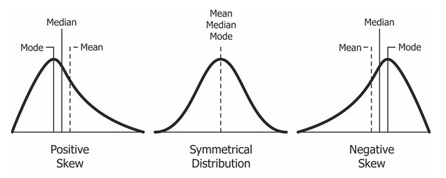
Skewness
Skewness is a measure of the asymmetry of the probability distribution of a real-valued random variable about its mean.
The skewness value can be positive or negative, or undefined.
In a perfect normal distribution, the tails on either side of the curve are exact mirror images of each other.

Slide 5
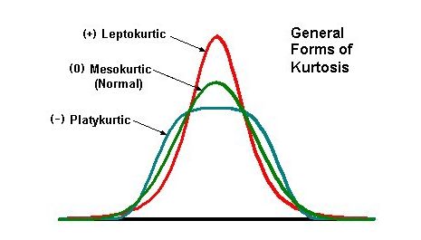
Kurtosis
Kurtosis is a measure of whether the data are heavy-tailed (profusion of outliers) or light-tailed (lack of outliers) relative to a normal distribution.
Skewness refers to the degree of symmetry
Kurtosis refers to the degree of presence of outliers in the distribution

Slide 6
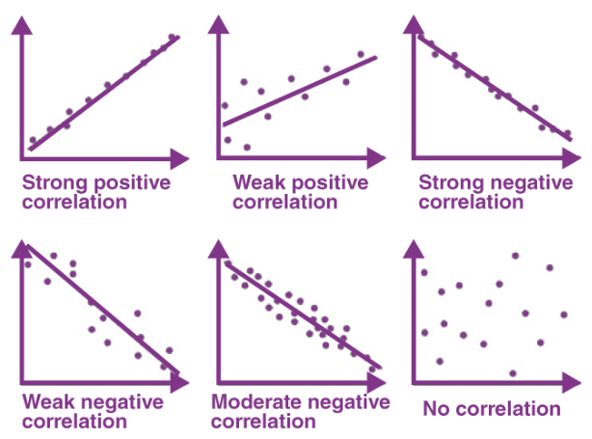
Correlation
Correlation is a statistic that measures the degree to which two variables move in relation to each other.
Correlation measures association, but doesn't show if x causes y or vice versa—or if the association is caused by a third factor.

Slide 7
p-value
A statistical measure used to determine the likelihood that an observed outcome is the result of chance
Probability may be small but p-value could be high
How to calculate:
The probability of random choice that would result in observation
The probability of observing something else that is equally rare
The probability of something rarer or extreme

Slide 8
p-value

