Slide 1
Natural Language Processing

Slide 2
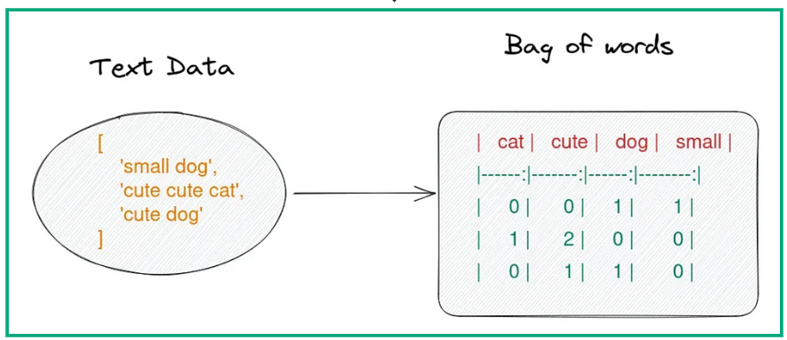
Bag of Words
Bag of words is NLP technique that represents in text based on their occurrence in the document. In other words, it captures the frequency of words.
BoW only represents the occurrence of words on the document and does not represent the context of the words
Steps:
Tokenization
Build Vocabulary of words
Count occurrence of words in each document

Slide 3
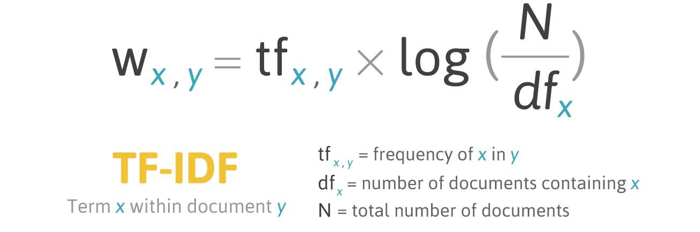
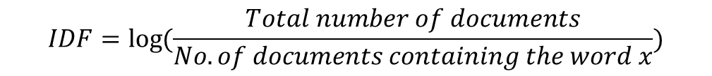

TF-IDF
Term Frequency – Inverse Document Frequency
TF-IDF is a text representation of how relevant is a word in a document in a collection of documents
Term frequency: raw count of instances a word appears in a document
Inverse Document frequency: how common or rare a word is in the entire document set
$$TF= \frac{Number of occurrences of word}{Total number of words in the document}$$
$$IDF=\log{(\frac{Total number of documents}{No. of documents containing the word x})}$$

Slide 4
TF-IDF
Advantages:
Term importance by considering both frequency and rarity of a word
Keyword extraction
Dimensionality reduction
Language independence
Disadvantages:
Sparse representation can cause increased overload for computation
Does not capture Semantic information as it treats words independently of their context

Slide 5
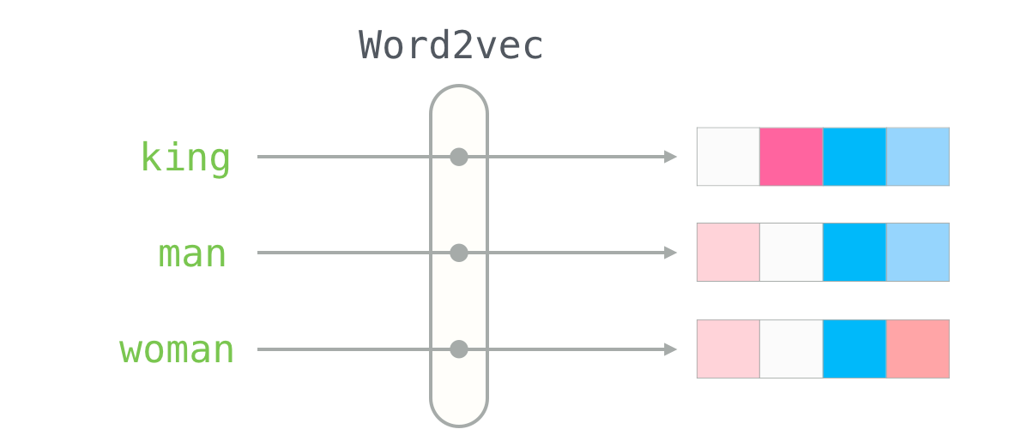
Word2Vec
Word2Vec are word representations that captures the semantic meaning of words by mapping them into dense vector spaces
In word embeddings, each word is represented as a high-dimensional vector, where similar words are located close to each other in the vector space.
These vectors are learned in an unsupervised manner from large text corpora using techniques such as Word2Vec, GloVe, or FastTex
Technically, Word2Vec is a two-layer neural network that processes text by taking in batches of raw textual data, processing them and producing a vector space of several hundred dimensions.
Each unique word in the data is assigned a corresponding vector in the space. The positioning of these vectors in the space is determined by the words’ semantic meanings and proximity to other words.

Slide 6
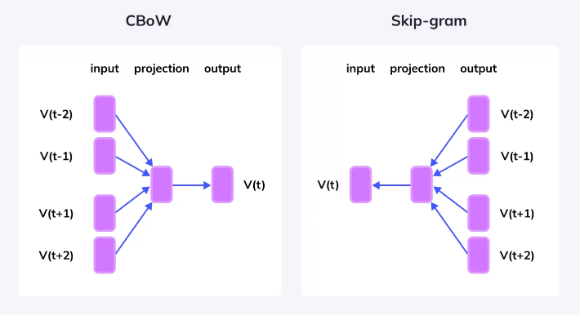
Word2Vec
The Word2Vec model can be implemented using two architectural designs:
Continuous Bag of Words (CBOW) Model
Continuous Skip-Gram Model.
The CBOW model predicts the target word from its surrounding context words. In other words, it uses the surrounding words to predict the word in the middle.
The Skip-Gram model predicts the surrounding context words from a target word. In other words, it uses a single word to predict its surrounding context.

Slide 7
Training Word2Vec
Initialization of vectors
Importance of window size
Each word in the corpus is initially represented as a high-dimensional vector with random values. These vectors serve as the starting point for the training process
The dimension of these vectors is typically around 100-300, and sometimes up to a thousand, depending on the size of the corpus and the specific requirements of the task at hand
As the training progresses, these vectors are updated based on the objective function of the Word2Vec model
Another critical aspect of training Word2Vec embeddings is the choice of window size.
The window size is like a sliding window that passes over the text and determines which words are analyzed in context of a target word.
Words within the window are considered as context words, while those outside are ignored.
A smaller window size results in learning more about the word’s syntactic roles, while a larger window size helps the model understand the broader semantic context.
A larger window size increases the computational complexity as more context words have to be processed for each target word

Slide 8
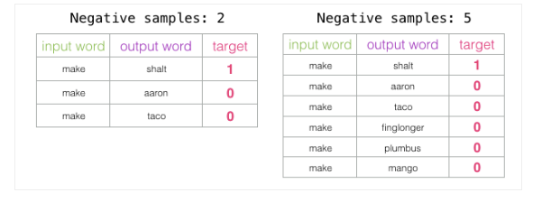
Training Word2Vec
Negative sampling
Negative sampling
Negative sampling is employed in word2vec to increase the efficiency and scalability of the training process
Lets take skipgram for example, for a given word we’ll have to identify the probability of being a context word for all the words in vocabulary
Negative sampling addresses the issue by restructuring the training objective. Instead of trying to predict probabilities of all the words in the vocabulary, negative sampling only focuses on small set of words
For each example, we randomly sample a small number of records to act as a negative sample
During training, we aim to maximize the probability of predicting a true context word and minimize the probability of predicting the negative sample

Slide 9
Shortcomings of Word2Vec
Lack of context awareness: Word2vec treats each word as a standalone word and ignores the context in which it appears. This leads to suboptimal embeddings when working with words/phrases that have multiple meanings
Limited vocabulary: OOV words are treated as special tokens. This can be problematic for tasks involving rare or domain-specific words not present in the training data
Fixed length word embeddings: Word2vec produces fixed-length embeddings for each word, regardless of the word's semantic complexity or variability in usage. As a result, it may not capture fine-grained semantic nuances or word variations effectively.
Difficulty in capturing long-range dependencies: Word2vec relies on local context windows to learn word embeddings, making it challenging to capture long-range dependencies or semantic relationships that span multiple words or sentences.

Slide 10
Recurrent Neural Networks
Variable length context:
RNNs can process sequence of variable lengths and can capture dependencies over arbitrary distances by managing a hidden state across time steps
This flexibility allows RNN to capture long-range dependencies and context information effectively
Sequential Modeling:
RNNs explicitly model sequential information and encode the context of each word based on its position within a sequence. By recurrently updating hidden states, RNNs can capture the sequential structure of input sequences and infer the meaning of words based on their context.
Handling Out-of-Vocabulary Words:
RNNs can handle out-of-vocabulary words by learning word representations dynamically from input sequences. Through backpropagation, RNNs can update word representations based on their context, allowing them to adapt to new or unseen words during training.
Context Sensitivity:
RNNs capture the dynamic context of words in different contexts by maintaining hidden states that encode contextual information. This enables RNNs to produce context-sensitive word representations that reflect the semantic meaning of words in diverse contexts.

