Slide 1
Large Language Model

Slide 2
Agenda
Seq2Seq models recap
Transformers
Attention mechanism
BERT
Large Language Models
ChatGPT

Slide 3
Sequence to Sequence models

Slide 4
Sequence to sequence models
A sequence-to-sequence model is a model that takes a sequence of items (words, letters, features of an images…etc) and outputs another sequence of items. A trained model would work like this

Slide 5
Sequence to sequence models

Slide 6
Sequence to sequence models
Under the hood, the model is composed of an encoder and a decoder. The encoder processes each item in the input sequence, it compiles the information it captures into a vector (called the context). After processing the entire input sequence, the encoder sends the context over to the decoder, which begins producing the output sequence item by item

Slide 7
Sequence to sequence models

Slide 8
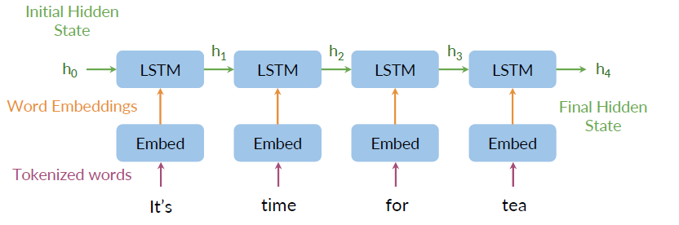
Sequence to sequence encoder

Slide 9
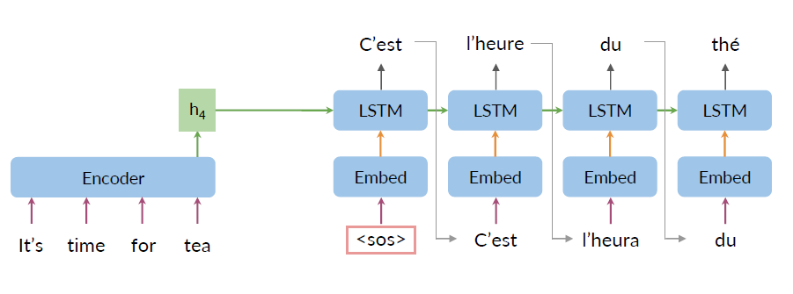
Sequence to sequence decoder

Slide 10
Seq2Seq bottlenecks
Loss of information
No parallel computing
Vanishing gradient

Slide 11
Attention mechanism

Slide 12
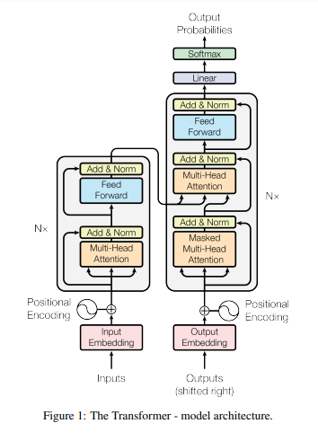
Attention is all you need

Slide 13
Attention is all you need
An attention function can be described as mapping a query and a set of key-value pairs to an output, where the query, keys, values, and output are all vectors.
The output is computed as a weighted sum of the values, where the weight assigned to each value is computed by a compatibility function of the query with the corresponding key.

Slide 14
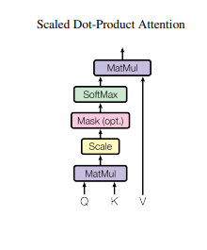

Attention is all you need

Slide 15
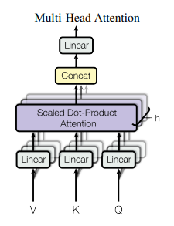

Attention is all you need
Multi-head attention allows the model to jointly attend to information from different representation subspaces at different positions. With a single attention head, averaging inhibits this.

Slide 16
BERT

Slide 17
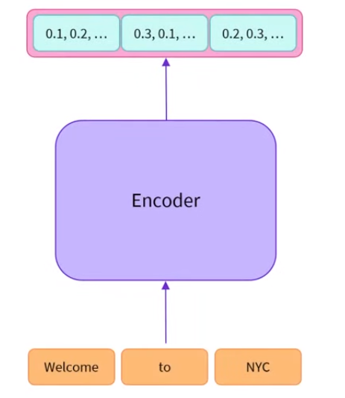
BERT
A bidirectional transformer pre-trained using a combination of masked language modeling objective and next sentence prediction on a large corpus comprising the Toronto Book Corpus and Wikipedia

Slide 18
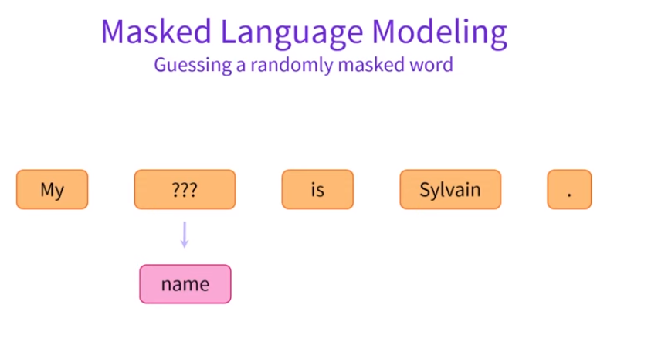
BERT

Slide 19
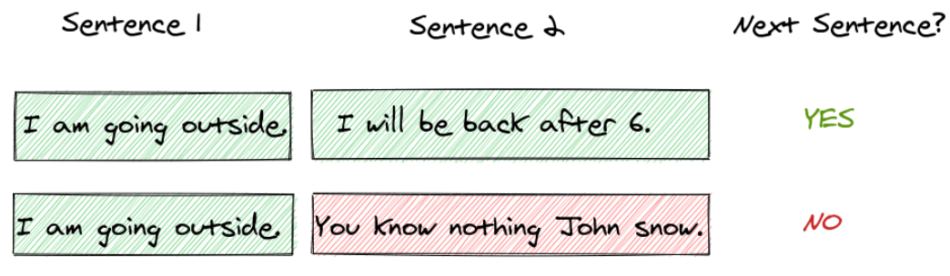
BERT
Next Sentence Prediction

Slide 20
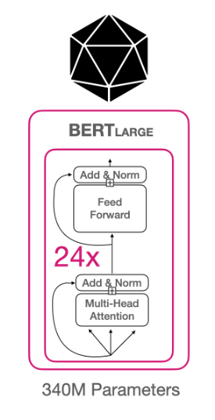
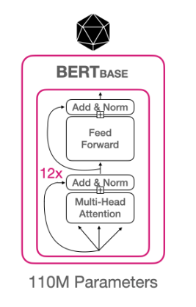
BERT Architecture

Slide 21
BERT Architecture

Slide 22
GPT

Slide 23
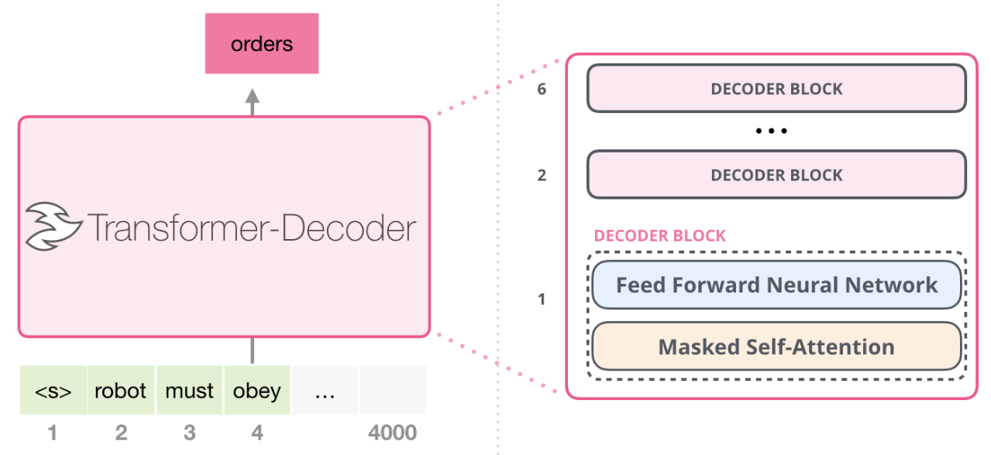
GPT
GPT is a language model with transformer based architecture that is trained to take input text and transform it into what it predicts the most useful result will be

Slide 24
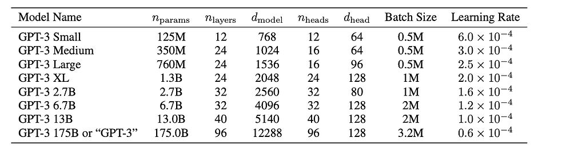
GPT Architecture
GPT is a language model with transformer based architecture that is trained to take input text and transform it into what it predicts the most useful result will be

Slide 25
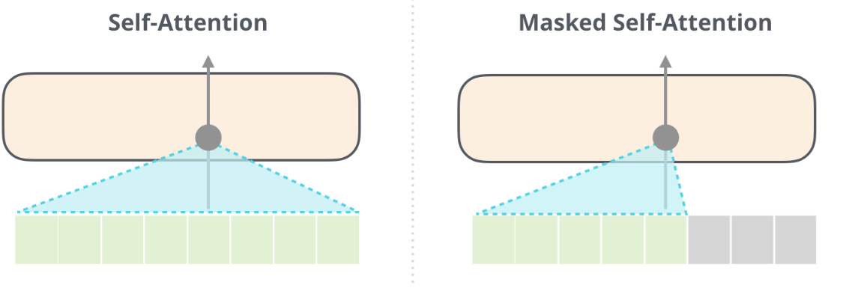
GPT Architecture

Slide 26
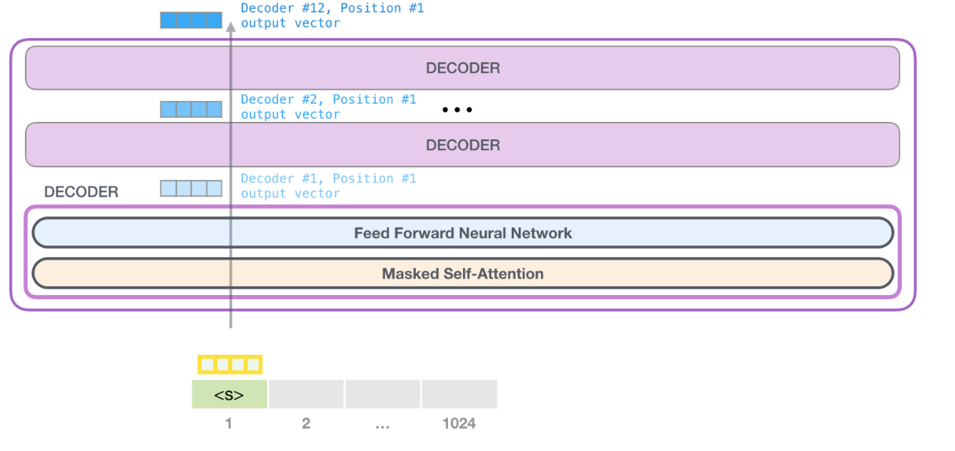
GPT Architecture

Slide 27
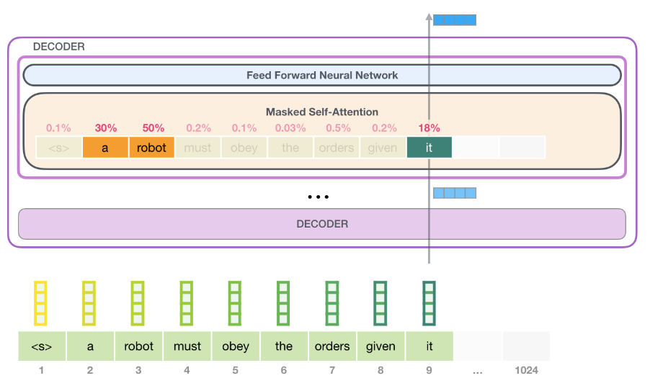
GPT Architecture

Slide 28
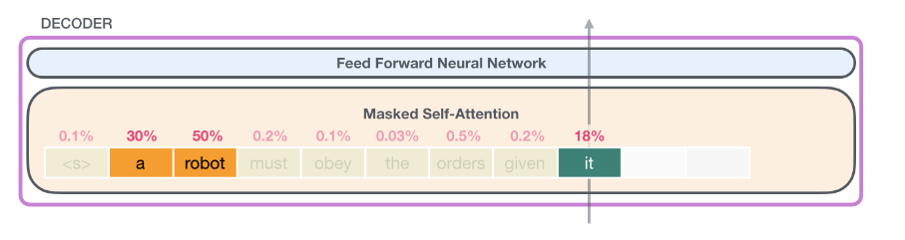
GPT Self attention

