Slide 1
TRANSFORMERS

Slide 2
LLM
Can you explain what a large language model is and how it works?
How are large language models trained? Describe the pre-training and fine-tuning processes.
What are some challenges or limitations associated with large language models?
Large language models like GPT-3 have been known to generate text that may be biased or offensive. How would you address this issue in a production setting?
How can large language models be used to generate text or assist in natural language processing tasks?
What are some common applications of large language models in industry?
How do you evaluate the performance of a large language model? What metrics or techniques can be used?
Can you explain the concept of transfer learning in the context of large language models?
What are some alternatives to large language models for natural language processing tasks?
Can you discuss any recent advancements or research in the field of large language models?

Slide 3
What IS LLM?
LLMs are powerful NLP models that use artificial neural networks and massive amounts of training data to understand and generate human language
They are called "large" because they are trained on massive amounts of text data, typically using unsupervised learning techniques.
LLMs are capable of performing a wide range of NLP tasks, such as language modeling, text classification, sentiment analysis, named entity recognition, machine translation, and text summarization.
They achieve state-of-the-art performance by leveraging a variety of techniques, including attention mechanisms, positional encodings, and self-supervised learning

Slide 4
What ARE TRANSFORMERS?
All the Transformer models mentioned above (GPT, BERT, BART, T5, etc.) have been trained as language models. This means they have been trained on large amounts of raw text in a self-supervised fashion.
Self-supervised learning is a type of training in which the objective is automatically computed from the inputs of the model. That means that humans are not needed to label the data!
This type of model develops a statistical understanding of the language it has been trained on, but it’s not very useful for specific practical tasks.
Because of this, the general pretrained model then goes through a process called transfer learning. During this process, the model is fine-tuned in a supervised way — that is, using human-annotated labels — on a given task.
An example of a task is predicting the next word in a sentence having read the n previous words. This is called causal language modeling because the output depends on the past and present inputs, but not the future ones

Slide 5
Tokenization
The text data is split into smaller units called tokens, such as words or subwords. This allows the model to process the text more efficiently.
Embedding
Each token is assigned a vector representation, called an embedding. This allows the model to learn relationships between the tokens and capture the meaning of the text.
Self-Attention
This mechanism allows the model to weigh the importance of different tokens in the text when making predictions. Self-attention is a key component of transformer-based LLMs, such as BERT and GPT
Pre-training
LLMs are pre-trained on large amounts of text data using unsupervised learning techniques. The pre-training involves tasks such as language modeling, where the model learns to predict the next word in a sequence of text
Fine-tuning
Once the LLM is pre-trained, it can be fine-tuned on specific NLP tasks using smaller amounts of labeled data. This allows the model to adapt to the specific characteristics of the task and achieve high accuracy

Slide 6
Hugging FACE AUTOBERT TOKENIZER
Hugging Face's AutoBERTTokenizer automatically selects the appropriate BERT-based tokenizer for a given pre-trained BERT model. This saves users the trouble of manually selecting and configuring the appropriate tokenizer for each pre-trained model.
BERT models have different architectures and different tokenization strategies, so the appropriate tokenizer must be used to ensure that the text is properly tokenized for the model. For example, some BERT models use sub-word tokenization, while others use word-piece tokenization
The AutoBERTTokenizer takes as input a pre-trained BERT model name or a BERT configuration object, and returns a tokenizer object.
Once the tokenizer is loaded, it can be used to tokenize text data in the appropriate format for the BERT model. This typically involves splitting the text into tokens, adding special tokens to mark the beginning and end of the text, and padding the tokens to ensure that all input sequences have the same length.

Slide 7
PRE-TRAINING
Pretraining is the act of training a model from scratch: the weights are randomly initialized, and the training starts without any prior knowledge.

Slide 8
FINE-TUNING
To perform fine-tuning, you first acquire a pretrained language model, then perform additional training with a dataset specific to your task.

Slide 9
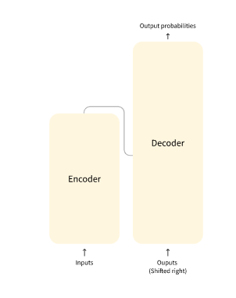
The encoder receives an input and builds a representation of it (its features). This means that the model is optimized to acquire understanding from the input.
The decoder uses the encoder’s representation (features) along with other inputs to generate a target sequence. This means that the model is optimized for generating outputs.

Slide 10
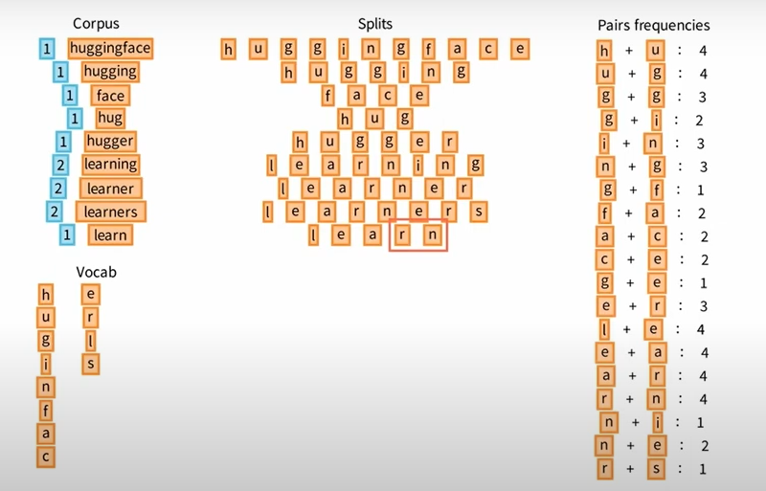
Byte Pair Encoding
BPE starts with initial vocabulary
Step 1: Split words into smaller units (characters).
Step 2: count the pair frequencies
Step 3: Choose the most frequent pair and add to merging rule. Add the token to vocabulary
Step 4: Do step 2 & step 3 till we reach our desired max vocabulary size
Step 5: Place the tokens to replace the original words

Slide 11
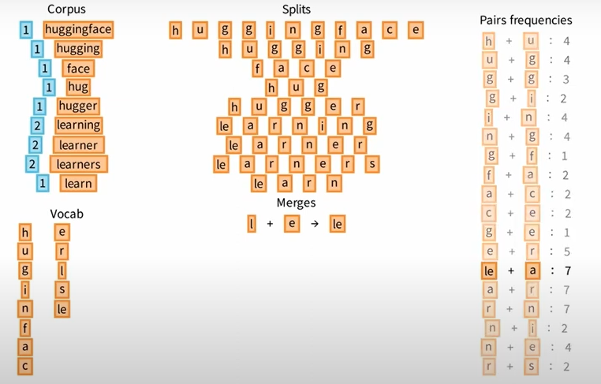
Byte Pair Encoding
BPE starts with initial vocabulary
Step 1: Split words into smaller units (characters).
Step 2: count the pair frequencies
Step 3: Choose the most frequent pair and add to merging rule. Add the token to vocabulary
Step 4: Do step 2 & step 3 till we reach our desired max vocabulary size
Step 5: Place the tokens to replace the original words

Slide 12
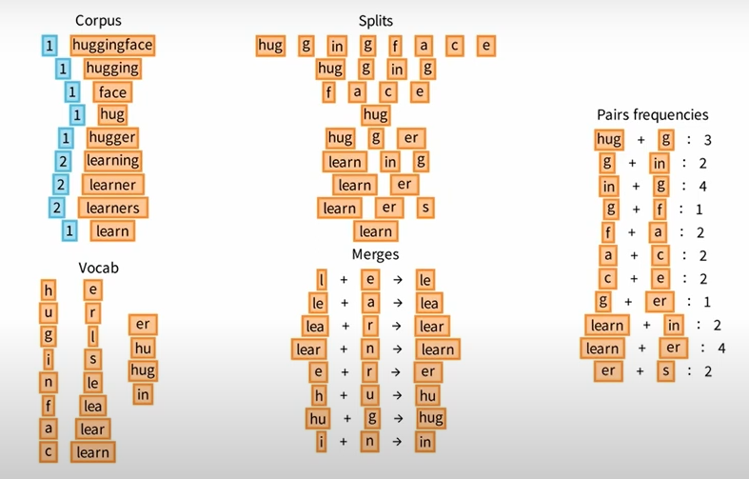
Byte Pair Encoding
BPE starts with initial vocabulary
Step 1: Split words into smaller units (characters).
Step 2: count the pair frequencies
Step 3: Choose the most frequent pair and add to merging rule. Add the token to vocabulary
Step 4: Do step 2 & step 3 till we reach our desired max vocabulary size
Step 5: Place the tokens to replace the original words

Slide 13
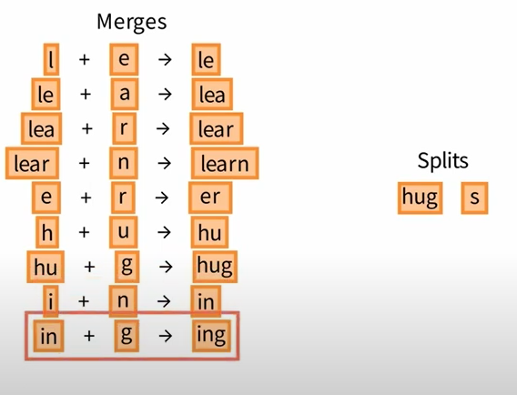
Byte Pair Encoding
BPE starts with initial vocabulary
Step 1: Split words into smaller units (characters).
Step 2: count the pair frequencies
Step 3: Choose the most frequent pair and add to merging rule. Add the token to vocabulary
Step 4: Do step 2 & step 3 till we reach our desired max vocabulary size
Step 5: Place the tokens to replace the original words

Slide 14
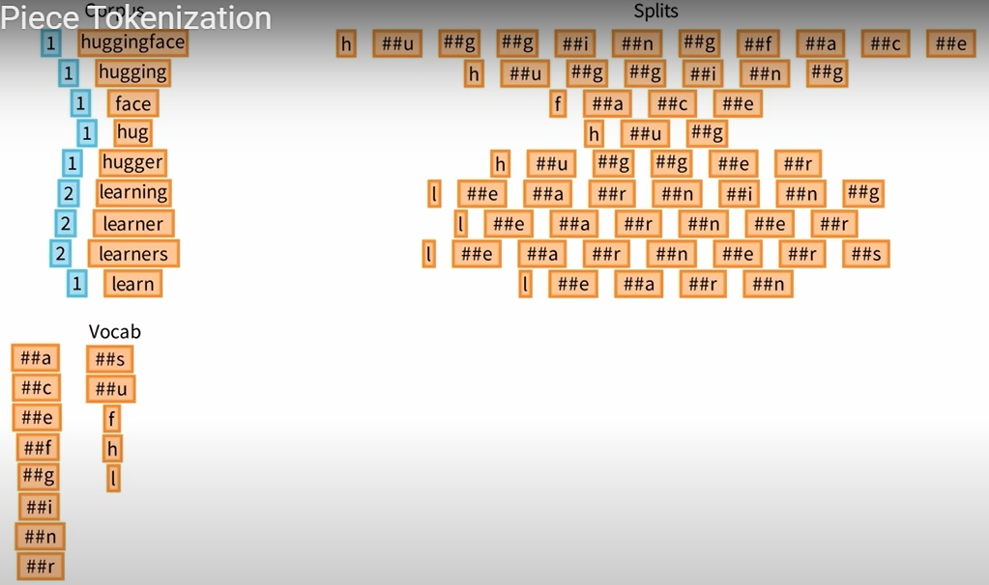
Word Piece Tokenization
Word Piece starts with initial vocabulary
Step 1: Split words into smaller units (characters).
Step 2: count the pair frequencies
Step 3: Compute pair score
Freq of pair/ (freq of element 1) * (freq of element 2)
Step 4: Do step 2 & step 3 till we reach our desired max vocabulary size and add the newly created tokens to vocab
Use the new vocabulary to tokenize

Slide 15
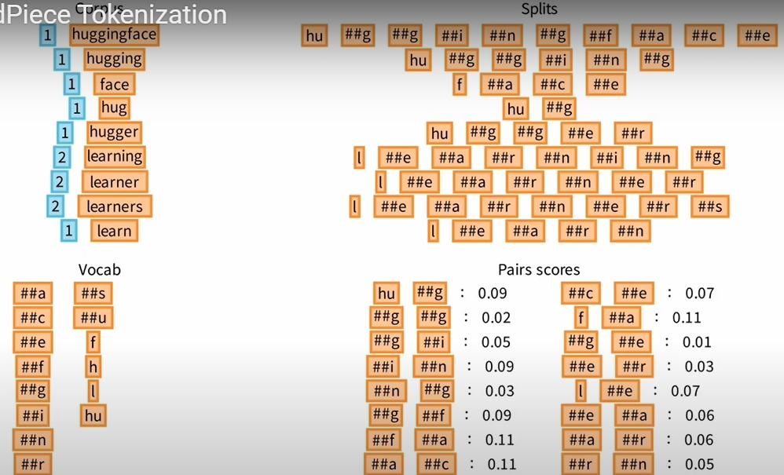
Word Piece Tokenization
Word Piece starts with initial vocabulary
Step 1: Split words into smaller units (characters).
Step 2: count the pair frequencies
Step 3: Compute pair score
Freq of pair/ (freq of element 1) * (freq of element 2)
Step 4: Do step 2 & step 3 till we reach our desired max vocabulary size and add the newly created tokens to vocab
Step 5: Use the new vocabulary to tokenize

Slide 16
ComParisons

Slide 17
 | Word2Vec | Transformers
Architecture | Word2Vec is a shallow, two-layer neural network-based model. It consists of either a continuous bag of words (CBOW) or skip-gram architecture. CBOW predicts a target word based on its surrounding context words, while skip-gram predicts context words given a target word. | Transformers are deep learning models that employ a self-attention mechanism. They consist of an encoder-decoder architecture with multiple self-attention layers. Transformers can capture long-range dependencies in text and have shown superior performance in various NLP tasks.
Contextual information | Word2Vec models generate fixed-length word embeddings, where each word is represented by a dense vector. These embeddings capture semantic and syntactic similarities between words but do not consider the context in which words appear. | Transformers, such as the popular BERT (Bidirectional Encoder Representations from Transformers), capture contextual information by considering the entire sentence or sequence of words. They produce contextual word embeddings that adapt to the context of the surrounding words

Slide 18
 | Word2Vec | Transformers
Pre-Training and Fine-tuning | Word2Vec models are typically trained on large amounts of unlabeled text data in an unsupervised manner. Once trained, the embeddings can be used in downstream tasks, such as sentiment analysis or named entity recognition. | Transformers can be pre-trained on massive amounts of text data using a masked language modeling objective, where some words are randomly masked and the model predicts them based on the remaining context. After pre-training, transformers can be fine-tuned on specific tasks with labeled data, allowing them to learn task-specific representations.
Performance | Word2Vec models are efficient and perform well in capturing word-level semantics and relationships. They are often used in tasks like word analogy or word similarity. | Transformers have achieved state-of-the-art performance in various NLP tasks, including text classification, named entity recognition, machine translation, and question answering. Their ability to capture contextual information contributes to their superior performance.

Slide 19
ComParisons

Slide 20
Solution Overview
Problem definition & Business success metrics
Data collection
Data preprocessing
Text preprocessing
Model selection
Text encoding
Summaries
Model evaluation
Model fine-tuning

Slide 21
Word2Vec Meeting summariser
Obtain the Zoom meeting transcript data in text format.
Clean the text by removing any irrelevant information, such as timestamps, participant names, or non-verbal cues.
Tokenize the text into sentences or paragraphs for further processing
Perform sentence or paragraph tokenization using libraries like NLTK.
Clean the text by removing any special characters, punctuation, or stop words that might not contribute to the summarization task
1 Data pre - processing
2 Text pre - processing
Prepare the preprocessed text data as input for training the Word2Vec model.
Instantiate and train a Word2Vec model on the meeting transcript data.
Specify the desired dimensions for the word embeddings
3 Word2Vec model

Slide 22
Word2Vec Meeting summariser
Generate sentence embeddings by averaging the word vectors of the words in each sentence.
Alternatively, you can use more sophisticated techniques like doc2vec to obtain paragraph-level embeddings
4
Sentence embedding
5 Generate summaries
6 Post process & evaluation
Apply an extractive summarization technique on the sentence embeddings to generate the meeting summary.
For extractive summarization, you can use techniques like ranking sentences based on importance (e.g., using cosine similarity with a reference summary) and selecting the top-ranked sentences
Perform any necessary postprocessing on the generated summary, such as removing additional padding or cleaning up the text.
Evaluate the quality of the summary using appropriate metrics like ROUGE (Recall-Oriented Understudy for Gisting Evaluation)

Slide 23
Scenario: Sentiment Analysis
Imagine you are working as an NLP data scientist at a financial services firm, and your team is tasked with developing a transformer-based model to analyze customer feedback and complaints. Your model should be able to identify common themes and sentiments in the customer feedback, and provide recommendations to improve customer satisfaction
Business objective: Identify common themes and sentiments in customer feedback.
Data collection: Curate data (customer feedbacks, customer demographics, products subscribed by the customer, customer characteristics)
Data preprocessing: Remove timestamps, non verbal cues
Text processing:Use NLTK library to perform text preprocessing.
Tokenization: Convert individual sentences/feedbacks into tokens. Use Huggingface Autotokenzer based on the model
Model selection: We can use a base bert to train from scratch or leverage “sentiment analysis” pretrained model from hugging face
Model Finetune: prepare dataset with human annotated labels to fine tune the model. This is needed as we can leverage financial org specific terminologies to indicate sentiment
Model evaluation: We can use F1-score to evaluate the model performance

Slide 24
Scenario: Sentiment Analysis
Overall, your answer provides a good high-level overview of the steps involved in developing and training a transformer-based model for analyzing customer feedback. Here are some additional comments and suggestions:
Data collection: In addition to customer feedback and demographics, it may be useful to include data on the products or services that the customer used or interacted with, as this can help to contextualize the feedback and identify specific areas for improvement.
Text processing: While NLTK is a useful library for text processing, it may be more efficient to use the built-in text preprocessing and tokenization functions provided by the transformer library that you are using (e.g., Huggingface Transformers). This can ensure that the preprocessing steps are consistent with the requirements of the model.
Model selection: In addition to BERT and sentiment analysis models, it may be worth considering other transformer-based models such as T5 or GPT-3 that have shown promising results in natural language generation tasks
Model fine-tuning: While using a pre-trained model can save time and resources, it's important to fine-tune the model on your specific task and domain to achieve optimal performance. It's also important to ensure that the labeled data used for fine-tuning is representative of the full range of feedback and sentiments that customers may express.
Model evaluation: While F1-score is a useful metric for evaluating model performance, it may be worthwhile to also consider other metrics such as precision, recall, and accuracy

Slide 25
Questions

Slide 26
HOW TO HANDLE BIAS IN LLM
Establish & implement ethical guidelines
Monitor model outputs
Train the models on diverse data sets
Explainable AI
Human oversight

Slide 27
TYPES OF TEXT SUMMARISATION
Extractive summarization
Abstractive summarization
Hybrid summarization
Query based summarization
Multi-document summarization

Slide 28
TYPES OF TEXT SUMMARISATION
Extractive summarization
Abstractive summarization
Hybrid summarization
Query based summarization
Multi-document summarization

Slide 29
TEXT SUMMARISATION METRICS
Extractive
ABStractive
ROGUE
Precision, Recall & F1-score
Cosine similarity
Jaccard similarity
Eucledian distance
ROGUE (Recall-Oriented Understudy for Gisting Evaluation)
BLEU (Bilingual Evaluation Understudy)
METEOR (Metric for Evaluation of Translation with Explicit Ordering)
CIDEr (Consensus-based Image Description Evaluation)
ROGUE-L

Slide 30
EXPLAIN ROGUE METRICS
The ROUGE metric measures the overlap between the generated summary and one or more reference summaries, using a variety of techniques such as n-gram matching, word-based matching, and recall-based matching
ROUGE-1 measures the overlap of unigrams between the generated summary and the reference summary
ROUGE-2 measures the overlap of bigrams.
ROUGE-L is a variant that uses the longest common subsequence instead of n-grams, which is more effective for capturing longer sequences of text

Slide 31

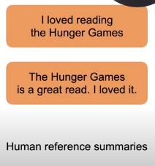
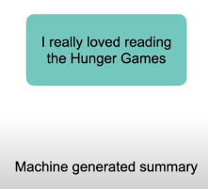
EXPLAIN ROGUE METRICS

Slide 32
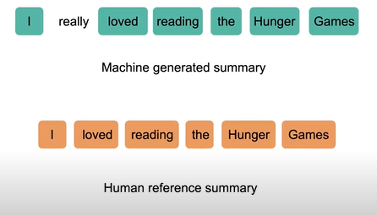
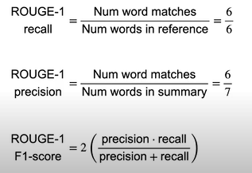
ROGUE-1 Example
6 unigram word matches

Slide 33
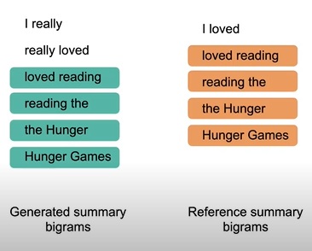
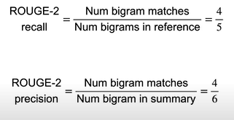
ROGUE-2 Example
4 bigram matches

Slide 34
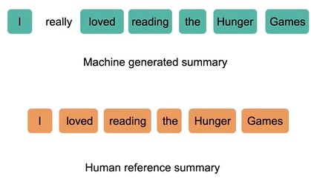
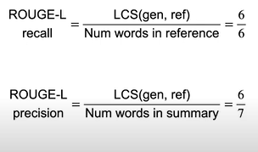
ROGUE-L Example

Slide 35
HandLE BERT MAX TOKEN LENGTH
When using BERT for text summarization, it is common for the input sentences to be longer than the maximum token length that can be handled by the model
Truncate the input: One approach is to simply truncate the input text to fit within the maximum token length of the model. This can result in loss of information, particularly for longer documents
Chunk the input: Another approach is to split the input text into smaller chunks that fit within the maximum token length of the model. This can be done by splitting the document into paragraphs or sentences, for example, and processing each chunk separately. The resulting summaries can then be combined to form a summary of the entire document.
Use a hierarchical model: A third approach is to use a hierarchical model that can handle longer input sequences. In this approach, the input text is first processed by a lower-level model that extracts important information, such as key phrases or sentences, and then passes that information to a higher-level model that generates the summary.
Use a summarization-specific model: Finally, another approach is to use a model that is specifically designed for text summarization, such as the T5 or GPT-3 models.

Slide 36
MULTI-HEADED ATTENTION
In the transformer architecture, the input sequence is first passed through a series of multi-headed self-attention layers, followed by feedforward layers. The multi-headed attention layer is composed of several attention heads. Each attention head is responsible for attending to different parts of the input sequence, allowing the model to capture more fine-grained information.
The input sequence is first transformed into three matrices: query, key, and value, by multiplying with learnable weights.
Each attention head then calculates a weighted sum of the values based on the dot product between the query and key matrices. This is done by computing the softmax of the dot product between the query and key matrices, and then multiplying the result with the value matrix. This results in an attention vector for each attention head.
The attention vectors for each attention head are concatenated and multiplied by another learnable weight matrix to produce the output of the multi-headed attention layer.
By allowing the model to attend to different parts of the input sequence, the multi-headed attention layer can capture more complex and nuanced relationships between the input tokens

Slide 37
ATTENTION MASK
The attention mechanism allows the model to focus on specific parts of the input sequence when generating output. The attention mechanism computes a weighted sum of the input sequence, where the weights are determined by the relevance of each input element to the current output step.
In some cases, not all elements of the input sequence are relevant for the task at hand. For example, in natural language processing tasks, padding tokens may be added to the input sequence to ensure that all sequences have the same length, but these padding tokens do not provide any useful information for the model
To address this issue, an attention mask can be used to indicate which elements of the input sequence are relevant for the task and which are not. The attention mask is a binary tensor with the same shape as the input sequence, where each element is either 0 or 1
During training and inference, the attention mask is multiplied element-wise with the attention weights to ensure that only valid elements of the input sequence are used to compute the output

