Slide 1
Image “painting”. Использование глубокого обучения (регрессия) для рисования «картин» в стиле различных художников
Анна Белова
Роман Власов
Алина Шадрина

Slide 2
Overview
Real projects
Prisma http://prisma-ai.com/ (OS X, Android) (free)
Deep dream http://deepdreamgenerator.com (free)
Deep art https://deepart.io/page/about/ (free) https://www.instapainting.com/ai-painter (49$)
How does it work
Demo

Slide 3
Prisma
Owner: Alexey Moiseenkov
Arch: CNN

Slide 4
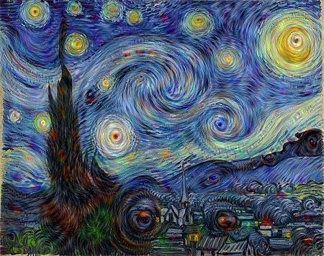
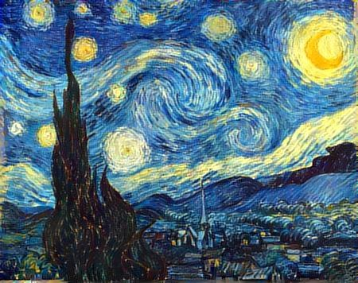
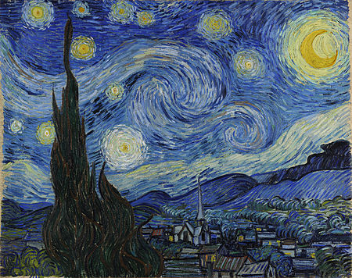
Deep Dream
Owner: Google
Arch: CNN
Deep dream
with inception3b_output layer
Deep style “Starry Night”
Works really fast!
Vincent van Gogh “Starry night”

Slide 5
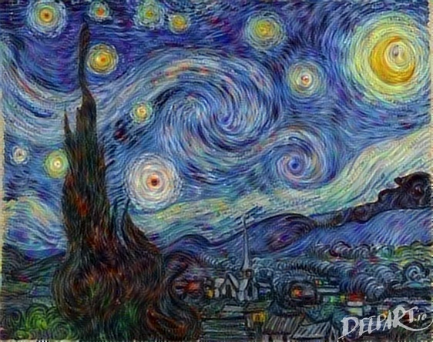
Deep Art
Owner: University of Tübingen has a pending patent application
Arch: CNN based on the VGG network by K. Simonyan and A.Zisserman
Initial image
Style image
Results

Slide 6
Overview
Real projects
Prisma http://prisma-ai.com/ (OS X, Android) (free)
Deep dream http://deepdreamgenerator.com/ (free)
Deep art https://deepart.io/page/about/ (free)
https://www.instapainting.com/ai-painter (49$)
How does it work
Demo

Slide 7
Network Architecture
Basis: VGG Network
Very Deep Convolutional Networks for Large-Scale Visual Recognition ⁽¹⁾
16-layer model had 7.4% accuracy on Imagenet test set in 2014
Available in the Caffe-framework ⁽²⁾
Model: Deep art
16 convolutional and 5 average pooling layers, no fully connected layers
Style and content representations are separable!
Content: non-linear filters generate feature maps
Style: compute the correlation between different types of neurons
New image generation: perform gradient descent from the noise to another image that matches the style or the original image
http://www.robots.ox.ac.uk/~vgg/research/very_deep/
http://caffe.berkeleyvision.org/

Slide 8
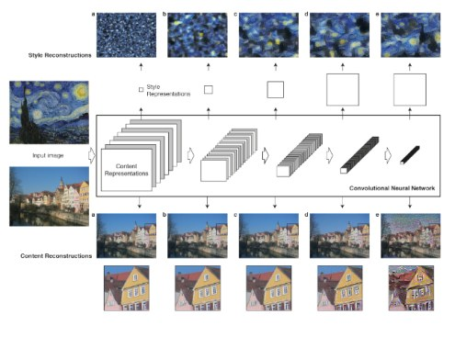
Convolutional Neural Network Layers
Textures
Style Feature
Space
Objects
Content Feature
Space
Objects
Textures

Slide 9
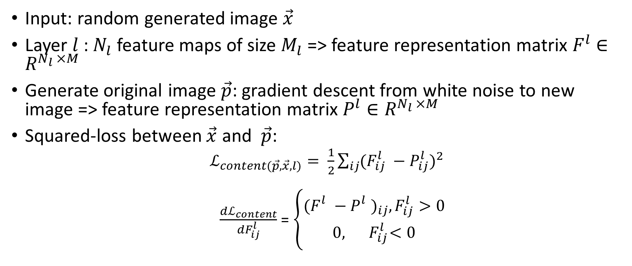
Learning (1)
Input: random generated image $\vec{x}$
Layer $l$: $N_{l}$ feature maps of size $M_{l}$ => feature representation matrix $F^{l}$ $∈R^{N_{l }×M}$
Generate original image $\vec{p}$: gradient descent from white noise to new image => feature representation matrix $P^{l}$ $∈R^{N_{l }×M}$
Squared-loss between $\vec{x}$ and $\vec{p}$:
$ℒ_{content(\vec{p},\vec{x}, l)}= \frac{1}{2}\sum_{ij}{{(F_{ij}^{l} −P_{ij}^{l})}^{2}}$
$\frac{dℒ_{content}}{dF_{ij}^{l}}$ = $\left\{\begin{aligned}{(F_{}^{l}−P_{}^{l})}_{ij},F_{ij}^{l}>0 \\ 0,{ F}_{ij}^{l}<0\end{aligned}\right.$

Slide 10
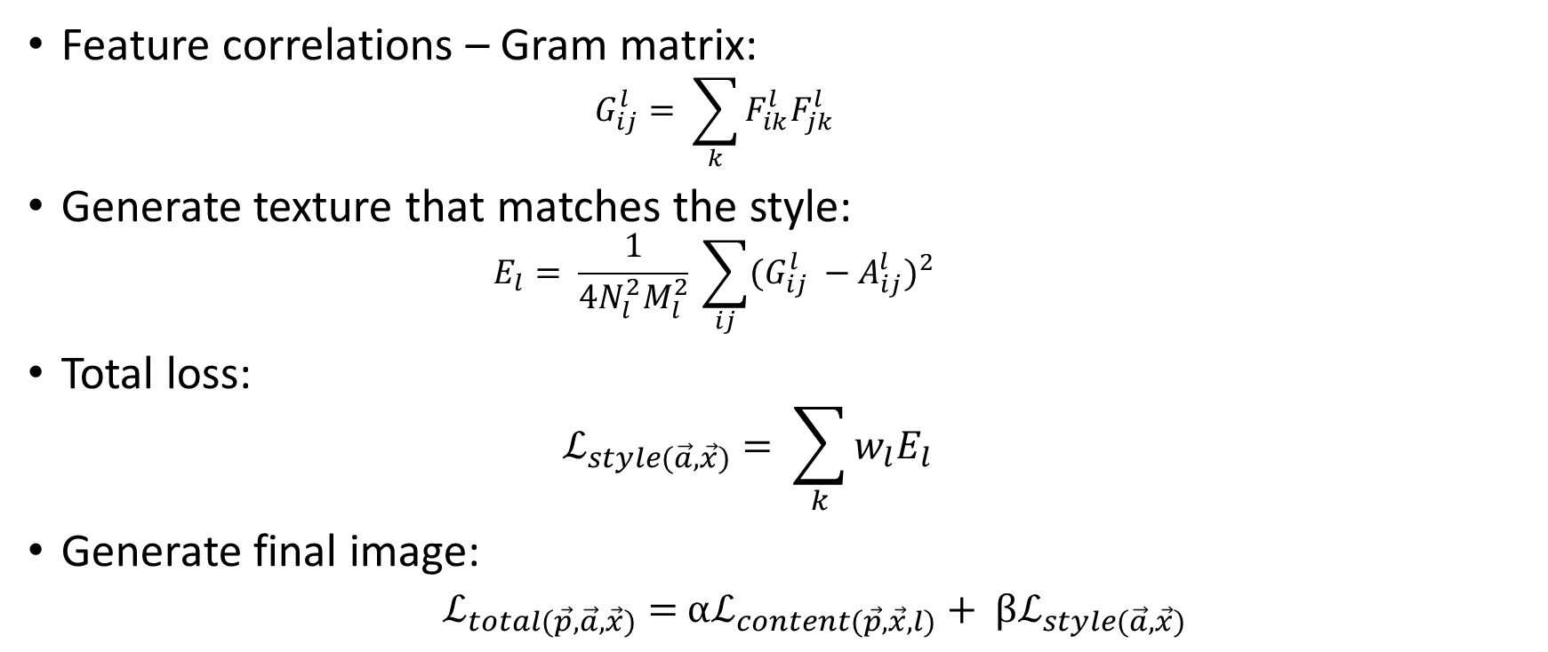
Learning (2)
Feature correlations – Gram matrix:
$$G_{ij}^{l}= \sum_{k}{F_{ik}^{l}F_{jk}^{l}}$$
Generate texture that matches the style:
$$E_{l}= \frac{1}{4N_{l}^{2}M_{l}^{2}} \sum_{ij}{{(G_{ij}^{l} −A_{ij}^{l})}^{2}}$$
Total loss:
$$ℒ_{style(\vec{a},\vec{x})}= \sum_{k}{w_{l}E_{l}}$$
Generate final image:
$ℒ_{total(\vec{p},\vec{a},\vec{x})}=$ $αℒ_{content(\vec{p},\vec{x}, l)}+ βℒ_{style(\vec{a},\vec{x})}$

Slide 11
Overview
Real projects
Prisma http://prisma-ai.com/ (OS X, Android) (free)
Deep dream http://deepdreamgenerator.com/ (free)
Deep art https://deepart.io/page/about/ (free)
https://www.instapainting.com/ai-painter (49$)
How does it work
Demo

Slide 12
Demo
Deep dream:
https://github.com/google/deepdream/blob/master/dream.ipynb
Deep art:
https://github.com/jcjohnson/neural-style

Slide 13
Sources
Leon A. Gatys, Alexander S. Ecker, and Matthias Bethge “A neural algorithm for artistic style”
How to build and install Caffe on Linux: http://caffe.berkeleyvision.org/installation.html
How Deep Learning Can Paint Videos in the Style of Art’s Great Masters: https://blogs.nvidia.com/blog/2016/05/25/deep-learning-paints-videos/

