Slide 1
BUILDING HIGH-LEVEL FEATURES USING LARGE SCALE UNSUPERVISED LEARNING
Presenter: Alina Shadrina
Authors:
Quoc Le, Marc'Aurelio Ranzato, Rajat Monga, Matthieu Devin, Kai Chen, Greg Corrado, Jeff Dean, Andrew Ng

Slide 2
Agenda
How does human brain studies inspire ANN studies?
How parallelism drives one of the largest ANN?
Is it possible to extract high-level features from only unlabeled data?

Slide 3
Task description
Simple task: build a good face detector
Obvious solution: get a large collection of images labeled as containing faces
Obvious feasibility: what if we do not have enough (or at all) labeled data?
Real task: build a face detector from only unlabeled data
Obvious best solution: no ☹ deep learning
Previous studies:
RBMS, autoencoders, sparse coding and K-means
Problem: learn only low-level features
Solution: will be discussed soon!

Slide 4
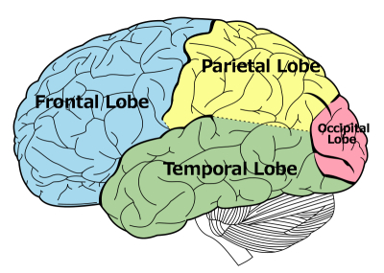
Results anticipated
Fast way to extract high-level features
Small step forward in the study of how children learn, how the human brain works
Temporal cortex: “grandmother neurons” –
highly selective neurons that recognize categories
Human vision – occipital lobe:
Primary VC recognizes only low-level features
(lines, points, geometric figures etc)
Secondary VC recognizes structures of features
* image: http://www.macalester.edu/academics/psychology/whathap/ubnrp/tle09/TLE.html

Slide 5
Study background
Sparse coding [1]
Unsupervised feature learning and deep learning [2]
Stacked sparse RBMs [3]
Convolutional DBNs [4]
Local receptive fields [5]

Slide 6
Datasets
Train set:
(10 million images)
10 million YouTube
videos
200
200
13 026 non-aligned images from Labeled Faces In the Wild
23 974 distractors from ImageNet
Test set
(37 000
images)

Slide 7
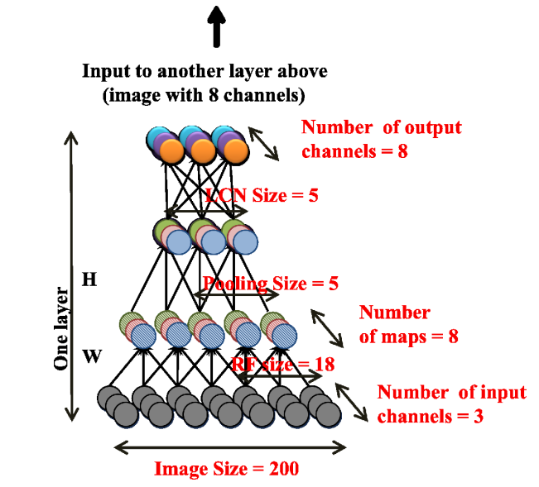
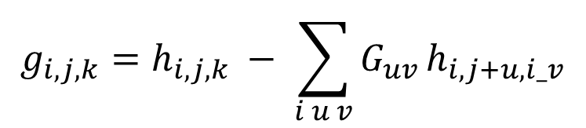
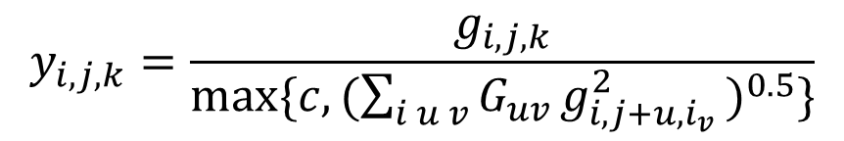
Model
9-Layer autoencoder:
Local receptive fields
Local L2 pooling
Local contrast normalization:
$$g_{i,j,k}=h_{i,j,k} − \sum_{i u v}{G_{uv}}h_{i,j+u,i_v}$$
$$y_{i,j,k}=\frac{g_{i,j,k}}{max⁡\{c,(\sum_{i u v}{G_{uv}}g_{i,j+u,i_{v} }^{2})^{0.5}\}}$$
1 billion trainable parameters!

Slide 8
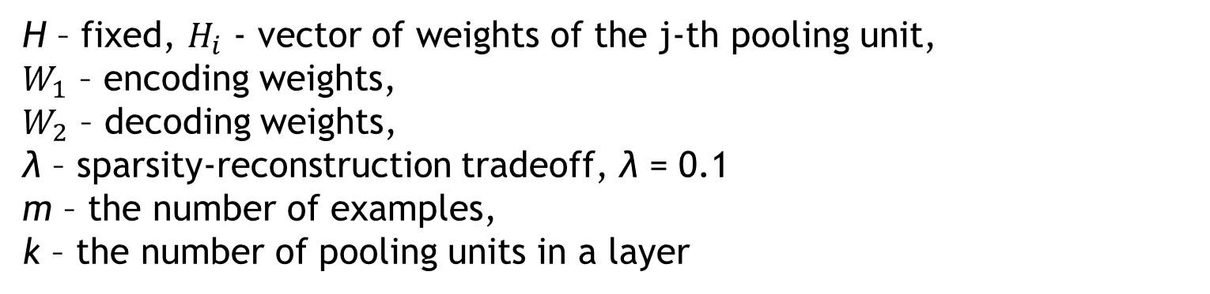
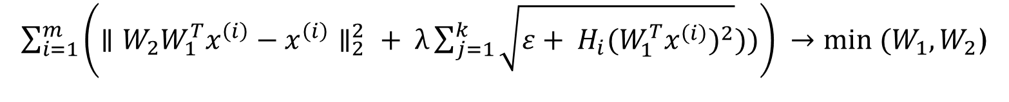

Learning
Topographic Independent Component Problem:
$\sum_{i=1}^{m}{\left(∥W_{2}W_{1}^{T}x^{\left(i\right)}−x^{\left(i\right)}∥_{2}^{2} + λ\sum_{j=1}^{k}{\sqrt{ε+ H_{i}(W_{1}^{T}x^{\left(i\right)})^{2}}}))\right)} →min (W_{1},W_{2}$)
H – fixed, $H_{i}$ - vector of weights of the j-th pooling unit,
$W_{1}$ – encoding weights,
$W_{2}$ – decoding weights,
λ – sparsity-reconstruction tradeoff, λ = 0.1
m – the number of examples,
k – the number of pooling units in a layer
$W_{1}$ ≠ $W_{2}!$

Slide 9
Optimization (1\2)
Model
Model Replica 1
Model Replica 2
Model Replica N
Partition 1
…
Partition 2
Partition 1000
Partition 999
…
Model Replica 3
…
16 CPU cores
Partition 169

Slide 10
Optimization (2\2)
Synchronous SGD:
Ask server to update params
Process mini-batch
Compute param gradient
Send the gradient to server
Apply gradient to current model param
Model Replica 1
Model Replica 5
Parameter
Server
Model Replica 2
Model Replica 4
Model Replica 3

Slide 11
Experiments on test set
Detect all distractors – 64.8%
Best neuron in current network – 81.7%
Best neuron in one-layered network – 71%
Best neuron in network without LCN sublayer – 78.5%
Picture: no faces, faces

Slide 12
Results
2011:DistBelief - Large Scale Distributed Deep Networks -> 2015: DistBelief2 = TensorFlow.
It’s possible to train neurons to be selective for high-level concepts using only unlabeled data
IMPACT:
“We’ve used it to demonstrate that concepts like “cat” can be learned from unlabeled YouTube images, to improve speech recognition in the Google app by 25%, and to build image search in Google Photos. DistBelief also trained the Inception model that won Imagenet’s Large Scale Visual Recognition Challenge in 2014, and drove our experiments in automated image captioning as well as DeepDream” *
* - https://research.googleblog.com/2015/11/tensorflow-googles-latest-machine_9.html

Slide 13
Backup

Slide 14
References (1\2)
[1] Sparse coding Lee, H., Battle, A., Raina, R., and Ng, Andrew Y. Efficient sparse coding algorithms. In NIPS, 2007.
[2] Unsupervised feature learning and deep learning
Bengio, Y. and LeCun, Y. Scaling learning algorithms towards AI. In Large-Scale Kernel Machines, 2007
Bengio, Y., Lamblin, P., Popovici, D., and Larochelle, H. Greedy layerwise training of deep networks. In NIPS, 2007
Hinton, G. E., Osindero, S., and Teh, Y. W. A fast learning algorithm for deep belief nets. Neural Computation, 2006
Lee, H., Ekanadham, C., and Ng, A. Y. Sparse deep belief net model for visual area V2. In NIPS, 2008.
Lee, H., Grosse, R., Ranganath, R., and Ng, A.Y. Convolutional deep belief networks for scalable unsupervised learning of hierarchical representations. In ICML, 2009

Slide 15
References (2\2)
[3] Stacked sparse RBMs
Lee, H., Ekanadham, C., and Ng, A. Y. Sparse deep belief net model for visual area V2. In NIPS, 2008.
[4] Convolutional DBNs
Lee, H., Grosse, R., Ranganath, R., and Ng, A.Y. Convolutional deep belief networks for scalable unsupervised learning of hierarchical representations. In ICML, 2009.
[5] Local receptive fields
Olshausen, B. and Field, D. Emergence of simple-cell receptive field properties by learning a sparse code for natural images. Nature, 1996.

Slide 16
Must read
How the human brain works:
А. Р. Лурия, "Потерянный и возвращенный мир"

