Slide 1

Microsurgery Study
COSC 6323 - Statistical Methods in Research
Spring 2018
Prepared By :
(Group – 9)
Ashna Shah
Gustavo Arismendi
Shivani Arora

Slide 2
Contents
Inferences
  State Psychometric Data
  Perinasal Perspiration (Stress) Signal
  Performance
Linear Model
Linear Effect Model

Slide 3
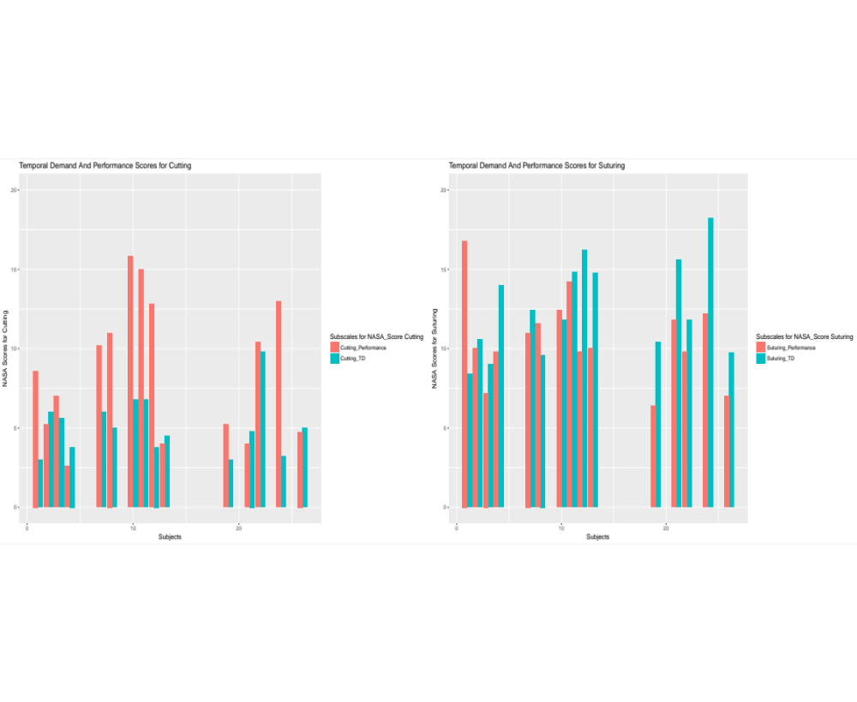
Inferences
[1] State Psychometric Data
(i) Temporal Demand and Performance : Cutting & Suturing

Slide 4
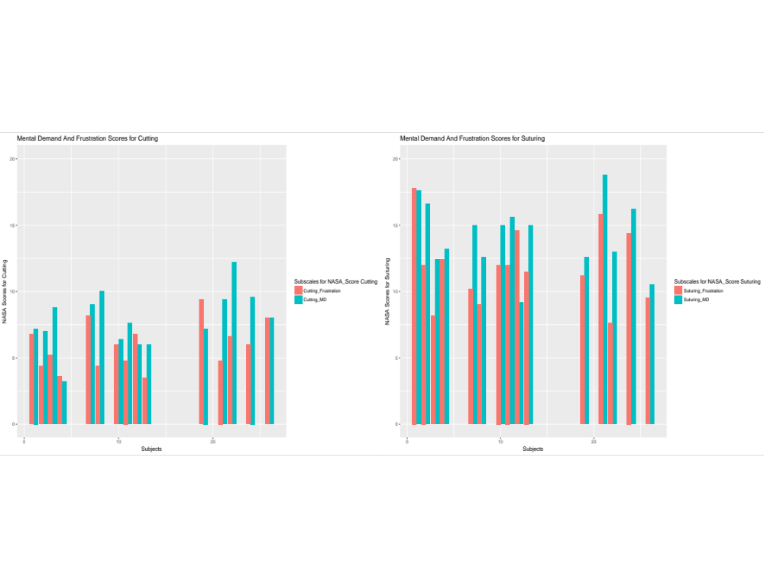
(ii) Mental Demand and Frustration : Cutting & Suturing

Slide 5
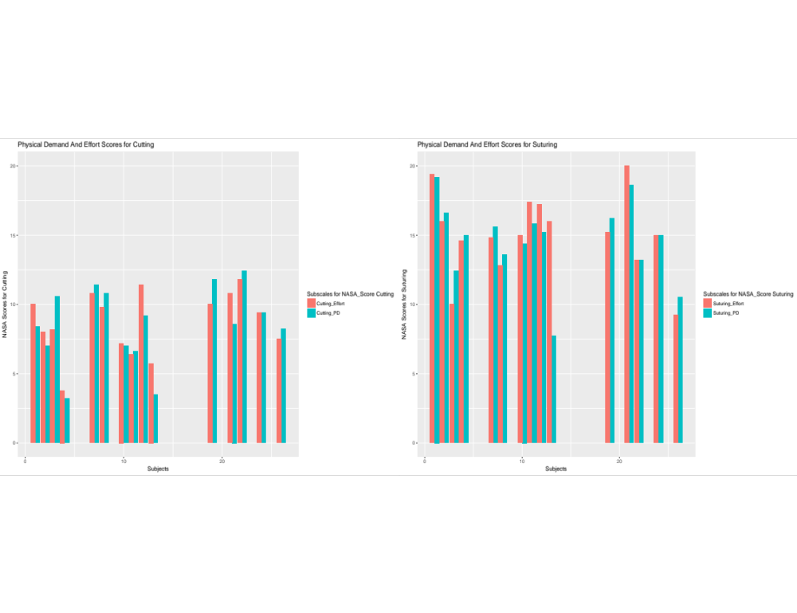
(iii) Physical Demand and Effort : Cutting & Suturing

Slide 6
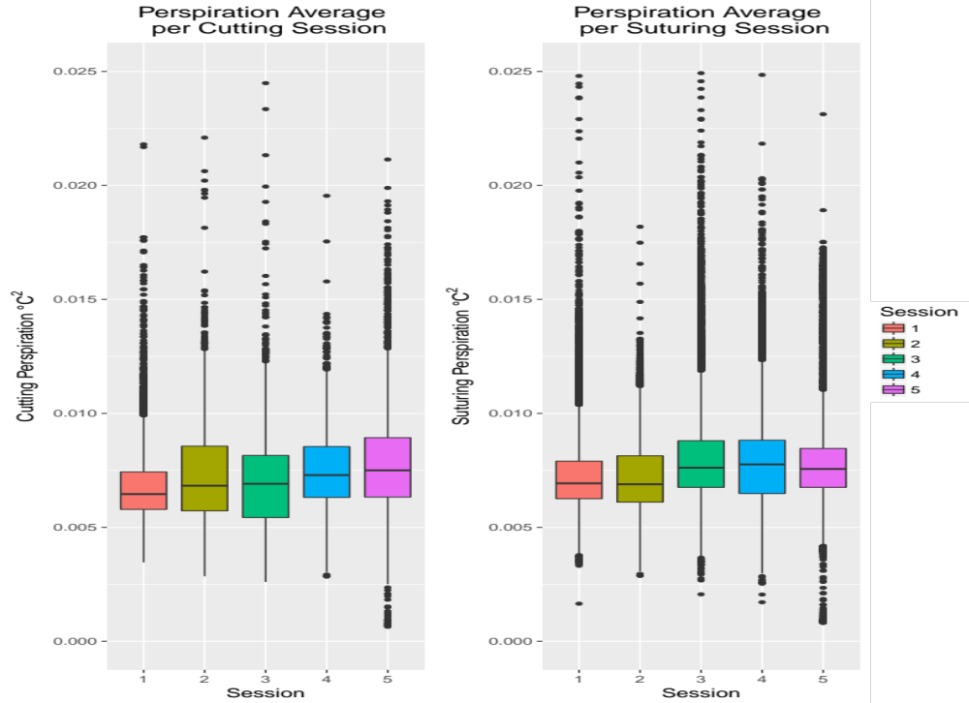
[2] Perinasal Perspiration (Stress) Signal

Slide 7
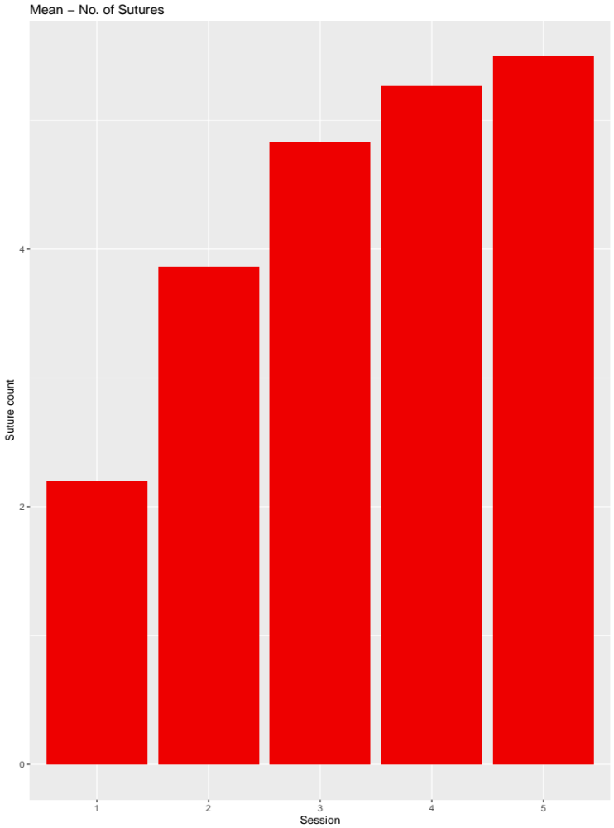
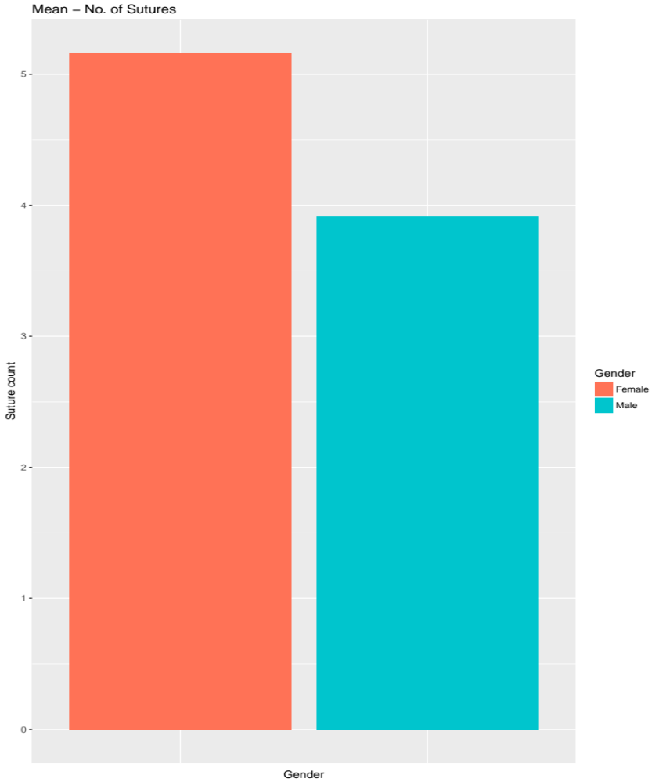
[3] Performance: Accuracy (Number of Sutures)

Slide 8
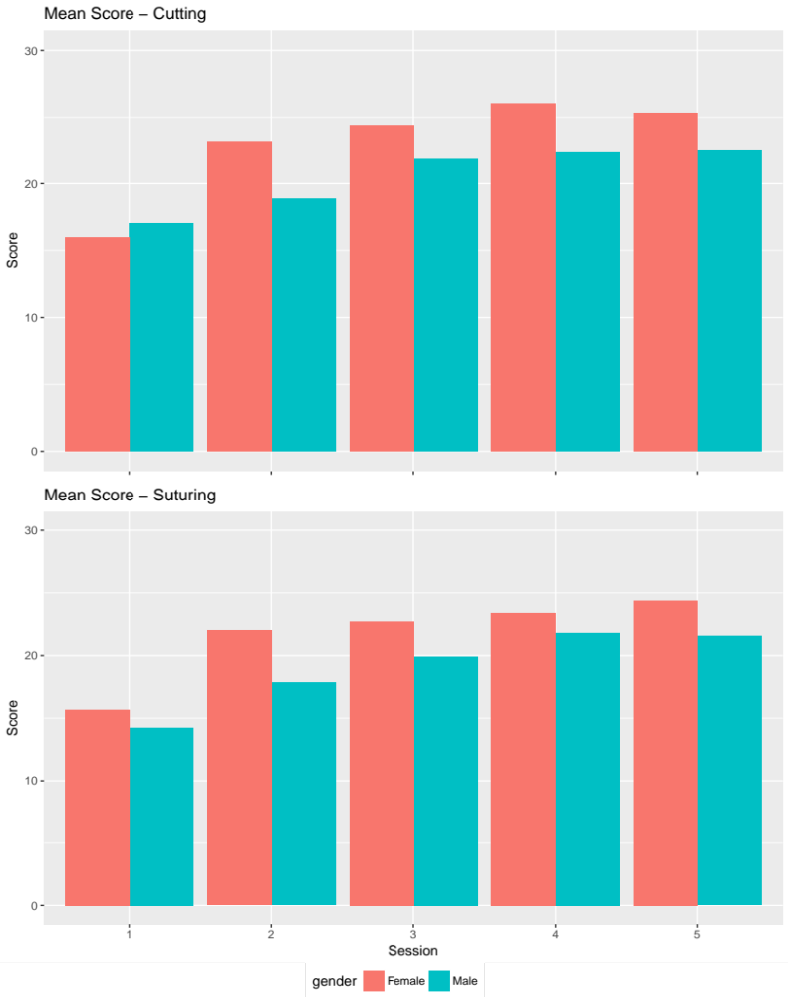
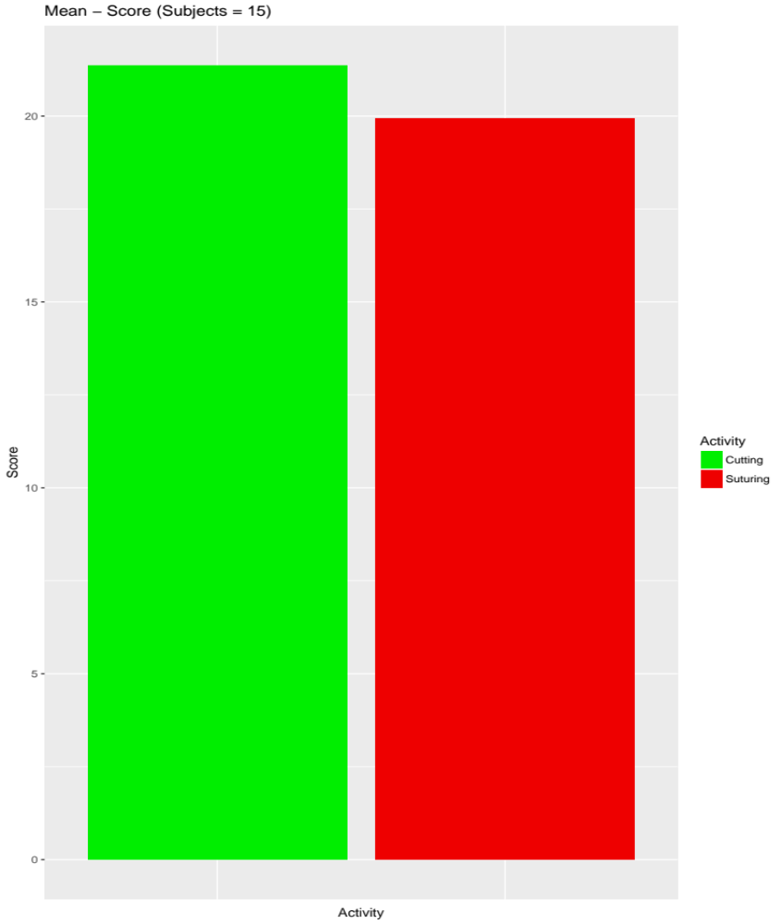
[3] Performance: Accuracy (Number of Sutures)

Slide 9
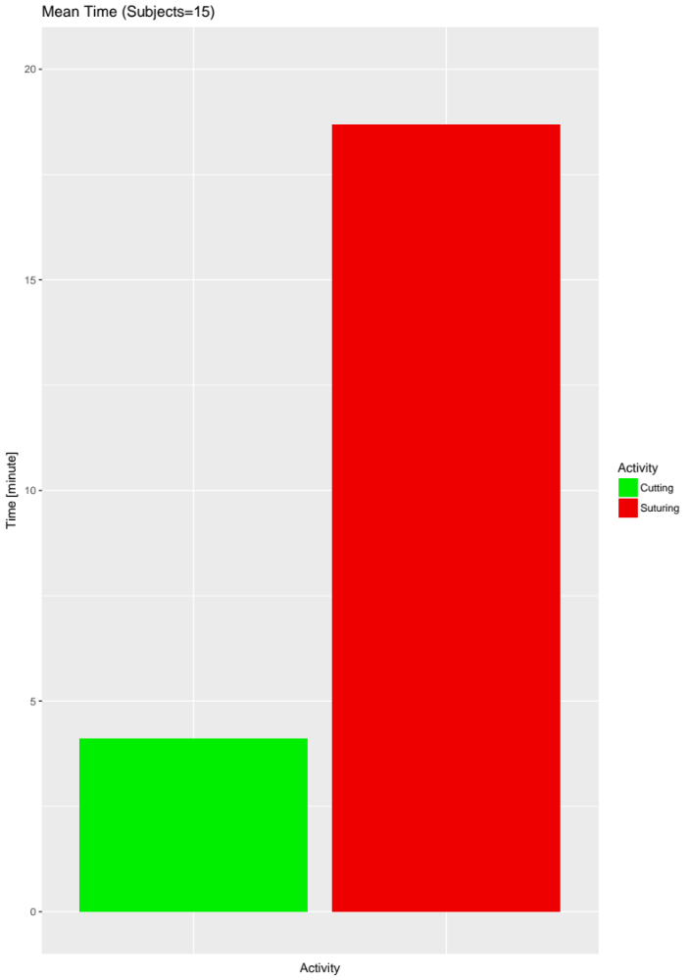
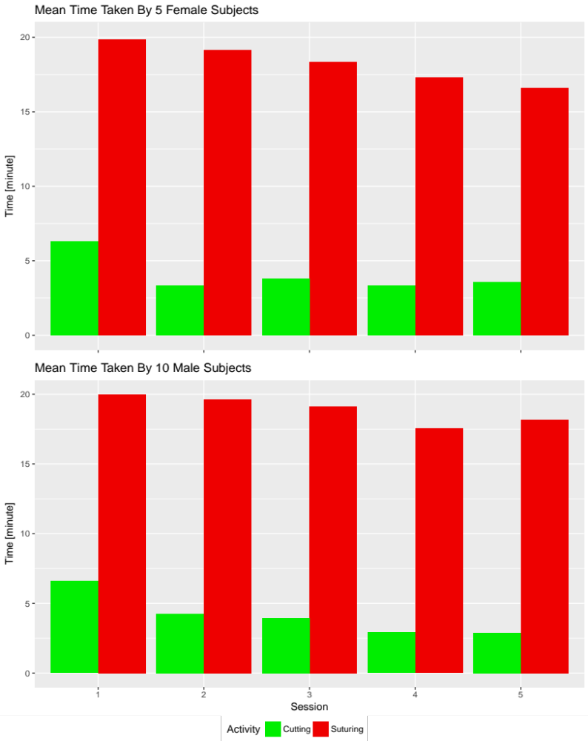
[3] Performance : Time Taken

Slide 10
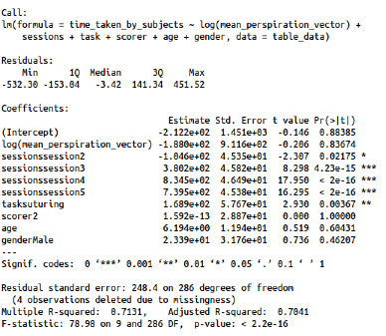
Linear Model : Time Taken
time_taken_by_subjects ~ log(mean_perspiration_vector) + sessions + task +
scorer + age + gender

Slide 11
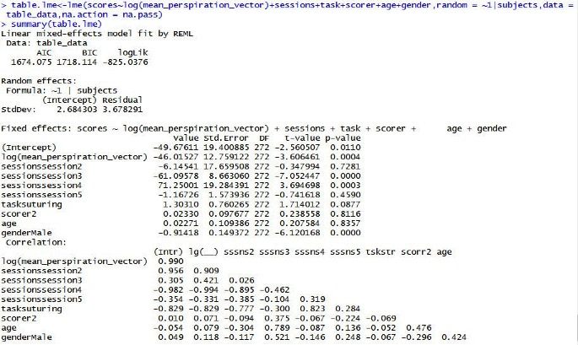
Linear Mixed Effects Model : Score
score ~ log(mean_perspiration_vector) + sessions + task + scorer + age +
gender, random = ~1|subjects

Slide 12
Thank You!

