Slide 1

ReactJS Tech Talk
By Asha H Sunagar

Slide 2
Contents
What is ReactJS?
Why ReactJS?
Render()
Hooks : useState, useEffect & Coding part
Props, Fetching API
React Router : Browser Router, Router, Link

Slide 3
What is REACTJS?
ReactJS was created by Jordan Walke, a software engineer at Facebook, in the year 2011. His objective was to develop a JavaScript-based library to facilitate more comfortable user experience.
React (also known as React.js or ReactJS) is a free and open-source front-end JavaScript library for building user interfaces or UI components
ReactJS is an Object Oriented Scripting Language
Object Oriented Scripting language connects to API
Object Oriented Programming language connects to both API & Database
Single Page Applications – parallax

Slide 4
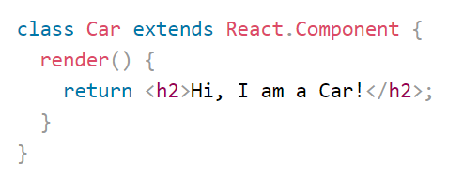
React Components : Class Components & Function Components
Components are independent and reusable bits of code. They serve the same purpose as JavaScript functions, but return HTML.
Class Components :

Slide 5
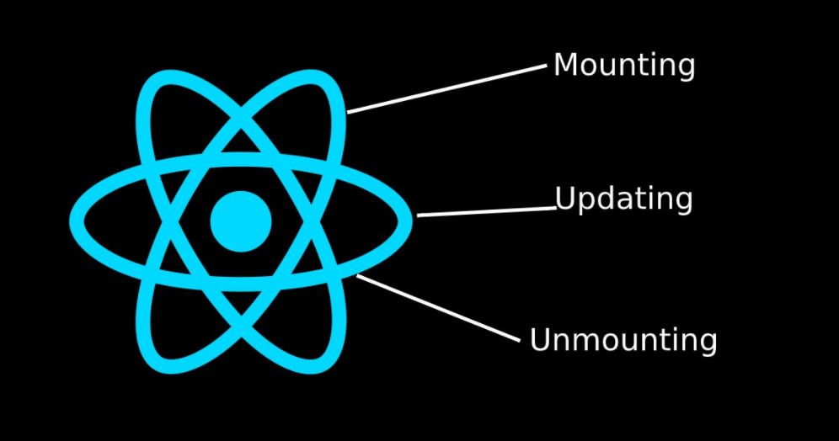
React Life cycle

Slide 6
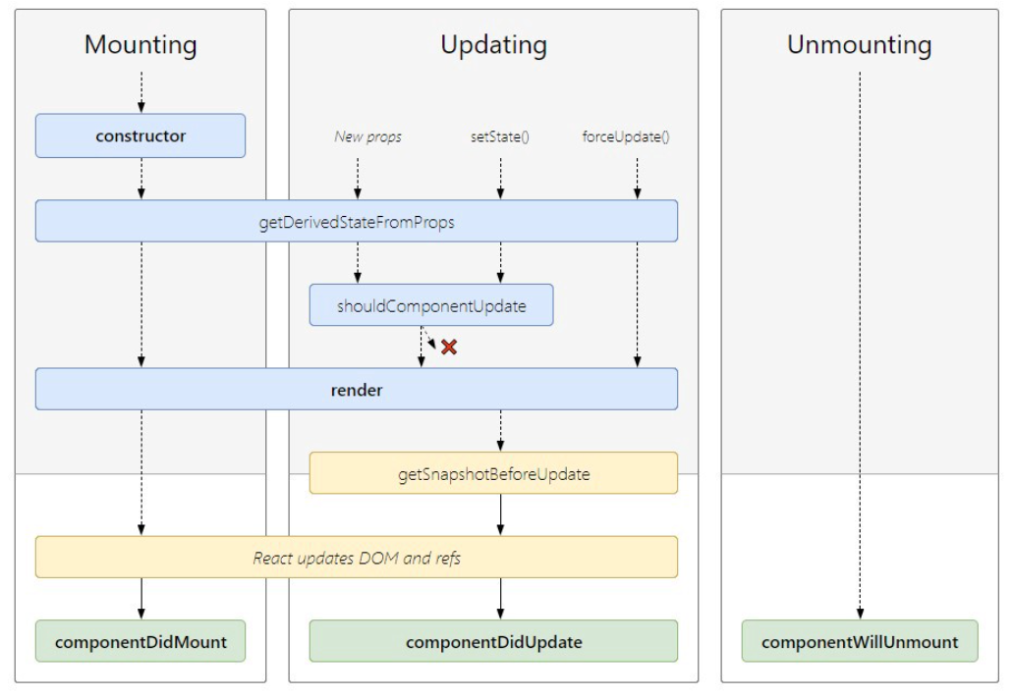
React Life Cycle in details

Slide 7
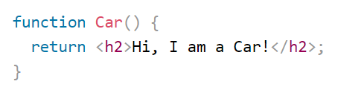
Function Components
Render() : the render() method is responsible for describing the view to be rendered to the browser window.
Virtual DOM : React now updates the virtual DOM using some calculations and also compares the new result with the actual DOM on the page.

Slide 8
Why Functional Components over class Components ?
Simple Syntax
A functional component is just a plain JavaScript function which accepts props as an argument and returns a React element.
A class component extends from React.Component and create a render function which returns a React element.

Slide 9
Why ReactJS?
Speed and efficiency
Flexibility
Performance
Easy to learn
ReactJS mobile development
Rich toolset
Strong community support - GitHub

Slide 10
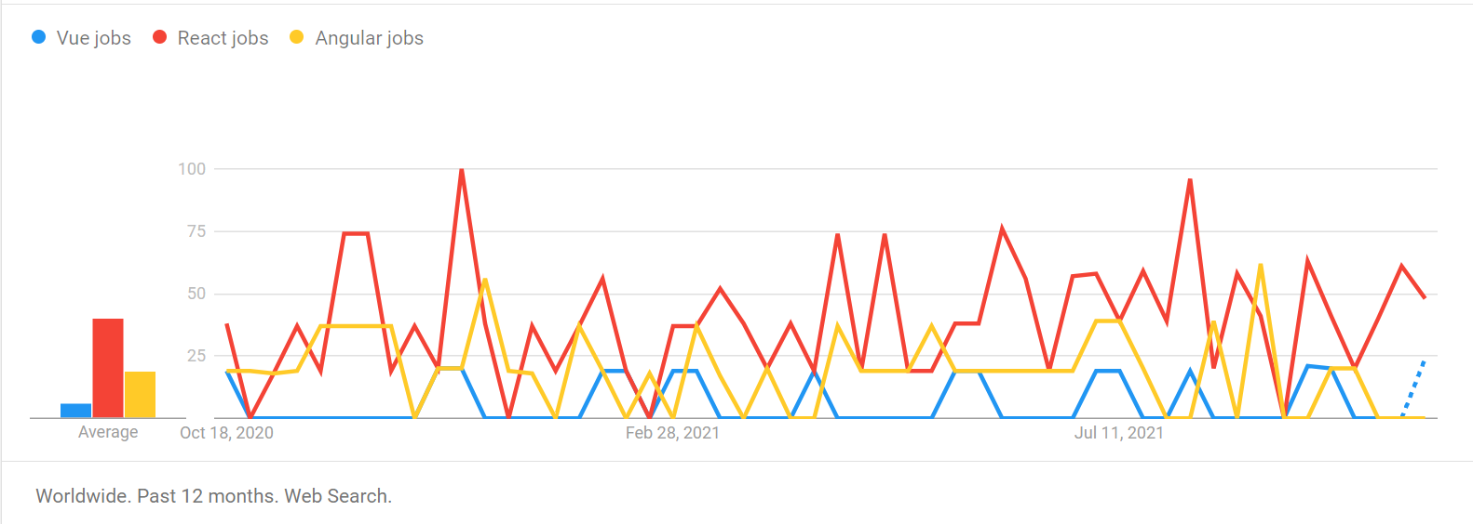
Comparison

Slide 11
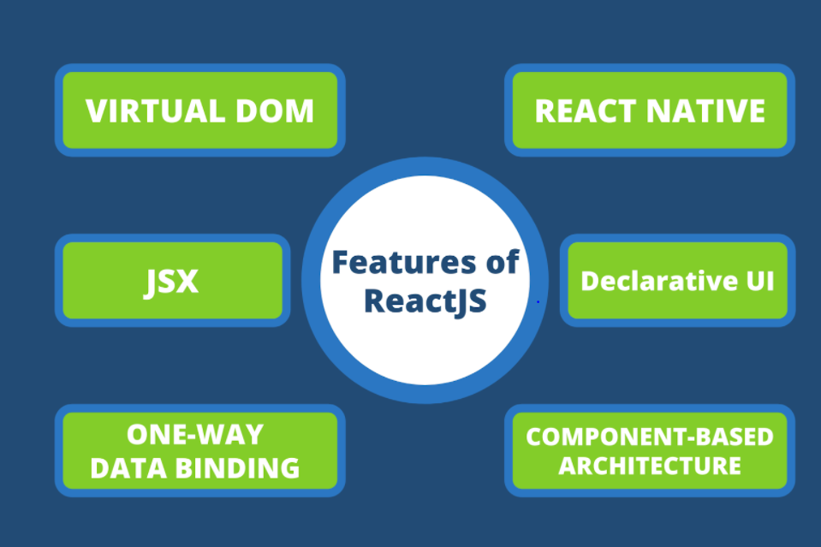
Features of React

Slide 12
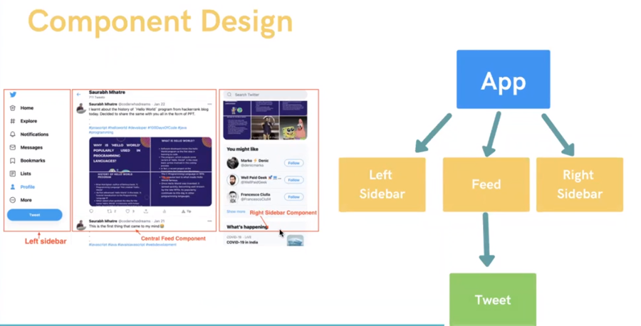

Slide 13
React Hooks & Props
Hooks are a new addition to React in version 16.8 that allows use state and other React features, like lifecycle methods, without writing a class.
useState Hook : The useState hook is a special function that takes the initial state as an argument and returns an array of two entries.
Syntax : const [count, setCount] = useState(0);
2) useEffect Hook : By using this Hook, we tell React that your component needs to do something after render.
3) Props : It’s a parameter passed to the child component from parent component like an object.

Slide 14
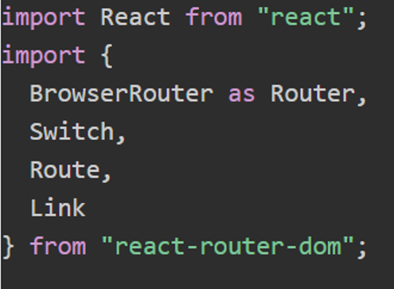
React Router
Import Browser Router at top level of App Component
Import Route & specify addresses for individual components -- go to specific page
Import Switch to prevent mixing of Components
Link to specify/redirect the path
Installation : npm install react-router-dom

Slide 15
To fetch API
Axios is a promise-based HTTP Client for node.js and the browser
Installation : npm install axios
syntax
async function fetchInformation()
{
const responseObject = await axios.get(‘API URL’);
}

Slide 16
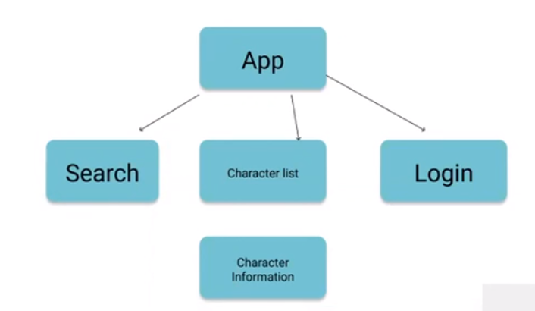
React Limitations
Data flows from parent (App) to child (Character) using props & not vice versa
Data can’t flow from Search to login
So in order to make data to share in different components which don’t have parent child relationship – State Management library like Redux

Slide 17
ReactJS Installation Steps
Visual Studio Code
Install Node.js
To create React Project
npx create-react-app project_name in terminal
To run React Project
npm start

Slide 18
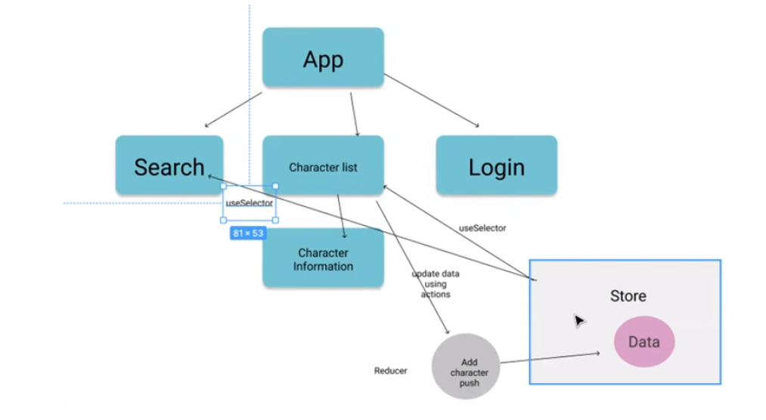
ReduxJS Introduction

Slide 19
Why Redux over React?
Installation : npx create-react-app my-app --template redux
Store is an external container to add data
To retrieve data : useSelector Hook
To update data : Action : update in react (change data in any way – add/delete)
When action is called : data updating logic is written in Reducer - action goes to reducer
Push() to add new character in data – Reducer, push() updates data
(Redux to share data between components – external comp Store, not in components)
useState in React & initialState

Slide 20
Conclusion
If someone tells you that you are not a good web developer, don’t react, learn REACT

Slide 21
Any Questions

