Slide 1
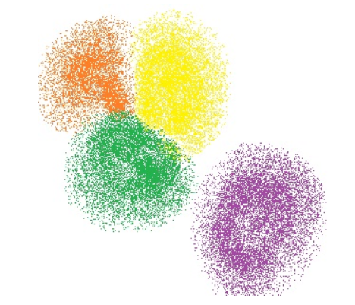
CLUSTERING

Slide 2
Outline
Types of machine learning
What is clustering?
Goal of clustering
Difference between classification and clustering
Types of clustering
Categories of clustering
Proximity measures
Evaluation of clustering algorithms

Slide 3
Types of Machine Learning

Slide 4
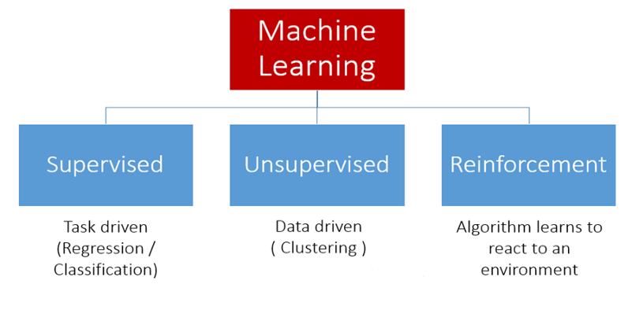

Slide 5
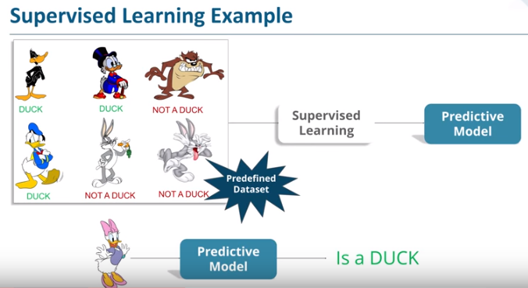
Supervised learning

Slide 6
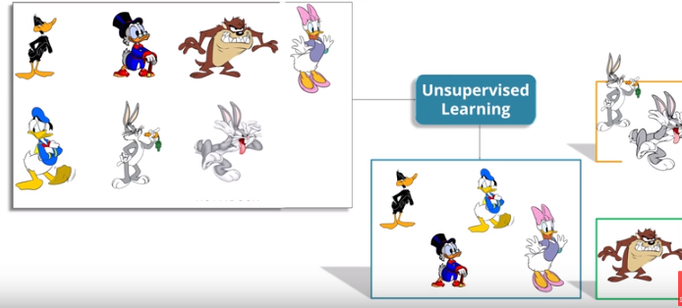
Unsupervised learning

Slide 7
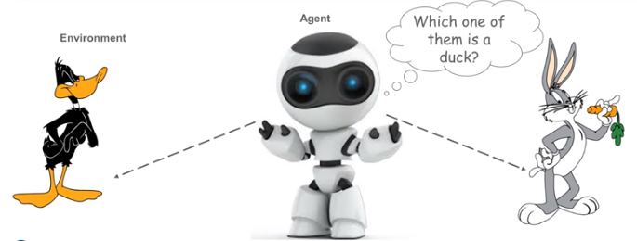
Reinforcement learning

Slide 8
What is clustering?
The process of organizing objects into groups whose members are similar in some way.

Slide 9
Goal of clustering
Group similar entities that gives us insight into underlying patterns of different groups or as a pre-processing step to other algorithms.

Slide 10
Difference between classification and clustering

Slide 11
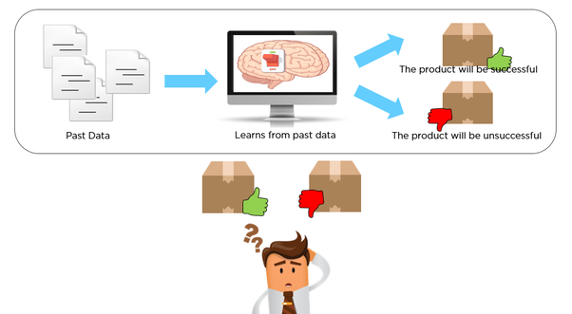
Classification Example

Slide 12
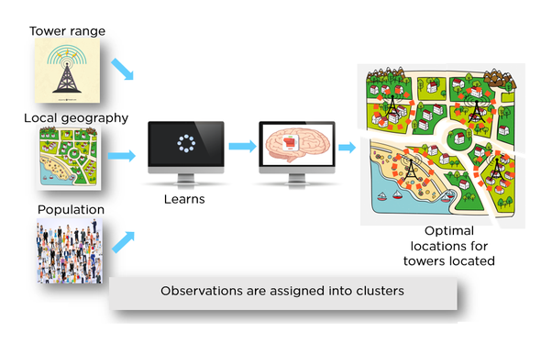
Clustering Example

Slide 13
Classification | Clustering
It involves the task of assigning instances/items/points to pre-defined classes. | It involves the task of grouping related points together.
Labelling is the priori activity. | Labelling the group of pints is posteriori activity.
Classification algorithm requires training data. | Clustering algorithm does not require the training data.
Thus, based on the training data the algorithm finds the category that new data point belongs to. | It involves the usage of statistical concepts that splits the datasets into sub-datasets such that they have similar data.
There is a concept of response or decision variable used. | There is no existence/concept of response variable.

Slide 14
Types of clustering

Slide 15
Clustering
Hard clustering
Soft clustering

Slide 16
Categories of clustering

Slide 17
Connectivity Based Clustering
Centroid Based Clustering
Distribution Based Clustering
Density Based Clustering

Slide 18
Connectivity Based Clustering
Centroid Based Clustering
Distribution Based Clustering
Density Based Clustering

Slide 19
Proximity measures

Slide 20
Proximity is measured in terms of how alike objects are to one another or how unlike they are.
Similarity measures are between 0 and 1.
Dissimilarity measures are between 0 and ∞.

Slide 21
A distance function d(x,y) when applied to two objects x and y, produces a real number and satisfies the below conditions:
Non-negativity
d(x,y) ≥ 0
Identity of indiscernibles
d(x,y) = 0 (if and only if x=y)
Distance symmetry
d(x,y) = d(y,x)
Triangle inequality
d(x,y) ≤ d(x,z)+d(z,y)
Note: A distance that satisfies these properties is called a metric.

Slide 22
Distance calculation for clustering
With quantitative variables, distance calculations are highly influenced by variable units and magnitude.
Use of a particular distance measure depends on the variable types.

Slide 23
Common proximity measures
Minkowski
Euclidean
Manhattan
Hamming
Gower
Cosine
Jaccard

Slide 24
Minkowski distance
m is a positive real number
x_{i} and y_{i} are two vectors in n-dimensional space

Slide 25
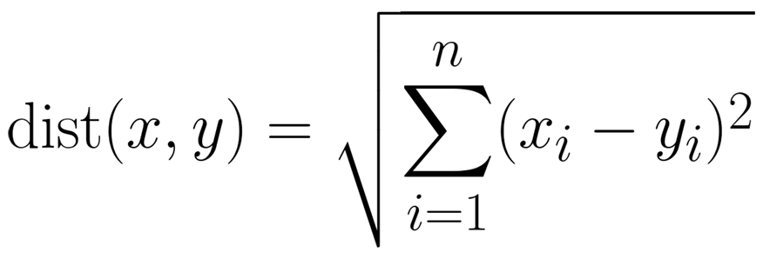
Euclidean distance
Known as L-2 distance.
Performs well when deployed to datasets that include isolated clusters.
Drawback:
Features with large values have higher influence than smaller values.
Solution: normalize the features

Slide 26
Manhattan distance
Known as L1 distance.
Absolute value of the sum of differences in given coordinates
Calculates the horizontal and vertical distances.

Slide 27
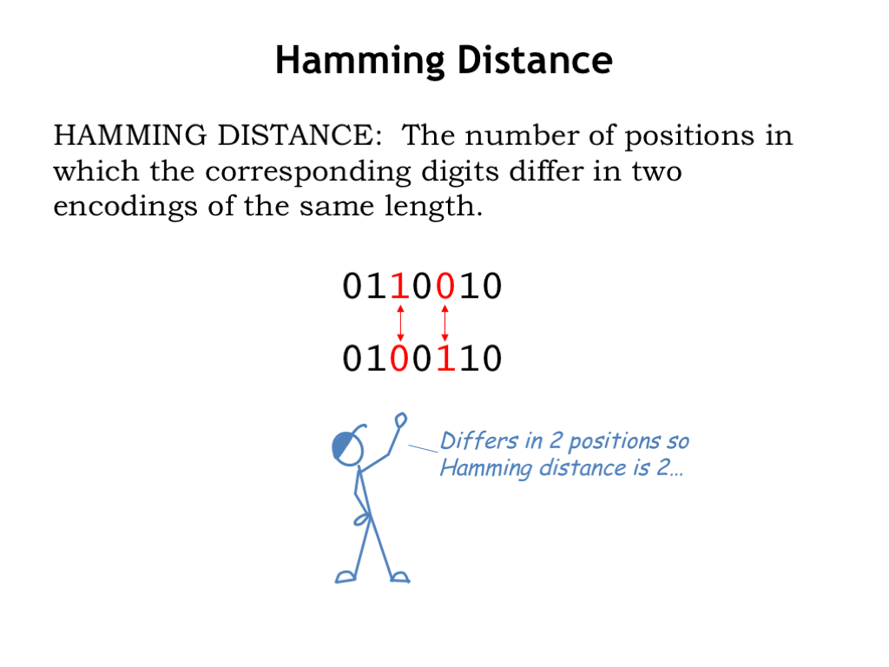
Hamming distance
Distance between categorical variables.
Uses contingency table to count the number of mismatches among the observations.
If categorical is binary, it encodes the variable as 0 or 1.

Slide 28
Gower distance
Gower distance
Measure how different two records are.
Distance is always a number between 0 (identical) and 1 (dissimilar).
Computes distance between observations weighted by its variable type, and then takes mean across all variables.

Slide 29
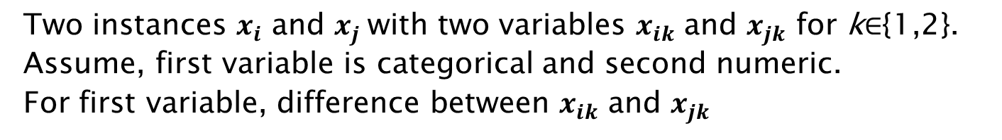

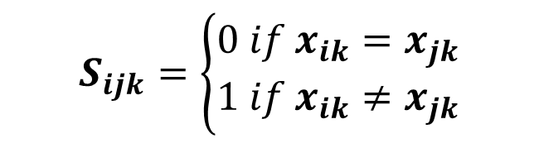

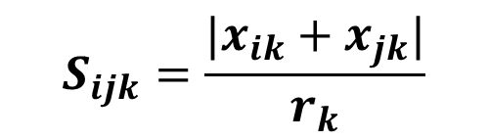
Gower distance Example
Two instances $x_{i}$ and $x_{j}$with two variables $x_{ik}$ and $x_{jk}$ for k$∈${1,2}.
Assume, first variable is categorical and second numeric.
For first variable, difference between $x_{ik}$ and $x_{jk}$
$$S_{ijk}=\left\{\begin{aligned}0 if &x_{ik}=x_{jk} \\ 1 if &x_{ik}≠x_{jk}\end{aligned}\right.$$
For second variable, difference between $x_{ik}$ and $x_{jk}$
$$S_{ijk}=\frac{|x_{ik}+x_{jk}|}{r_{k}}$$
${[r}_{k}$ - range of variable k]
$max\left(x_{.k}\right)− min(x_{.k})$

Slide 30
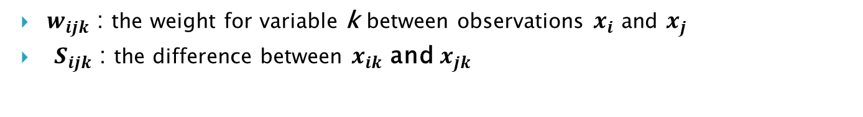
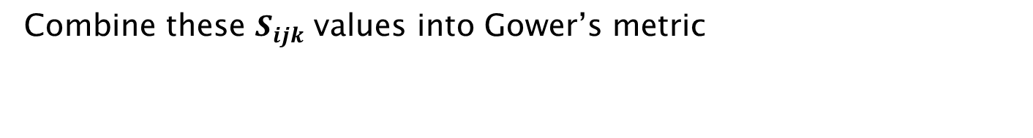

Gower distance Example
Combine these $S_{ijk}$ values into Gower’s metric
$$S_{ij}=\frac{\sum_{k=1}^{N}{w_{ijk}S_{ijk}}}{\sum_{k=1}^{N}{w_{ijk}}}$$
$w_{ijk}$ : the weight for variable k between observations $x_{i}$ and $x_{j}$
$S_{ijk}$ : the difference between $x_{ik}$ and $x_{jk}$

Slide 31
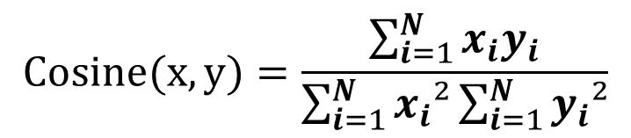
Cosine Similarity
1D array is called a vector.
Calculates cosine of the angle between two vectors.
Used in sparse high dimensional datasets (text), numerical and binary
$$Cosine(x,y)=\frac{\sum_{i=1}^{N}{x_{i}y_{i}}}{\sum_{i=1}^{N}{x_{i}²}\sum_{i=1}^{N}{y_{i}²}}$$

Slide 32
When to use Cosine similarity?
Used when the magnitude of vectors doesn’t matter.
Used where some properties of instances weights might be larger.
Example: Sensor values captured in various lengths (in time) between instances
Similarity is measured in the range 0 to 1.
Similarity = 1 if X = Y (X, Y are two objects)
Similarity = 0 if X ≠ Y

Slide 33
Cosine Similarity Case study
text1 = ‘How can I be a good geologist?’.
text2 = What should I do to be a great geologist?’.
Represent them in mathematical form in two steps:
Combine two strings into a word vector space
[HOW, CAN, I, BE, A, GOOD, GEOLOGIST, WHAT, SHOULD, DO TO, GREAT]
Document a matrix value based on the occurrence of each text against its set of vector space that is defined in above step
S₁: [1,1,1,1,1,1,1,0,0,0,0,0]
S₂: [0,0,1,1,1,0,1,1,1,1,1,1]

Slide 34


Cosine Similarity Case study
S₁ . S₂ = |S₁| |S₂| cos $θ$
cos $θ$ (which is our cosine similarity) = (S₁ . S₂) / (|S₁| |S₂|)
S₁ . S₂ = 4
|S₁| = √ (1²+1²⁺1²+1²+1²⁺1²+1²⁺0²⁺0²+0²+0²+0²) ≈ 2.64575
|S₂| = √ (0²+0²+1²+1²+1²⁺0²⁺1²⁺1²+1²+1²+1²+1²) ≈ 3
cos $θ$ = 4 / (2.64575 * 3) ≈ 0.50395
|S₁| is the square root of the magnitude of the values in S₁.
|S₂| is the square root of the magnitude of the values in S₂

Slide 35
Jaccard Similarity
Measures similarity between sets.
Defined as the ratio of the cardinality of the intersection and cardinality of union of the two sets
Jaccard Similarity = |A ∩ B| : |A U B|

Slide 36
Jaccard Similarity Case study
A = ‘How can I be a good geologist?’.
B = What should I do to be a great geologist?’.
A ∩ B = { ‘ I ’ , ‘ be ‘ , ‘ a ‘ , ‘ geologist ‘ }
A U B = { ‘how’ , ‘can’ , ‘I’ , ‘be’ , ‘a’ , ‘good’ , ‘geologist’ , ‘what’ , ‘should’ , ‘do’ , ‘to’ , ‘great’ }
| A ∩ B | = 4
| A U B | = 12
Jaccard Similarity = | A ∩ B | : | A U B |
= 4 : 12
= 0.33

Slide 37
Connectivity based clustering

Slide 38
Hierarchical clustering
Hierarchical Clustering
Divisive
Agglomerative

Slide 39
Divisive method
Assign all observations to a single cluster.
Partition the cluster to two least similar clusters.
Proceed recursively on each cluster until one cluster for each observation is left.
Agglomerative method
Assign each observation to its own cluster.
Combine the two most similar clusters by computing similarity between each cluster.
Repeat above step until a single cluster is left.

Slide 40
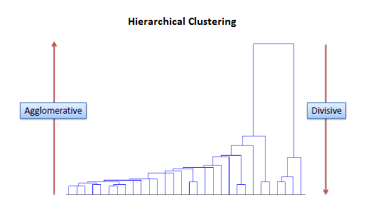

Slide 41
How distance between each cluster is measured?
Single linkage
Complete linkage
Average linkage
Ward’s method

Slide 42
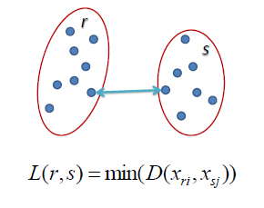
Single linkage
Distance between two clusters is the shortest distance between two points in each cluster.

Slide 43
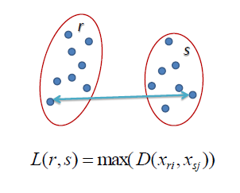
Complete linkage
Distance between two clusters is the longest distance between two points in each cluster.

Slide 44
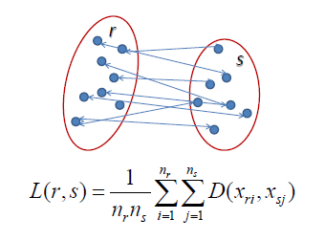
Average linkage
Distance between two clusters is the average distance between each point in one cluster to every point in other cluster.

Slide 45
Ward’s method/minimum variance method
Creates compact, even sized clusters.
Involves agglomerative clustering algorithm.
Starts with n clusters, each containing a single object.
N clusters are combined to make a single cluster containing all objects.
At each step the process makes a new cluster that minimizes variance, measured by an index called E (sum of squares index).

Slide 46
Ward’s method/minimum variance method
At each step, the following calculations are made to find E.
Find the mean of each cluster.
Calculate the distance between each object in a particular cluster.
Square the differences from step2.
Sum (add up) the squared values from step3.
Add up all the sum of squares from step4.

Slide 47
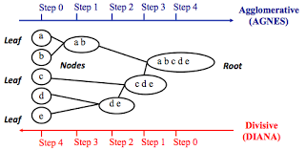
Hierarchical clustering Example

Slide 48
Advantages of hierarchical clustering
Outputs a hierarchy that is more informative than unstructured set of flat clusters.
Easy to decide on number of clusters looking at dendrogram.
Easy to implement.
Disadvantages of hierarchical clustering
Not possible to undo previous step.
Time complexity: not suitable for large datasets.
Sensitive to outliers

Slide 49
Centroid based clustering

Slide 50
K-means
It is a partitioning clustering algorithm and partitions the data into k clusters.
Each cluster has a center called centroid.
K is specified by the user.
How do we quantify the best clustering?
The best clustering will have the minimum within/intra-cluster distances and maximum between/inter-cluster distances.

Slide 51
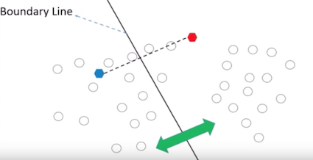
K-means
Step-1 : Initialization
randomly choose k points as initial centroids.
Step-2 : Cluster assignment

Slide 52
K-means
Step-3 : Centroid Update
updates cluster centroids to achieve less intra-cluster distances and large inter-cluster distances.
Repeat step 2 and 3 until centroid stops moving.

Slide 53
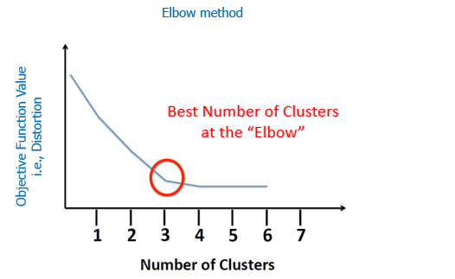
Choosing the number of clusters

Slide 54
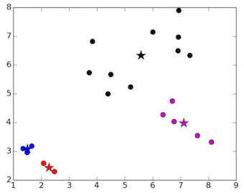
Unlucky centroids

Slide 55
Advantages of k-means
Easy to implement.
With large # of variables, k-means is faster than hierarchical.
An instance can change cluster(move to another cluster) when centroids are recomputed.
Disadvantages of k-means
Difficult to predict the # of clusters.
Sensitive to outliers.
Rescaling the datasets (normalization or standardization) will completely change results.

Slide 56
Density based clustering

Slide 57
DBSCAN
Density Based Spatial Clustering of Applications with Noise (DBSCAN).
Works on a parametric approach.
The two parameters involved are
∊ (epsilon) – radius of the neighbourhood around data point p
minPts – minimum # of points we want in neighbourhood

Slide 58
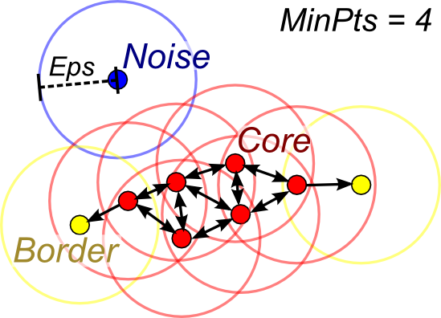
DBSCAN
Once the parameters are defined, the algorithm divides the data points into three points:
Core points
Border points
Outliers

Slide 59
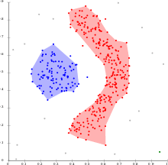
Steps in DBSCAN
Pick a random point which is not assigned to any cluster and calculates its neighbourhood, if the point has minPts makes a cluster or marks it as outlier.
Once all core points are found, expand it to include border points.
Repeat above steps until all points are assigned to a cluster or to an outlier.

Slide 60
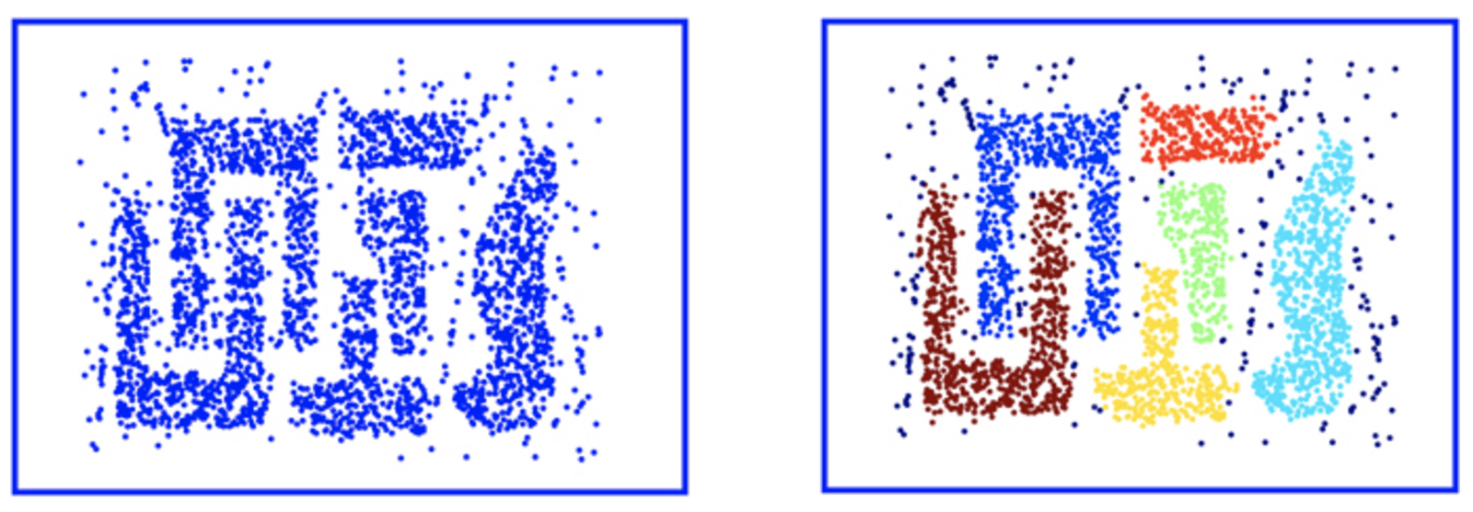
Advantages of DBSCAN
Resistant to noise and can handle clusters of various sizes.
There are lot of structures k-means would not be able to find but DBSCAN can find those structures.

Slide 61
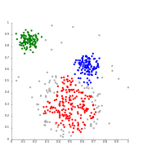
Disadvantages of DBSCAN
Does not work well when dealing with clusters of varying densities or with high dimensional data

Slide 62
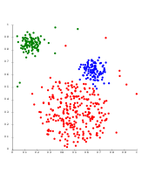
OPTICS is a DBSCAN variant that handles different densities much better.

Slide 63
Cluster Evaluation

Slide 64
Cluster Evaluation
Internal
External

Slide 65
Internal Evaluation

Slide 66
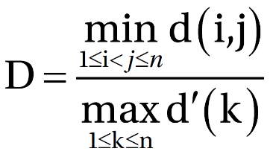
Dunn Index
Aims to identify dense and well-separated clusters.
Defined as ratio between minimal inter cluster distance to maximum
Intra cluster distance.
Dunn index has value between 0 and infinity.
For each cluster partition the Dunn index is calculated by
d(i,j) represents the distance between cluster i and j
d’(k) measures the intra-cluster distance of cluster k

Slide 67
Silhouette coefficient
Average distance to elements in the same cluster with the average distance to elements in other clusters.
Objects with high Silhouette coefficient are considered well clustered.
Objects with low Silhouette coefficient may be outliers.

Slide 68
External Evaluation

Slide 69

Rand Index
Measures how many items that are returned by the cluster and the actual labels are common and how many differ.
It is a measure of percentage of correct decisions made by the algorithm.
FP and FN are equally weighted , this may be an undesirable characteristic for some clustering applications.

Slide 70
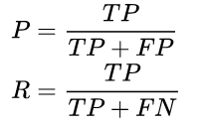

F-measure
Used to balance the contribution of FN by weighting recall through a parameter β≥0.
Recall has no impact on the F-measure when β=0 and increasing β increases weight to recall in the final F-measure

Slide 71

Jaccard Index
Similar to Rand index.
Used to quantify the similarity between two datasets.
Varies between 0 and 1, 0 implies no overlap and 1 indicates identical datasets.
FP and FN are equally weighted , this may be an undesirable characteristic for some clustering applications.

Slide 72
Summary
Types of machine learning
What is clustering?
Goal of clustering
Difference between classification and clustering
Types of clustering
Categories of clustering
Proximity measures
Evaluation of clustering algorithms

Slide 73
Thank you !

