Slide 1
Data analysis Lifecycle

Slide 2
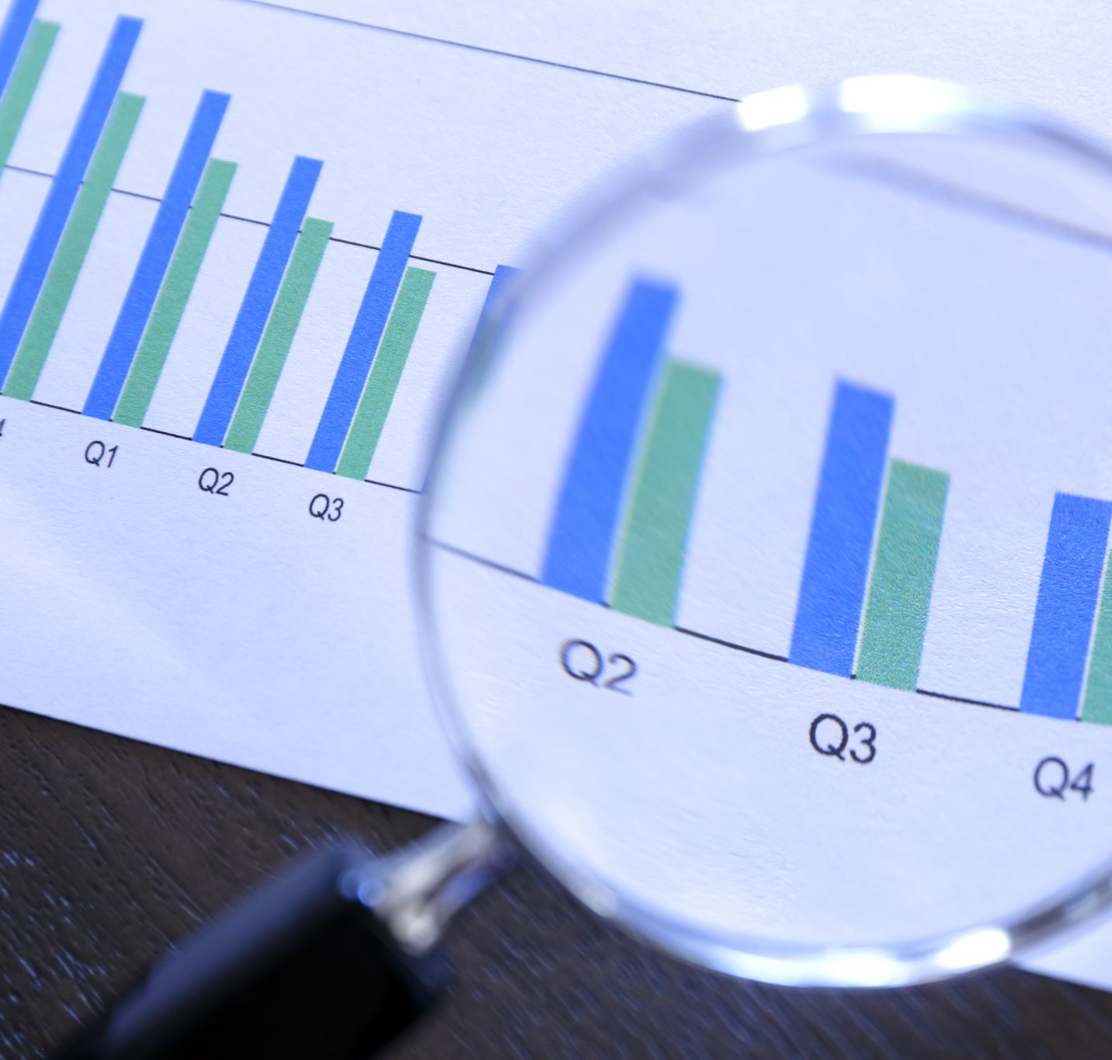
Which aspects of the data analysis lifecycle are you primarily involved with on this project?
Acquire – Acquired from ChatData in a CSV format
Transform – Already in a suitable CSV format
Organise – The data was already organised
Analyse – Used SQL for analysis
Communicate – Has not been communicated yet
Maintain – can be maintained using a RDBMS

Slide 3
What activities would you need to do before undertaking this project? Think about where the data came from.
The activities that would need to be done before undertaking this project are:
Feel intimate with the data by loading it into a readable format
Create an Entity Relationship diagram (ERD) – to understand how each of the datasets relate to each other

Slide 4
What would you need to do to allow this analysis to be repeated with updated data, and how would this solution be maintained?
To use updated data:
Can use SQL to import updated data into the notebook
However, a RDBMS could make things easier to maintain
On the other hand, Using the Jupyter notebook may be a hassle

Slide 5
How does this project fit into a broader data lifecycle?
Create: In terms of the creation of the data, the data was acquired from Chatdata themselves in a CSV format.
Storage: was directly stored in the Jupyter notebook.
Use: Analysis using SQLite and Python Pandas
Archive: If the data was to be archived, it would be difficult to do this in the Jupyter notebook itself since the notebook is stored locally in the user’s computer.
Delete: Can be deleted and removed from the users computer

Slide 6
Requirements

Slide 7
What aspects of the requirements were not 100% clear to you?
Requirements that were clear:
Loading the Dataset and Creating a database
Cross Table Queries
Requirements that were not clear:
Last Requirement from the Single table queries - “Rank the days of the week from highest to lowest in terms of the volume of ViewCount as a percentage”

Slide 8
Would it have been easier if you could talk directly to Oliver? If so, what sorts of questions would you want to ask him?
Would it have been easier to talk to Oliver?
Yes – in order to understand what he expects from each requirement
What Questions would you ask him?
If he could explain more about what he wants to see from each requirement
If he could find an alternative for the requirement that was not clear to me

Slide 9
How did you analyse the requirements?
How was the requirements analyzed in this project?
The main component was SQLite
The main functions used were:
COUNT
JOIN
GROUP BY
ORDER BY
LIMIT

Slide 10
Tools

Slide 11
Were the tools you used appropriate for the job?
SQL made it easier to:
Manipulate the data set and conduct analysis
Extract the information I needed
Move onto the next requirement quickly, which made it time efficient

Slide 12
Why was SQLite used over PostgreSQL for this project?
The main reason SQLite was used over PostgreSQL was due to:
Security and Privacy reasons
SQLite is Lightweight and the best for smaller databases

Slide 13
What are the benefits of adopting relational database technologies for an IT organisation?
Benefits of adopting a relational database for an IT organization:
Data Accuracy – Relational databases ensure that the data is non-repetitive
Better Security – Certain tables can be flagged as confidential and users can be created to grant access to those tables
Simplicity – A relational database is much simpler and easier to use

Slide 14
Quality

Slide 15
What did you think of the organisation of the source data and how that mapped to the structure of your database? Was there a natural mapping from the CSV files to the database tables?
What made the CSV files match to the database tables?:
The organization of the data
The transparency of the data in terms of the Primary key and foreign keys

Slide 16
Was the data consistent? In other words, were there any issues with the data that prevented you from producing good quality results?
The data was consistent, However there were:
Null and 0 values – indicates Missing Information
To avoid problems in the future:
The data must be cleaned to avoid inaccuracies

Slide 17
Did you find the definitions of the data were detailed enough to assist you in the tasks?
In this case, the definitions of the data were not clear enough.
If it was, it could have helped feel more intimate with the datasets which could have aided the analysis process

Slide 18
What steps would you take to ensure that any concerns about data quality are dealt with appropriately? Who would you talk to about this?
Steps to ensure data quality:
Clean the data thoroughly
Main factors to consider:
Accuracy
Relevance
Completeness
Consistency

Slide 19
Security, Ethics and Legislation

Slide 20
Was the data sufficiently masked, or are there personal details present in the data?
What is Data masking?
Data masking is a technique for producing an inauthentic but structurally identical version of an organization's data that can be utilised for things like user training and software testing. The goal is to safeguard the real data while having a useful backup in case the real data isn't needed.
Was the data sufficiently masked?
Yes – through numerical ID values

Slide 21
Can you think of possible techniques (e.g. statistics) that could unmask the participants in this data?
Factors that could unmask participants in the dataset:
Full access or Unauthorized access to the production database
If Users location, display name and profile picture match to their real identity

Slide 22
Are there any ethical considerations with our intended use of this data?
Ethical Considerations:
Informed Consent – participants should be able to give their consent towards their data being used
Making sure data is kept safe and secure – personal information must be kept safe
Maintaining confidentiality and anonymity – participants have the right towards keeping their data confidential and their identity anonymized

Slide 23
Is the use of this data covered by any legislation, and if so, what is that legislation?
The Data Protection Act 2018 - Everyone responsible for using personal data has to follow strict rules called ‘data protection principles.
Data Protection by Design (GDPR) - Data protection by design is a strategy that eventually ensures that privacy and data protection concerns are considered during the design stage of any system, service, product, or process as well as all along the product's lifecycle.

