Slide 1
KONNECT
Gabriele Bieliauskaite, Nathalie Le,
Rachel Schomp, Alen Shaju
TEAM 7

Slide 2
OUR VISION
Create a way to connect those impacted by cancer

Slide 3
Main Points
Connect | Chat
News & Events | Support

Slide 4
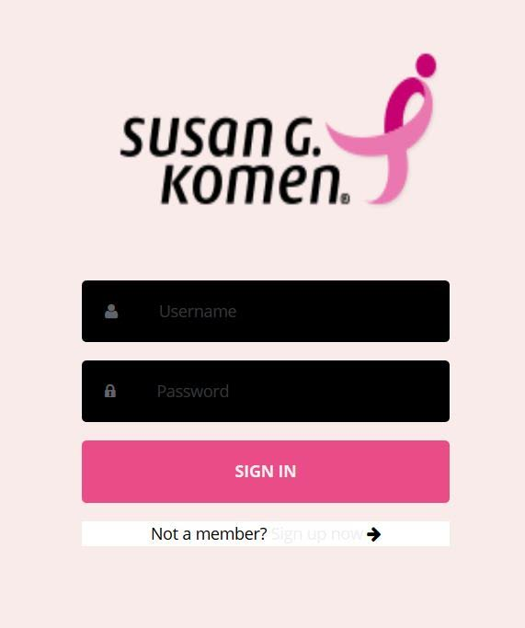
Current implementation

Slide 5
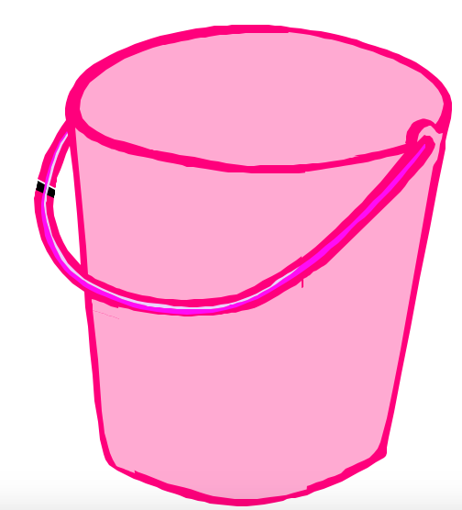


Future Implementation
Data Collection
Reviews
Match by Location

