Slide 1
Microsoft Movie Studio Analysis
Armun Shakeri

Slide 2
Summary
Descriptive analysis of film information to reveal that Microsoft’s initial film should:
Have a budget of $200,000,000
Film’s genre should be Action, Adventure, Animation
Film should be a family oriented film, with a PG-13 rating.

Slide 3
Outline
Business Problem
Data and methods
Results
Conclusion

Slide 4
Business Problem
Microsoft is new to the movie production industry
Movie needs to be profitable and popular
Ensure accuracy and diligence in data preparation and analysis

Slide 5
Data
Data was obtained from:
IMDB
Box Office Mojo
The-numbers.com

Slide 6
Data and Methods
Movie production budgets
Domestic gross profit
Film ratings
Genre counts

Slide 7
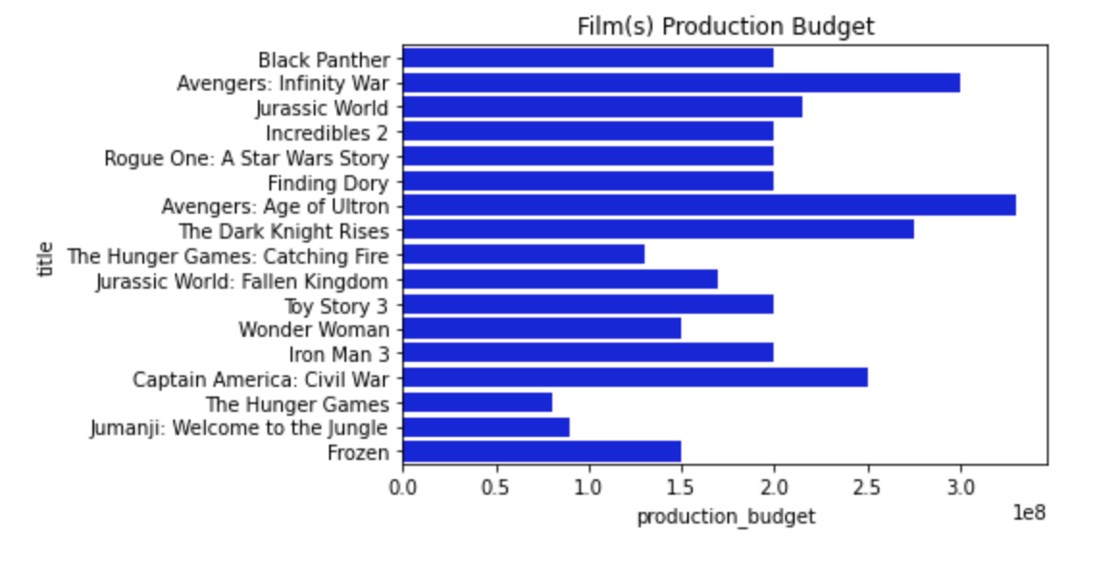
Results
The average film production budget is $170,000,000, for Microsoft to create a successful film we will need to implement a higher production budget of $200,000,000.

Slide 8
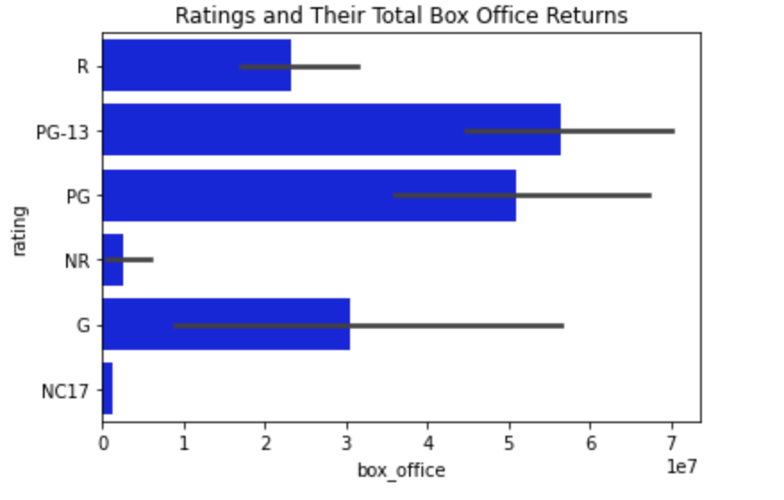
Results
Movies that are considered family type movies are the most popular and highest grossing

Slide 9
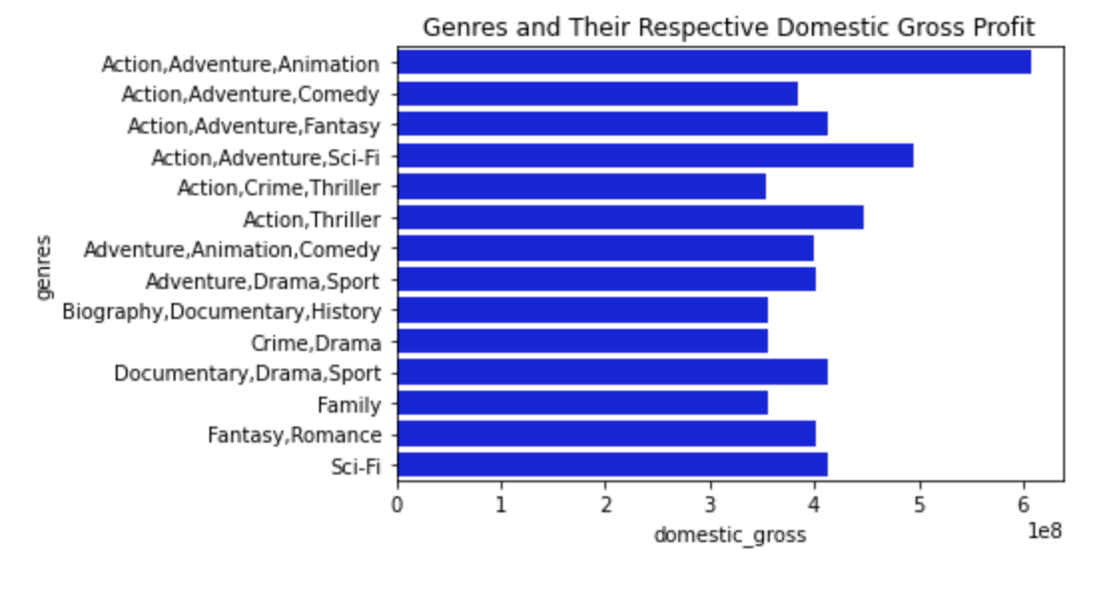
Results
Action, Adventure, Animation films is the highest grossing film genre.

Slide 10
Conclusions
1) The film should have a maximum budget of $200,000,000
2) The film's genre should be action, adventure, and animation.
3) The film should be a family type of movie, with a PG-13 rating.
Next steps:
Incorporate more niche genres such as horror or documentaries.
Incorporate worldwide gross income

Slide 11
Thank you
Email: ashakeri62@gmail.com
Linkedin: https://www.linkedin.com/in/armun-shakeri/
Github: https://github.com/ashakeri92

