Slide 1
BE Assessment- Solution
By Asha Kolakaluri

Slide 2
Project Description
The project is a recipe management application called "MyRecipeRestApp". It allows users to create, store, and manage recipes. The application provides a RESTful API for performing various operations on recipe.
The project is developed using the Spring Boot framework, which is a popular Java framework for building robust and scalable applications. Spring Boot provides a simplified and opinionated approach to developing Java applications, offering features such as auto-configuration, embedded servers, and easy dependency management.
The project utilizes Apache Maven as the build automation tool and dependency management tool. Maven simplifies the build process by managing project dependencies, compiling source code, running tests, and packaging the application into a deployable artifact.
The application also incorporates OAuth2 authentication with GitHub. OAuth2 is an open standard for authorization that allows users to grant third-party applications access to their resources without sharing their credentials. By integrating with GitHub's OAuth2 authentication, the application can authenticate users using their GitHub accounts, enhancing security and providing a seamless user experience.

Slide 3






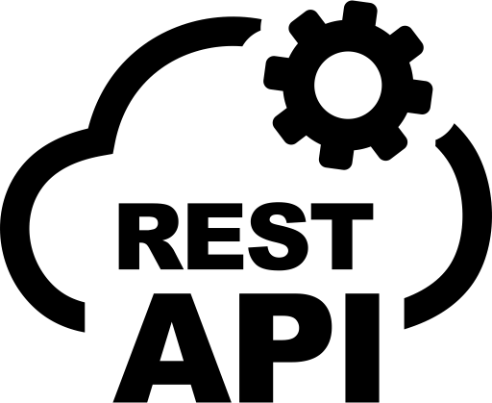

Recipe API Project Components
Binding
JPA Repository
Request
Recipe Controller
Recipe Service
Recipe Repository
Response
Client
Database
pom.xml
application.yml
Server
Tools/Technologies

Slide 4

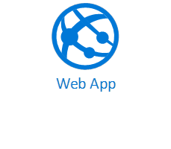




Desired High level Architecture in Azure Ecosystem
Request
Azure
Request
Azure SQL database
Response
Response
Client
Server
Tools/Technologies

Slide 5
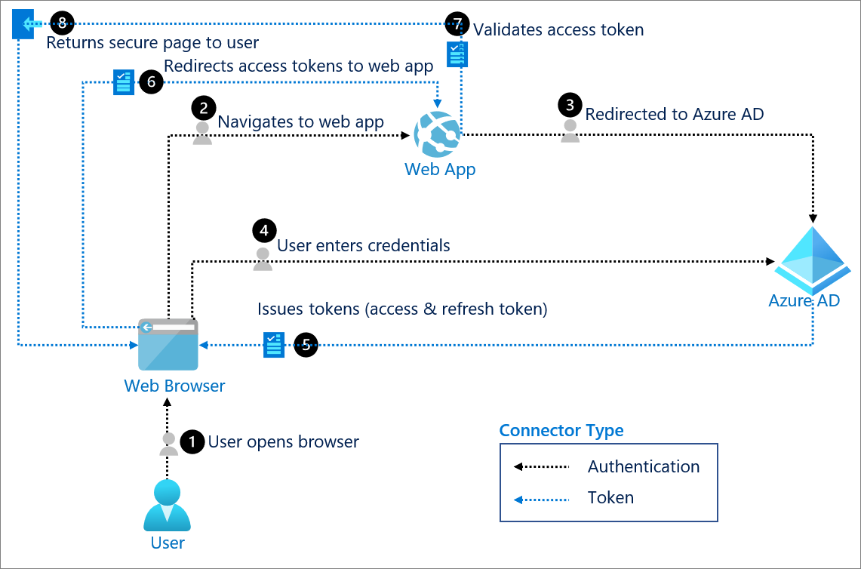
Desired OAuth 2.0 authentication with Azure Active Directory
Server
Tools/Technologies

Slide 6
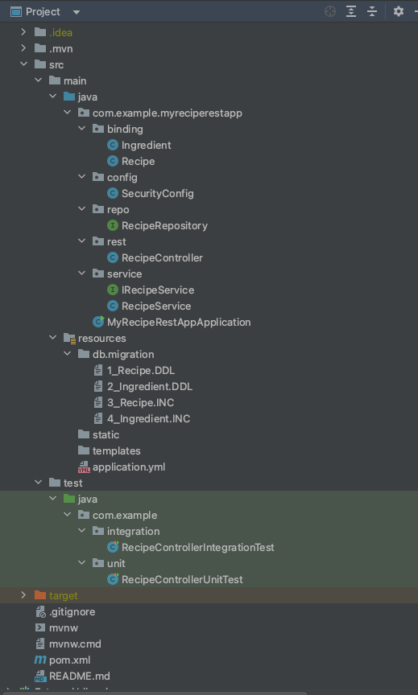
Project Structure
Entity
Security
Repository
Controller
Service
Application
DB Components
Configuration
Unit and Integration Tests
Build
Documentation

Slide 7
Endpoints List
POST /api/v1/recipe - Create a new recipe.
PUT /api/v1/recipe - Update an existing recipe.
DELETE /api/v1/recipe/{id} - Delete a recipe by ID.
GET /api/v1/recipe/{id} - Get a recipe by ID.
GET /api/v1/recipes - Get all recipes.
GET /api/v1/recipes/byCookingTimeAndServings - Get recipes by cooking time and servings.
GET /api/v1/recipes/byVegetarian - Get recipes with veg/non-veg filter.
GET /api/v1/recipes/byServings - Get recipes by servings.
GET /api/v1/recipes/byInstructions - Get recipes by instructions.
GET /api/v1/recipe/vegetarian - Check if a dish is vegetarian based on title.
GET /api/v1/recipes/byIngredients - Get recipes by ingredients.
GET /api/v1/recipes/byServingsAndIngredient - Get recipes by servings and ingredient.
GET /api/v1/recipes/byInstructionsAndNotIngredientName - Search recipes by instructions and exclude ingredient name.
GET /api/v1/status - Get application status.

Slide 8
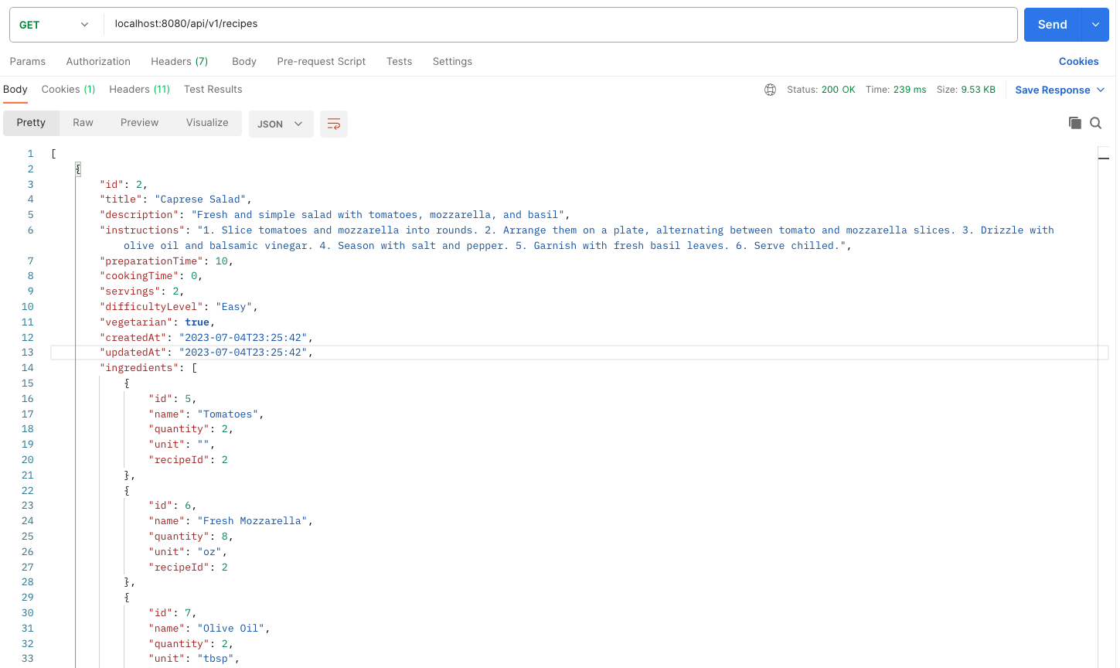
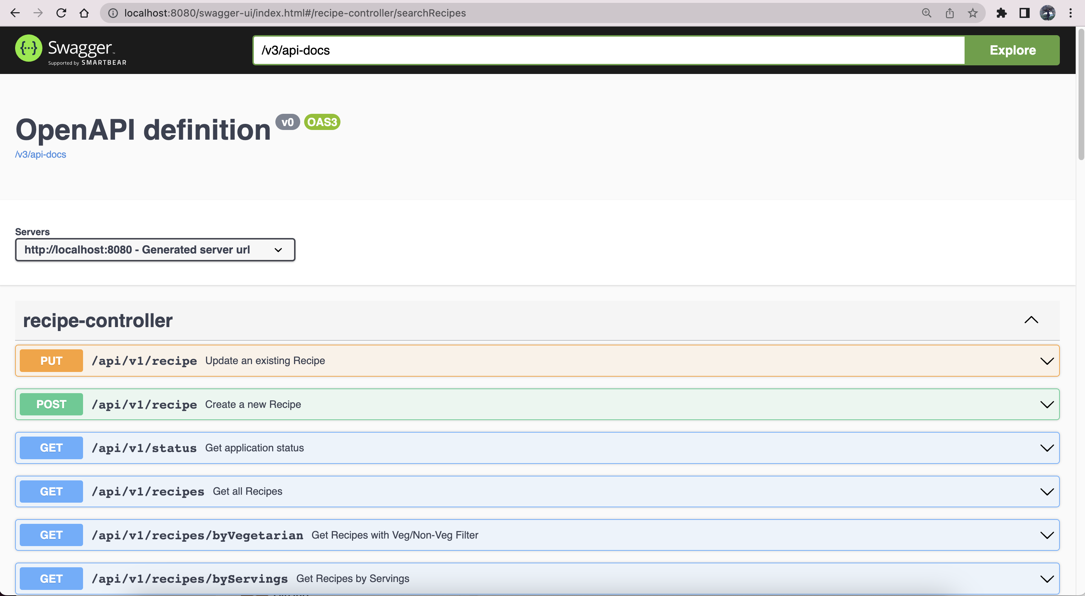
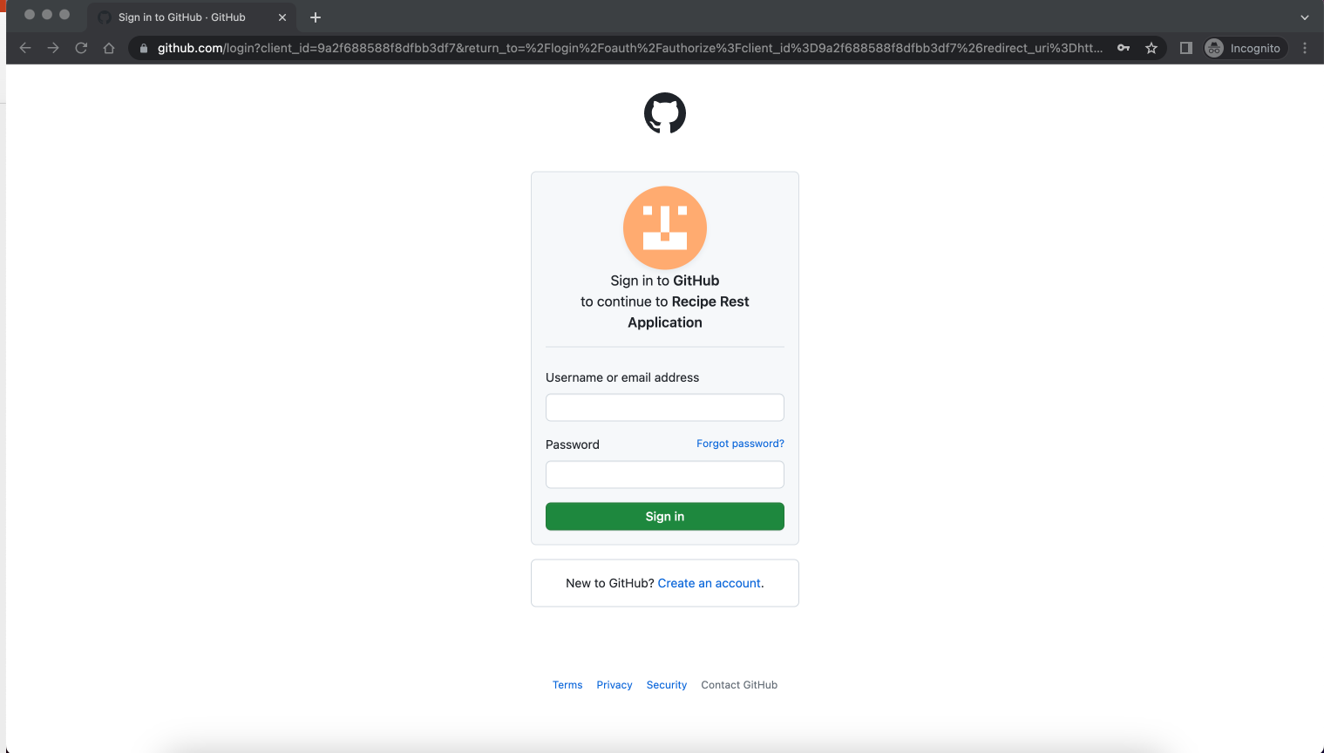
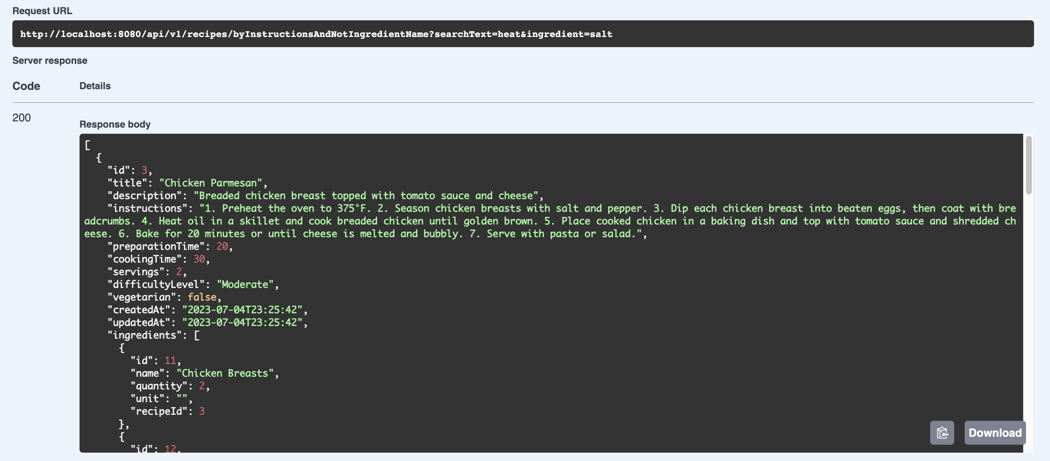
Few screen shots from the output

Slide 9
